Slide 1
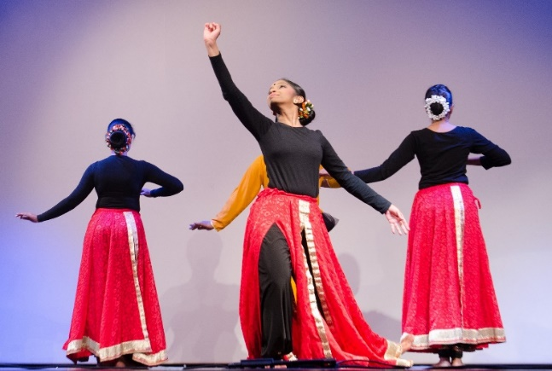
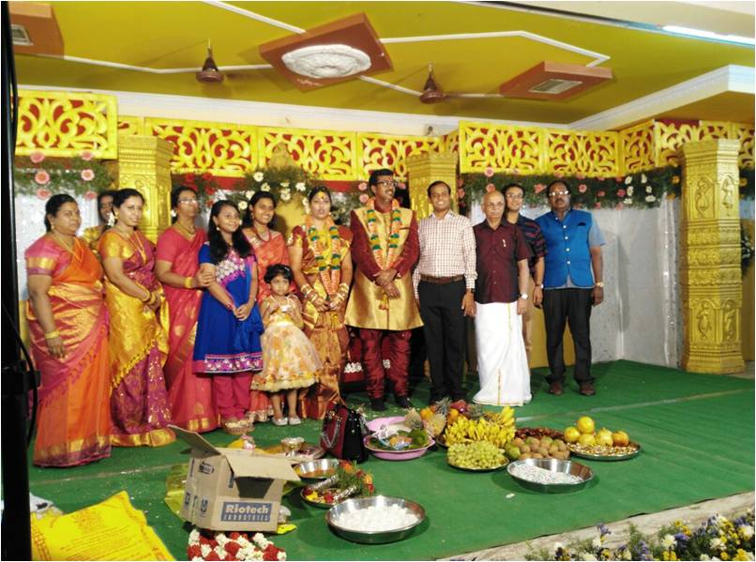
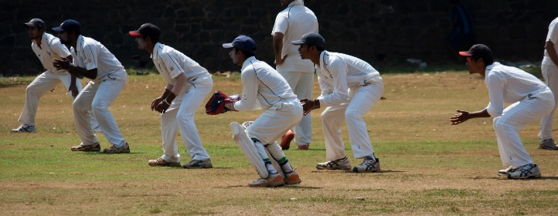
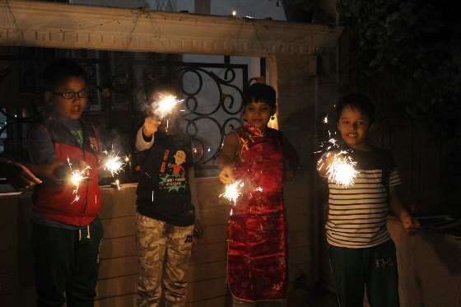
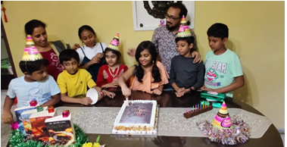
Play And Learn
Notes:
Notes for Teacher – N/A
Suggestions: N/A
Source of Multimedia used in this slide -
Dancing - https://pixabay.com/photos/indian-dance-india-traditional-599611/
Cricket - https://pixabay.com/photos/slips-wicket-keeper-cricket-wicket-390558/
Birthday – SSSVV Image Gallery: Search Keyword ”birthday”
Diwali – SSSVV Image Gallery: Search Keyword ”diwali”
Marriage – SSSVV Image Gallery: Search Keyword “marriage”

Slide 2
Past Continuous Tense
Students Dance Program
Cricket Match
Notes:
Notes for Teacher -The teacher can show the visual and verbal inputs to the students and can encourage them to speak about the events and incidents which they have experienced in PAST. The shy students can be encouraged to speak and share.
Suggestions – N/A
Source of Multimedia used in this slide -
Dancing - https://pixabay.com/photos/indian-dance-india-traditional-599611/
Cricket - https://pixabay.com/photos/slips-wicket-keeper-cricket-wicket-390558/

Slide 3
Past Continuous Tense
Birthday Party
Diwali Mela (Fair)
Notes:
Notes for Teacher -The teacher can show the visual and verbal inputs to the students and can encourage them to speak about the events and incidents which they have experienced in PAST. The shy students can be encouraged to speak and share.
Suggestions – N/A
Source of Multimedia used in this slide -
Birthday – SSSVV Image Gallery: Search Keyword ”birthday”
Diwali – SSSVV Image Gallery: Search Keyword ”diwali”

Slide 4
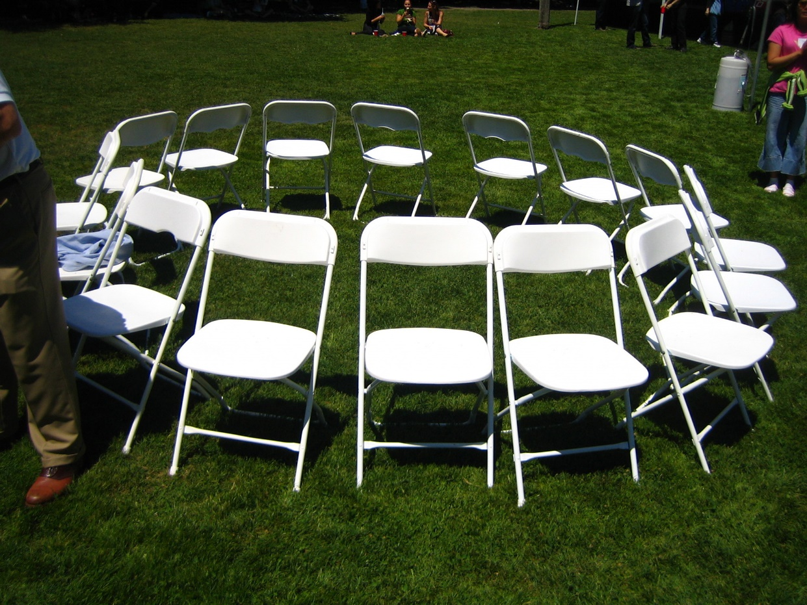
Past Continuous Tense
Musical Chairs
Marriage
Notes:
Notes for Teacher -The teacher can show the visual and verbal inputs to the students and can encourage them to speak about the events and incidents which they have experienced in PAST. The shy students can be encouraged to speak and share.
Suggestions – N/A
Source of Multimedia used in this slide -
Marriage – SSSVV Image Gallery: Search Keyword “marriage”
Musical Chair - https://www.flickr.com/photos/35034361412@N01/1009892593 By rick

Slide 5
MM Index
Slide # | Thumbnail | Source link and Attribution
1,2 |  | Dancing - https://pixabay.com/photos/indian-dance-india-traditional-599611/ Cricket - https://pixabay.com/photos/slips-wicket-keeper-cricket-wicket-390558/
4 |  | Musical Chair - https://www.flickr.com/photos/35034361412@N01/1009892593 By rick
Notes:
Notes for Teacher – N/A
Suggestions: N/A
Source of Multimedia used in this slide - N/A

