Slide 1
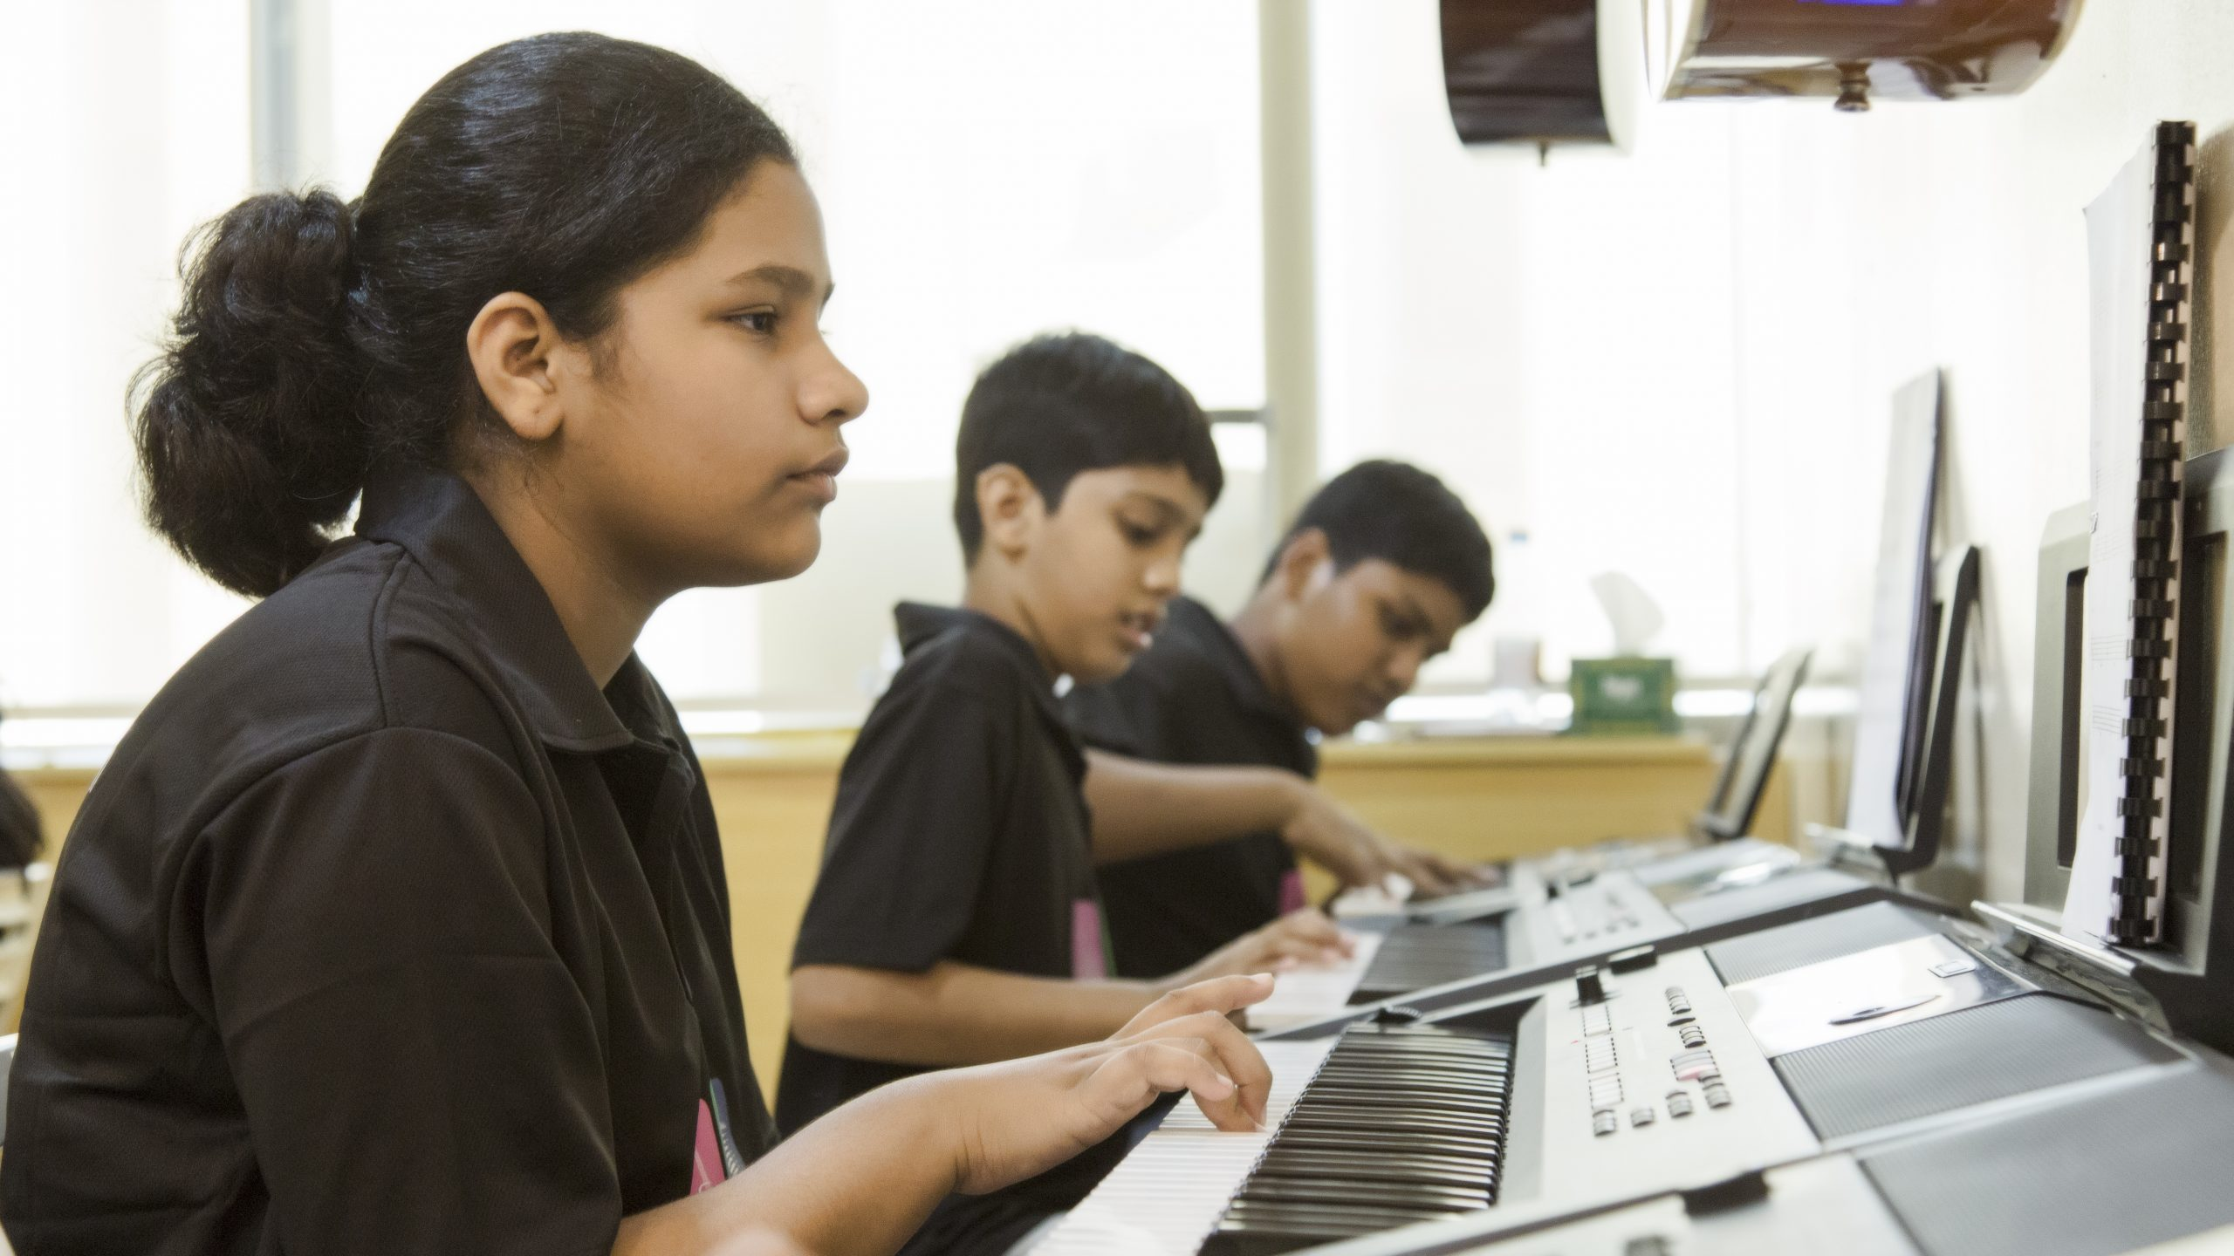
Hard Work Pays
Notes:
Notes for Teacher – N/A
Suggestions: N/A
Source of Multimedia used in this slide -
Student: https://pixahive.com/photo/student-2/ -Attribute to Luquman

Slide 2
Concept-Value Connection
The past continuous tense talks about actions or events that were happening over a period of time in the past.
In daily activities, the success one achieves is a result of continuous hard work put forth by them in the past.
Notes:
Notes for Teacher – N/A
Suggestions: N/A
Source of Multimedia used in this slide - N/A

Slide 3
Hard Work pays
Ravi and Kiran were best friends.
Ravi
Kiran
Kiran was a good athlete and was the fastest runner in his class.
Notes:
Notes for Teacher –
The past continuous tense talks about actions or events that were happening over a period of time in the past.
In daily activities, the success one achieves is a result of continuous hard work put forth by them in the past.
Suggestions: N/A
Source of Multimedia used in this slide –
Students: https://www.freepik.com/free-vector/university-student-collection_4580939.htm#page=5&query=students&position=35&from_view=search&track=sph- Attribute to freepik
Running: https://www.freepik.com/free-vector/boy-running_6903535.htm#page=2&query=boy%20running%20silhouette&position=2&from_view=search&track=ais- Attribute to brgfx

Slide 4
Hard Work pays
Ravi and Kiran had given their names for the 100 m running race for the Annual Sports Day of the school.
Notes:
Notes for Teacher – N/A
Suggestions: N/A
Source of Multimedia used in this slide –
School: https://www.freepik.com/free-vector/large-school-building-scene_5098498.htm#query=school%20building&position=1&from_view=search&track=sph- brgfx

Slide 5
Hard Work pays
Kiran was sure that he would win the race. He kept whiling away his time, staying indoors.
His mother advised him, “Kiran, you are not working hard. You may be a good athlete but without hard work, your talent will not give you success.”
Notes:
Notes for Teacher – N/A
Suggestions: N/A
Source of Multimedia used in this slide –
Mother: SSSVV Gallery(Teacher)
Student: https://www.freepik.com/free-vector/group-businessmen-back-avatar-character_5984946.htm#page=17&query=boy&position=46&from_view=search&track=sph-Attribute to studiogstock

Slide 6
Hard Work pays
Ravi was not a fast runner compared to Kiran.
But he was very dedicated and was a hard worker. He spent some time everyday practicing for the race and even encouraged his other classmates to do so.
Notes:
Notes for Teacher – N/A
Suggestions: N/A
Source of Multimedia used in this slide –
Training: https://pixabay.com/vectors/gymnast-stick-man-man-stick-2353968/ By ha11ok

Slide 7
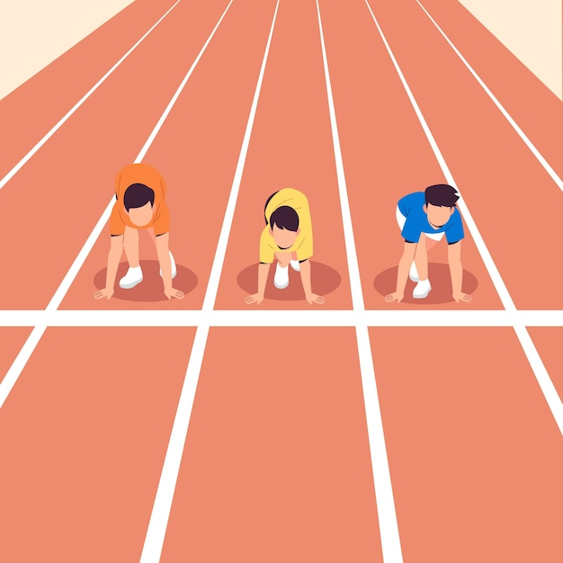
Hard Work pays
Finally, the sports day arrived. Ravi ran so fast that Kiran could hardly keep pace with him.
Ravi not only came first but also broke the earlier record of Kiran as the fastest runner.
Notes:
Notes for Teacher – N/A
Suggestions: N/A
Source of Multimedia used in this slide –
Sports day: https://www.freepik.com/free-vector/flat-national-sports-day-illustration_14960957.htm#query=sports%20day%20running&position=0&from_view=search&track=ais-Attribute to freepik
Race: https://www.freepik.com/free-vector/race-starting-line-sport-illustration_29760400.htm#query=running%20track&position=25&from_view=search&track=sph-Attribute to freepik

Slide 8
Hard Work pays
Seeing Kiran sad and upset, she told Kiran “See Kiran,
you could have won today’s race if you had continuously
worked hard for it.
Notes:
Notes for Teacher – N/A
Suggestions: N/A
Source of Multimedia used in this slide –
Running: https://pixabay.com/vectors/mother-son-mothers-day-woman-3500136/ By mohamed_hassan

Slide 9
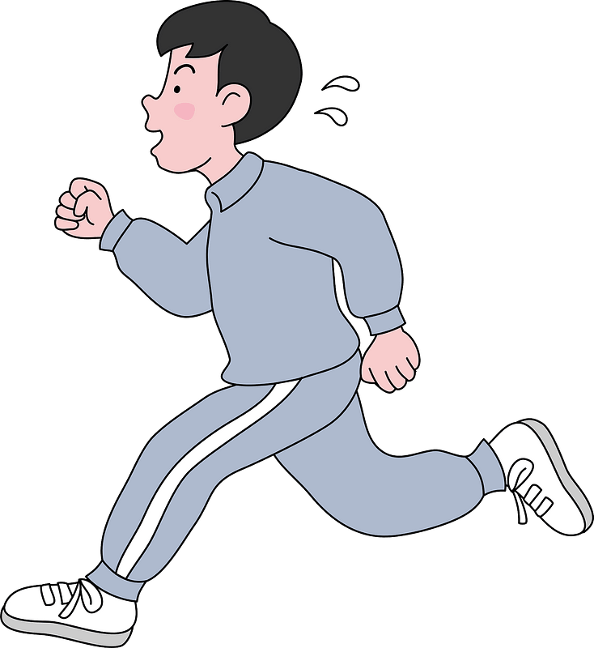
Hard Work pays
Talent without hard work is of no use.
Success comes only through hard work.
Notes:
Notes for Teacher – N/A
Suggestions: N/A
Source of Multimedia used in this slide –
Running: https://creazilla.com/nodes/14716-boy-is-jogging-for-exercise-clipart

Slide 10
Points to Ponder/reflect upon
1
2
Be disciplined and spend your time wisely.
Success comes through continuous efforts.
Notes:
Notes for Teacher – N/A
Suggestions: N/A
Source of Multimedia used in this slide - N/A

Slide 11
Attribution / Citation
Slide # | Thumbnail | Source link | Author
1 |  | Student: https://pixahive.com/photo/student-2/ | Luquman
3 |  | Students: https://www.freepik.com/free-vector/university-student-collection_4580939.htm#page=5&query=students&position=35&from_view=search&track=sph Running: https://www.freepik.com/free-vector/boy-running_6903535.htm#page=2&query=boy%20running%20silhouette&position=2&from_view=search&track=ais | Freepik brgfx
4 |  | School: https://www.freepik.com/free-vector/large-school-building-scene_5098498.htm#query=school%20building&position=1&from_view=search&track=sph Students: https://www.freepik.com/free-vector/university-student-collection_4580939.htm#page=5&query=students&position=35&from_view=search&track=sph | 1.Brgfx 2. freepik
5 |  | Student: https://www.freepik.com/free-vector/group-businessmen-back-avatar-character_5984946.htm | studiogstock
6 |  | Training: https://pixabay.com/vectors/gymnast-stick-man-man-stick-2353968/ | ha11ok
7 |  | Sports day: https://www.freepik.com/free-vector/flat-national-sports-day-illustration_14960957.htm Race: https://www.freepik.com/free-vector/race-starting-line-sport-illustration_29760400.htm | freepik freepik
8 |  | Running: https://pixabay.com/vectors/mother-son-mothers-day-woman-3500136/ | mohamed_hassan
9 |  | Running: https://creazilla.com/nodes/14716-boy-is-jogging-for-exercise-clipart | publicdomainq.net
Notes:
Notes for Teacher – N/A
Suggestions: N/A
Source of Multimedia used in this slide - N/A

