Slide 1
I Am Trying
Notes:
Notes for Teacher – N/A
Suggestions: N/A
Source of Multimedia used in this slide - <Please provide source URL where we find the image and the license agreement>
Image: https://pixabay.com/vectors/challenge-difficulty-struggle-hill-6689107/

Slide 2
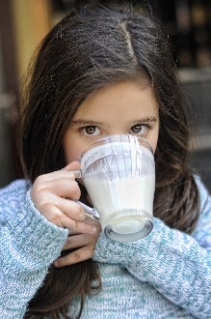
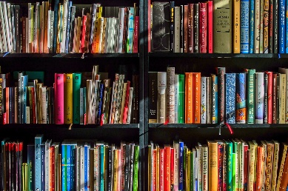
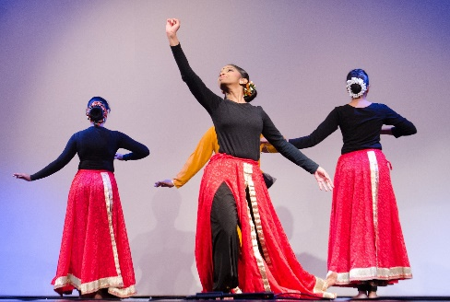
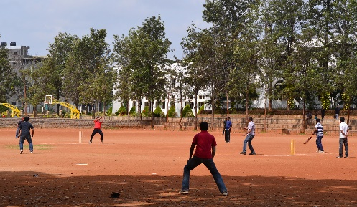
Simple Past Tense
Make meaningful sentences in Simple Past Tense by filling the blanks with the correct form of the verb given in the bracket:
1
(Click here for Answers)
drank
Sita ______ (drink) milk in the morning.
2
My father ______ (give) me chocolate yesterday.
gave
3
Our teacher ______ (take) us to the library in the first period.
took
4
came
She ________ (come) early to the dance class.
5
played
We _________ (play) cricket with our friends.
Notes:
Notes for Teacher – N/A
Suggestions: N/A
Source of Multimedia used in this slide - <Please provide source URL where we find the image and the license agreement>
Milk: https://pixabay.com/photos/yogurt-milk-white-drink-fresh-2868179/
Chocolate: https://pixabay.com/photos/chocolates-chocolate-bars-kit-kat-1200318/
Library: https://pixabay.com/photos/books-bookstore-book-reading-1204029/
Dance class - https://pixabay.com/photos/indian-dance-india-traditional-599611/
Cricket – SSSVV Gallery – Search word Cricket

Slide 3
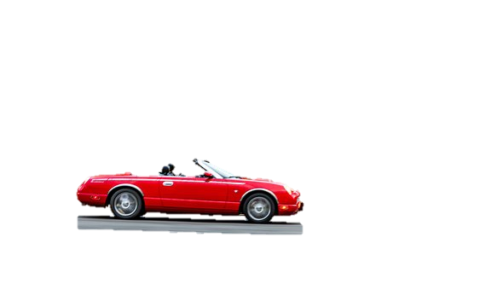
Past Continuous Tense
Use word(s) from each of the columns given below and make 5 meaningful sentences in Past Continuous Tense form:
A | B | C | D
My father | was | reading | a car.
The dog | were | driving | a book.
The boys | was | running | in the field.
We | were | dancing | cricket.
Our teacher | was | playing | at home.
Sample Answer: My father was driving a car.
Notes:
Notes for Teacher – N/A
Suggestions: N/A
Source of Multimedia used in this slide - <Please provide source URL where we find the image and the license agreement>
Car: https://pixabay.com/photos/car-vehicle-road-highway-5667107/

Slide 4
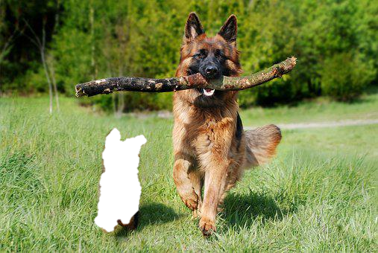
Past Continuous Tense
Use word(s) from each of the columns given below and make 5 meaningful sentences in Past Continuous Tense form:
A | B | C | D
My father | was | reading | a car.
The dog | were | driving | a book.
The boys | was | running | in the field.
We | were | dancing | cricket.
Our teacher | was | playing | at home.
Sample Answer: The dog was running in the field.
Notes:
Notes for Teacher – N/A
Suggestions: N/A
Source of Multimedia used in this slide - <Please provide source URL where we find the image and the license agreement>
Dog: https://pixabay.com/photos/shepherd-dog-dog-domestic-animal-4357790/

Slide 5
Past Continuous Tense
Use word(s) from each of the columns given below and make 5 meaningful sentences in Past Continuous Tense form:
A | B | C | D
My father | was | reading | a car.
The dog | were | driving | a book.
The boys | was | running | in the field.
We | were | dancing | cricket.
Our teacher | was | playing | at home.
Sample Answer: The boys were playing cricket.
Notes:
Notes for Teacher – N/A
Suggestions: N/A
Source of Multimedia used in this slide - <Please provide source URL where we find the image and the license agreement>
Cricket – SSSVV gallery search word - cricket

Slide 6
Past Continuous Tense
Use word(s) from each of the columns given below and make 5 meaningful sentences in Past Continuous Tense form:
A | B | C | D
My father | was | reading | a car.
The dog | were | driving | a book.
The boys | was | running | in the field.
We | were | dancing | cricket.
Our teacher | was | playing | at home.
Sample Answer: We were dancing at home.
Notes:
Notes for Teacher – N/A
Suggestions: N/A
Source of Multimedia used in this slide - <Please provide source URL where we find the image and the license agreement>
Dance: https://publicdomainvectors.org/en/free-clipart/Dancing-girls/74960.html

Slide 7
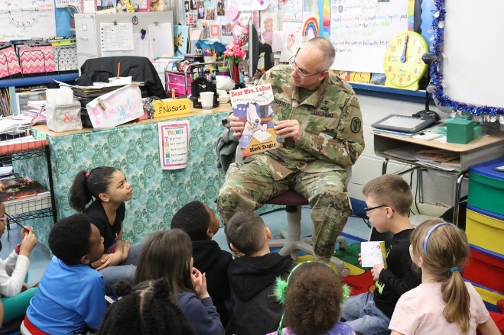
Past Continuous Tense
Use word(s) from each of the columns given below and make 5 meaningful sentences in Past Continuous Tense form:
A | B | C | D
My father | was | reading | a car.
The dog | were | driving | a book.
The boys | was | running | in the field.
We | were | dancing | cricket.
Our teacher | was | playing | at home.
Sample Answer: Our teacher was reading a book.
Notes:
Notes for Teacher – N/A
Suggestions: N/A
Source of Multimedia used in this slide - <Please provide source URL where we find the image and the license agreement>
Teacher: https://www.flickr.com/photos/usagapg/33363260458; Attribution: Aberdeen Proving Ground

Slide 8
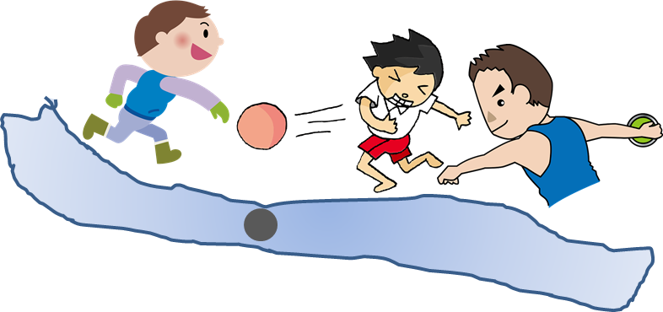
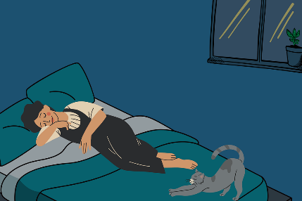
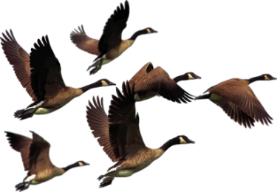
Past Continuous Tense
Make your own sentences using the past continuous form of the given verbs:
(Click here for Sample Answers)
Parul was walking on the road when I met her.
1. Walk – __________________________________________
The boys were throwing pebbles in the river when the teacher caught them.
2. Throw – ______________________________________________________________
My mother was sleeping when my father came back.
3. Sleep – ______________________________________________
We were swimming in the pool when we saw a frog jump into the water.
4. Swim – _______________________________________________________________
Birds were flying in the sky when we looked up.
Fly – ____________________________________________
Notes:
Notes for Teacher – N/A
Suggestions: N/A
Source of Multimedia used in this slide - <Please provide source URL where we find the image and the license agreement>
Walking: https://creazilla.com/nodes/25379-woman-walking-clipart
Throwing1: https://creazilla.com/nodes/7769079-ball-throw-boy-clipart
Throwing 2: https://creazilla.com/nodes/36409-discus-throw-clipart
Throwing 3: https://creazilla.com/nodes/7800415-boy-clipart
Sleeping: https://pixabay.com/illustrations/sleep-sleep-peacefully-to-dream-7635600/
Swimming: https://creazilla.com/nodes/7816901-synchronised-swimming-clipart
Flying: https://pixabay.com/vectors/animals-birds-flying-geese-goose-2030018/

Slide 9
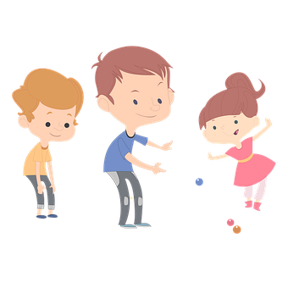
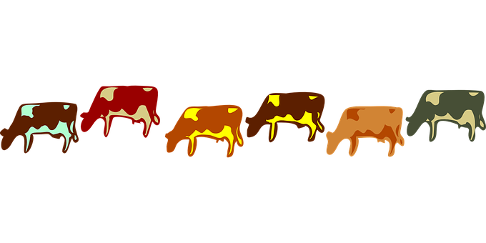
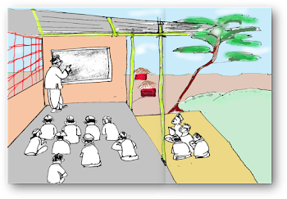
Past Continuous Tense
Fill in the blanks with the correct answers:
(Click here for Answers)
1
My brother ______ telling my mother a story. (was/were)
was
2
My friends ______ playing in the park yesterday. (was/were)
were
3
The cows ________eating grass in the meadow. (was/were)
were
4
was
The teacher ________teaching in the class. (was/were)
5
were
We _________ singing a song. (was/were)
Notes:
Notes for Teacher – N/A
Suggestions: N/A
Source of Multimedia used in this slide - <Please provide source URL where we find the image and the license agreement>
Story: https://pixabay.com/vectors/family-storytelling-father-reading-7199714/
Play: https://pixabay.com/vectors/children-marbles-playing-childhood-5674132/
Cows: https://pixabay.com/vectors/cows-animal-eating-farm-cattle-24487/
Teaching: SSSVV Gallery - Title: olden classrooms-2003202115618PM.png
Singing: https://creazilla.com/nodes/7809282-karaoke-singing-clipart

Slide 10
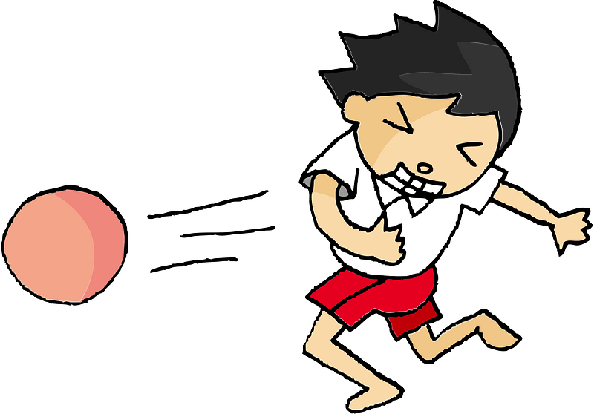
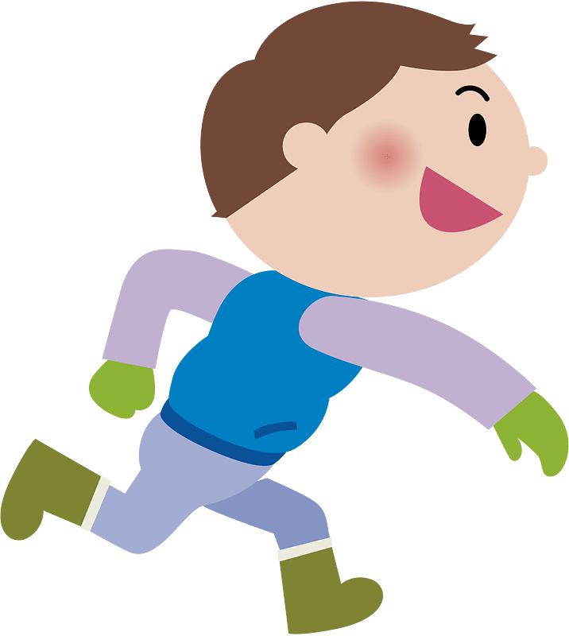
MM INDEX
Slide # | Thumbnail | Source link and Attribution
1 |  | Image: https://pixabay.com/vectors/challenge-difficulty-struggle-hill-6689107/
2 |  | Milk: https://pixabay.com/photos/yogurt-milk-white-drink-fresh-2868179/ Chocolate: https://pixabay.com/photos/chocolates-chocolate-bars-kit-kat-1200318/ Library: https://pixabay.com/photos/books-bookstore-book-reading-1204029/ Dance class - https://pixabay.com/photos/indian-dance-india-traditional-599611/
3 |  | https://pixabay.com/photos/car-vehicle-road-highway-5667107/
4 |  | https://pixabay.com/photos/shepherd-dog-dog-domestic-animal-4357790/
6 |  | https://publicdomainvectors.org/en/free-clipart/Dancing-girls/74960.html
7 |  | https://www.flickr.com/photos/usagapg/33363260458; Attribution: Aberdeen Proving Ground
8 |  | Walking: https://creazilla.com/nodes/25379-woman-walking-clipart Throwing1: https://creazilla.com/nodes/7769079-ball-throw-boy-clipart Throwing 2: https://creazilla.com/nodes/36409-discus-throw-clipart Throwing 3: https://creazilla.com/nodes/7800415-boy-clipart Sleeping: https://pixabay.com/illustrations/sleep-sleep-peacefully-to-dream-7635600/ Swimming: https://creazilla.com/nodes/7816901-synchronised-swimming-clipart Flying: https://pixabay.com/vectors/animals-birds-flying-geese-goose-2030018/
9 |  | Story: https://pixabay.com/vectors/family-storytelling-father-reading-7199714/ Play: https://pixabay.com/vectors/children-marbles-playing-childhood-5674132/ Cows: https://pixabay.com/vectors/cows-animal-eating-farm-cattle-24487/ Teaching: SSSVV Gallery - Title: olden classrooms-2003202115618PM.png Singing: https://creazilla.com/nodes/7809282-karaoke-singing-clipart
Notes:
Notes for Teacher – N/A
Suggestions: N/A
Source of Multimedia used in this slide - N/A

