Slide 1
Think Ahead
Notes:
Notes for Teacher - < Information for further reference or explanation >
Suggestions: <Ideas/ Images/ Animations / Others – To make better representation of the content >
Source of Multimedia used in this slide - <Please provide source URL where we find the image and the license agreement>
Traffic Signal Image - https://www.rawpixel.com/image/6290340/png-sticker-public-domain | Attribution - https://www.rawpixel.com/

Slide 2
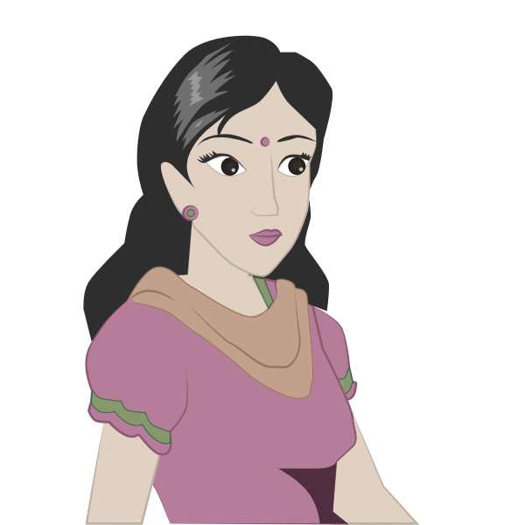
When the Light Turns Red
Light has turned Red
What WILL
the bus driver do?
The bus driver will stop at the traffic light
Notes:
Notes for Teacher - < Information for further reference or explanation > Slide run starts with a single click
The teacher could begin the class by talking about the traffic signals and the need to follow the rules to be safe. The PPT could be used and the teacher could arouse the interest of the students by narrating what the group of children in the school bus in the picture are doing.
Alternatively the teacher could use the model (as explained in the TLM) and encourage some students to enact the scene as narrated. Some imaginary names could be used to make the narration interesting.
Suggestions: <Ideas/ Images/ Animations / Others – To make better representation of the content >
Source of Multimedia used in this slide - <Please provide source URL where we find the image and the license agreement>
School bus: https://pixabay.com/illustrations/bus-cartoon-bus-schoolbus-vehicle-3894196/
Teacher Image - https://freesvg.org/1504025068
Traffic Signal: PPT icon
Black bus: PPT icon

Slide 3
When the Light Turns Amber
What WILL
the bus driver do?
Light has turned Amber
The bus driver will get ready to start the bus
Notes:
Notes for Teacher - < Information for further reference or explanation > Slide run starts with a single click
These children are going to school. They are talking and laughing in the bus . They approach the traffic signal and it has turned Red. Suggestions: <Ideas/ Images/ Animations / Others – To make better representation of the content >
Source of Multimedia used in this slide - <Please provide source URL where we find the image and the license agreement>

Slide 4
When the Light Turns Green
What WILL
the bus driver do?
Light has turned Green
The bus driver will start the bus and go to school
Notes:
Notes for Teacher - < Information for further reference or explanation > Slide run starts with a single click The teacher could now ask the students about the new verb form that has been used in the questions and answers and help them to correlate the use of ‘will+V1’ (V1 - present form of verb) with an action that is yet to happen. Thus introduce the new tense form called ‘Simple Future Tense’.
Suggestions: <Ideas/ Images/ Animations / Others – To make better representation of the content >
Source of Multimedia used in this slide - <Please provide source URL where we find the image and the license agreement>

Slide 5
MM Index
Slide# | Thumbnail | Source link and Attribution
1 |  | Traffic Signal Image - https://www.rawpixel.com/image/6290340/png-sticker-public-domain | Attribution - https://www.rawpixel.com/
2, 3, 4 |  | School bus: https://pixabay.com/illustrations/bus-cartoon-bus-schoolbus-vehicle-3894196/ Teacher Imagehttps://freesvg.org/1504025068 -
Notes:
Notes for Teacher - < Information for further reference or explanation >
Suggestions: <Ideas/ Images/ Animations / Others – To make better representation of the content >
Source of Multimedia used in this slide - <Please provide source URL where we find the image and the license agreement>

