Slide 1
PPY Title
KNOW THE FUTURE
Notes:
Notes for Teacher - < Information for further reference or explanation >
Suggestions: <Ideas/ Images/ Animations / Others – To make better representation of the content >
Source of Multimedia used in this slide - <Please provide source URL where we find the image and the license agreement>

Slide 2
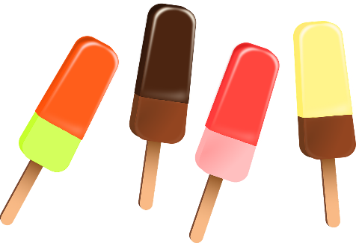
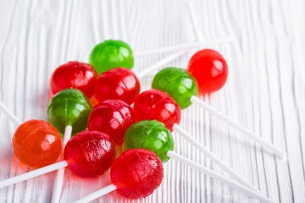
KNOW THE FUTURE
Simple future tense: is used for an action that is yet to happen.
In a positive sentence is, ‘will + present form of verb (V1)’.
Example
Simple Present Tense
He/She/It - eats junk food.
Simple Future Tense
He/She/It - will eat junk food.
Notes:
Notes for Teacher - < Information for further reference or explanation >
The teacher could begin the class with a reference to the IA asset about using ‘will+V1’ for the Future Tense. The teacher could use the GO and the PPT for better understanding of the Simple Future Tense. (Keeping the concept simple is the key with just the introduction to Simple Future Tense and the use of ‘will+V1’.)
Suggestions: <Ideas/ Images/ Animations / Others – To make better representation of the content >
Source of Multimedia used in this slide - <Please provide source URL where we find the image and the license agreement>
Candies - https://pixabay.com/photos/candies-sweetmeats-sweets-caramel-1961539/
Ice cream - https://pixabay.com/vectors/ice-cream-snack-food-cream-dessert-1296112/

Slide 3
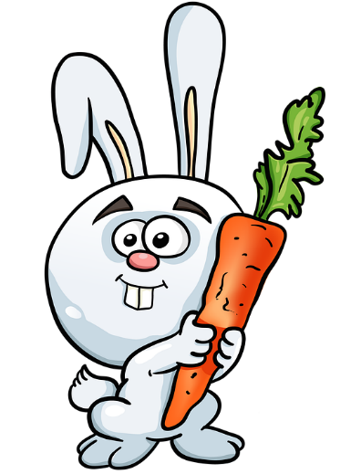
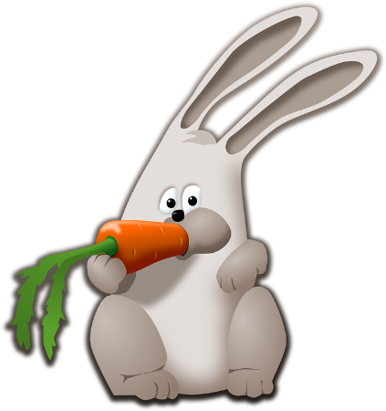
KNOW THE FUTURE
Simple future tense : is used for an action that is yet to happen.
In a negative sentence is, ‘will not + present form of verb (V1)’.
Example
Simple Present Tense
He/She/It – does not eat junk food.
Simple Future Tense
He/She/It - will not eat junk food.
Notes:
Notes for Teacher - < Information for further reference or explanation >
The teacher could begin the class with a reference to the IA asset about using ‘will+V1’ for the Future Tense. The teacher could use the GO and the PPT for better understanding of the Simple Future Tense. (Keeping the concept simple is the key with just the introduction to Simple Future Tense and the use of ‘will+V1’.)
Suggestions: <Ideas/ Images/ Animations / Others – To make better representation of the content >
Source of Multimedia used in this slide - <Please provide source URL where we find the image and the license agreement>
Rabbit eating - https://pixabay.com/vectors/animal-bunny-carrot-eat-hare-158571/
Rabbit holding - https://pixabay.com/illustrations/rabbit-hare-carrot-cute-ears-4735414/

Slide 4
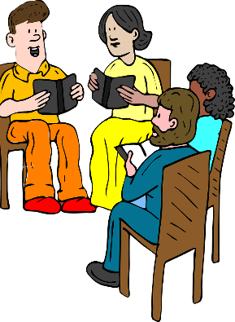
SIMPLE FUTURE TENSE
The Verb form (will+V1) remains constant for all subject forms (singular or plural).
Example
Simple Present Tense
I/You/They/We – read/do not read story books.
Simple Future Tense
I/You/They/We - will read/will not read story books.
Notes:
Notes for Teacher - < Information for further reference or explanation >
The teacher could begin the class with a reference to the IA asset about using ‘will+V1’ for the Future Tense. The teacher could use the GO and the PPT for better understanding of the Simple Future Tense. (Keeping the concept simple is the key with just the introduction to Simple Future Tense and the use of ‘will+V1’.)
Suggestions: <Ideas/ Images/ Animations / Others – To make better representation of the content >
Source of Multimedia used in this slide - <Please provide source URL where we find the image and the license agreement>
Group reading - https://pixabay.com/vectors/teachers-meeting-books-reading-23820/
Boy - https://pixabay.com/vectors/boy-reading-book-specs-spectacles-34619/

Slide 5
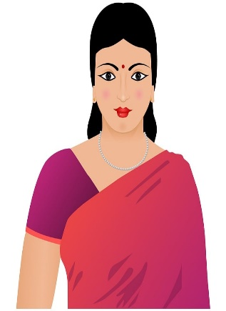
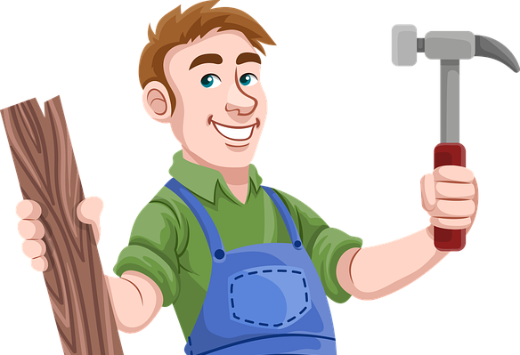
SIMPLE FUTURE TENSE EXAMPLES
Let’s see some more examples.
Simple Present Tense
Simple Future Tense
Rohan and Tilak work/do not work at the factory.
Rohan and Tilak will work/will not work at the factory.
Notes:
Notes for Teacher - < Information for further reference or explanation >
Suggestions: <Ideas/ Images/ Animations / Others – To make better representation of the content >
Source of Multimedia used in this slide - <Please provide source URL where we find the image and the license agreement>
Mechanic - https://openclipart.org/detail/17436/mechanic
Carpenter - https://pixabay.com/vectors/carpenter-hummer-wood-construction-1453880/

Slide 6
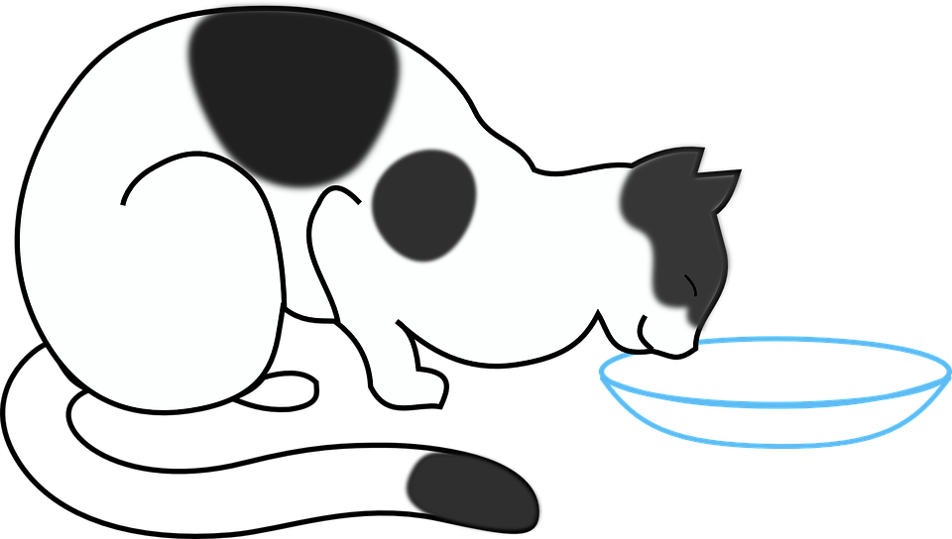
SIMPLE FUTURE TENSE EXAMPLES
Simple Present Tense
Simple Future Tense
The cat drinks/does not drink hot milk.
The cat will drink/will not drink hot milk.
Notes:
Notes for Teacher - < Information for further reference or explanation >
The class could be concluded with a synopsis of the verb form of Simple Future Tense and its usage.
Suggestions: <Ideas/ Images/ Animations / Others – To make better representation of the content >
Source of Multimedia used in this slide - <Please provide source URL where we find the image and the license agreement>
Cat - https://pixabay.com/vectors/cat-drinking-milk-kitten-33595/

Slide 7
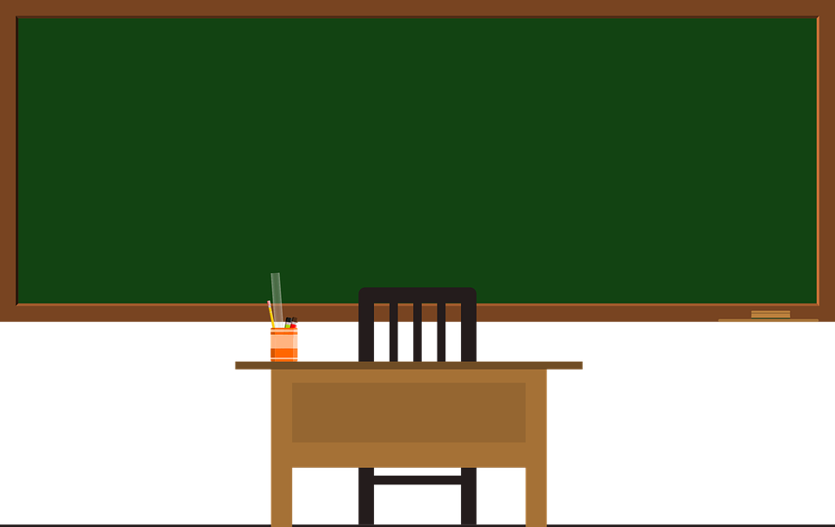
SIMPLE FUTURE TENSE
Simple future tense: is used for an action that is yet to happen.
The verb form in a positive sentence is ‘will+present form of verb (V1)’.
The verb form in a negative sentence is ‘will not+present form of verb (V1)’.
The verb form remains constant during singular or plural.
Notes:
Notes for Teacher - < Information for further reference or explanation >
Suggestions: <Ideas/ Images/ Animations / Others – To make better representation of the content >
Source of Multimedia used in this slide - <Please provide source URL where we find the image and the license agreement>
Blackboard - https://pixabay.com/vectors/blackboard-green-frame-school-green-1788630/

Slide 8
MM INDEX
Slide # | Thumbnail | Source link and Attribution
2 |  | Candies - https://pixabay.com/photos/candies-sweetmeats-sweets-caramel-1961539/ Ice cream - https://pixabay.com/vectors/ice-cream-snack-food-cream-dessert-1296112/
3 |  | https://pixabay.com/vectors/animal-bunny-carrot-eat-hare-158571/ https://pixabay.com/illustrations/rabbit-hare-carrot-cute-ears-4735414/
4 |  | Group reading - https://pixabay.com/vectors/teachers-meeting-books-reading-23820/ Boy - https://pixabay.com/vectors/boy-reading-book-specs-spectacles-34619/
5 |  | https://pixabay.com/vectors/carpenter-hummer-wood-construction-1453880/ https://openclipart.org/detail/17436/mechanic https://pixabay.com/illustrations/indian-woman-woman-girl-indian-1084227/
6 |  | https://pixabay.com/vectors/cat-drinking-milk-kitten-33595/
7 |  | https://pixabay.com/vectors/blackboard-green-frame-school-green-1788630/
Notes:
Notes for Teacher - < Information for further reference or explanation >
Suggestions: <Ideas/ Images/ Animations / Others – To make better representation of the content >
Source of Multimedia used in this slide - <Please provide source URL where we find the image and the license agreement>

