Slide 1
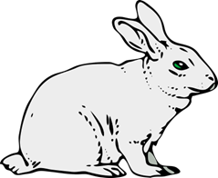
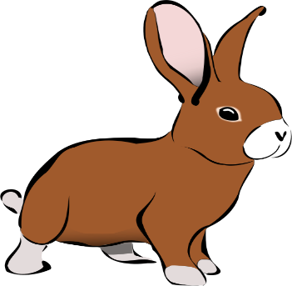
WILL the Future
Notes:
Notes for Teacher - < Information for further reference or explanation >
The teacher could use the PPT to narrate the anecdote to highlight the strange fact that unlike the Simple Past and Simple Present Tenses, the Simple Future Tense has no verb form of its own. It is made by adding WILL to the Present form of the verb.
Suggestions: <Ideas/ Images/ Animations / Others – To make better representation of the content >
Source of Multimedia used in this slide -
White bunny : https://pixabay.com/vectors/rabbit-animal-mammal-easter-bunny-47898/
Brown bunny: https://openclipart.org/detail/188698/brown-rabbit

Slide 2
Little Bunny -Hopping
This cute little bunny rabbit has just learnt to hop around. He is enjoying himself hopping all day in the lovely meadows and soaking in the pleasant sunshine.
Notes:
Notes for Teacher: Click for animation
Suggestions: <Ideas/ Images/ Animations / Others – To make better representation of the content >
Source of Multimedia used in this slide -
Meadow: https://www.freepik.com/free-vector/flat-design-spring-landscape_12239771.html Attribution to Freepik
White bunny : https://pixabay.com/vectors/rabbit-animal-mammal-easter-bunny-47898/
Brown bunny: https://openclipart.org/detail/188698/brown-rabbit

Slide 3
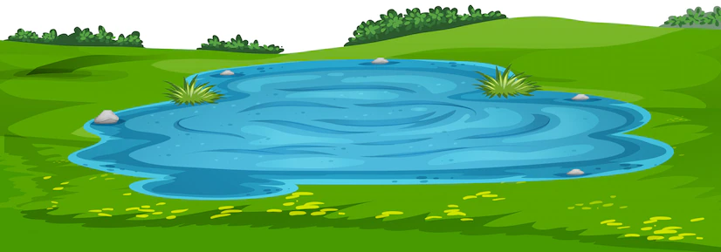
Little Bunny -Hopping
Little Bunny -Hopping
Suddenly he comes to a little pool and does not know what to do.
Notes:
Notes for Teacher
Suggestions: <Ideas/ Images/ Animations / Others – To make better representation of the content >
Source of Multimedia used in this slide -
Meadow with pool: https://www.freepik.com/free-vector/nature-scene-landscape template_6126542.htm attribution to brgfx
White bunny : https://pixabay.com/vectors/rabbit-animal-mammal-easter-bunny-47898/
Brown bunny: https://openclipart.org/detail/188698/brown-rabbit

Slide 4
Little Bunny -Hopping
His mother asks him, “Oh my dear! What did you do yesterday?”
The little rabbit replied “I hopped.”
“That’s right you hopped.
And what about now?”, probed the mother.
“This is a beautiful meadow ma and I hop….hop……hop everywhere”, said the little one with a smile,
“But look what I have ahead. A pool of water! What should I do?” he said with fear.
Notes:
Notes for Teacher
Suggestions: <Ideas/ Images/ Animations / Others – To make better representation of the content >
Source of Multimedia used in this slide -
https://www.freepik.com/free-vector/nature-scene-landscape template_6126542.htm attribution to brgfx
White bunny : https://pixabay.com/vectors/rabbit-animal-mammal-easter-bunny-47898/
Brown bunny: https://openclipart.org/detail/188698/brown-rabbit

Slide 5
Little Bunny -Hopping
The mother fondled the scared little one and said, ”Oh dear! That's quite simple.
You just have to add ‘Will’ to the Present.”
The confused little rabbit looked at his mother.
She continued,“In the Present you ‘hop’ and in the Future you ‘Will hop’ - You Will hop over the pool.”
The mother patted his back and the little rabbit got ready to hop.
Notes:
Notes for Teacher
Suggestions: <Ideas/ Images/ Animations / Others – To make better representation of the content >
Source of Multimedia used in this slide -
Meadow: https://www.freepik.com/free-vector/landscape-summer-alpine-medow-poster_3817340.htm#query=medow&position=1&from_view=search&track=sph
https://www.freepik.com/free-vector/nature-scene-landscape template_6126542.htm attribution to brgfx
White bunny : https://pixabay.com/vectors/rabbit-animal-mammal-easter-bunny-47898/
Brown bunny: https://openclipart.org/detail/188698/brown-rabbit

Slide 6
Little Bunny - Hopping
The mother gave him a hug and said, “Now that you are ready, always remember that the ‘WILL’ you add to the present, prepares you to succeed in Future.” As the little rabbit leapt over the pool he said, "Yes Ma, I Will succeed!”
I WILL succeed
Notes:
Notes for Teacher: Click for animation
The teacher could conclude the class reinstating that the Future Tense has no verb form of its own. It is formed by adding WILL to the Present form of the verb. Alongside the value of WILL (will power) to succeed in future could be hinted at.
Suggestions: <Ideas/ Images/ Animations / Others – To make better representation of the content >
Source of Multimedia used in this slide - <https://pixabay.com/photos/animal-rabbit-mammal-species-fauna-1850192/>
Meadow: https://www.freepik.com/free-vector/nature-scene-landscape template_6126542.htm attribution to brgfx
White bunny : https://pixabay.com/vectors/rabbit-animal-mammal-easter-bunny-47898/
Brown bunny: https://openclipart.org/detail/188698/brown-rabbit

Slide 7
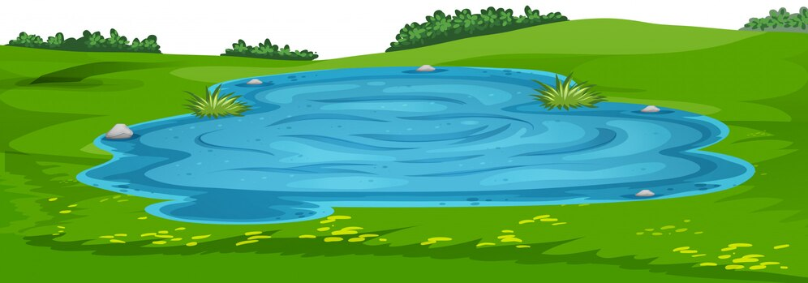
MM Index
Slide # | Thumbnail | Source link and Attribution
1-6 |  | White bunny : https://pixabay.com/vectors/rabbit-animal-mammal-easter-bunny-47898/ Brown bunny: https://openclipart.org/detail/188698/brown-rabbit
2 |  | https://www.freepik.com/free-vector/flat-design-spring-landscape_12239771.htm Attribution to Freepik
3-6 |  | Meadow with pool: https://www.freepik.com/free-vector/nature-scene-landscape template_6126542.htm attribution to brgfx
Notes:
Notes for Teacher - < Information for further reference or explanation >
The teacher could conclude the class reinstating that the Future Tense has no verb form of its own. It is formed by adding WILL to the Present form of the verb. Alongside the value of WILL (will power) to succeed in future could be hinted at.
Suggestions: <Ideas/ Images/ Animations / Others – To make better representation of the content >
Source of Multimedia used in this slide - <Please provide source URL where we find the image and the license agreement>

