Slide 1
Change to Future
Notes:
Notes for Teacher - < Information for further reference or explanation >
Suggestions: <Ideas/ Images/ Animations / Others – To make better representation of the content >
Source of Multimedia used in this slide - https://www.freepik.com/free-vector/language-composition-with-flat-design_2609860.htm Attribution to macrovector

Slide 2
Good Habits
I will go for a walk every morning.
Come up with a habit that you will cultivate.
Notes:
Notes for Teacher - The teacher could begin by introducing the value of good habits for success in the future.
Suggestions: <Ideas/ Images/ Animations / Others – To make better representation of the content >
Source of Multimedia used in this slide -
Teacher Image - https://freesvg.org/1504025068
https://pixabay.com/vectors/blackboard-green-frame-school-green-1788630/

Slide 3
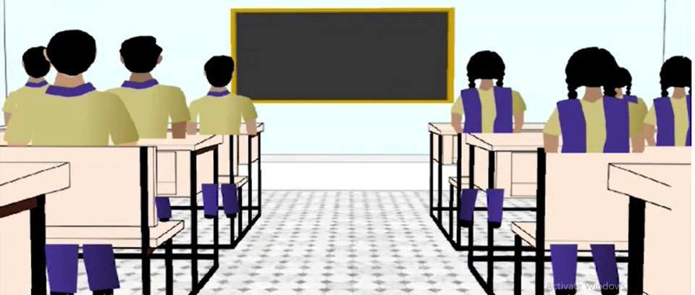
Good Habits
I will keep my room tidy.
I will not speak rudely to anyone.
I will wake up early.
Notes:
Notes for Teacher - The key should, however, be to ensure that students use the correct verb form for Simple Future Tense (will/will not+V1) in their sentences. The teacher should encourage maximum participation.
OBSERVATION: The students are able to use the correct verb form (will/will not+V1) for Simple Future Tense in their regular conversations.
Suggestions: <Ideas/ Images/ Animations / Others – To make better representation of the content >
Source of Multimedia used in this slide -
SSSVV Gallery – search word classroom

Slide 4
MM INDEX
Slide # | Thumbnail | Source link and Attribution
1 |  | https://www.freepik.com/free-vector/language-composition-with-flat-design_2609860.htm Attribution to macrovector
2 |  | Teacher Image - https://freesvg.org/1504025068 https://pixabay.com/vectors/blackboard-green-frame-school-green-1788630/
3 |  | SSSVV gallery - classroom
Notes:
Notes for Teacher - < Information for further reference or explanation >
Suggestions: <Ideas/ Images/ Animations / Others – To make better representation of the content >
Source of Multimedia used in this slide - <Please provide source URL where we find the image and the license agreement>

