Slide 1
I will
Notes:
Notes for Teacher – N/A
Suggestions: N/A
Source of Multimedia used in this slide - N/A

Slide 2
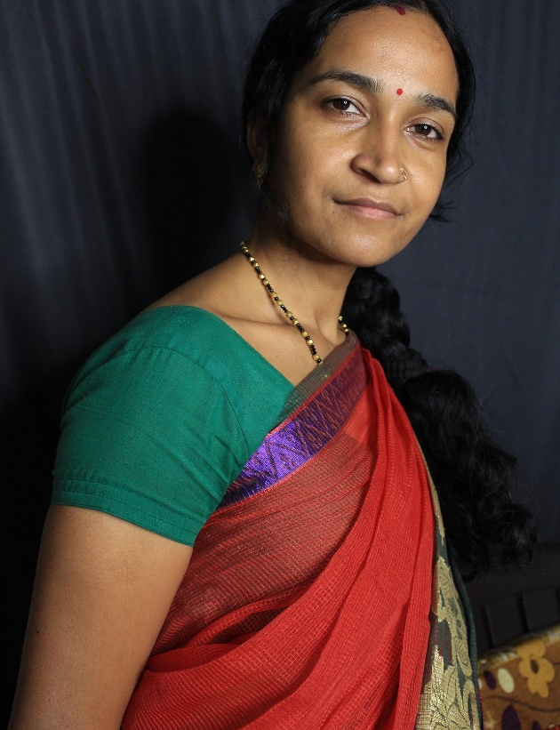
I Will
I am tired too. But, I will not rest until I finish all the pending work.
It has been a busy day. I will go home and take rest.
Notes:
Notes for Teacher – The teacher could begin the class by talking about how the Simple Future Tense is an integral part of our daily conversations and unknowingly we use it often
Suggestions: N/A
Source of Multimedia used in this slide -
https://pixabay.com/photos/indian-women-female-sari-nice-4460367/
https://pixabay.com/photos/women-indian-female-mother-woman-4419735/

Slide 3
I Will
1. We have a long weekend coming up. What will you do to spend it usefully?
I will play football with my friends.
I will not go anywhere, I will stay at home and clean my room.
I will prepare for the upcoming test.
I will help my mother in the kitchen.
I will read the new story book.
Notes:
Notes for Teacher –The teacher could let the students identify the verb forms of Simple Future Tense used in the conversation.
Now the teacher could ask questions and encourage students (a conscious pick of active and passive students could be called) to answer. The teacher could put forth questions that would have the Simple Future Tense in the answer.
Suggestions: N/A
Source of Multimedia used in this slide - N/A

Slide 4
I Will
2. What will you like to be when you grow up?
I will become a doctor.
I will not go abroad and work. I will stay in India and serve in the Indian Army.
I will become a scientist.
I will not leave my parents alone. I will take care of them when they are old.
I will become a writer of children’s story books.
Notes:
Notes for Teacher – The teacher could let students identify the Verb form used for Simple Future Tense.
The teacher may add more suitable questions from imagination. However, the emphasis should be on the correct use of Simple Future Tense in the answers. A watch on ethical answers is essential to keep the purpose of the activity from losing its value.
The class could then be concluded by helping the students relate to the use of Simple Future Tense in their regular conversations.
Suggestions: N/A
Source of Multimedia used in this slide - N/A

Slide 5
MM Index
Slide # | Thumbnail | Source link and Attribution
2 |  | /https://pixabay.com/photos/indian-women-female-sari-nice-4460367/ https://pixabay.com/photos/women-indian-female-mother-woman-4419735

