Slide 1
Focus on Future
Notes:
Notes for Teacher - < Information for further reference or explanation >
Suggestions: <Ideas/ Images/ Animations / Others – To make better representation of the content >
Source of Multimedia used in this slide - <Please provide source URL where we find the image and the license agreement>

Slide 2
Concept - Value Connection
The simple future tense is a verb tense that focuses on actions that happen in the future.
In order to make our dreams come true in life, we must remain focused and work hard.
Notes:
Notes for Teacher - < Information for further reference or explanation >
Suggestions: <Ideas/ Images/ Animations / Others – To make better representation of the content >
Source of Multimedia used in this slide - Process Infographics SSSVV

Slide 3
Story Time
Rohit and Rekha are siblings
They are both hardworking children
Notes:
Notes for Teacher - < Information for further reference or explanation >
Suggestions: <Ideas/ Images/ Animations / Others – To make better representation of the content >
Source of Multimedia used in this slide - <Please provide source URL where we find the image and the license agreement>

Slide 4
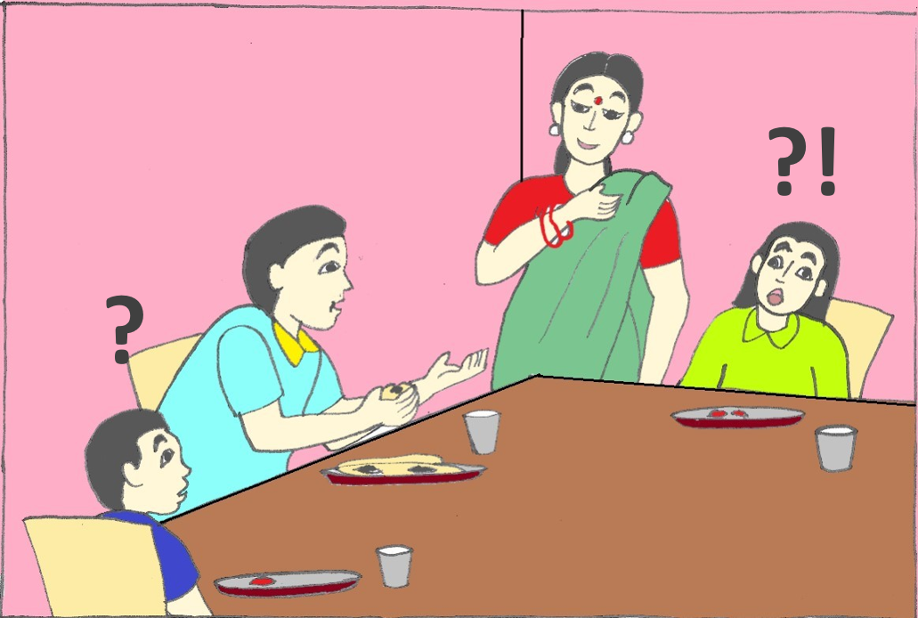
Dreams
That’s great. Rohit, I will arrange a coach for you and Rekha, I will look for a good music teacher for you.
What do you want to be when you grow up?
I want to become a singer.
I want to become a cricketer.
Notes:
Notes for Teacher - < Information for further reference or explanation >
Suggestions: <Ideas/ Images/ Animations / Others – To make better representation of the content >
Source of Multimedia used in this slide - SSSVV Gallery search word - family

Slide 5
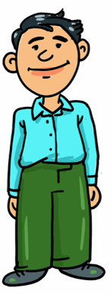
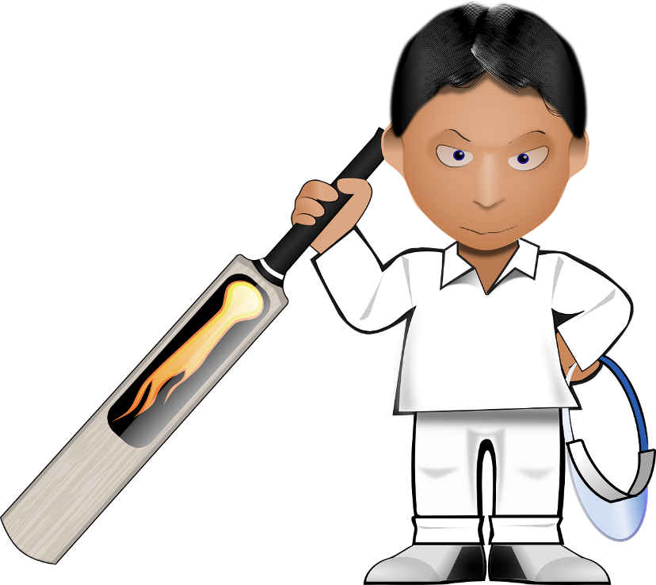
Story continues…
Their father quickly found them a cricket coach and music teacher respectively.
Notes:
Notes for Teacher - < Information for further reference or explanation >
Suggestions: <Ideas/ Images/ Animations / Others – To make better representation of the content >
Source of Multimedia used in this slide - Music Teacher SSSVV Gallery

Slide 6
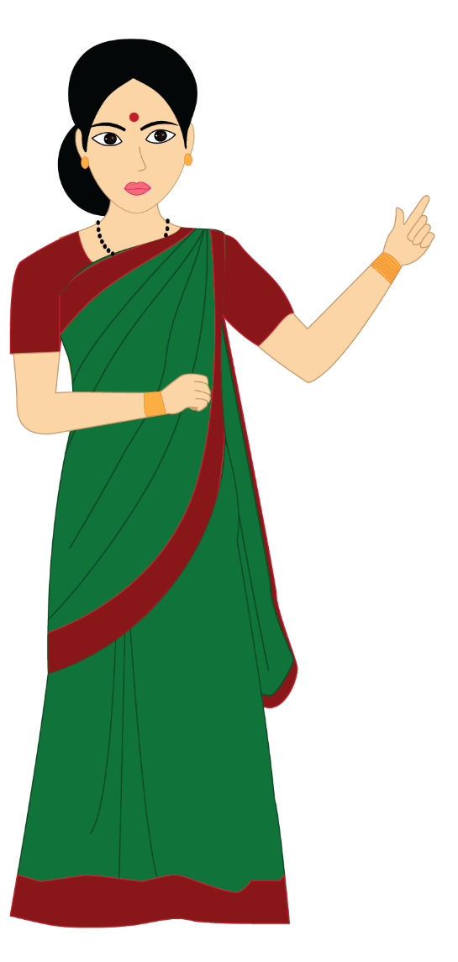
Hardwork
Now your papa has found you, your teachers. But do you know that it does not stop here? You will have to work hard to achieve your dreams.
Yes ma. We know. We will work hard.
Notes:
Notes for Teacher - < Information for further reference or explanation >
Suggestions: <Ideas/ Images/ Animations / Others – To make better representation of the content >
Source of Multimedia used in this slide - Mother SSSVV Gallery

Slide 7
Hard work
Every day, I will get up early and go to practice. This weekend there will be an inter-school match. I’ll be practicing throughout the week because I want our team to win this game. If we win, our school will be proud of us.
What will you both do?
Good. I will also accompany you every morning to your practice sessions.
Notes:
Notes for Teacher - < Information for further reference or explanation >
Suggestions: <Ideas/ Images/ Animations / Others – To make better representation of the content >
Source of Multimedia used in this slide - Mother SSSVV Gallery

Slide 8
Hard work
Very good Rekha. I’ll also sit with you when you practice in the early hours of morning.
My music teacher told me that if I practice music early in the mornings, it will help my voice open up. There will be a competition coming up next week in school. I’ll also get up early with Rohit and work on my music lessons. I, too, hope to sing well in this competition. My teacher will be overjoyed if I perform well in the competition.
Notes:
Notes for Teacher - < Information for further reference or explanation >
Suggestions: <Ideas/ Images/ Animations / Others – To make better representation of the content >
Source of Multimedia used in this slide - Mother SSSVV Gallery

Slide 9
Story continues…
Sure. We will come.
Ma and Pa. Will you both come to the game, sit in the stands to cheer us on?
Notes:
Notes for Teacher - < Information for further reference or explanation >
Suggestions: <Ideas/ Images/ Animations / Others – To make better representation of the content >
Source of Multimedia used in this slide - Mother SSSVV Gallery

Slide 10
Focus on Future
Yes Dear, we will all come!
Hey. Why did you exclude me? I will also come with Ma and Pa to cheer you up. But you three will also have to attend my competition to cheer me up. When I see all the three of you, I’ll be even more motivated to sing well.
Notes:
Notes for Teacher - < Information for further reference or explanation >
Suggestions: <Ideas/ Images/ Animations / Others – To make better representation of the content >
Source of Multimedia used in this slide - Mother SSSVV Gallery

Slide 11
Points to Ponder/reflect
Focus on Future
1
2
3
4
Aim high
Work hard.
Stay focused on what you want to achieve.
Work hard to realise your dreams.
With focus and hard work our dreams come true.
Notes:
Notes for Teacher - < Information for further reference or explanation >
Suggestions: <Ideas/ Images/ Animations / Others – To make better representation of the content >
Source of Multimedia used in this slide - Process Infographics SSSVV

Slide 12
MM INDEX
Slide # | Thumbnail | Source link and Attribution
3 |  | https://pixabay.com/vectors/asian-cartoon-child-kids-mural-1294104/ - Attribution to OpenClipart-Vectors
4 |  | https://pixabay.com/illustrations/cricket-cricket-sport-ball-game-3311473/ - Attribution – LillyCantabile https://pixabay.com/illustrations/girl-singing-music-female-people-1292241/ - Attribution - Josemairing
6 |  | https://pixabay.com/vectors/cricket-bat-cricketer-player-33064/ - Attribution - Clker-Free-Vector-Images https://pixabay.com/vectors/notes-music-sheet-music-musical-311995/ - Attribution - Clker-Free-Vector-Images
5 - 10 |  | https://pixabay.com/vectors/cartoon-father-dad-happy-son-7041484/ - Attribution - azmeyart-design
6 - 10 |  | Girl: https://pixabay.com/vectors/girl-school-pupil-desk-answer-say-307747/ Attribution - Clker-Free-Vector-Images Boy: https://pixabay.com/vectors/cartoon-father-dad-happy-son-7041484/ - Attribution - azmeyart-design
Notes:
Notes for Teacher - < Information for further reference or explanation >
Suggestions: <Ideas/ Images/ Animations / Others – To make better representation of the content >
Source of Multimedia used in this slide - <Please provide source URL where we find the image and the license agreement>

