Slide 1
Test your WILL
Notes:
Notes for Teacher – N/A
Suggestions: N/A
Source of Multimedia used in this slide - N/A

Slide 2
1. REWRITE THE FOLLOWING SENTENCES IN SIMPLE FUTURE TENSE
Ans
a.
Mohan will go to school by bus.
Mohan goes to school by bus.
Ans
My baby sister will not wake up early.
My baby sister does not wake up early.
b.
Ans
Those boys will sing for the school band.
Those boys sing for the school band.
c.
Ans
Reena will not tell anyone about her visit.
Reena did not tell anyone about her visit.
d.
Ans
The doctor will advise the patient to take rest.
The doctor advised the patient to take rest.
e.
Notes:
Notes for Teacher – N/A
Suggestions: N/A
Source of Multimedia used in this slide - N/A

Slide 3
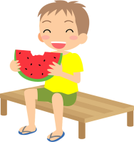
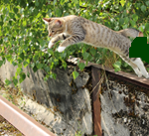
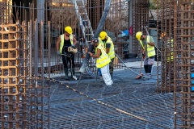
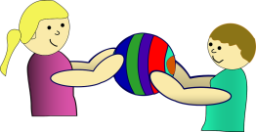
2. MAKE SENTENCES USING THE SIMPLE FUTURE FORM OF THE GIVEN VERBS
Eat:
Jivan will eat fruits when he is hungry.
Jump:
The cat will jump over the wall.
Sleep:
They will not sleep until the work is done.
Share:
My sister will share her toys with me.
Write:
I will write a letter to my grandparents.
Notes:
Notes for Teacher –
The teacher could use his/her discretion during correction. However, emphasis should be on the use of correct verb form for Simple Future Tense to frame meaningful sentences)
The class could be concluded with a discussion of the answers and a synopsis of the verb form used for Simple Future Tense.
Suggestions: N/A
Source of Multimedia used in this slide - N/A
Eating: https://creazilla.com/nodes/13573-boy-is-eating-watermelon-clipart
Cat Jump: https://pxhere.com/en/photo/1228419
Fruits: https://www.maxpixel.net/Basket-Fruits-Food-Eat-Fruit-Fruit-Basket-2729770
Workers: https://www.maxpixel.net/Pouring-Construction-Workers-Cement-Machinery-7226875
Sharing: https://pixabay.com/vectors/child-kid-sharing-friendship-game-145067/-By OpenClipart-Vectors
Writing: https://freesvg.org/1553605483

Slide 4
MM INDEX
Slide # | Thumbnail | Source link and Attribution
1 |  | Click: https://pixabay.com/vectors/index-finger-pointer-click-hand-303579/-By Clker-Free-Vector-Images
2 |  | Eating: https://creazilla.com/nodes/13573-boy-is-eating-watermelon-clipart Cat Jump: https://pxhere.com/en/photo/1228419 Fruits: https://www.maxpixel.net/Basket-Fruits-Food-Eat-Fruit-Fruit-Basket-2729770 Workers: https://www.maxpixel.net/Pouring-Construction-Workers-Cement-Machinery-7226875 Sharing: https://pixabay.com/vectors/child-kid-sharing-friendship-game-145067/-By OpenClipart-Vectors Writing: https://freesvg.org/1553605483

