Slide 1
Remember Me
Notes:
Notes for Teacher - < Information for further reference or explanation >
Suggestions: <Ideas/ Images/ Animations / Others – To make better representation of the content >
Source of Multimedia used in this slide - <Please provide source URL where we find the image and the license agreement>

Slide 2
Simple Present Tense
Refers to action taking place in the present
Simple Present Tense
Present - now, regularly or always
Universal Truths, Unchanging situations or habits
Notes:
Notes for Teacher - The teacher could start with a quick recap of the verb forms used in Simple Present Tense and Simple Past Tense.
The teacher could begin by giving a few sentences (orally) like -
My friends watched a game of tennis yesterday.
Birds fly in search of food.
We visited a farm last week.
She eats a healthy breakfast daily.
Now ask students to identify the tense used and help them recall their earlier learning.
Suggestions: <Ideas/ Images/ Animations / Others – To make better representation of the content >
Source of Multimedia used in this slide - <Please provide source URL where we find the image and the license agreement>

Slide 3
Simple Present Tense - Verb Form
He/She/It/Sita
eats/goes
a sandwich/to school
Singular Subject
V1s/es
Object
Boys/They/I/You
read
story books
Plural Subject
V1
Object
Please Click on the Boat for examples
Notes:
Notes for Teacher – The teacher could now show pictures wherein the time of action is mentioned and pick students (ensure a conscious mix of students who generally don’t speak up along with the smart ones) and probe them to identify the tense to be used in the given situation. (Yesterday – past tense, everyday - present tense, always – present tense, last week – past tense, a few days ago – past tense, etc.) and make complete sentences orally.
Suggestions: <Ideas/ Images/ Animations / Others – To make better representation of the content >
Source of Multimedia used in this slide - <Please provide source URL where we find the image and the license agreement>

Slide 4
Simple Past Tense
Refers to an action that has taken place in the past
Verb Form
He/I/You/They/Girls
laughed (verb+ed)
at the clown
Singular/Plural Subject
V2 (regular verbs only)
Object
Please Click on the Boat for examples
Notes:
Notes for Teacher - < Information for further reference or explanation >
Suggestions: <Ideas/ Images/ Animations / Others – To make better representation of the content >
Source of Multimedia used in this slide - <Please provide source URL where we find the image and the license agreement>

Slide 5
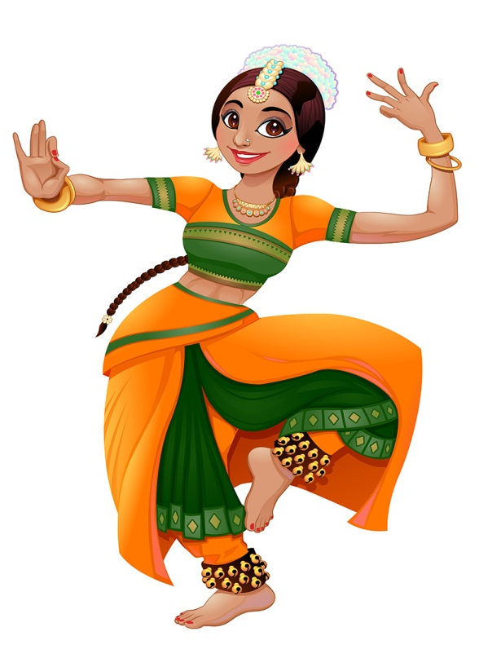
Identify the Tense to be used and make sentences
As a hobby
Tense:
Simple Present Tense
Probable answers
This girl dances whenever she is free.
She dances beautifully.
Gita dances very well.
Click Here for Sample answers
Notes:
Notes for Teacher - The probable answers provided are only samples.
The teacher could use his/her discretion to mark the answers right or wrong keeping in mind the correct tense to be used.
Suggestions: <Ideas/ Images/ Animations / Others – To make better representation of the content >
Source of Multimedia used in this slide -
https://www.freepik.com/free-vector/indian-woman-dancing_1036080.htm

Slide 6
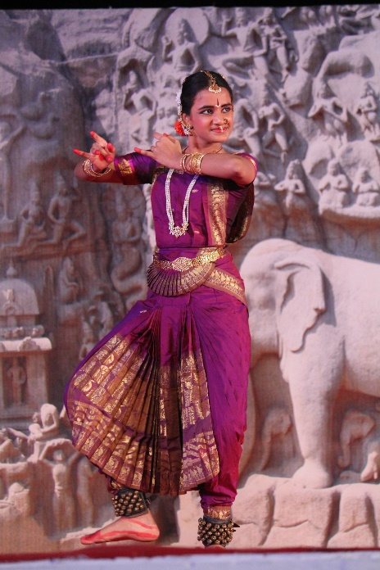
Identify the Tense to be used and make sentences
Yesterday
Tense:
Simple Past Tense
Probable answers
I danced at the school function yesterday.
You danced very well.
Gita danced for a competition yesterday.
Click Here for Sample answers
Notes:
Notes for Teacher - The probable answers provided are only samples.
The teacher could use his/her discretion to mark the answers right or wrong keeping in mind the correct tense to be used.
Suggestions: <Ideas/ Images/ Animations / Others – To make better representation of the content >
Source of Multimedia used in this slide - <Please provide source URL where we find the image and the license agreement>

Slide 7
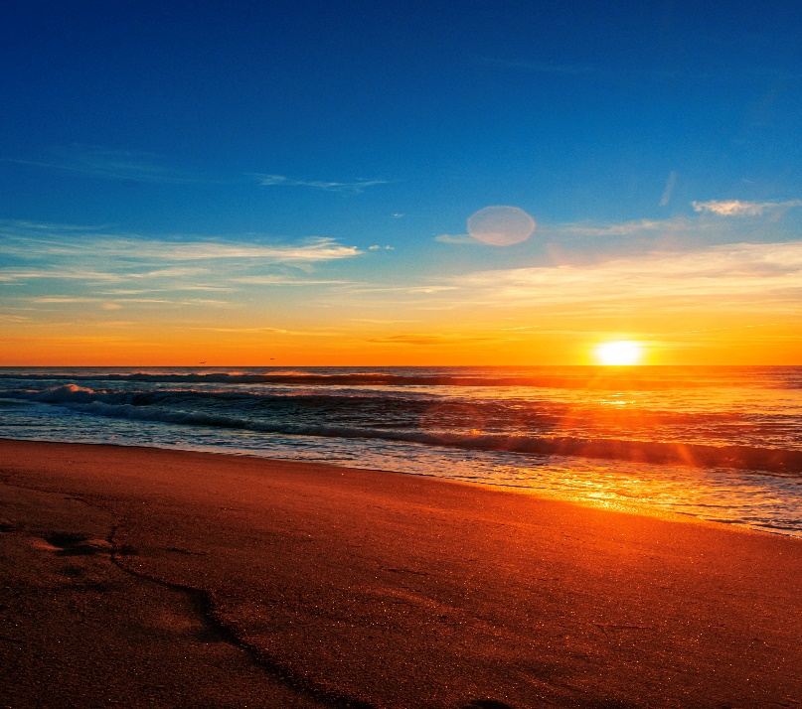
Identify the Tense to be used and make sentences
Everyday
Tense:
Simple Present Tense
Probable answers
The Sun rises in the East.
When the Sun rises, the sky looks beautiful.
I wake up when the Sun rises.
Click Here for Sample answers
Notes:
Notes for Teacher - The probable answers provided are only samples.
The teacher could use his/her discretion to mark the answers right or wrong keeping in mind the correct tense to be used.
Suggestions: <Ideas/ Images/ Animations / Others – To make better representation of the content >
Source of Multimedia used in this slide - <Please provide source URL where we find the image and the license agreement>

Slide 8
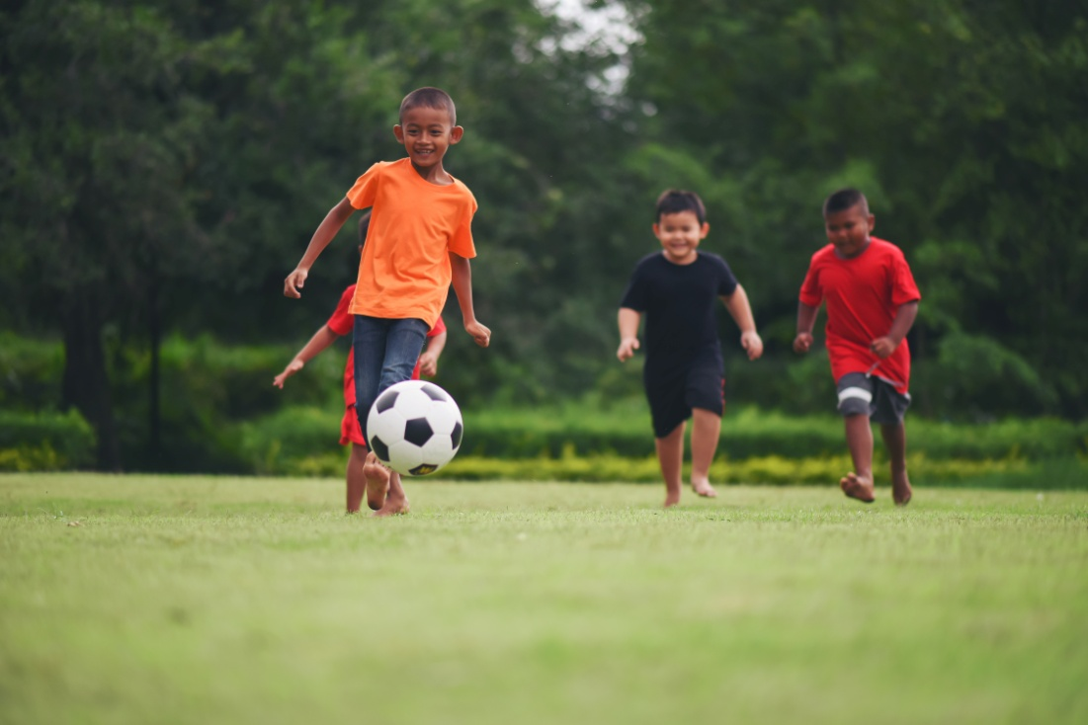
Identify the Tense to be used and make sentences
Last Week
Tense:
Simple Past Tense
Probable answers
These boys played football last week.
The boys played a football match in our school.
My friends played football in the playground.
Click Here for Sample answers
Notes:
Notes for Teacher - The probable answers provided are only samples.
The teacher could use his/her discretion to mark the answers right or wrong keeping in mind the correct tense to be used.
Suggestions: <Ideas/ Images/ Animations / Others – To make better representation of the content >
Source of Multimedia used in this slide - <Please provide source URL where we find the image and the license agreement>

Slide 9
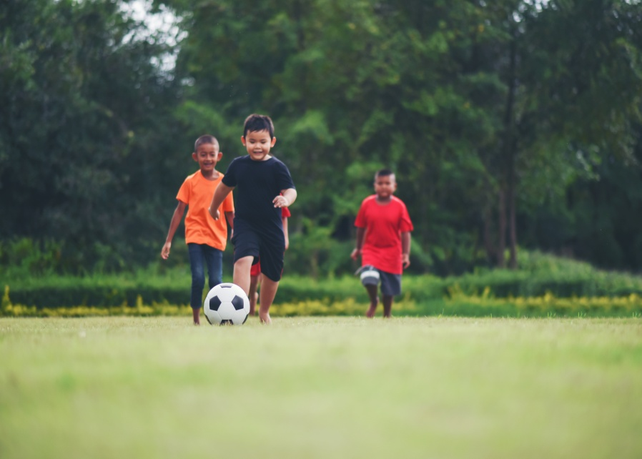
Identify the Tense to be used and make sentences
Today
Tense:
Simple Present Tense
Probable answers
The boys play football in the playground.
Those boys play football.
They play football because it is a holiday.
Click Here for Sample answers
Notes:
Notes for Teacher - The probable answers provided are only samples.
The teacher could use his/her discretion to mark the answers right or wrong keeping in mind the correct tense to be used.
Suggestions: <Ideas/ Images/ Animations / Others – To make better representation of the content >
Source of Multimedia used in this slide - <Please provide source URL where we find the image and the license agreement>

Slide 10
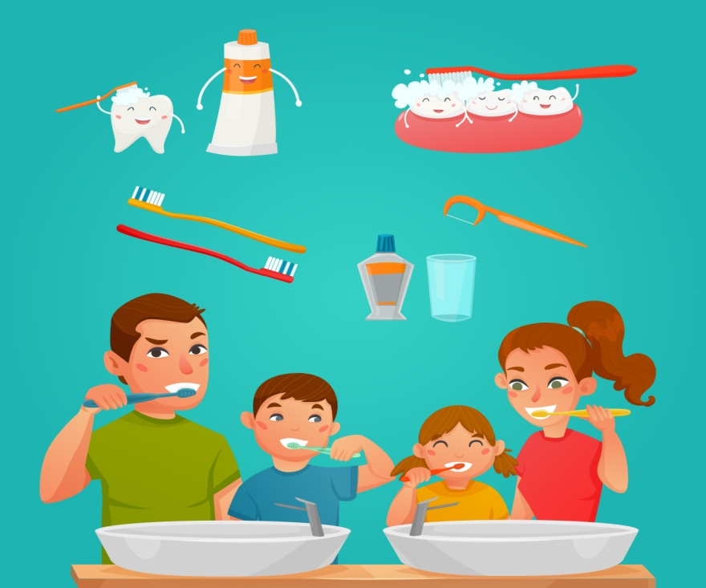
Identify the Tense to be used and make sentences
Regularly
Tense:
Simple Present Tense
Probable answers
He/She brushes his/her teeth in the morning.
I brush my teeth regularly.
We should brush our teeth everyday.
Rahul/Mira brushes his/her teeth after dinner.
Click Here for Sample answers
Notes:
Notes for Teacher - The probable answers provided are only samples.
The teacher could use his/her discretion to mark the answers right or wrong keeping in mind the correct tense to be used.
Suggestions: <Ideas/ Images/ Animations / Others – To make better representation of the content >
Source of Multimedia used in this slide - <Please provide source URL where we find the image and the license agreement>

Slide 11
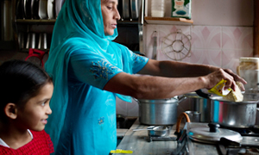
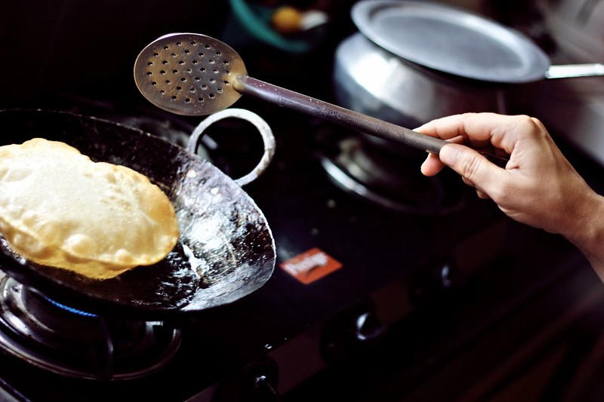
Identify the Tense to be used and make sentences
A few days ago
Tense:
Simple Past Tense
Probable answers
My mother cooked food for my friends a few days ago.
She cooked a tasty meal for guests a few days ago.
My aunt cooked a special meal for me the other day.
Click Here for Sample answers
Notes:
Notes for Teacher - The probable answers provided are only samples.
The teacher could use his/her discretion to mark the answers right or wrong keeping in mind the correct tense to be used.
Suggestions: <Ideas/ Images/ Animations / Others – To make better representation of the content >
Source of Multimedia used in this slide - <Please provide source URL where we find the image and the license agreement>
Mother: https://www.flickr.com/photos/28056346@N06/5552880728 By Nestlé
Puri: https://www.flickr.com/photos/58385162@N05/6098827717 By Ahmed Mahin Fayaz

Slide 12
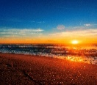
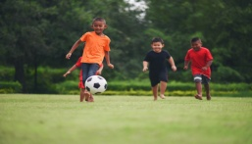
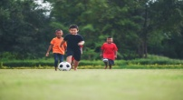
MM Index
Slide # | Thumbnail | Source link and Attribution
5 |  | https://www.freepik.com/free-vector/indian-woman-dancing_1036080.htm By ddraw
6 |  | https://www.flickr.com/photos/67769030@N07/9902519434 By Arian Zwegers
7 |  | https://www.freepik.com/free-photo/beautiful-beach-sunrise-blue-sky_12045461.htm By wirestock
8 |  | https://www.freepik.com/free-photo/kids-playing-soccer-football_2523579.htm By jcomp
9 |  | https://www.freepik.com/free-photo/kids-playing-soccer-football_2523580.htm By jcomp
10 |  | https://www.freepik.com/free-vector/young-family-brushing-teeth-together_4359536.htm By macrovector
11 |  | Mother: https://www.flickr.com/photos/28056346@N06/5552880728 By Nestlé Puri: https://www.flickr.com/photos/58385162@N05/6098827717 By Ahmed Mahin Fayaz
Notes:
Notes for Teacher - < Information for further reference or explanation >
Suggestions: <Ideas/ Images/ Animations / Others – To make better representation of the content >
Source of Multimedia used in this slide - <Please provide source URL where we find the image and the license agreement>

