Slide 1
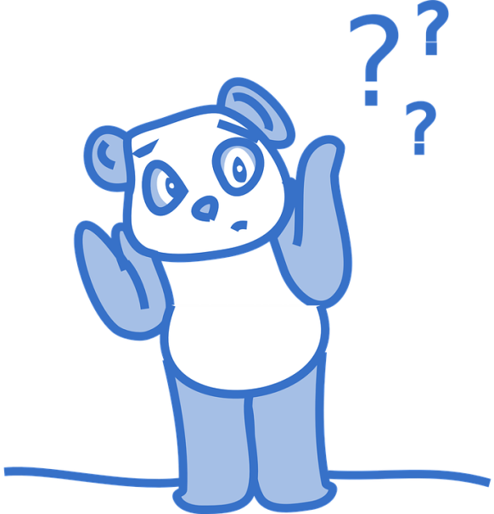
?
What am I doING
Notes:
Notes for Teacher - < Information for further reference or explanation >
Suggestions: <Ideas/ Images/ Animations / Others – To make better representation of the content >
Source of Multimedia used in this slide - <
Bear with Question marks - https://pixabay.com/vectors/panda-confused-questions-shrug-303949/ By Clker-Free-Vector-Images

Slide 2
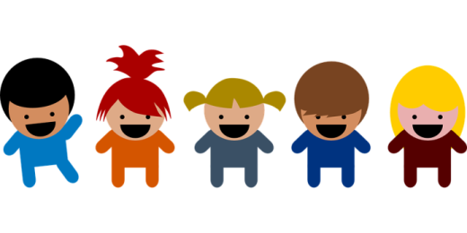
Activity
Get 5 students to act
What are these children DOING?
Click here for a sample answer
These children are laughING.
Notes:
Notes for Teacher - The teacher could begin the class with an introduction to the activity that is to be conducted to create curiosity and excitement. The teacher could arouse their interest by telling them about the game of ‘Dumb Charade’ except that here they would have to answer a question based on their acting.
Materials required for the activity :
An open box or a bowl.
Chits (around 10) with actions written along with a number to indicate the number of students to participate.
Procedure :
The teacher may divide the class into two groups (ensure a mix of active and passive students in both groups).
The teacher may then call one student from each group in turns and let him/her pick a chit.
Based on what is written in the chit, the student may perform the action individually or select more students (as mentioned in the chit) from the same group to perform .
When the action is in progress, the teacher could ask the other group ,”What are they/he/she/name DOING?”
Emphasis on ‘Doing’ is a clue to use ‘ing’ in the answer.
The teacher could also stress on the auxiliary verb used to indicate the number of the subject.
Suggestions: <Ideas/ Images/ Animations / Others – To make better representation of the content >
Source of Multimedia used in this slide -
1. Children laughing - https://pixabay.com/vectors/playschool-children-human-kids-151938/ By OpenClipart-Vectors

Slide 3
Activity
Get 1 student to act
Click here for a sample answer
What is she/he/name DOING?
She/He/Name is readING.
Notes:
Notes for Teacher - Suggestions: <Ideas/ Images/ Animations / Others – To make better representation of the content >
Source of Multimedia used in this slide -
https://pixabay.com/vectors/person-reading-book-pictogram-310799/ By Clker-Free-Vector-Images

Slide 4
Activity
Get 1 student to act
Click here for a sample answer
What is he/she/name DOING?
He/She/Name is singING.
Notes:
Notes for Teacher - Suggestions: <Ideas/ Images/ Animations / Others – To make better representation of the content >
Source of Multimedia used in this slide -
https://pixabay.com/vectors/crooner-melody-music-singing-sing-154620/ By OpenClipart-Vectors

Slide 5
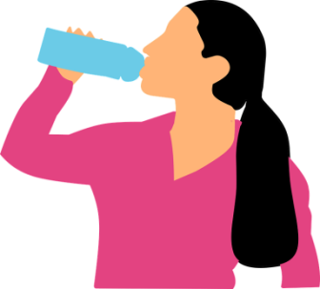
Activity
Get 1 student to act
Click here for a sample answer
What is your friend DOING?
My friend is drinkING water.
Notes:
Notes for Teacher - Suggestions: <Ideas/ Images/ Animations / Others – To make better representation of the content >
Source of Multimedia used in this slide -
Girl drinking water - https://pixabay.com/vectors/drinking-water-woman-bottle-2704297/ By mohamed_hassan

Slide 6
Activity
Get 3 students to act
Click here for a sample answer
What are these boys/girls DOING?
These boys/girls are jumpING.
Notes:
Notes for Teacher - Suggestions: <Ideas/ Images/ Animations / Others – To make better representation of the content >
Source of Multimedia used in this slide -
Jumping - https://pixabay.com/vectors/jumping-people-man-woman-male-2789737/ By GDJ

Slide 7
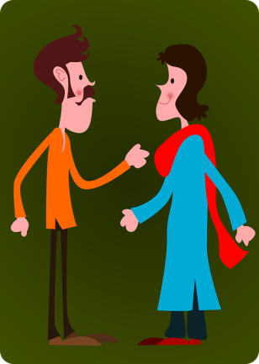
Activity
Get 2 students to act
Click here for a sample answer
What are Sudhir and Anita DOING?
Sudhir and Anita are talkING.
Notes:
Notes for Teacher - Suggestions: <Ideas/ Images/ Animations / Others – To make better representation of the content >
Source of Multimedia used in this slide -
Boy and girl talking - https://pixabay.com/vectors/couple-man-woman-talking-together-41463/ By Clker-Free-Vector-Images

Slide 8
Activity
Get 1 student to act
Click here for a sample answer
What am I DOING?
I am eatING. /
You are eatING.
Notes:
Notes for Teacher - Suggestions: <Ideas/ Images/ Animations / Others – To make better representation of the content >
Source of Multimedia used in this slide -
Child eating - https://pixabay.com/illustrations/child-rice-eating-kid-asian-7121211/ By 鹈鹂夏Tilixia

Slide 9
Activity
Get 4 students to act
Click here for a sample answer
What are they DOING?
They are runnING.
Notes:
Notes for Teacher - Suggestions: <Ideas/ Images/ Animations / Others – To make better representation of the content >
Source of Multimedia used in this slide -
People running - https://pixabay.com/vectors/runners-silhouette-people-running-33482/ By Clker-Free-Vector-Images

Slide 10
Activity
Get 6 students to act
What are those students DOING?
Click here for a sample answer
Those students are writING.
Notes:
Notes for Teacher - Suggestions: <Ideas/ Images/ Animations / Others – To make better representation of the content >
Source of Multimedia used in this slide -
Students writing - https://pixabay.com/illustrations/write-notebook-student-desks-6906817/ By Elf-Moondance
Boy writing - https://pixabay.com/illustrations/student-child-homework-boy-male-5677625/ By Felixmh
Boy & Girl writing - https://www.freepik.com/free-vector/work-home-font-design-with-two-kids-doing-homework_9720402.htm by brgfx
Boy writing - https://www.freepik.com/free-vector/school-student-passing-exam-classroom_16701552.htm By upklyak

Slide 11
Activity
Get 1 student to act
Click here for a sample answer
What are you DOING?
I am drawING.
Notes:
Notes for Teacher - The teacher could aim for maximum participation and ensure students answer (orally) using the ‘ing’ form of the verb with appropriate auxiliary verbs and in complete sentences.
Now the teacher could tell the students to identify the use of ‘ing’ for an action in progress in the present and mention the use of auxiliary verbs to indicate the number of the subject. Hence, the name ‘Present Continuous Tense’ Suggestions: <Ideas/ Images/ Animations / Others – To make better representation of the content >
Source of Multimedia used in this slide -
Student drawing - https://pixabay.com/vectors/scribbling-writing-student-write-152216/ By OpenClipart-Vectors

Slide 12
MM INDEX
Slide # | Thumbnail | Source link and Attribution
1 |  | Bear with Question marks - https://pixabay.com/vectors/panda-confused-questions-shrug-303949/ By Clker-Free-Vector-Images
2 |  | Children laughing - https://pixabay.com/vectors/playschool-children-human-kids-151938/ By OpenClipart-Vectors
3 |  | Read: https://pixabay.com/vectors/person-reading-book-pictogram-310799/ By Clker-Free-Vector-Images
4 |  | Sing: https://pixabay.com/vectors/crooner-melody-music-singing-sing-154620/ By OpenClipart-Vectors
5 |  | Girl drinking water - https://pixabay.com/vectors/drinking-water-woman-bottle-2704297/ By mohamed_hassan
6 |  | Jumping - https://pixabay.com/vectors/jumping-people-man-woman-male-2789737/ By GDJ
7 |  | Boy and girl talking - https://pixabay.com/vectors/couple-man-woman-talking-together-41463/ By Clker-Free-Vector-Images
8 |  | Child eating - https://pixabay.com/illustrations/child-rice-eating-kid-asian-7121211/ By 鹈鹂夏Tilixia
9 |  | People running - https://pixabay.com/vectors/runners-silhouette-people-running-33482/ By Clker-Free-Vector-Images
10 |  | Students writing - https://pixabay.com/illustrations/write-notebook-student-desks-6906817/ By Elf-Moondance Boy writing - https://pixabay.com/illustrations/student-child-homework-boy-male-5677625/ By Felixmh Boy & Girl writing - https://www.freepik.com/free-vector/work-home-font-design-with-two-kids-doing-homework_9720402.htm by brgfx Boy writing - https://www.freepik.com/free-vector/school-student-passing-exam-classroom_16701552.htm By upklyak
11 |  | Student drawing - https://pixabay.com/vectors/scribbling-writing-student-write-152216/ By OpenClipart-Vectors
Notes:
Notes for Teacher - < Information for further reference or explanation >
Suggestions: <Ideas/ Images/ Animations / Others – To make better representation of the content >
Source of Multimedia used in this slide - <Please provide source URL where we find the image and the license agreement>

