Slide 1
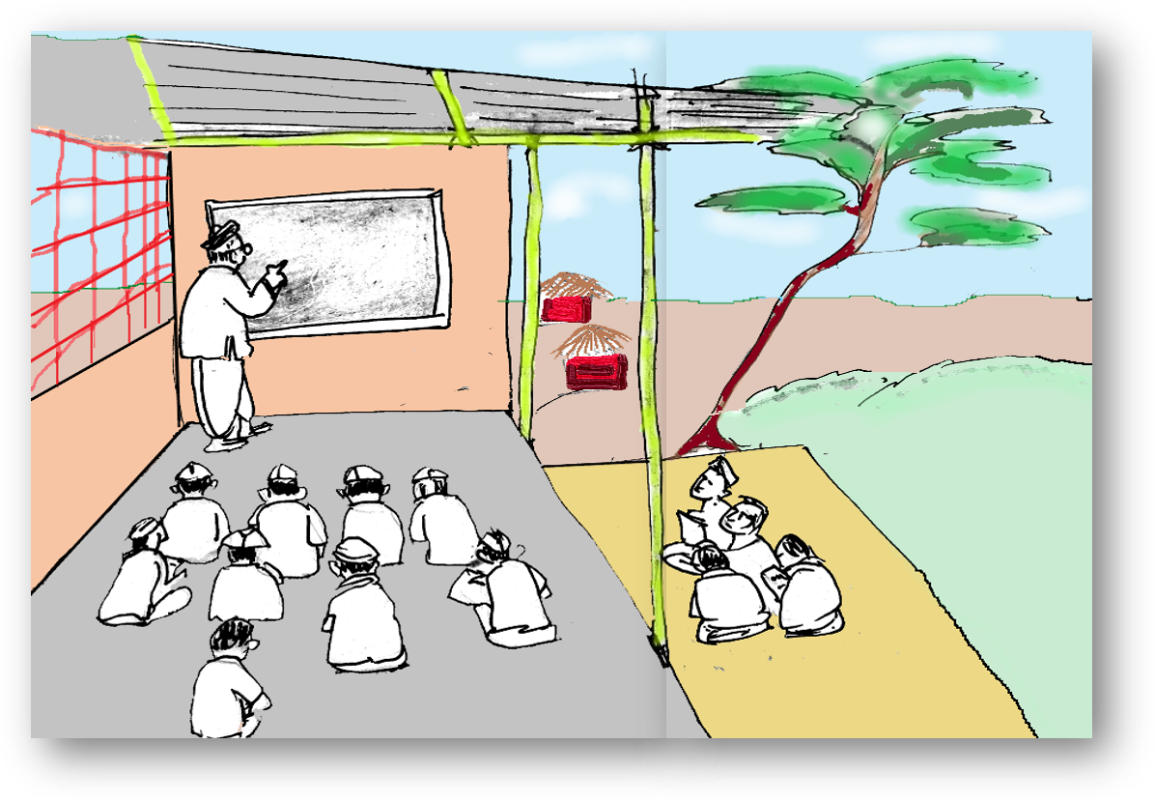
Knowing the ‘ING’
Notes:
Notes for Teacher - The teacher could begin the class with a detailed explanation of the verb form used in the Present Continuous Tense. She/he could go into detailing about the use of auxiliary verbs (referred to as ‘helping verbs’ here) to enable the students to understand the changes occurring with the number of the subject. The pictorial description given in the GO and the PPT could enable easy understanding of the topic. The teacher could add some chalk and board work to add value to the explanation.
Suggestions: <Ideas/ Images/ Animations / Others – To make better representation of the content >
Source of Multimedia used in this slide - <Please provide source URL where we find the image and the license agreement>
<Classroom> <SSSVV – classroom>

Slide 2
Present Continuous Tense
It is used for actions in the present that are still in progress.
Subject
helping verb
verb(ing)
Object
I/They/She
am/are/is
singing
a song
I
He/She/It
We/They/You
am
is
are
reading
eating
playing
a book
an apple
cricket
Notes:
Notes for Teacher - < Information for further reference or explanation >
Suggestions: <Ideas/ Images/ Animations / Others – To make better representation of the content >
Source of Multimedia used in this slide - <Please provide source URL where we find the image and the license agreement>

Slide 3
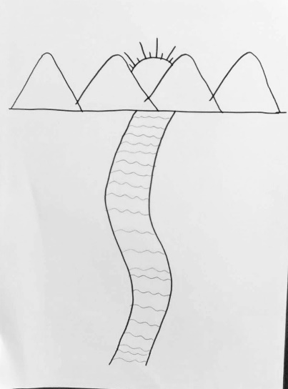
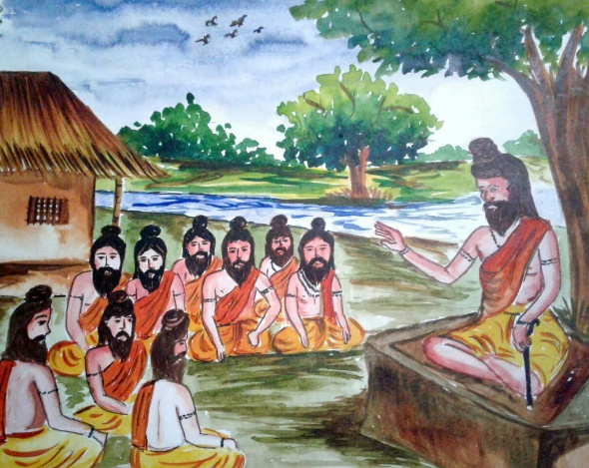
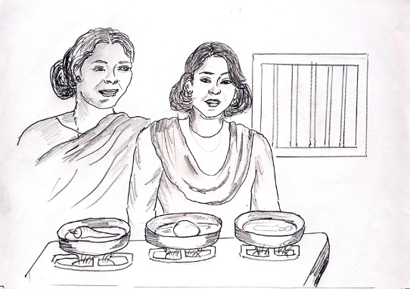
Present Continuous Tense
Verbs to which only ‘ing’ is added.
Sing
Singing
Play
Playing
Draw
Drawing
Learn
Learning
Do
Doing
Notes:
Notes for Teacher - < Information for further reference or explanation >
Suggestions: <Ideas/ Images/ Animations / Others – To make better representation of the content >
Source of Multimedia used in this slide - <Please provide source URL where we find the image and the license agreement>
<singing> <https://pixabay.com/vectors/singer-female-silhouette-woman-4753813/>
<playing> <https://pixabay.com/vectors/children-playing-ball-silhouette-310582/>
<drawing> <SSSVV – drawing>
<learning> <SSSVV – learning, Gurukul>
<cooking> <SSSVV – cooking>

Slide 4
Present Continuous Tense
For one syllable words that end with ‘consonant’ – ‘vowel’ – ‘consonant’,
double the last consonant and add ‘ing’.
Sit
Sitting
Swim
Swimming
Plan
Planning
Stop
Stopping
Put
Putting
Notes:
Notes for Teacher - < Information for further reference or explanation >
Suggestions: <Ideas/ Images/ Animations / Others – To make better representation of the content >
Source of Multimedia used in this slide - <Please provide source URL where we find the image and the license agreement>
<sitting> <SSSVV – sitting>
<swimming> <SSSVV – swimming>
<stop> <SSSVV – stop signal>
<water> <https://pixabay.com/photos/bottle-mineral-water-glass-pour-2032980/>
<planning> <https://pixabay.com/illustrations/priority-goal-plan-importance-4297708/>

Slide 5
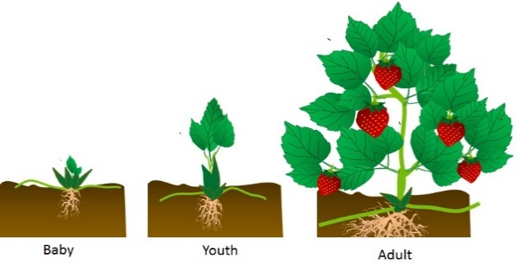
Present Continuous Tense
For verbs that end with the vowel ‘e’, drop the ‘e’ and add ‘ing’.
Dance
Dancing
Write
Writing
Come
Coming
Smile
Smiling
Live
Living
Notes:
Notes for Teacher - < Information for further reference or explanation >
Suggestions: <Ideas/ Images/ Animations / Others – To make better representation of the content >
Source of Multimedia used in this slide - <Please provide source URL where we find the image and the license agreement>
<dance> <SSSVV – dance>
<write> <https://pixabay.com/vectors/hand-pen-writing-holding-pen-5431113/>
<come> <https://pixabay.com/photos/coming-soon-chalk-board-blackboard-2550190/>
<smile> <SSSVV – smile>
<living> <SSSVV – growth>

Slide 6
Present Continuous Tense
For verbs that end in ‘ie’, drop the ‘ie’ and add ‘ying’.
Tie
Tying
Die
Dying
Lie
Lying
Notes:
Notes for Teacher - < Information for further reference or explanation >
Suggestions: <Ideas/ Images/ Animations / Others – To make better representation of the content >
Source of Multimedia used in this slide - <Please provide source URL where we find the image and the license agreement>
<rope> <https://pixabay.com/photos/rope-knots-tie-node-loop-line-6184477>
<Die> <https://pixabay.com/photos/nature-flower-plant-pink-flora-4740827/>
<lie> <SSSVV-sleep>

Slide 7
MM INDEX
Slide # | Thumbnail | Source link and Attribution
3 |  | <singing> <https://pixabay.com/vectors/singer-female-silhouette-woman-4753813/> <playing> <https://pixabay.com/vectors/children-playing-ball-silhouette-310582/>
4 |  | <water> <https://pixabay.com/photos/bottle-mineral-water-glass-pour-2032980/> <planning> <https://pixabay.com/illustrations/priority-goal-plan-importance-4297708/>
5 |  | <write> <https://pixabay.com/vectors/hand-pen-writing-holding-pen-5431113/> <come> <https://pixabay.com/photos/coming-soon-chalk-board-blackboard-2550190/>
6 |  | <rope> <https://pixabay.com/photos/rope-knots-tie-node-loop-line-6184477> <Die> <https://pixabay.com/photos/nature-flower-plant-pink-flora-4740827/>
Notes:
Notes for Teacher - < Information for further reference or explanation >
Suggestions: <Ideas/ Images/ Animations / Others – To make better representation of the content >
Source of Multimedia used in this slide - <Please provide source URL where we find the image and the license agreement>

