Slide 1
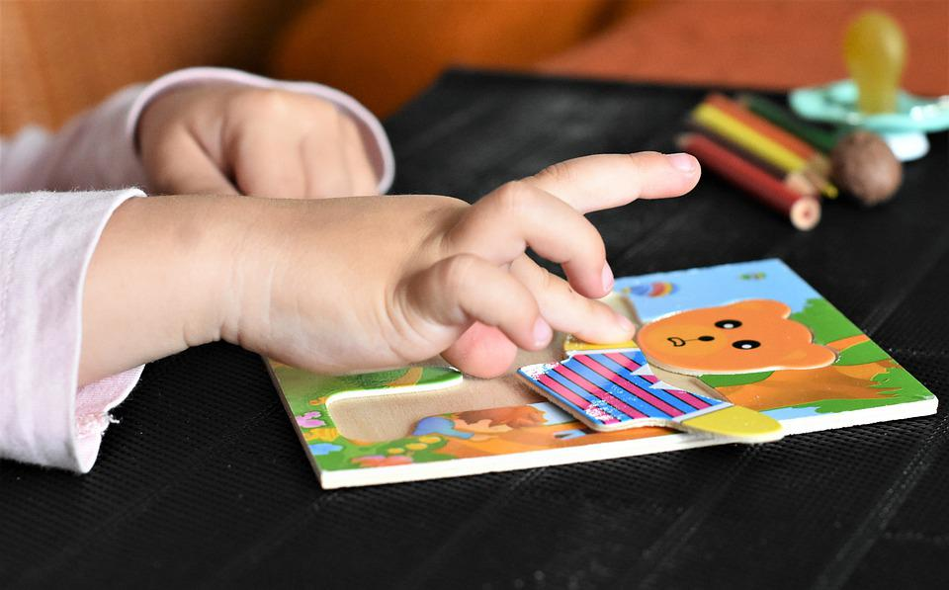
Play and Learn
Notes:
Notes for Teacher - < Information for further reference or explanation >
Suggestions: <Ideas/ Images/ Animations / Others – To make better representation of the content >
Source of Multimedia used in this slide - https://cdn.pixabay.com/photo/2019/08/03/20/50/child-4382645_960_720.jpg

Slide 2
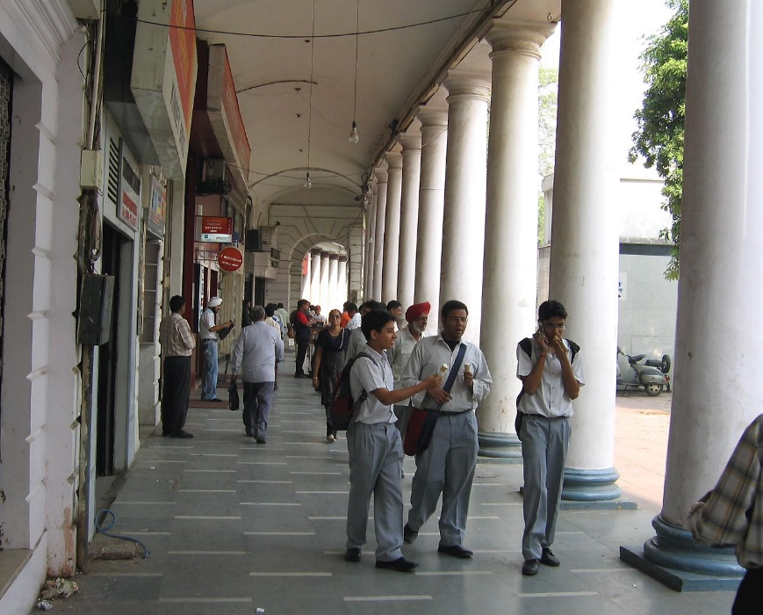
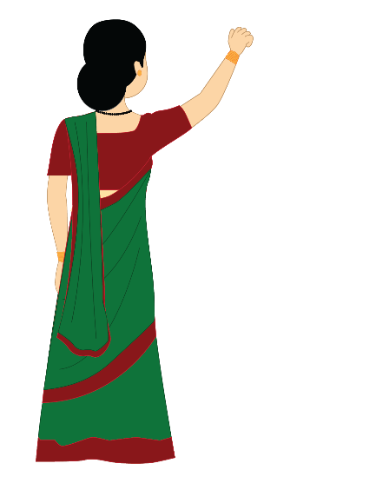
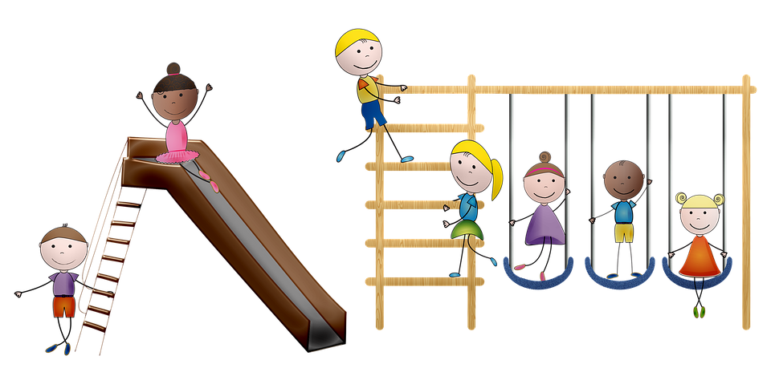
Present Continuous Tenses around us
C
That boy is walking in the corridor.
a, e, i, o, u - Vowels
I am teaching grammar to my class
Students are playing in the playground
Notes:
Notes for Teacher - The teacher could begin the class by talking to the students about the relevance of Present Continuous Tense in our daily conversations. Students could just look around and highlight the multiple opportunities available to use present continuous tense
- Teacher will pick random number of students (a mix of active and passive ones). Students should look around and make a sentence using Present Continuous Tense. Teacher will encourage maximum participation. Teacher will Emphasys on the use of correct verb forms and auxiliary verbs
Questions will be asked based on the verb forms and auxiliary verbs used to reinforce understanding.
Why did you use ‘is’ in your sentence?
How will your sentence change if the subject is a group of girls instead of one?
What is the spelling of ‘coming’ / ‘putting’ that you have used in your sentence? (or any relevant question)
The attached PPT could give better clarity about what is expected of the students and get them started.
Suggestions: <Ideas/ Images/ Animations / Others – To make better representation of the content >
Source of Multimedia used in this slide -
Boys: https://www.flickr.com/photos/71279724@N00/284714813 By Prato
Blackboard: https://pixabay.com/vectors/chalkboard-blackboard-whiteboard-34694/ By Clker-Free-Vector-Images Teacher: SSSVV Image Gallery: Search Keyword “teacher”
Playground: https://pixabay.com/illustrations/children-s-playground-swing-slide-5067156/ By AnnaliseArt

Slide 3
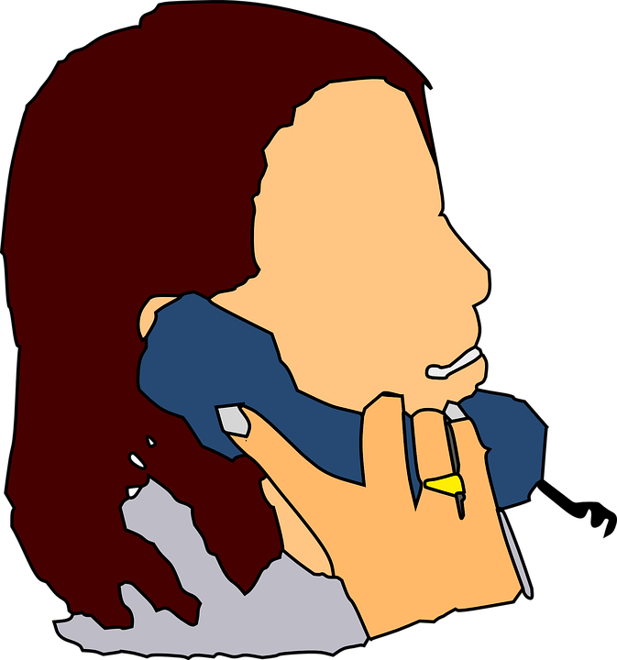
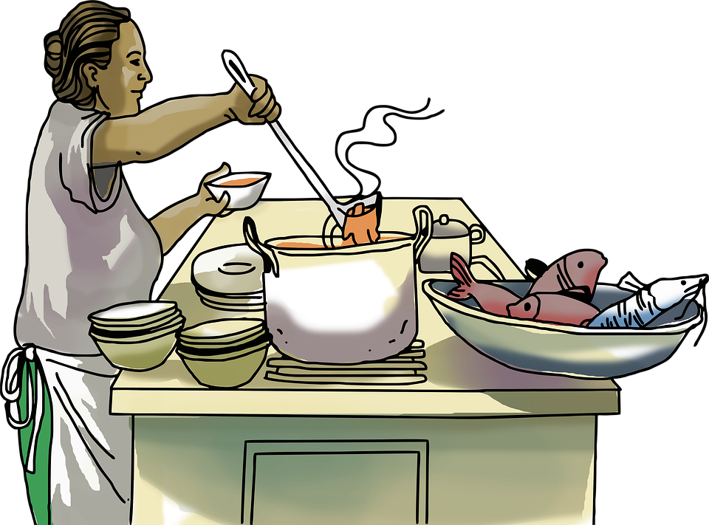
Present Continuous Tense
C
Enjoy using Present Continuous Tense
Birds are chirping in the tree
My friend is talking on the phone
My mother is preparing dinner for me
Notes:
Notes for Teacher: -
. Suggestions: <Ideas/ Images/ Animations / Others – To make better representation of the content >
Source of Multimedia used in this slide - https://cdn.pixabay.com/photo/2014/03/24/13/47/phone-294368_960_720.png
https://pixabay.com/illustrations/kitchen-cooking-woman-chef-6585871/ By DremArtes
https://pixabay.com/vectors/phone-hand-people-lady-woman-girl-294368/ By Clker-Free-Vector-Images
Tree & Birds: Powerpoint Shapes

Slide 4
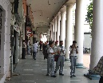
MM Index
Slide # | Thumbnail | Source link and Attribution
1 |  | https://pixabay.com/photos/child-to-play-small-child-puzzle-4382645/ By RitaE
2 |  | Boys: https://www.flickr.com/photos/71279724@N00/284714813 By Prato Blackboard: https://pixabay.com/vectors/chalkboard-blackboard-whiteboard-34694/ By Clker-Free-Vector-Images Teacher: SSSVV Image Gallery: Search Keyword “teacher” Playground: https://pixabay.com/illustrations/children-s-playground-swing-slide-5067156/ By AnnaliseArt
3 |  | Kitchen: https://pixabay.com/illustrations/kitchen-cooking-woman-chef-6585871/ By DremArtes Phone: https://pixabay.com/vectors/phone-hand-people-lady-woman-girl-294368/ By Clker-Free-Vector-Images
Notes:
Notes for Teacher - < Information for further reference or explanation >
Suggestions: <Ideas/ Images/ Animations / Others – To make better representation of the content >
Source of Multimedia used in this slide - <Please provide source URL where we find the image and the license agreement>

