Slide 1
A rhyme for TENSE
Notes:
Notes for Teacher - < This PPT has an audio narration, kindly make sure to increase the device volume.
The teacher may begin the class on a lighter note addressing the boredom students generally feel towards Grammar. She/he could point out the apprehension prevailing among students about the study of tenses being tough. To set the mood the teacher could tell them to imagine what it would be like if they did not have to learn about tenses.
Then the teacher could recite the poem (PPT may be used) and encourage the students to repeat. (Proper intonation and rhythm could help in making the recitation interesting and grasping the essence of the poem.) >
Suggestions: <Ideas/ Images/ Animations / Others – To make better representation of the content >
Source of Multimedia used in this slide - <Please provide source URL where we find the image and the license agreement>

Slide 2
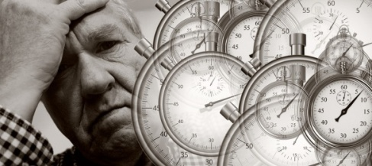
Why the Tense?!
Think of a life without any tense
Your time of work will make no sense.
Yesterday, tomorrow and today
Will be words, just for a say.
The picnic you had or the holiday you’ve planned
Will be a beat - repeat in a band.
To say ‘I run’ when it’s past - is so silly,
And the same ‘I run’ for the still running - ha, so funny!
Notes:
Notes for Teacher - < >
Suggestions: <Ideas/ Images/ Animations / Others – To make better representation of the content >
Source of Multimedia used in this slide - <1.Think - https://pixabay.com/photos/question-question-mark-help-2309040/
2. Time making no sense - https://pixabay.com/illustrations/stress-hurry-rush-run-success-6784607/
3. Picnic - https://pixabay.com/photos/autumn-tea-fall-picnic-drink-4579561/
4. Stickman Run - https://pixabay.com/vectors/stick-man-runner-silhouette-figure-295293/ >

Slide 3
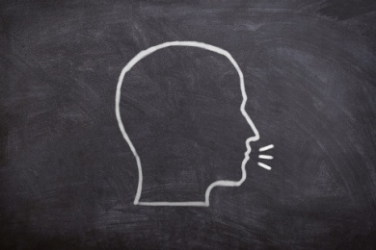
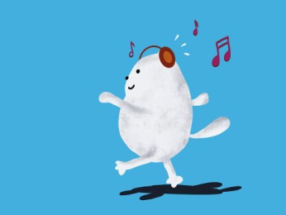
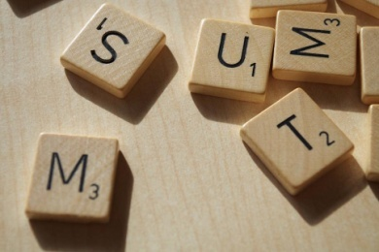
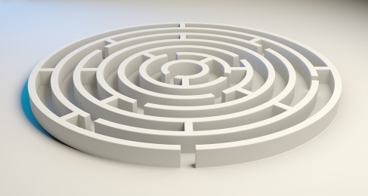
Why the Tense ?!
Speak and spoke or tear and tore,
Walk and walked or wear and wore.
These aren’t just random words,
But carefully made, time bound verbs.
Maybe it’s tough - the study of tense,
But when you speak, it makes good sense.
Notes:
Notes for Teacher - < The teacher could conclude the class by highlighting how the study of tenses actually makes our conversations meaningful.>
Suggestions: <Ideas/ Images/ Animations / Others – To make better representation of the content >
Source of Multimedia used in this slide - <5. Speak - https://pixabay.com/photos/board-chalk-head-talk-to-speak-3700375/
6. Walking - https://pixabay.com/illustrations/cat-walking-listen-music-5775895/
7.Random words - https://pixabay.com/photos/scrabble-game-tiles-random-word-2273910/
8. Tough maze - https://pixabay.com/illustrations/maze-labyrinth-solution-lost-1804496/ >

Slide 4
MM Index
Slide # | Thumbnail | Source link and Attribution
2 |  | Think - https://pixabay.com/photos/question-question-mark-help-2309040/ Time making no sense - https://pixabay.com/illustrations/stress-hurry-rush-run-success-6784607/ Picnic - https://pixabay.com/photos/autumn-tea-fall-picnic-drink-4579561/ Stickman Run - https://pixabay.com/vectors/stick-man-runner-silhouette-figure-295293/
3 |  | Speak - https://pixabay.com/photos/board-chalk-head-talk-to-speak-3700375/ Walking - https://pixabay.com/illustrations/cat-walking-listen-music-5775895/ Random words - https://pixabay.com/photos/scrabble-game-tiles-random-word-2273910/ Tough maze - https://pixabay.com/illustrations/maze-labyrinth-solution-lost-1804496/
Notes:
Notes for Teacher - < Information for further reference or explanation >
Suggestions: <Ideas/ Images/ Animations / Others – To make better representation of the content >
Source of Multimedia used in this slide - <Please provide source URL where we find the image and the license agreement>

