Slide 1
Keep Working to Keep Growing
Notes:
Notes for Teacher - < Information for further reference or explanation >
Suggestions: <Ideas/ Images/ Animations / Others – To make better representation of the content >
Source of Multimedia used in this slide - https://www.freepik.com/free-vector/businessman-jumps-graph-columns-way-success-positive-thinking-success-achievement-self-confidence-concept-white-background_11668414.htm By vectorjuice

Slide 2
Introducing Rahul
Rahul is an intelligent and talented child.
Rahul
But he is lazy. He is never regular in his studies or activities.
Notes:
Notes for Teacher - < Information for further reference or explanation >
Suggestions: <Ideas/ Images/ Animations / Others – To make better representation of the content >
Source of Multimedia used in this slide –
Boy: https://www.freepik.com/free-vector/little-boy-pointing-with-index-finger-flat-vector-illustration_9871189.htm By nizovatina

Slide 3
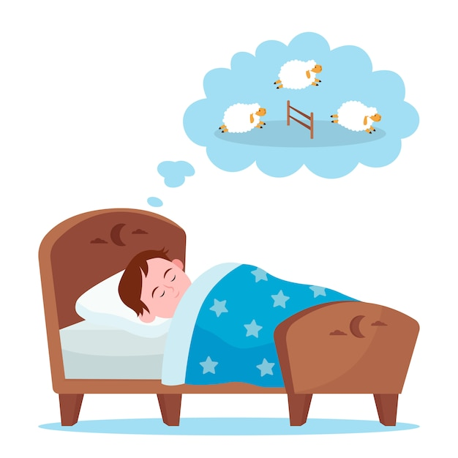
Rahul’s Dream
Notes:
Notes for Teacher - < Information for further reference or explanation >
Suggestions: <Ideas/ Images/ Animations / Others – To make better representation of the content >
Source of Multimedia used in this slide -
Boys: https://www.freepik.com/free-vector/little-boy-lying-bed-counting-sheep_9650026.htm By pch.vector
Bubble: https://www.freepik.com/free-vector/thought-bubble-black-business-icon-clipart_16339902.htm By rawpixel.com
Earth: https://www.freepik.com/free-vector/smiling-earth-planet-with-green-hair_22746504.htm By brgfx
Sun: https://pixabay.com/vectors/sun-cartoon-character-graphic-5277491/
Ant: https://pixabay.com/illustrations/ant-cartoon-insect-bug-cute-5535447/
Bee: https://pixabay.com/illustrations/honey-bee-bee-honey-icon-bee-icon-469560/

Slide 4
Rahul’s Dream
We have all come to teach you the importance of continuous efforts in life.
WELCOME!
What brings you here?
Notes:
Notes for Teacher - < Information for further reference or explanation >
Suggestions: <Ideas/ Images/ Animations / Others – To make better representation of the content >
Source of Multimedia used in this slide - https://www.freepik.com/free-vector/little-boy-pointing-with-index-finger-flat-vector-illustration_9871189.htm#query=boy%20cartoon&position=1&from_view=search;By nizovatina
https://www.freepik.com/free-vector/collection-colorful-speech-bubbles-vector_3109989.htm#query=speech%20bubble&position=3&from_view=search;By rawpixel.com
https://www.freepik.com/free-vector/personal-goals-concept-illustration_13416138.htm#query=effort&position=1&from_view=search;By storyset

Slide 5
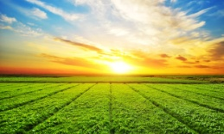
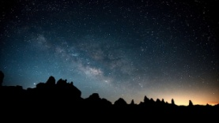
Sun’s tips for Rahul
Why should I make
continuous efforts?
If one day, I decide not to rise and just take rest, there will be darkness everywhere.
Notes:
Notes for Teacher - < Information for further reference or explanation >
Suggestions: <Ideas/ Images/ Animations / Others – To make better representation of the content >
Source of Multimedia used in this slide - https://www.freepik.com/free-photo/beautiful-sky-full-stars-trona-ca_13381243.htm#query=night&position=14&from_view=keyword;By wirestock
https://www.freepik.com/free-photo/sunny-meadow-landscape_877658.htm#query=sunny%20day&position=4&from_view=search;Byonlyyouqj
https://www.freepik.com/free-vector/day-night-formation-with-sun-light-earth-white-background_16265007.htm#query=earth%20rotation&position=6&from_view=search;By brgfx

Slide 6
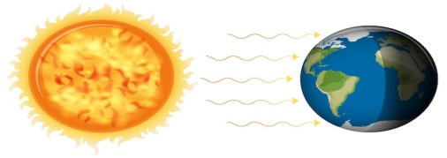
Earth’s tips for Rahul
Why should I make
continuous efforts?
If I don’t rotate continuously, day and night will not occur. One half of the planet will be hot, and the other half will be freezing cold.
Notes:
Notes for Teacher - < Information for further reference or explanation >
Suggestions: <Ideas/ Images/ Animations / Others – To make better representation of the content >
Source of Multimedia used in this slide - https://www.freepik.com/free-photo/beautiful-sky-full-stars-trona-ca_13381243.htm#query=night&position=14&from_view=keyword;By wirestock
https://www.freepik.com/free-photo/sunny-meadow-landscape_877658.htm#query=sunny%20day&position=4&from_view=search;Byonlyyouqj
https://www.freepik.com/free-vector/day-night-formation-with-sun-light-earth-white-background_16265007.htm#query=earth%20rotation&position=6&from_view=search;By brgfx

Slide 7
Bee’s tips for Rahul
If we don’t move continuously from flower to flower, we won’t have any nuts and fruits to eat.
Why should I make
continuous efforts?
Notes:
Notes for Teacher - < Information for further reference or explanation >
Suggestions: <Ideas/ Images/ Animations / Others – To make better representation of the content >
Source of Multimedia used in this slide - https://www.freepik.com/free-vector/underground-animal-burrow-with-ant-family_13988069.htm#query=ant&position=0&from_view=search;By brgfx
https://pixabay.com/vectors/pollination-flowers-insects-bees-5615146/

Slide 8
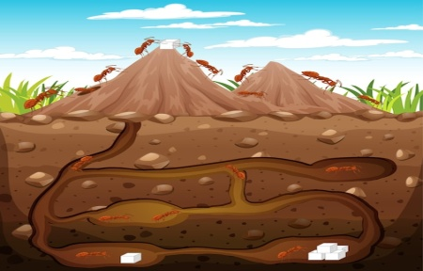
Ant’s tips for Rahul
If we don’t work continuously and store food in summer, we would remain hungry during winter. Our strength comes from continuous efforts.
Why should I make
continuous efforts?
Notes:
Notes for Teacher - < Information for further reference or explanation >
Suggestions: <Ideas/ Images/ Animations / Others – To make better representation of the content >
Source of Multimedia used in this slide - https://www.freepik.com/free-vector/underground-animal-burrow-with-ant-family_13988069.htm#query=ant&position=0&from_view=search;By brgfx
https://pixabay.com/vectors/pollination-flowers-insects-bees-5615146/

Slide 9
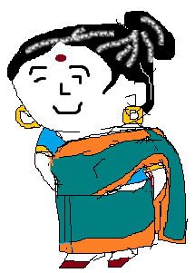
Rahul’s narrates his dream to Grandmother
Notes:
Notes for Teacher - < Information for further reference or explanation >
Suggestions: <Ideas/ Images/ Animations / Others – To make better representation of the content >
Source of Multimedia used in this slide - https://contentmanagement.srisathyasaividyavahini.org/index.php#,grandmother

Slide 10
Grandmother’s advice to Rahul
Remember Rahul, like the Earth, the Sun, Bee and Ant, we humans also have to keep working. Remember - Achievement comes through continuous efforts.
Notes:
Notes for Teacher - < Information for further reference or explanation >
Suggestions: <Ideas/ Images/ Animations / Others – To make better representation of the content >
Source of Multimedia used in this slide - https://www.freepik.com/free-vector/kid-winning-gold-medal-trophy-cup-competition-happy-boy-holding-prize-hand-standing-pedestal_25872325.htm#query=trophy%20icon&position=37&from_view=keyword;Bystudio4rt

Slide 11
Points to Discuss
be active
be regular
don’t give up a task half-way
make a little progress each day
be patient
enjoy what you do
Notes:
Notes for Teacher - < Information for further reference or explanation >
Suggestions: <Ideas/ Images/ Animations / Others – To make better representation of the content >
Source of Multimedia used in this slide - https://www.freepik.com/free-vector/businessman-jumps-graph-columns-way-success-positive-thinking-success-achievement-self-confidence-concept-white-background_11668414.htm#query=motivation&position=12&from_view=keyword ;By vectorjuice

Slide 12
Points to ponder
Keep improving and Keep Achieving!
Keep Working.
Success comes through continuous efforts.
Notes:
Notes for Teacher - < Information for further reference or explanation >
Suggestions: <Ideas/ Images/ Animations / Others – To make better representation of the content >
Source of Multimedia used in this slide - <Please provide source URL where we find the image and the license agreement>

Slide 13
MM INDEX
Slide # | Thumbnail | Source link and Attribution
1 |  | https://www.freepik.com/free-vector/businessman-jumps-graph-columns-way-success-positive-thinking-success-achievement-self-confidence-concept-white-background_11668414.htm By vectorjuice
2, 3, 4, 5, 6, 7, 8, 9, 10 |  | Boy: https://www.freepik.com/free-vector/little-boy-pointing-with-index-finger-flat-vector-illustration_9871189.htm By nizovatina Planet: https://www.freepik.com/free-vector/smiling-earth-planet-with-green-hair_22746504.htm By brgfx Sun: https://pixabay.com/vectors/sun-cartoon-character-graphic-5277491/ Ant: https://pixabay.com/illustrations/ant-cartoon-insect-bug-cute-5535447/ Bee: https://pixabay.com/illustrations/honey-bee-bee-honey-icon-bee-icon-469560/
3 |  | https://www.freepik.com/free-vector/little-boy-lying-bed-counting-sheep_9650026.htm By pch.vector Bubble: https://www.freepik.com/free-vector/thought-bubble-black-business-icon-clipart_16339902.htm By rawpixel.com
4, 5, 6, 7 |  | https://www.freepik.com/free-vector/collection-colorful-speech-bubbles-vector_3109989.htm By rawpixel.com
4 |  | https://www.freepik.com/free-vector/personal-goals-concept-illustration_13416138.htm By storyset
5 |  | Night: https://www.freepik.com/free-photo/beautiful-sky-full-stars-trona-ca_13381243.htm By wirestock Day: https://www.freepik.com/free-photo/sunny-meadow-landscape_877658.htm By onlyyouqj
6 |  | Sun: https://www.freepik.com/free-vector/day-night-formation-with-sun-light-earth-white-background_16265007.htm By brgfx
7 |  | Bee: https://pixabay.com/vectors/pollination-flowers-insects-bees-5615146/
8 |  | Ant: https://www.freepik.com/free-vector/underground-animal-burrow-with-ant-family_13988069.htm By brgfx
9, 10 |  | Grandmother: SSSVV Image Gallery: Search Keyword “grandmother”
10 |  | https://www.freepik.com/free-vector/kid-winning-gold-medal-trophy-cup-competition-happy-boy-holding-prize-hand-standing-pedestal_25872325.htm By studio4rt
Notes:
Notes for Teacher - < Information for further reference or explanation >
Suggestions: <Ideas/ Images/ Animations / Others – To make better representation of the content >
Source of Multimedia used in this slide - <Please provide source URL where we find the image and the license agreement>

