Slide 1
I am tryING
Notes:
Notes for Teacher - < Information for further reference or explanation >
The Teacher may begin the class with a synopsis of the verb form used in Present Continuous Tense along with the changing auxiliary
verbs indicating the number of the subject.
Now the following worksheet could be given to assess the understanding among students. The teacher may choose to use the worksheet
for class work or homework. (PDF attached
Suggestions: <Ideas/ Images/ Animations / Others – To make better representation of the content >
Source of Multimedia used in this slide - <Please provide source URL where we find the image and the license agreement>
<https://pixabay.com/illustrations/q-and-a-question-answer-q-sign-2453376/>

Slide 2
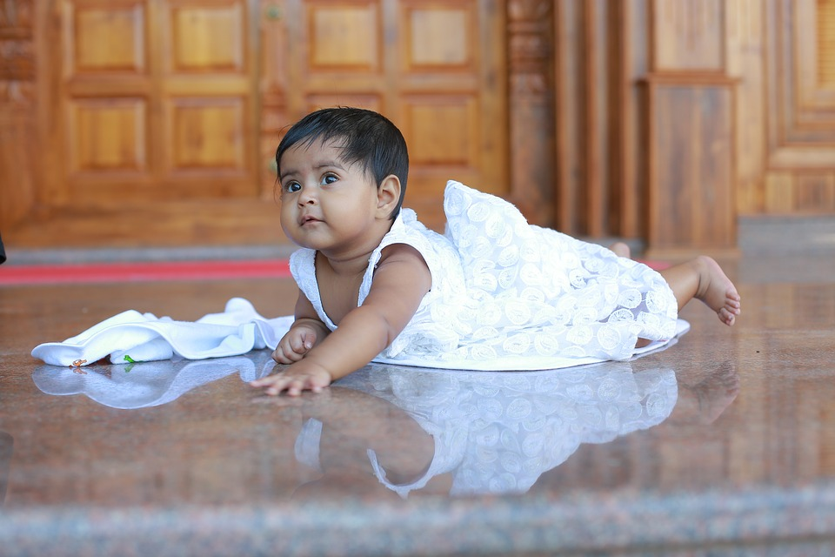
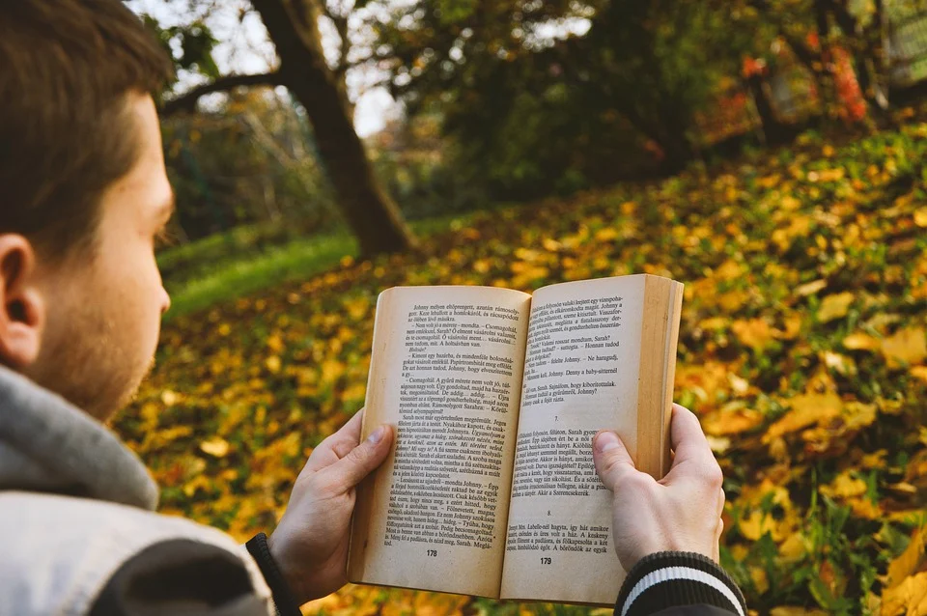
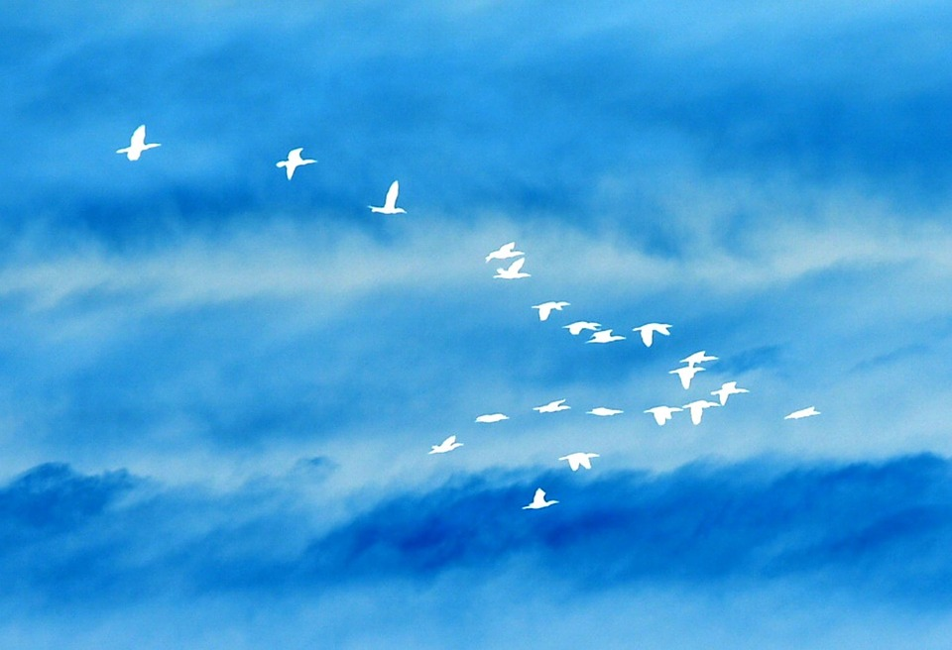
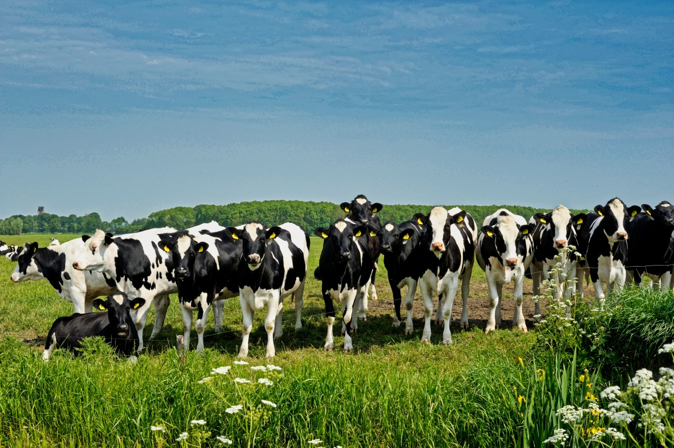
Match the words
Match the words in the columns given below to make meaningful Sentences
A
B
C
D
The Birds
is
reading
in the sky.
The Birds are flying in the sky.
The Baby
are
flying
a book.
The Baby is crawling on the floor.
My Friend
are
coming
in the fields.
My Friend is coming home.
I
is
grazing
on the floor.
I am reading a book.
The Cows
am
crawling
home.
The Cows are grazing in the fields.
Notes:
Notes for Teacher - < Information for further reference or explanation >
(Any variable in the answers can be accepted as long as it is meaningful and the verb form plus auxiliary verb used are correct.)
Suggestions: <Ideas/ Images/ Animations / Others – To make better representation of the content >
Source of Multimedia used in this slide - <Please provide source URL where we find the image and the license agreement>
https://pixabay.com/fr/illustrations/des-oiseaux-dans-vol-silhouette-707348/ - The birds
https://pixabay.com/fr/photos/enfant-b%c3%a9b%c3%a9-fille-mignonne-3595345/ - the baby
https://pixabay.com/fr/photos/enfants-fratrie-fr%c3%a8re-s%c5%93ur-817365/ - my friend
https://pixabay.com/fr/photos/livre-en-train-de-lire-5852743/ - reading a book
https://pxhere.com/en/photo/1626876 – The cows grazing

Slide 3
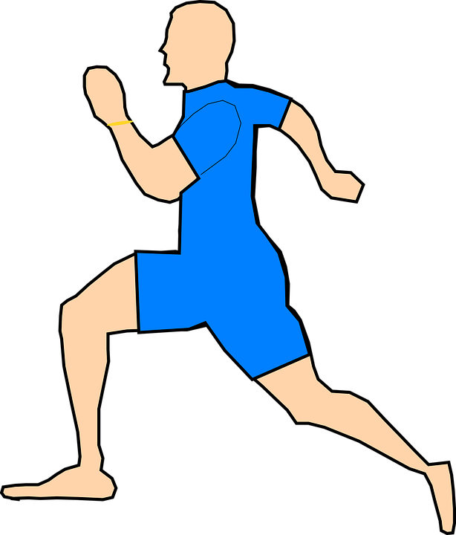
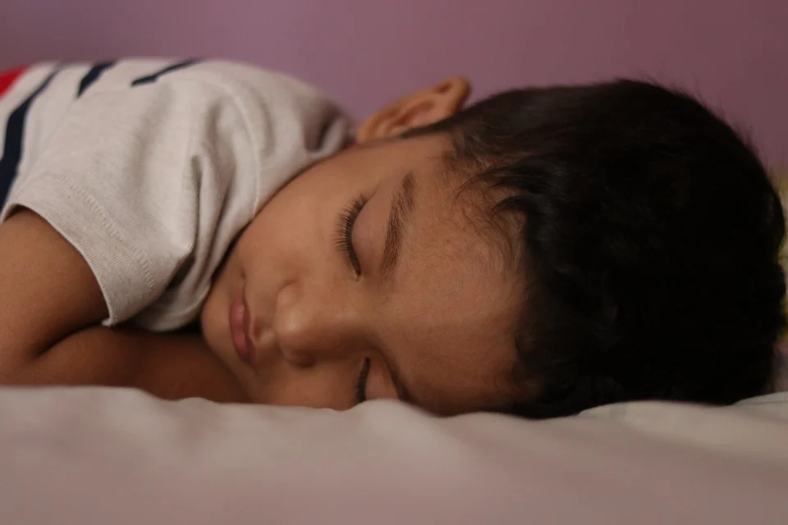
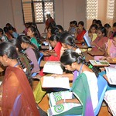
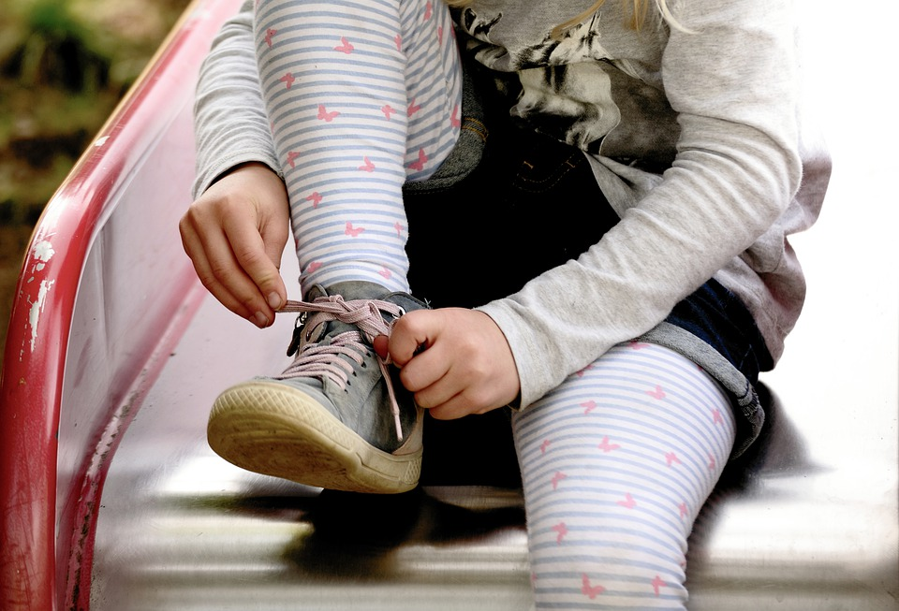
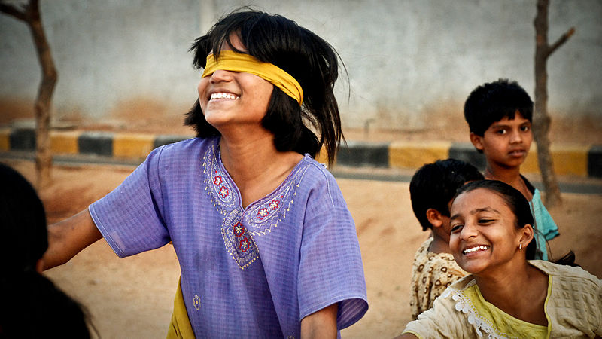
Make Sentences
Using the Present Continuous form of the given Verb.
1. Run
Rohan is running fast.
2. Sleep
My Brother is sleeping.
3. Write
They are writing a test.
4. Tie
You are tying your shoelace.
5. Play
I am playing with my friends.
Notes:
Notes for Teacher - < Information for further reference or explanation >
(Any meaningful sentence with correct verb form could be accepted. The teacher should also keep a watch on the use of appropriate auxiliary verbs and the spellings of the verbs with ‘ing’.)
Suggestions: <Ideas/ Images/ Animations / Others – To make better representation of the content > The class could be concluded with a discussion of the answers to the questions given in the worksheet.
Source of Multimedia used in this slide - <Please provide source URL where we find the image and the license agreement>
Running - https://pixabay.com/fr/vectors/homme-fonctionnement-le-jogging-306488/
Sleeping - https://pixabay.com/fr/photos/dormir-gar%c3%a7on-indien-mignonne-3621405/
Writing - https://www.flickr.com/photos/88360766@N02/8569765781 attributed by IAPEN activities
Tieing - https://pixabay.com/fr/photos/enfant-fille-cravate-chaussures-4818426/
Playing - https://commons.wikimedia.org/wiki/File:Blind_man%27s_buff_India.jpg

Slide 4
MM INDEX
Slide # | Thumbnail | Source link and Attribution
1 |  | https://pixabay.com/illustrations/q-and-a-question-answer-q-sign-2453376/>
2 |  | https://pixabay.com/fr/illustrations/des-oiseaux-dans-vol-silhouette-707348/ - The birds https://pixabay.com/fr/photos/enfant-b%c3%a9b%c3%a9-fille-mignonne-3595345/ - the baby https://pixabay.com/fr/photos/livre-en-train-de-lire-5852743/ - reading a book https://pxhere.com/en/photo/1626876 – The cows grazing
3 |  | Running - https://pixabay.com/fr/vectors/homme-fonctionnement-le-jogging-306488/ Sleeping - https://pixabay.com/fr/photos/dormir-gar%c3%a7on-indien-mignonne-3621405/ Writing - https://www.flickr.com/photos/88360766@N02/8569765781 attributed by IAPEN activities Tying - https://pixabay.com/fr/photos/enfant-fille-cravate-chaussures-4818426/ Playing - https://commons.wikimedia.org/wiki/File:Blind_man%27s_buff_India.jpg
Notes:
Notes for Teacher - < Information for further reference or explanation >
Suggestions: <Ideas/ Images/ Animations / Others – To make better representation of the content >
Source of Multimedia used in this slide - <Please provide source URL where we find the image and the license agreement>

