Slide 1
I AM DOING
Notes:
Notes for Teacher - < Information for further reference or explanation >
The teacher could use the given worksheet as a home assignment (pdf attached) to assess and reinforce the verb forms involved in the use of Present Continuous Tense.
Suggestions: <Ideas/ Images/ Animations / Others – To make better representation of the content >
Source of Multimedia used in this slide - <Please provide source URL where we find the image and the license agreement>
https://pixabay.com/fr/vectors/point-d-interrogation-id%c3%a9e-ampoule-5976736/

Slide 2
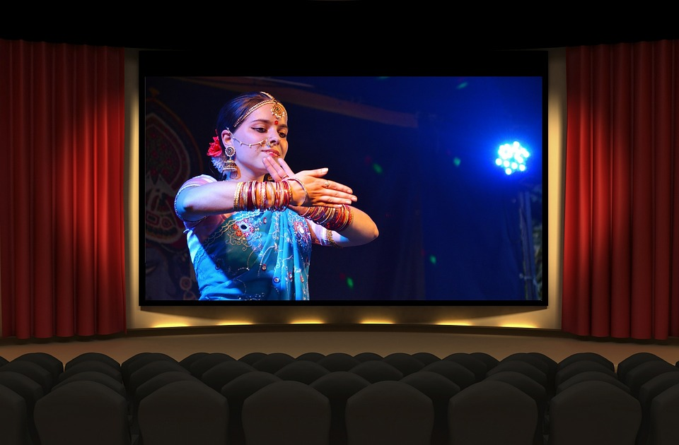
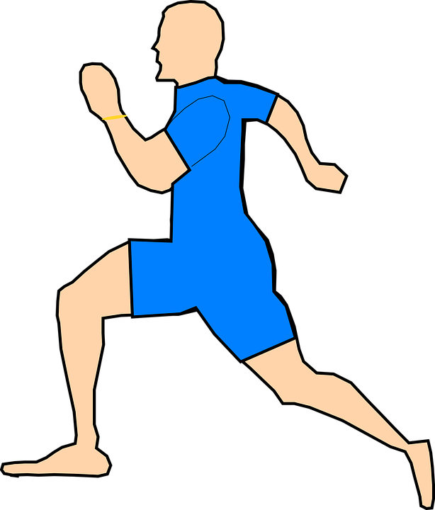
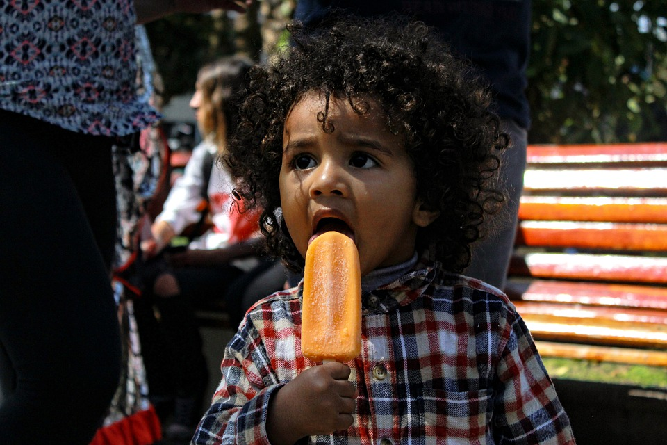
Fill in the Blanks
Fill in the blanks choosing the Suitable word from the Box.
A
are
milking
doing
you
she
am
I
is
they
singing
1. My brother ____ running fast.
2. ___ am watching a movie.
4. Suman is _________ a song.
3. You ____ eating ice cream.
5. Are ____ preparing well for your exams?
To get answer click on the question
Notes:
Notes for Teacher - < Information for further reference or explanation >
Suggestions: <Ideas/ Images/ Animations / Others – To make better representation of the content >
Source of Multimedia used in this slide - <Please provide source URL where we find the image and the license agreement>
1. Running - https://pixabay.com/fr/vectors/homme-fonctionnement-le-jogging-306488/
2. Watching movie - https://pixabay.com/fr/photos/bollywood-film-cin%c3%a9ma-inde-th%c3%a9%c3%a2tre-1687410/
3. Icecream - https://pixabay.com/fr/photos/enfant-palette-cr%c3%a8me-glac%c3%a9e-boucles-2403596/
4.

Slide 3
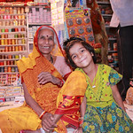
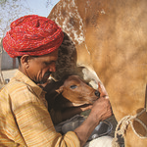
Fill in the Blanks
Fill in the blanks choosing the Suitable word from the Box.
A
are
milking
doing
you
She
am
I
is
they
singing
6. What are you ________?
7. I _____ reading a book.
8. When are _______ returning from their vacation?
9. ______ is talking to my grandmother.
To get answer click on the question
10. The milkman is ________ the cows.
Notes:
Notes for Teacher - < Information for further reference or explanation >
Suggestions: <Ideas/ Images/ Animations / Others – To make better representation of the content >
Source of Multimedia used in this slide - <Please provide source URL where we find the image and the license agreement>
Reading - https://pixabay.com/fr/photos/livre-en-train-de-lire-5852743/ - reading a book
Grandmother - https://www.flickr.com/photos/briangratwicke/3596876102 attributed by Brian Gratwicke
Milking - https://www.flickr.com/photos/ilri/4189986967 ILRI

Slide 4
MM INDEX
Slide # | Thumbnail | Source link and Attribution
1 |  | https://pixabay.com/fr/vectors/point-d-interrogation-id%c3%a9e-ampoule-5976736/
2 |  | 1. Running - https://pixabay.com/fr/vectors/homme-fonctionnement-le-jogging-306488/ 2. Watching movie - https://pixabay.com/fr/photos/bollywood-film-cin%c3%a9ma-inde-th%c3%a9%c3%a2tre-1687410/ 3. Icecream - https://pixabay.com/fr/photos/enfant-palette-cr%c3%a8me-glac%c3%a9e-boucles-2403596/
3 |  | Reading - https://pixabay.com/fr/photos/livre-en-train-de-lire-5852743/ - reading a book Grandmother - https://www.flickr.com/photos/briangratwicke/3596876102 attributed by Brian Gratwicke Milking - https://www.flickr.com/photos/ilri/4189986967 ILRI
Notes:
Notes for Teacher - < Information for further reference or explanation >
Suggestions: <Ideas/ Images/ Animations / Others – To make better representation of the content >
Source of Multimedia used in this slide - <Please provide source URL where we find the image and the license agreement>

