Slide 1
Keen Learners - Interrogative and Possessive Adjectives
Happy
Small
Beautiful
Old
Big
Sad
Notes:
Notes for Teacher - < Information for further reference or explanation >
Suggestions: <Ideas/ Images/ Animations / Others – To make better representation of the content >
Source of Multimedia used in this slide - <Please provide source URL where we find the image and the license agreement>

Slide 2
Let us learn to use Adjectives
How does the girl look?
How does the monster look?
The girl looks pretty.
The monster looks ugly.
Notes:
Notes for Teacher - < Information for further reference or explanation >
Suggestions: <Ideas/ Images/ Animations / Others – To make better representation of the content >
Source of Multimedia used in this slide - <Please provide source URL where we find the image and the license agreement>

Slide 3
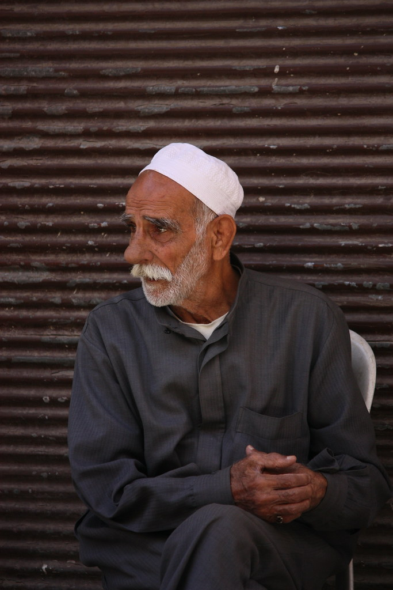
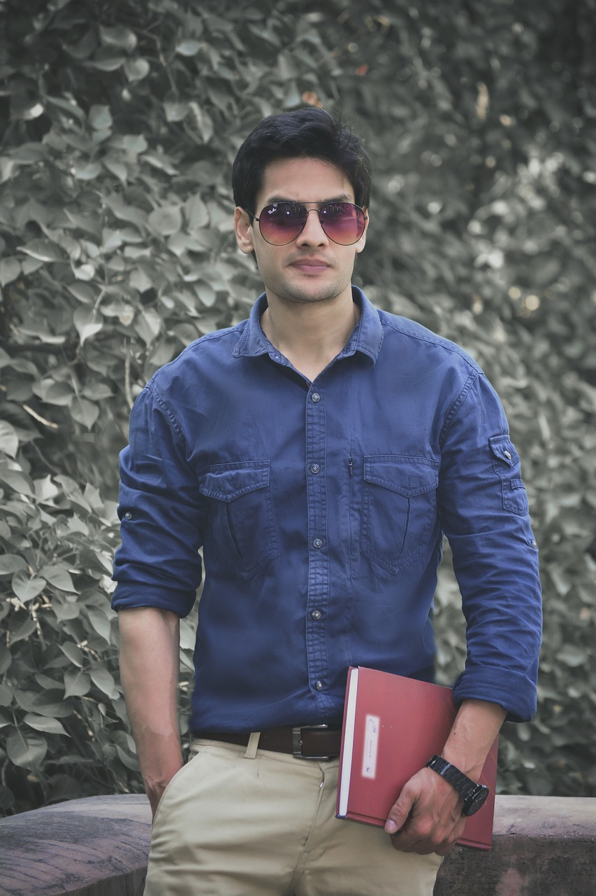
Let us learn to use Adjectives
How are the two persons in the picture different?
One of them is an old man and the other is a young man.
Notes:
Notes for Teacher - < Information for further reference or explanation >
Suggestions: <Ideas/ Images/ Animations / Others – To make better representation of the content >
Source of Multimedia used in this slide - <Please provide source URL where we find the image and the license agreement>

Slide 4
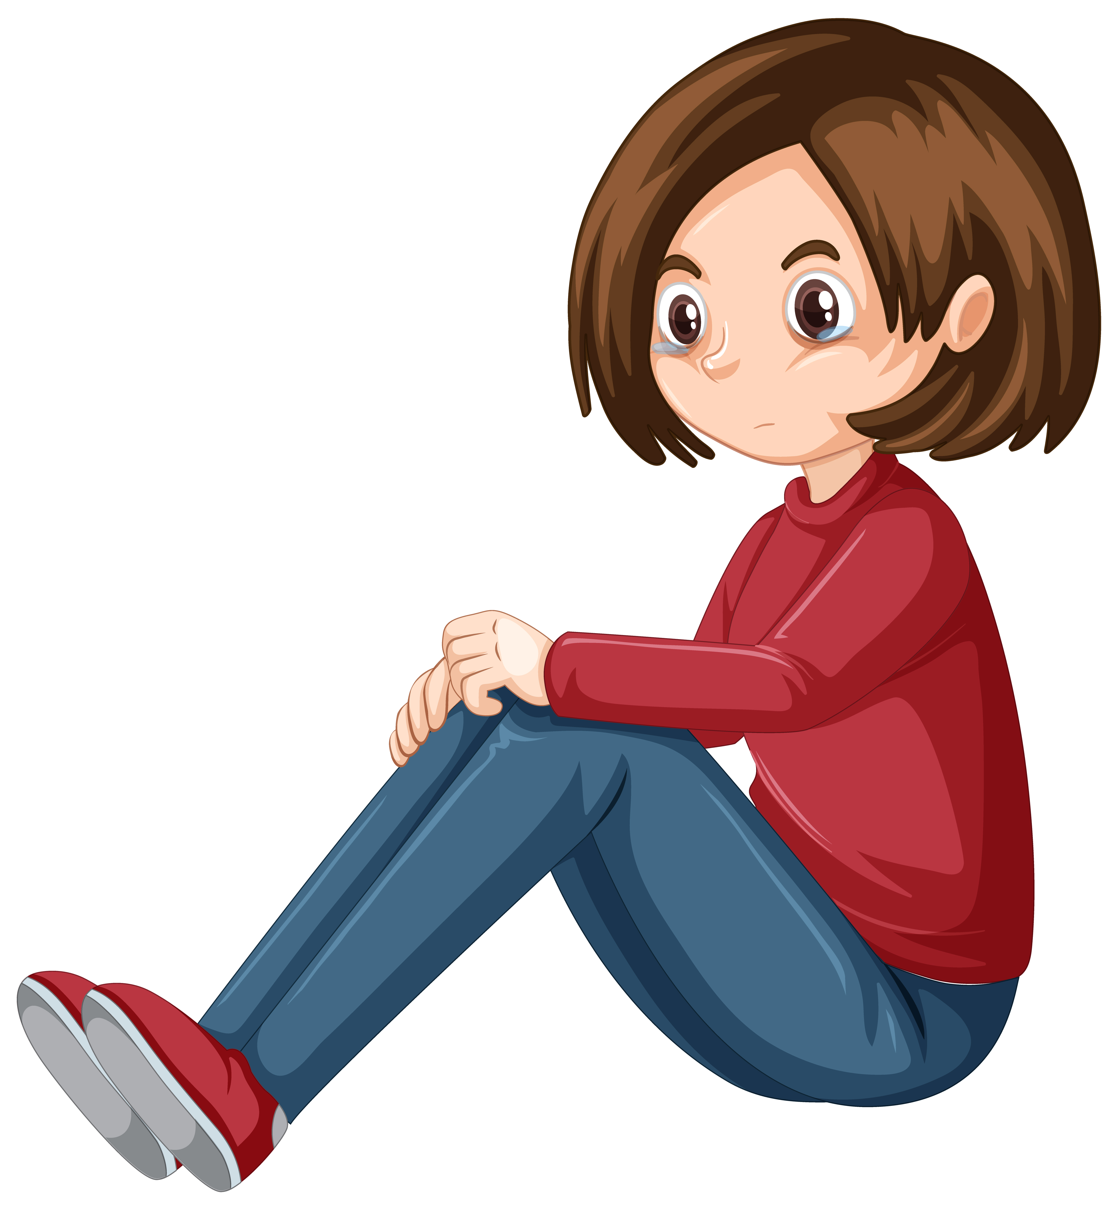
Let us learn to use Adjectives
How do they look?
The boy is happy with the toy but his sister is sad.
Notes:
Notes for Teacher - < Information for further reference or explanation >
Suggestions: <Ideas/ Images/ Animations / Others – To make better representation of the content >
Source of Multimedia used in this slide - <Please provide source URL where we find the image and the license agreement>

Slide 5
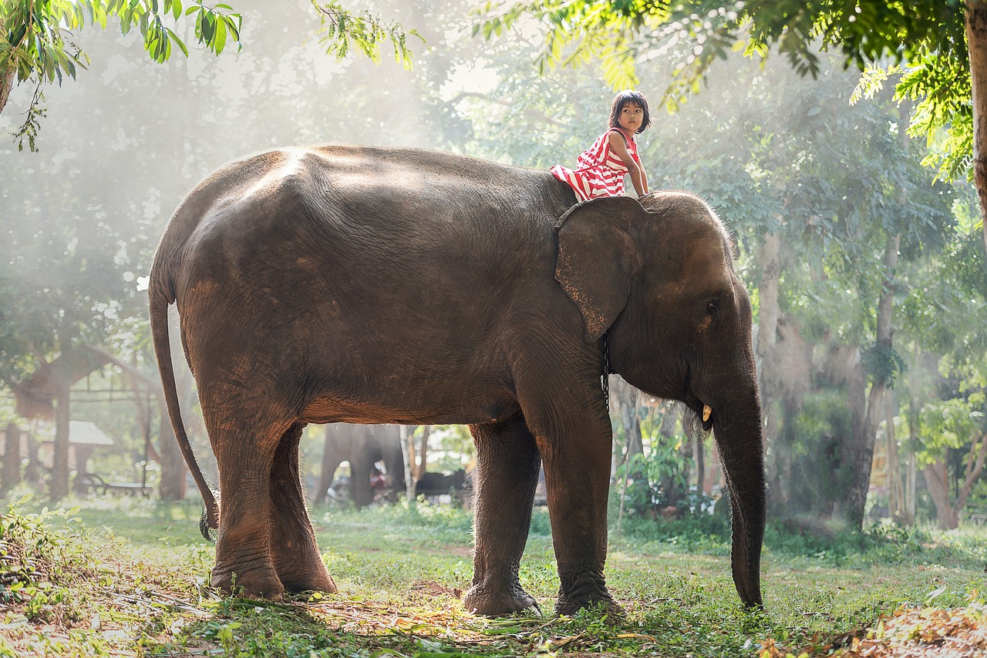
Let us learn to use Adjectives
What do we see here?
A small girl is sitting on the big elephant.
Notes:
Notes for Teacher - < Information for further reference or explanation >
Suggestions: <Ideas/ Images/ Animations / Others – To make better representation of the content >
Source of Multimedia used in this slide - <Please provide source URL where we find the image and the license agreement>

Slide 6
Attribution / Citation
Slide # | Thumbnail | Source link | Author
2 |  | https://pixabay.com/de/vectors/au%C3%9Ferirdischer-monster-drucken-1295486/ | Open Clipart vectors
2 |  | https://openclipart.org/detail/102169/litle-girl-by-alynecastro | alynecastro
3 |  | https://pixabay.com/photos/smile-expressions-happiness-man-6043222/ | Virat_Maurya
3 |  | https://www.flickr.com/photos/67769030@N07/6365459683 | Arian Zwegers
4 |  | https://www.freepik.com/free-vector/boy-playing-with-remote-controlled-car_1311394.htm | iconicbestiary
4 |  | https://www.freepik.com/free-vector/one-teenage-girl-crying-white-background_8700531.htm | brgfs
5 |  | https://pixabay.com/photos/child-africa-animal-asia-ties-1822494/ | sasint
COPYRIGHT Cum DISCLAIMER NOTICE
Content owned by Sri Sathya Sai Central Trust, Prashanthi Nilayam, Puttaparthi, Sathya Sai District, Andhra Pradesh, India.
Strictly not for Commercial Use, excluding content that falls in Public Domain or common knowledge facts.
Content can be downloaded and used for personal, educational, informational and other non-commercial purposes, subject to attribution in the name of ‘Sri Sathya Sai Central Trust, Prashanthi Nilayam, Puttaparthi’ only. Any attempt to remove, alter, circumvent, or distort the data that is accessed is illegal and strictly prohibited.
Some of the content is owned by Third Parties and are used in compliance with their licensing conditions. Anyone infringing the Copyright of such Third Parties will be doing so at their own risks and costs.
Notes:
Notes for Teacher - < Information for further reference or explanation >
Suggestions: <Ideas/ Images/ Animations / Others – To make better representation of the content >
Source of Multimedia used in this slide - <Please provide source URL where we find the image and the license agreement>

