Slide 1
Learning about Interrogative Adjectives
Whose
What
Which
Notes:
Notes for Teacher –
Teacher should show the PPT for examples and explain how to use Interrogative Adjectives.
Source of Multimedia used in this slide -
1. Interrogation mark: https://pixabay.com/illustrations/question-mark-question-black-red-4846645/(Gerd Altmann)

Slide 2
Interrogative Adjectives
There are only three interrogative adjectives in English.
1. Whose
2. What
3. Which
What
Which
Whose
Notes:
Notes for Teacher - < Information for further reference or explanation >
Source of Multimedia used in this slide -
1. Interrogative Adjectives: https://pixabay.com/illustrations/question-question-mark-people-4785895/ (Gerd Altmann )

Slide 3
Interrogative Adjectives
Whose pencil is this?
Whose book did you borrow?
Each of them can be used in sentences to modify the noun.
Example 1: ‘Whose’
Notes:
Pencil- https://pixabay.com/vectors/boy-pencil-drawing-school-student-4220282/ (André Santana AndreMS )
Books- https://pixabay.com/vectors/boy-books-school-student-reading-160174/ (OpenClipart-Vectors)

Slide 4
Interrogative Adjectives
What kind of books would you recommend for young children?
Do you know what ice-cream flavour Shyam likes?
Each of them can be used in sentences to modify the noun.
Example 2: ‘What’
Notes:
Books- https://pixabay.com/vectors/books-literature-pile-study-2022464/(OpenClipart-Vectors )
Ice-Cream- https://pixabay.com/photos/ice-cream-flavors-flat-lay-5928080/(Seksak Kerdkanno)

Slide 5
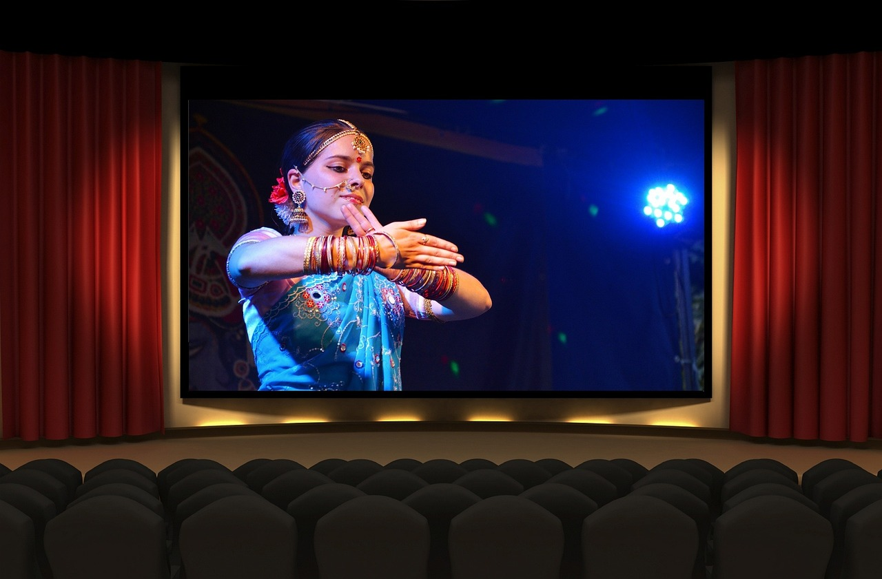
Interrogative Adjectives
Do you have any idea which teacher
will be teaching Mathematics?
Which movie would you like to watch?
Each of them can be used in sentences to modify the noun.
Example 3: ‘Which’
Notes:
1.Maths Teacher- https://pixabay.com/vectors/teacher-classroom-chalk-board-man-651318/(Ruddin Ardzi )
2. Movie Theatre- https://pixabay.com/photos/bollywood-movie-cinema-india-1687410/(Tumisu)

Slide 6
Definition of an Interrogative Adjective
Do you know what the word ‘interrogative’ means?
The words ‘interrogation’ and ‘interrogative’ refer to the action or procedure of questioning someone, about something to collect information.
Now, let us see the meaning of an interrogative adjective, its definition and usage.
Notes:
Notes to the Teacher:
Teacher should ask the students the questions given above and then start explaining the definition.
Sources-
Question Mark- https://pixabay.com/illustrations/question-mark-question-response-1019983/(Peggy und Marco Lachmann-Anke)
Questioning- https://pixabay.com/vectors/detective-searching-man-search-1424831/(GraphicMama-team)
Questioning- https://pixabay.com/illustrations/questions-demand-doubts-psychology-1922476/(Elisa )
Collecting Information- https://pixabay.com/vectors/kid-study-book-child-figure-3326960/(David)
Questioning- https://pixabay.com/vectors/thinker-thinking-person-idea-28741/(Clker-Free-Vector-Images)
6. Interrogative- https://pixabay.com/illustrations/question-help-question-mark-answer-1127660/(Prawny )

Slide 7
Definition of an Interrogative Adjective
1. An interrogative adjective, is an adjective that modifies a noun by asking a question.
Which
2. The interrogative adjectives in English are 'what', 'which', and 'whose'.
What
Whose
3. An interrogative adjective is usually followed by a noun.
For Example:
Whose pencil is this?
Interrogative Adjective
Noun
Notes:
Interrogation- https://pixabay.com/illustrations/question-mark-a-notice-duplicate-2110767/(Gerd Altmann)
Interrogative adjectives- https://pixabay.com/illustrations/question-confused-boy-man-male-5663412/(HtcHnm)

Slide 8
Definition of an Interrogative Adjectives
What time is it?
Which shoes shall I wear?
Whose bag is this?
Few more Examples:
Interrogative Adjectives
Noun
What
(followed by)
time
Which
(followed by)
shoes
Whose
(followed by)
bag
An interrogative adjective is usually followed by a noun.
All these interrogative determiners modify nouns ("time," "shoes, and "bag")
Notes:
Notes to the Teacher:
The words in Bold letters are Interrogative Adjectives and the coloured ones are nouns that must be addressed.

Slide 9
Attribution / Citation
Slide # | Thumbnail | Source link | Author
1 |  | 1. Interrogation mark: https://pixabay.com/illustrations/question-mark-question-black-red-4846645/ | 1. Gerd Altmann
2 |  | 1. Interrogative Adjectives: https://pixabay.com/illustrations/question-question-mark-people-4785895/ | 1. Gerd Altmann
3 |  | Pencil- https://pixabay.com/vectors/boy-pencil-drawing-school-student-4220282/ Books- https://pixabay.com/vectors/boy-books-school-student-reading-160174/ | André Santana AndreMS OpenClipart-Vectors
4 |  | Books- https://pixabay.com/vectors/books-literature-pile-study-2022464/ Ice-Cream- https://pixabay.com/photos/ice-cream-flavors-flat-lay-5928080/ | OpenClipart-Vectors Seksak Kerdkanno
5 |  | 1.Maths Teacher- https://pixabay.com/vectors/teacher-classroom-chalk-board-man-651318/ 2. Movie Theatre- https://pixabay.com/photos/bollywood-movie-cinema-india-1687410/ | Ruddin Ardzi Tumisu
6 |  | Question Mark- https://pixabay.com/illustrations/question-mark-question-response-1019983/ Questioning- https://pixabay.com/vectors/detective-searching-man-search-1424831/ Questioning- https://pixabay.com/illustrations/questions-demand-doubts-psychology-1922476/ Collecting Information- https://pixabay.com/vectors/kid-study-book-child-figure-3326960/ Questioning- https://pixabay.com/vectors/thinker-thinking-person-idea-28741/ Interrogative- https://pixabay.com/illustrations/question-help-question-mark-answer-1127660/ | Peggy und Marco Lachmann-Anke GraphicMama-team Elisa David Clker-Free-Vector-Images Prawny
7 |  | Interrogation- https://pixabay.com/illustrations/question-mark-a-notice-duplicate-2110767/ Interrogative adjectives- https://pixabay.com/illustrations/question-confused-boy-man-male-5663412/ | Gerd Altmann HtcHnm
COPYRIGHT Cum DISCLAIMER NOTICE
Content owned by Sri Sathya Sai Central Trust, Prashanthi Nilayam, Puttaparthi, Sathya Sai District, Andhra Pradesh, India.
Strictly not for Commercial Use, excluding content that falls in Public Domain or common knowledge facts.
Content can be downloaded and used for personal, educational, informational and other non-commercial purposes, subject to attribution in the name of ‘Sri Sathya Sai Central Trust, Prashanthi Nilayam, Puttaparthi’ only. Any attempt to remove, alter, circumvent, or distort the data that is accessed is illegal and strictly prohibited.
Some of the content is owned by Third Parties and are used in compliance with their licensing conditions. Anyone infringing the Copyright of such Third Parties will be doing so at their own risks and costs.
Notes:
Notes for Teacher - < Information for further reference or explanation >
Suggestions: <Ideas/ Images/ Animations / Others – To make better representation of the content >
Source of Multimedia used in this slide - <Please provide source URL where we find the image and the license agreement>

