Slide 1
Poem - Interrogative and Possessive Adjectives
Notes:
Notes for Teacher - < Information for further reference or explanation >
Suggestions: <Ideas/ Images/ Animations / Others – To make better representation of the content >
Source of Multimedia used in this slide - <Please provide source URL where we find the image and the license agreement>

Slide 2
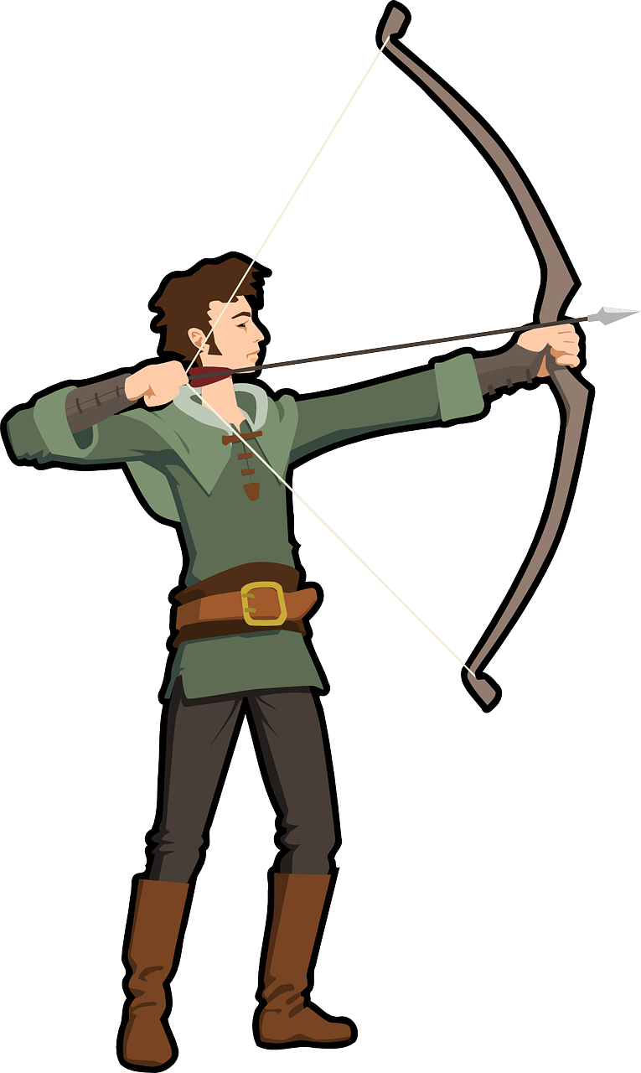
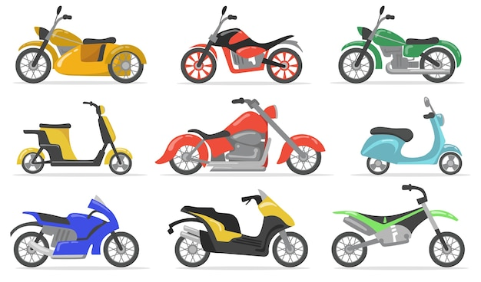
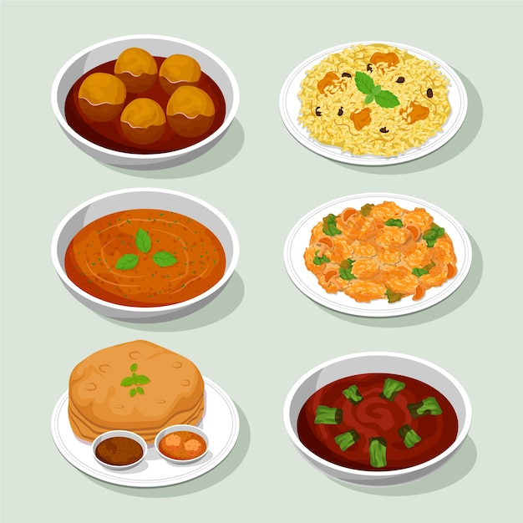
Poem- Interrogative Adjective
Interrogative adjectives - What, Which, Whose are the three musketeers.
Always Followed by nouns, modifying them, and shooting questions without fear.
What dishes do you like?
Which is your bike?
Whose bag was found on the hike?
WHAT
These are a few examples my dears.
This is my book, that is her purse.
He is our cook, and she is his nurse.
WHOSE
WHICH
Notes:
Notes for Teacher - < Information for further reference or explanation >
Suggestions: <Ideas/ Images/ Animations / Others – To make better representation of the content >
Source of Multimedia used in this slide -https://www.freepik.com/free-vector/hand-drawn-indian-cuisine-illustration_24235552.htm#query=indian%20veg%20dishes&position=3&from_view=search&track=ais
https://www.freepik.com/free-vector/various-motorbikes-flat-item-set-cartoon-motorcycles-moto-cycles-scooters-bikes-isolated-vector-illustration-collection-transportation-delivery-concept_11672041.htm#query=bikes&position=25&from_view=search&track=sph
https://www.freepik.com/free-vector/explorer-with-backpack_4412267.htm#query=Whose%20bag%20was%20found%20on%20the%20hike&position=2&from_view=search&track=ais
https://www.freepik.com/free-vector/torn-paper-floral-background_16352116.htm#query=poem%20background&position=4&from_view=search&track=ais
https://www.freepik.com/free-vector/soldier-with-gun_23715048.htm#page=4&query=soldiers%20three&position=22&from_view=search&track=ais
https://www.freepik.com/free-vector/brave-soldier_23823439.htm#page=4&query=soldiers%20three&position=25&from_view=search&track=ais
https://www.freepik.com/free-vector/soldier-uniform-cartoon-character_27181414.htm#page=4&query=soldiers%20three&position=34&from_view=search&track=ais

Slide 3
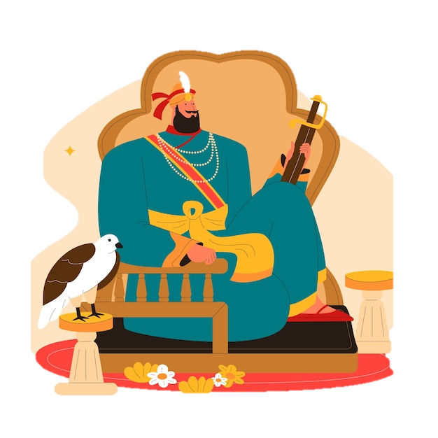
Poem- Interrogative Adjective
NOUN
Interrogative adjectives - What, Which, Whose are the three musketeers.
Always Followed by nouns, modifying them, and shooting questions without fear,
What dishes do you like?
Which is your bike?
Whose bag was found on the hike?
These are a few examples my dears.
This is my book, that is her purse.
He is our cook, and she is his nurse.
THEY
OUR
ITS
HER
My, his, her, its, our, they are owned by nouns.
HIS
MY
Possessive Adjectives are the names by which they win renown.
Notes:
Notes for Teacher - < Information for further reference or explanation >
Suggestions: <Ideas/ Images/ Animations / Others – To make better representation of the content >
Source of Multimedia used in this slide -https://www.freepik.com/free-vector/hand-drawn-indian-cuisine-illustration_24235552.htm#query=indian%20veg%20dishes&position=3&from_view=search&track=ais
https://www.freepik.com/free-vector/various-motorbikes-flat-item-set-cartoon-motorcycles-moto-cycles-scooters-bikes-isolated-vector-illustration-collection-transportation-delivery-concept_11672041.htm#query=bikes&position=25&from_view=search&track=sph
https://www.freepik.com/free-vector/explorer-with-backpack_4412267.htm#query=Whose%20bag%20was%20found%20on%20the%20hike&position=2&from_view=search&track=ais
https://www.freepik.com/free-vector/torn-paper-floral-background_16352116.htm#query=poem%20background&position=4&from_view=search&track=ais
https://www.freepik.com/free-vector/soldier-with-gun_23715048.htm#page=4&query=soldiers%20three&position=22&from_view=search&track=ais
https://www.freepik.com/free-vector/brave-soldier_23823439.htm#page=4&query=soldiers%20three&position=25&from_view=search&track=ais
https://www.freepik.com/free-vector/soldier-uniform-cartoon-character_27181414.htm#page=4&query=soldiers%20three&position=34&from_view=search&track=ais

Slide 4
Attribution / Citation
Slide # | Thumbnail | Source link | Author
2 |  | Dish: https://www.freepik.com/free-vector/hand-drawn-indian-cuisine-illustration_24235552.htm Bikes: https://www.freepik.com/free-vector/various-motorbikes-flat-item-set-cartoon-motorcycles-moto-cycles-scooters-bikes-isolated-vector-illustration-collection-transportation-delivery-concept_11672041.htm Paper: https://www.freepik.com/free-vector/torn-paper-floral-background_16352116.htm Arrow1: https://www.freepik.com/free-vector/sporting-activity-people-white-background_18973418.htm Arrow2: https://www.freepik.com/free-vector/flat-design-warrior-background_28368612.htm Arrow3: https://pixabay.com/vectors/marksman-shoot-aim-archer-arrow-159536/ | freepik pch.vector rawpixel.com brgfx pikisuperstar OpenClipart-Vectors
3 |  | https://www.freepik.com/free-vector/flat-guru-gobind-singh-jayanti-illustration_34074559.htm https://www.freepik.com/free-vector/red-carpet-background-realistic-style_1832077.htm | freepik Freepik
COPYRIGHT Cum DISCLAIMER NOTICE
Content owned by Sri Sathya Sai Central Trust, Prashanthi Nilayam, Puttaparthi, Sathya Sai District, Andhra Pradesh, India.
Strictly not for Commercial Use, excluding content that falls in Public Domain or common knowledge facts.
Content can be downloaded and used for personal, educational, informational and other non-commercial purposes, subject to attribution in the name of ‘Sri Sathya Sai Central Trust, Prashanthi Nilayam, Puttaparthi’ only. Any attempt to remove, alter, circumvent, or distort the data that is accessed is illegal and strictly prohibited.
Some of the content is owned by Third Parties and are used in compliance with their licensing conditions. Anyone infringing the Copyright of such Third Parties will be doing so at their own risks and costs.
Notes:
Notes for Teacher - < Information for further reference or explanation >
Suggestions: <Ideas/ Images/ Animations / Others – To make better representation of the content >
Source of Multimedia used in this slide - <Please provide source URL where we find the image and the license agreement>

