Slide 1
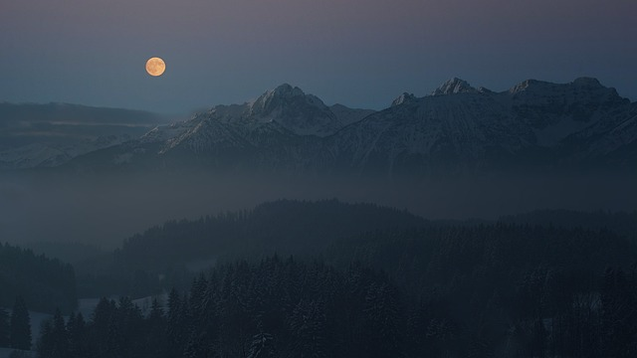
Definite Article - The
Notes:
Notes for Teacher - < Information for further reference or explanation >
Suggestions: <Ideas/ Images/ Animations / Others – To make better representation of the content >
Source of Multimedia used in this slide -
1. The Moon: https://pixabay.com/photos/night-moon-mountains-alps-4702174/ (Attribution: jplenio)

Slide 2
Introduction
Definite Article THE
I had dosa and chutney.
The dosa was crispy but the
chutney was spicy.
I had puris and channa masala. The puris were soft and fluffy. The channa masala was yummy too!
Geetha, What did
you have for
breakfast today?
What did you have
for breakfast
Ramu?
Ramu and Geetha, why
did both of you use ‘the’
before dosa, chutney,
puris and channa masala
the second time?
Notes:
Notes for Teacher –
The teacher may elicit answers from the students first before giving the reason-when it is clear in the
situation which thing we mean. Initially it was dosa, chutney, puris and channa masala. The second time,
since we know what we are talking about, definite article ‘the’ is added.
Suggestions: <Ideas/ Images/ Animations / Others – To make better representation of the content >
Source of Multimedia used in this slide -
Boy: https://www.freepik.com/free-vector/set-happy-children-doing-different-actions_5934375.htm#query=children&position=44&from_view=search&track=sph (Attribution: brgfx)
Boy and girl: https://www.freepik.com/free-vector/boy-girl-school-uniform_6052413.htm#page=6&query=children&position=41&from_view=search&track=sph (Attribution: brgfx)

Slide 3
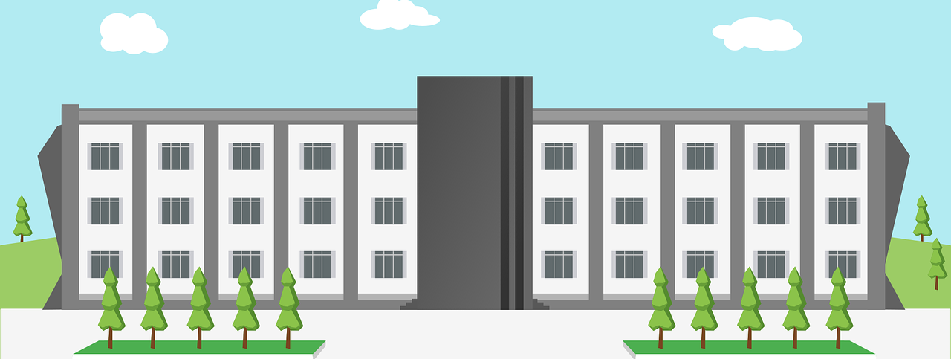
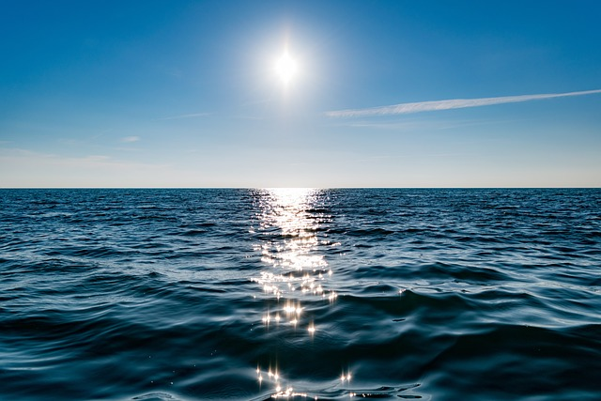
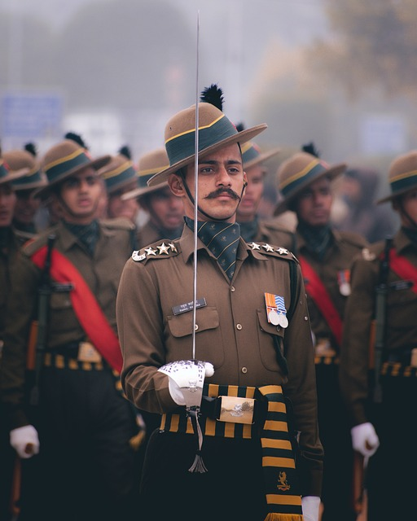
Using Definite Article
Before a noun when the listener /reader knows exactly what we are referring to.
My school
1
We say:
The door/ the dog/ the game/ the school
The school I go to has a big library.
2
We say:
The Moon/ the Sky/ the Sun
The sky is blue.
3
We say:
The army/ the police
My uncle is in the army.
Notes:
Notes for Teacher - < Information for further reference or explanation >
Suggestions: <Ideas/ Images/ Animations / Others – To make better representation of the content >
Source of Multimedia used in this slide -
School: https://pixabay.com/vectors/school-design-building-learning-1727586/ (Attribution: 200degrees)
Sky: https://pixabay.com/photos/sea-horizon-sun-sunlight-sky-1836480/ (Attribution: Pexels)
Army: https://pixabay.com/photos/uniform-army-war-republic-day-7406028/ (Attribution: 29458918)

Slide 4
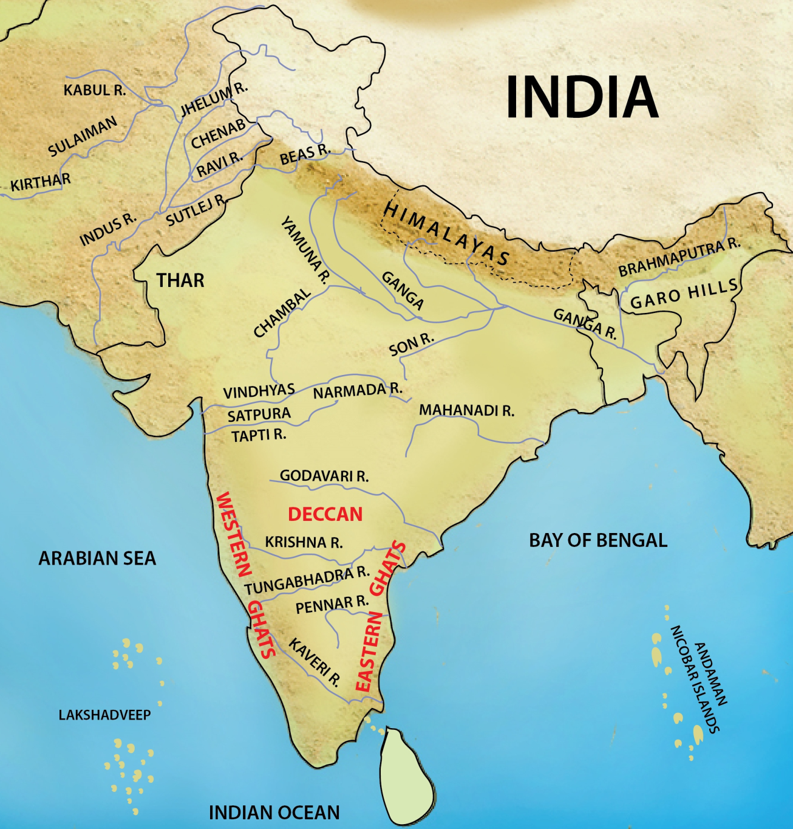
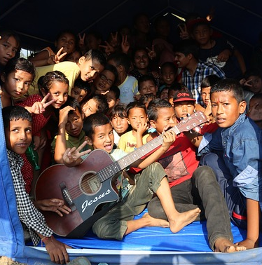
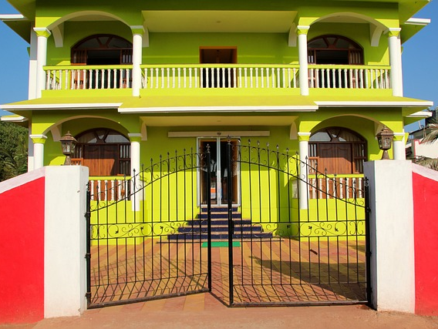
Using Definite Article
N
4
We say:
The top/ the end/ the right/ the north/ the west
I have been to the north but not the east of India.
W
E
S
5
We say:
The piano/ the guitar/ the veena (instruments)
Many children know how to play the guitar.
BUS STOP
6
We say:
The cinema/ the bank/ the doctor/ the bus stop
The bus stop is very near my house.
Notes:
Notes for Teacher - < Information for further reference or explanation >
Suggestions: <Ideas/ Images/ Animations / Others – To make better representation of the content >
Source of Multimedia used in this slide -
India: SSSVV gallery
Children guitar: https://pixabay.com/photos/kids-school-trip-back-to-school-942513/ (Attribution: rameshbh)
House: https://pixabay.com/photos/house-multicoloured-india-gate-1028456/ (Attribution: Peggy_Marco)
Bus: https://www.freepik.com/free-vector/double-decker-bus-concept-illustration_31385194.htm#query=bus&position=6&from_view=search&track=sph (Attribution: storyset)

Slide 5
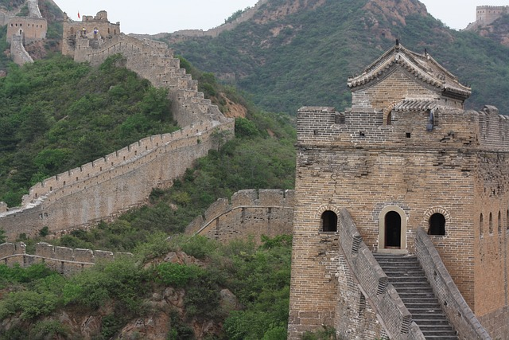
Using Definite Article
7
We say:
The sea/ the river/ the ocean/ the desert
The River Ganges is in India.
8
We say:
The +_____ of_______
The great wall of China is man made .
9
We say:
The + Superlative adjective
Which is the tallest animal?
Notes:
Notes for Teacher - < Information for further reference or explanation >
Suggestions: <Ideas/ Images/ Animations / Others – To make better representation of the content >
Source of Multimedia used in this slide -
Map: SSSVV Gallery (Map)
Great wall of China: https://pixabay.com/photos/great-wall-of-china-china-asia-3632971/ (Attribution: MaiBaum27)
Animals: https://www.freepik.com/free-vector/many-cute-animals-bamboo-forest_5288851.htm#query=animals&position=1&from_view=search&track=sph (Attribution: brgfx)

Slide 6
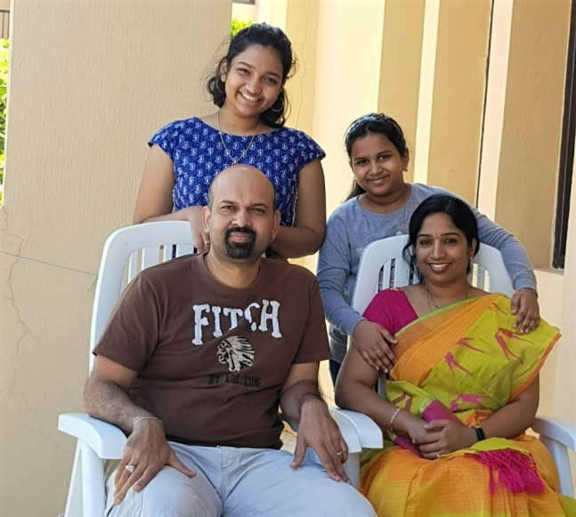
Using Definite Article
10
We say:
The + Plural names of countries, islands, mountains
The Andaman and Nicobar islands belong to India.
The United States
of America
11
We say:
The + kingdoms, states and republics
My aunt lives in the United States of America.
The Shankars
12
We say:
The + plural family name
The Shankars live near my house.
Notes:
Notes for Teacher - < Information for further reference or explanation >
Suggestions: <Ideas/ Images/ Animations / Others – To make better representation of the content >
Source of Multimedia used in this slide -
India : SSSVV Gallery (Map)
USA: https://pixabay.com/vectors/world-map-continents-africa-151576/ (Attribution: OpenClipart-vectors)
The Shankars: SSSVV Gallery (Family)

Slide 7
Other languages and definite Article ‘the’
No definite article
3 definite articles
4 definite articles
No definite article
Tamil, Sanskrit, Hindi, Japanese Korean, Chinese, Turkish
German
des, die, and das
French
la, le, les and l’
Notes:
Notes for Teacher -The teacher may ask the students the following questions before showing the ppt.
Do all languages in India have the definite article ‘the’?
Do all foreign languages other than English have ‘the’ in their grammar?
After eliciting some answers from the students, the teacher may show the slide and discuss further if time permits.
Suggestions: <Ideas/ Images/ Animations / Others – To make better representation of the content >
Source of Multimedia used in this slide -

Slide 8
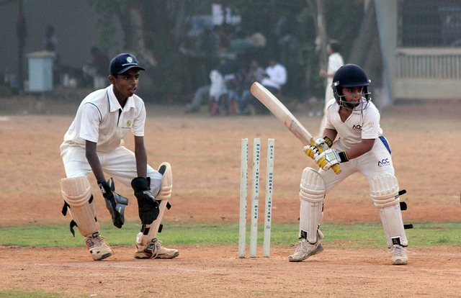
Attribution / Citation
Slide # | Thumbnail | Source link | Author
1 |  | 1. The Moon: https://pixabay.com/photos/night-moon-mountains-alps-4702174/ | jplenio
2 |  | Boy: https://www.freepik.com/free-vector/set-happy-children-doing-different-actions_5934375.htm#query=children&position=44&from_view=search&track=sph (Attribution: brgfx) Boy and girl: https://www.freepik.com/free-vector/boy-girl-school-uniform_6052413.htm#page=6&query=children&position=41&from_view=search&track=sph (Attribution: brgfx) | Brgfx brgfx
3 |  | 1. School: https://pixabay.com/vectors/school-design-building-learning-1727586/ (Attribution: 200degrees) 1727586/ (Attribution: 200degrees) 2. Sky: https://pixabay.com/photos/sea-horizon-sun-sunlight-sky-1836480/ (Attribution: pexels) 3. Army: https://pixabay.com/photos/uniform-army-war-republic-day-7406028/ (Attribution: 29458918) | 200degrees Pexels 29458918
4 |  | 1. Children guitar: https://pixabay.com/photos/kids-school-trip-back-to-school-942513/ (Attribution: rameshbh) 2. House: https://pixabay.com/photos/house-multicoloured-india-gate-1028456/ (Attribution: Peggy_Marco) 3. Bus: https://www.freepik.com/free-vector/double-decker-bus-concept-illustration_31385194.htm#query=bus&position=6&from_view=search&track=sph (Attribution: storyset) | Rameshbh Peggy_Marco storyset
5 |  | Great wall of China: https://pixabay.com/photos/great-wall-of-china-china-asia-3632971/ (Attribution: MaiBaum27) Animals: https://www.freepik.com/free-vector/many-cute-animals-bamboo-forest_5288851.htm#query=animals&position=1&from_view=search&track=sph (Attribution: brgfx) | MaiBaum27 brgfx
6 |  | 1. USA: https://pixabay.com/vectors/world-map-continents-africa-151576/ (Attribution: OpenClipart-vectors) | OpenClipart-Vectors
COPYRIGHT Cum DISCLAIMER NOTICE
Content owned by Sri Sathya Sai Central Trust, Prashanthi Nilayam, Puttaparthi, Sathya Sai District, Andhra Pradesh, India.
Strictly not for Commercial Use, excluding content that falls in Public Domain or common knowledge facts.
Content can be downloaded and used for personal, educational, informational and other non-commercial purposes, subject to attribution in the name of ‘Sri Sathya Sai Central Trust, Prashanthi Nilayam, Puttaparthi’ only. Any attempt to remove, alter, circumvent, or distort the data that is accessed is illegal and strictly prohibited.
Some of the content is owned by Third Parties and are used in compliance with their licensing conditions. Anyone infringing the Copyright of such Third Parties will be doing so at their own risks and costs.
Notes:
Notes for Teacher - < Information for further reference or explanation >
Suggestions: <Ideas/ Images/ Animations / Others – To make better representation of the content >
Source of Multimedia used in this slide - <Please provide source URL where we find the image and the license agreement>

