Slide 1
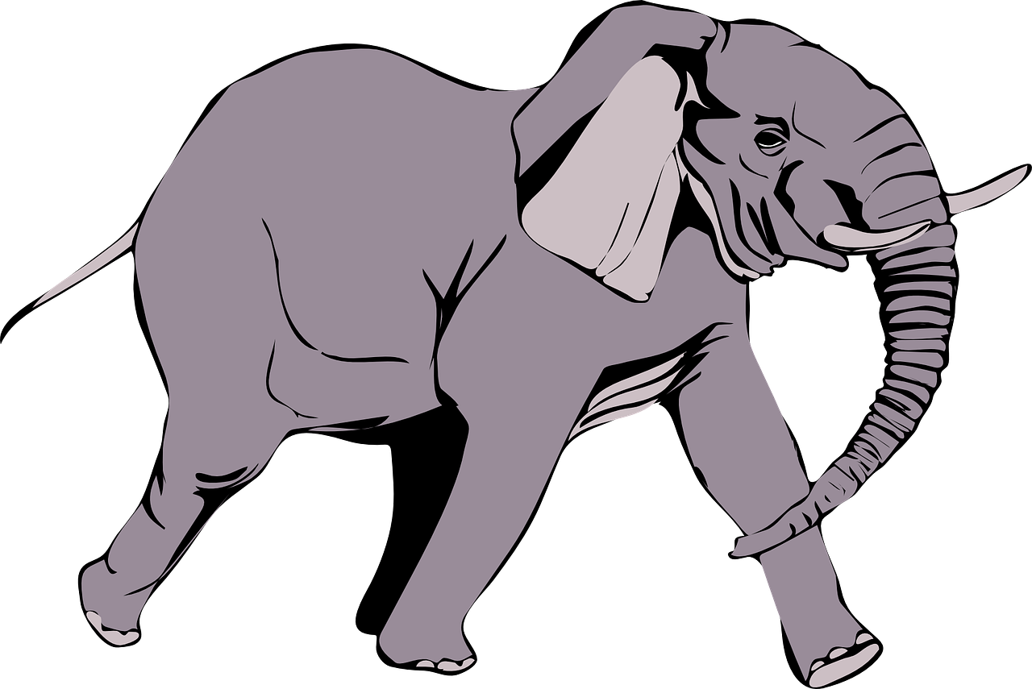
The Helpful Elephant
Notes:
Notes for Teacher - < Information for further reference or explanation >
Suggestions: <Ideas/ Images/ Animations / Others – To make better representation of the content >
Source of Multimedia used in this slide - <Please provide source URL where we find the image and the license agreement>
<elephant> <https://pixabay.com/vectors/elephant-wild-animal-mammal-trunk-24421/>

Slide 2
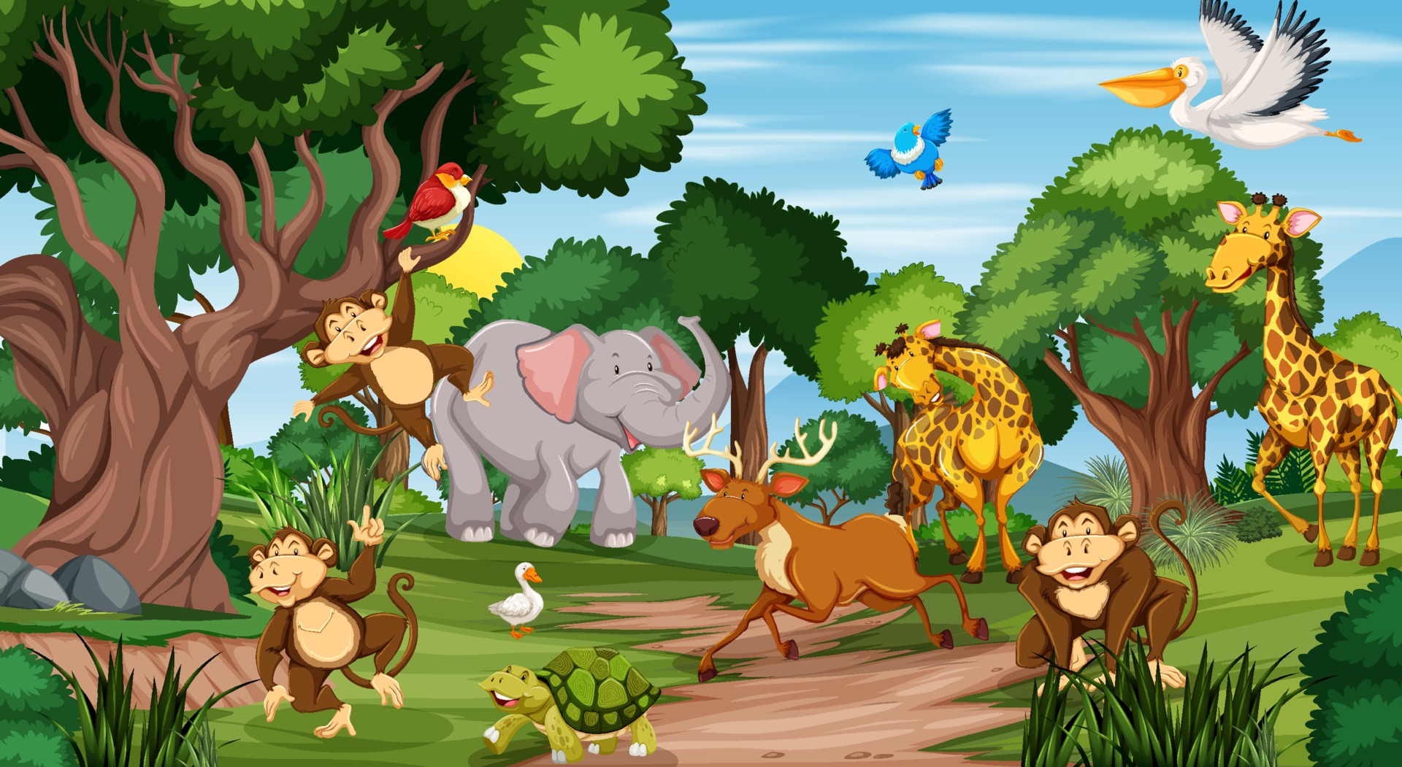
Story
In a jungle, there were many animals. They lived in different parts of the forest. All of them were wild. The larger animals preyed on the smaller ones for their food.
A tiger was one of them. He was very clever and was proud of his
strength. He made fun of the other animals. No one went near him.
Notes:
Notes for Teacher - < Information for further reference or explanation >
Suggestions: <Ideas/ Images/ Animations / Others – To make better representation of the content >
Source of Multimedia used in this slide - <Please provide source URL where we find the image and the license agreement>
<animals in a forest> <https://www.vecteezy.com/vector-art/1929087-many-different-animals-in-the-forest-scene>
<tiger> <https://pixabay.com/vectors/tiger-stripes-standing-animal-tail-48303/>

Slide 3
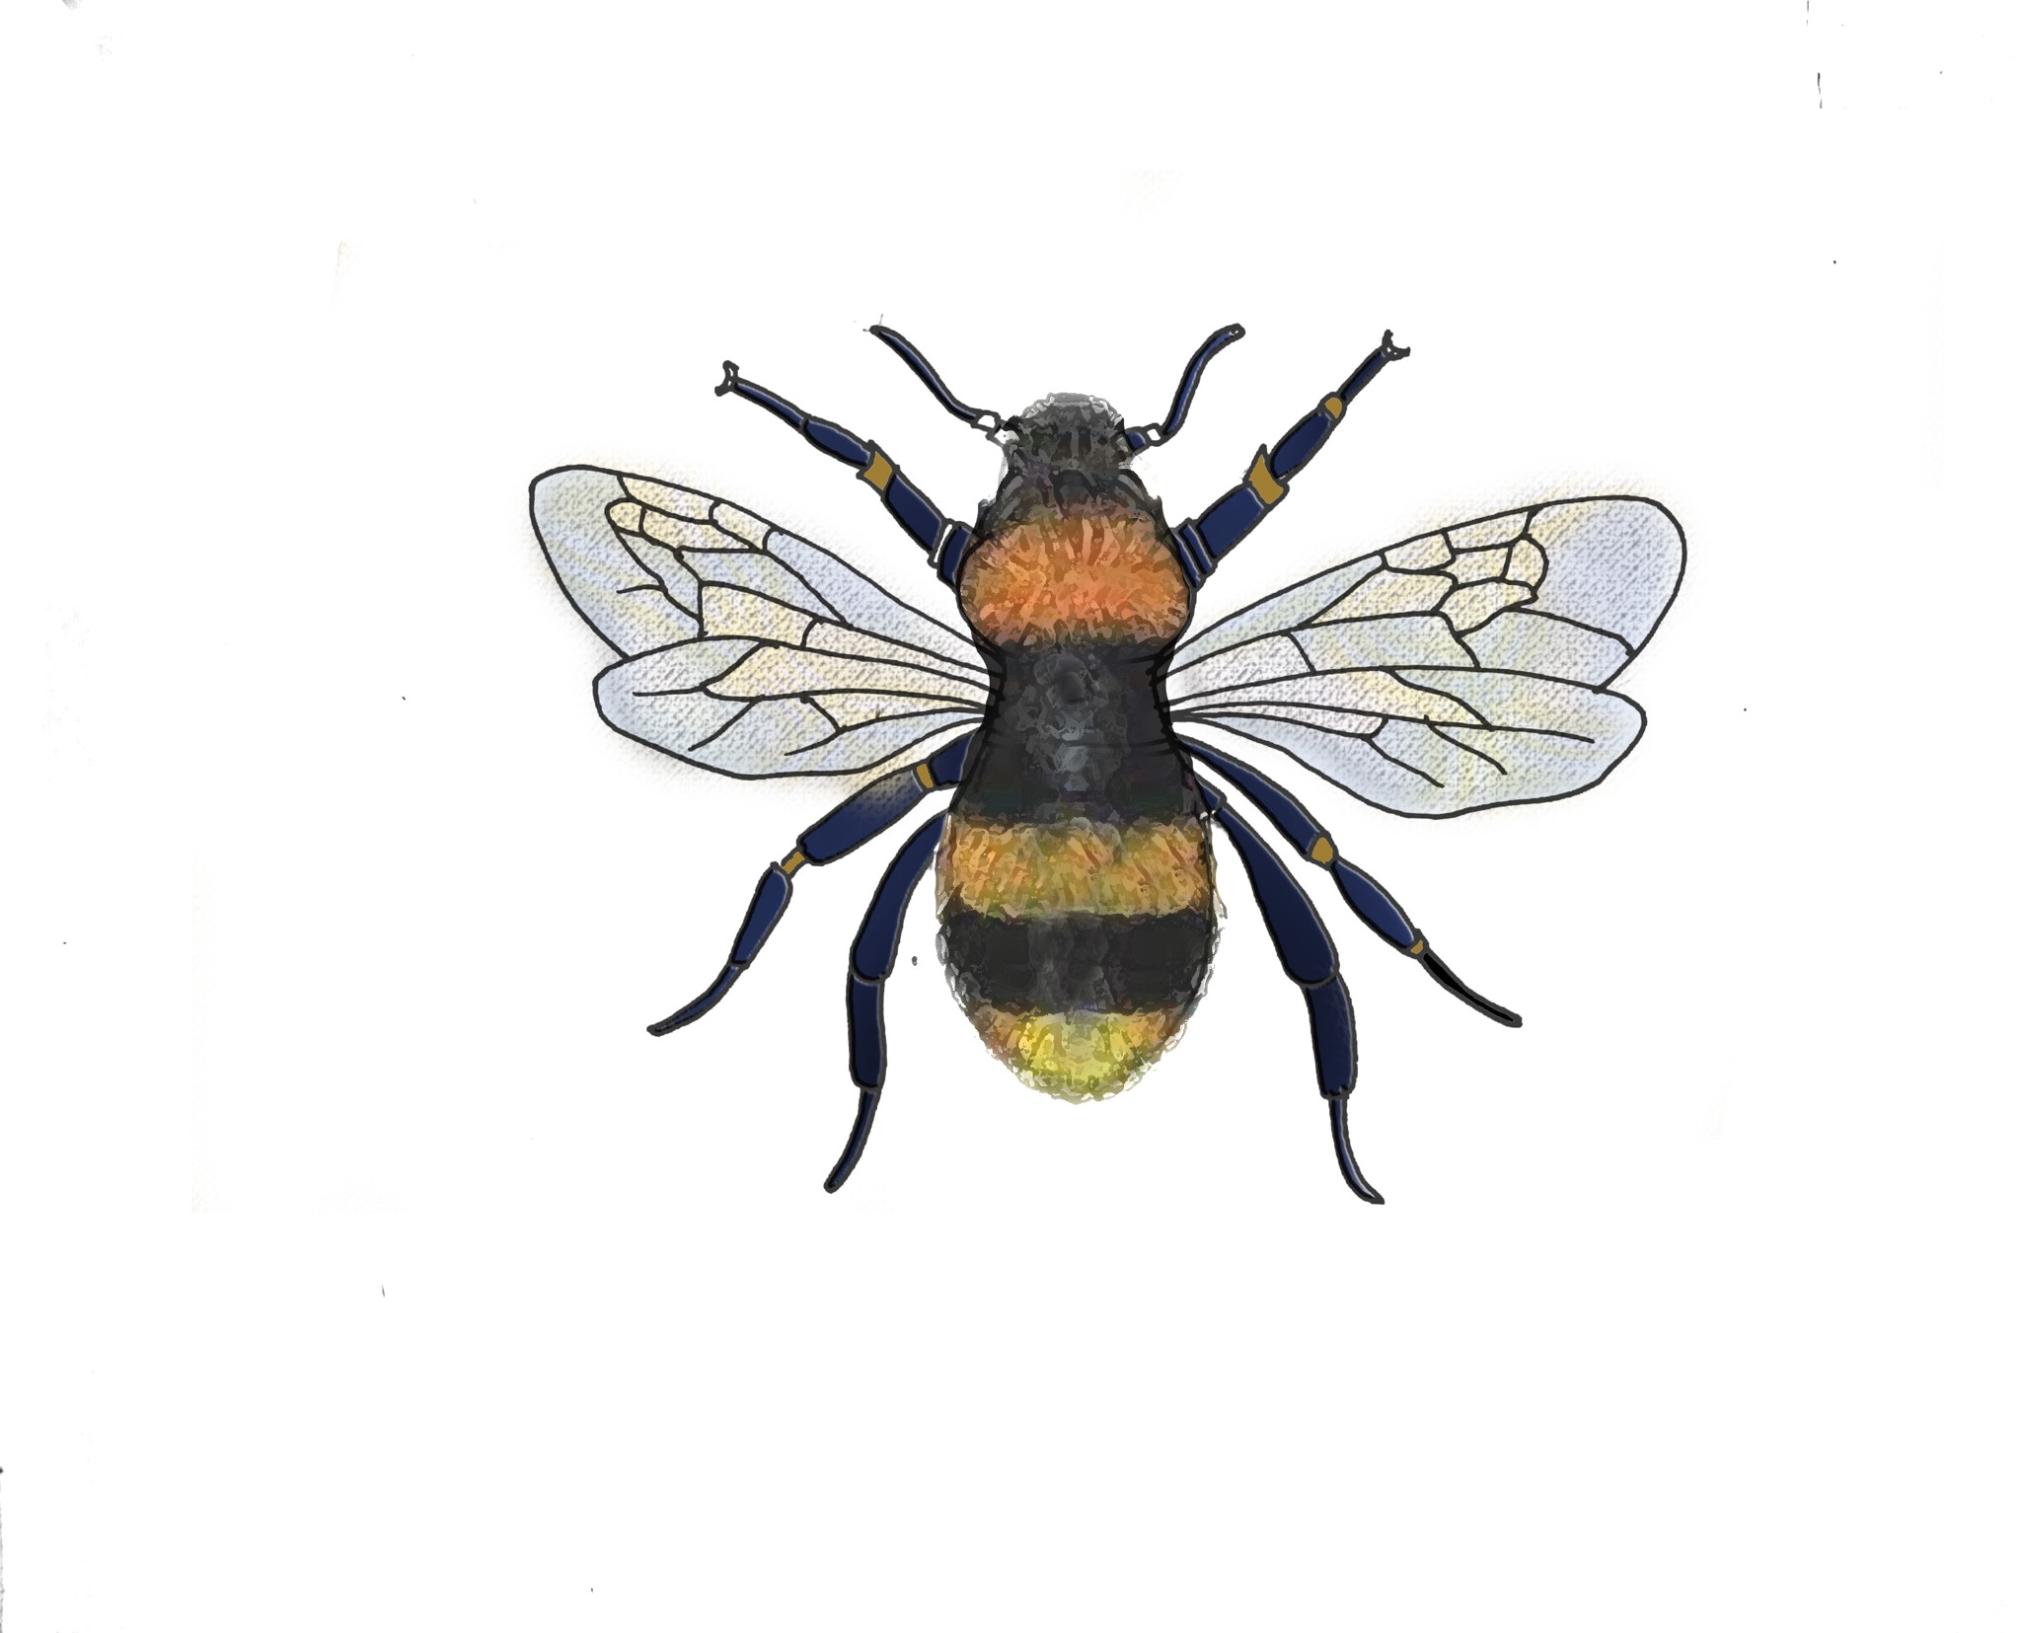
Story
He teased the tiny bumblebee and the mighty elephant which moved slowly swaying from side to side.
One day, there was a huge storm with thunder and lightning. All the animals hurried to a big cave to protect themselves.
Notes:
Notes for Teacher - < Information for further reference or explanation >
Suggestions: <Ideas/ Images/ Animations / Others – To make better representation of the content >
Source of Multimedia used in this slide - <Please provide source URL where we find the image and the license agreement>
<bumbleebee> <SSSVV-Bumble bee bumble-bee-7821 Bumble bee>
<elephant> <https://pixabay.com/vectors/elephant-wild-animal-mammal-trunk-24421/>
<cave> <https://pixabay.com/vectors/cave-stone-rock-fern-paleozoic-era-3167206/>

Slide 4
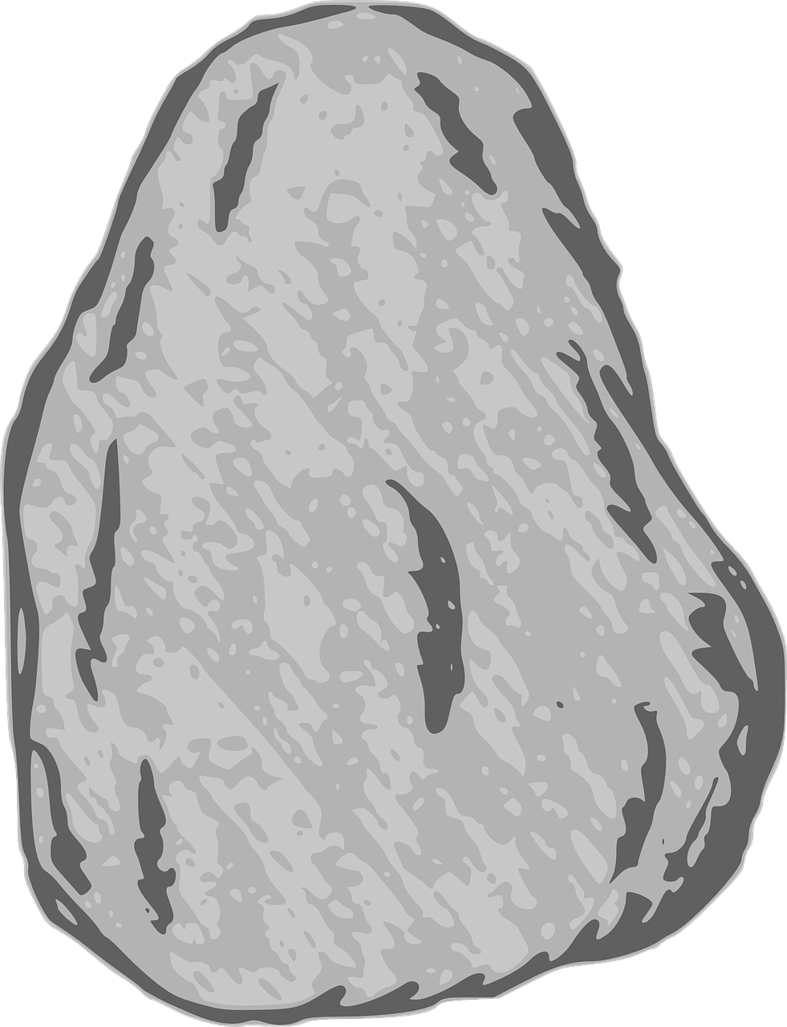
Story
Thud, thud! Down came a huge rock which sealed the entrance of the cave.
They all tried with all their might to push away the huge boulder and unblock the entrance. Alas, it was too heavy for them. The tiger tried his hand and came back disappointed. The boulder was too heavy for him so he could not push it. The animals became frightened.
Notes:
Notes for Teacher - < Information for further reference or explanation >
Suggestions: <Ideas/ Images/ Animations / Others – To make better representation of the content >
Source of Multimedia used in this slide - <Please provide source URL where we find the image and the license agreement>
<bumbleebee> <SSSVV-Bumble bee bumble-bee-7821 Bumble bee>
<cave> <https://pixabay.com/vectors/cave-stone-rock-fern-paleozoic-era-3167206/>
<boulder> <https://pixabay.com/vectors/rock-hard-stone-rough-boulder-35522/>

Slide 5
Story
Suddenly, the tiny bumblebee spotted a small gap between the rock and the entrance. “Wait for me friends, I shall bring help,” he screamed and flew away.
Notes:
Notes for Teacher - < Information for further reference or explanation >
Suggestions: <Ideas/ Images/ Animations / Others – To make better representation of the content >
Source of Multimedia used in this slide - <Please provide source URL where we find the image and the license agreement>
<bumbleebee> <SSSVV-Bumble bee bumble-bee-7821 Bumble bee>
<cave> <https://pixabay.com/vectors/cave-stone-rock-fern-paleozoic-era-3167206/>
<boulder> <https://pixabay.com/vectors/rock-hard-stone-rough-boulder-35522/>

Slide 6
Story
He went in search of the gentle giant; the friendly elephant. At the request of the bumblebee, the elephant came there with his friends and together they pushed the huge boulder away.
Notes:
Notes for Teacher - < Information for further reference or explanation >
Suggestions: <Ideas/ Images/ Animations / Others – To make better representation of the content >
Source of Multimedia used in this slide - <Please provide source URL where we find the image and the license agreement>
<bumbleebee> <SSSVV-Bumble bee bumble-bee-7821 Bumble bee>
<cave> <https://pixabay.com/vectors/cave-stone-rock-fern-paleozoic-era-3167206/>
<boulder> <https://pixabay.com/vectors/rock-hard-stone-rough-boulder-35522/>
<elephant pushing> <https://pixabay.com/vectors/elephant-animal-mammal-wild-3298569/>

Slide 7
Story
The animals ran out thanking the elephant. The tiger was ashamed and vowed never to trouble the other animals again.
Notes:
Notes for Teacher - < Information for further reference or explanation >
Suggestions: <Ideas/ Images/ Animations / Others – To make better representation of the content >
Source of Multimedia used in this slide - <Please provide source URL where we find the image and the license agreement>
<bumbleebee> <SSSVV-Bumble bee bumble-bee-7821 Bumble bee>
<cave> <https://pixabay.com/vectors/cave-stone-rock-fern-paleozoic-era-3167206/>
<boulder> <https://pixabay.com/vectors/rock-hard-stone-rough-boulder-35522/>
<elephant pushing> <https://pixabay.com/vectors/elephant-animal-mammal-wild-3298569/>

Slide 8
Attribution / Citation
Slide # | Thumbnail | Source link | Author
1,3,5,6,7 |  | https://pixabay.com/vectors/elephant-wild-animal-mammal-trunk-24421/ | Clker-Free-Vector-I
2,6,7 |  | <animals in a forest> <https://www.vecteezy.com/vector-art/1929087-many-different-animals-in-the-forest-scene> <tiger> <https://pixabay.com/vectors/tiger-stripes-standing-animal-tail-48303/> | www.vecteezy.com Clker-Free-Vector-I
3 |  | <cave> <https://pixabay.com/vectors/cave-stone-rock-fern-paleozoic-era-3167206/> | creozavr
4,5,6 |  | <cave> <https://pixabay.com/vectors/cave-stone-rock-fern-paleozoic-era-3167206/> <boulder> <https://pixabay.com/vectors/rock-hard-stone-rough-boulder-35522/> | Creozavr Clker-Free-Vector-Images
6 |  | <elephant pushing> <https://pixabay.com/vectors/elephant-animal-mammal-wild-3298569/> | mohamed_hassan
COPYRIGHT Cum DISCLAIMER NOTICE
Content owned by Sri Sathya Sai Central Trust, Prashanthi Nilayam, Puttaparthi, Sathya Sai District, Andhra Pradesh, India.
Strictly not for Commercial Use, excluding content that falls in Public Domain or common knowledge facts.
Content can be downloaded and used for personal, educational, informational and other non-commercial purposes, subject to attribution in the name of ‘Sri Sathya Sai Central Trust, Prashanthi Nilayam, Puttaparthi’ only. Any attempt to remove, alter, circumvent, or distort the data that is accessed is illegal and strictly prohibited.
Some of the content is owned by Third Parties and are used in compliance with their licensing conditions. Anyone infringing the Copyright of such Third Parties will be doing so at their own risks and costs.
Notes:
Notes for Teacher - < Information for further reference or explanation >
Suggestions: <Ideas/ Images/ Animations / Others – To make better representation of the content >
Source of Multimedia used in this slide - <Please provide source URL where we find the image and the license agreement>

