Slide 1
Comparing Homophones and Homographs
Notes:
Notes for Teacher - < Information for further reference or explanation >
Suggestions: <Ideas/ Images/ Animations / Others – To make better representation of the content >
Source of Multimedia used in this slide - <Please provide source URL where we find the image and the license agreement>

Slide 2
Homophones
Two or more
words
Share the same pronunciation
Different
Spellings and
Meanings
EXAMPLE
I can see the mountains from here.
All rivers flow into the sea.
Hear
Here
See
Sea
More examples: I and eye, eight and ate, new and knew.
Notes:
Notes for Teacher –
Suggestions: <Ideas/ Images/ Animations / Others – To make better representation of the content >
Source of Multimedia used in this slide - PPT ICONS
https://www.freepik.com/free-vector/hand-drawn-flat-design-lake-scenery_20289001.htm#query=river%20into%20sea&position=24&from_view=search&track=ais

Slide 3
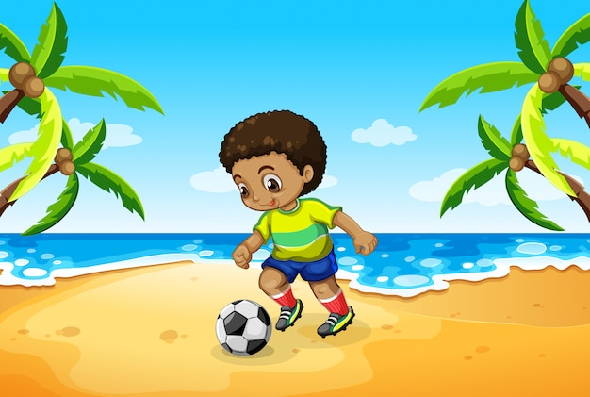
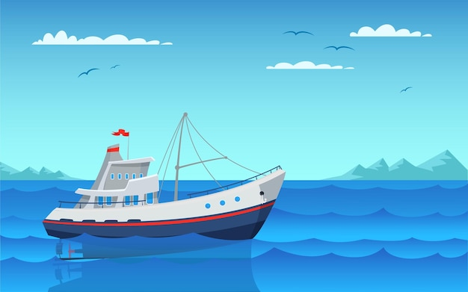
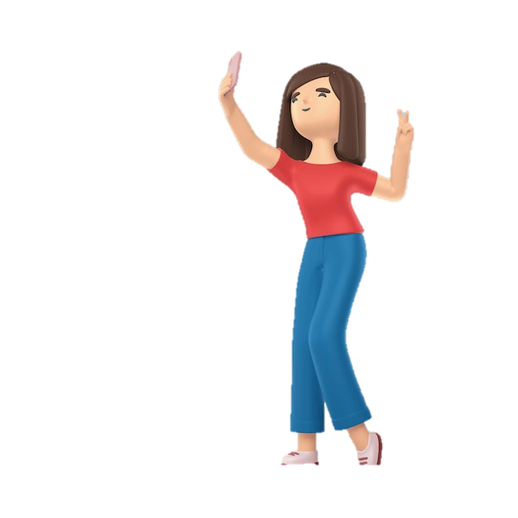
Sample Sentences
1
Raju’s seven year old son likes to spend time outside in the sun .
2
Anu went to the sea to see the ships sailing.
3
The teacher asked the student to write the right answer on the board.
Notes:
https://www.freepik.com/free-vector/boy-playing-football-beach_4228020.htm#query=indian%20boy%20playing%20in%20sun&position=2&from_view=search&track=ais
https://www.freepik.com/free-vector/modern-fishing-boat-empty-vessel-floating-waves-side-view-fishery-industry-commercial-transport-bay_24023139.htm#query=ship&position=10&from_view=search&track=sph
https://www.freepik.com/free-psd/3d-rendering-woman-waving_23735416.htm#query=indian%20girl%20cartoon&position=11&from_view=search&track=ais
https://www.freepik.com/free-vector/school-classroom-with-schoolchild-pupils-teachers-vector-flat-illustration-classroom-education-schoolchild-classroom-lesson-classroom_13381419.htm#query=classroom&position=14&from_view=search&track=sph

Slide 4
Homographs
Two or
more words
Spelt Same
Different
Sounds and
Meanings
EXAMPLE
I live in Bengaluru
I watched the match live on TV.
More examples : lead, read, wind, tear, minute.
Notes:
Notes for Teacher – Can be Read as I can see th mountains from here. All rivers flow into the sea.
Suggestions: <Ideas/ Images/ Animations / Others – To make better representation of the content >
Source of Multimedia used in this slide - PPT ICONS

Slide 5
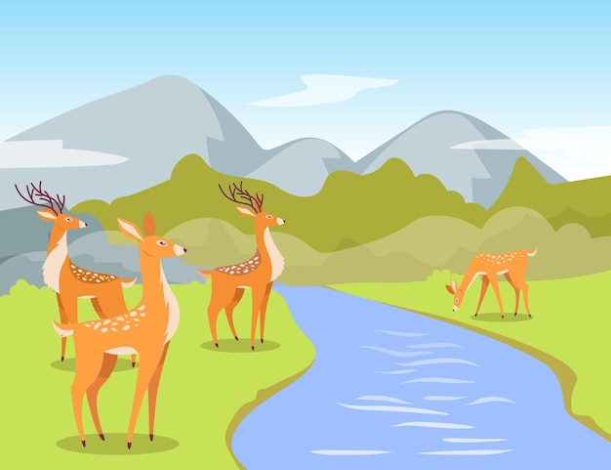
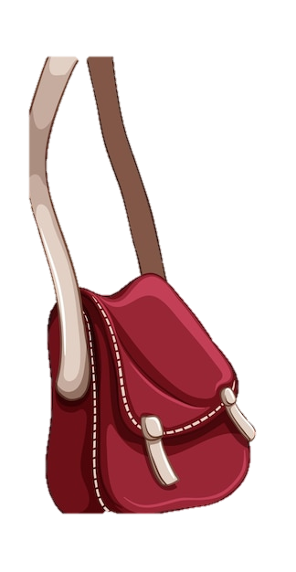
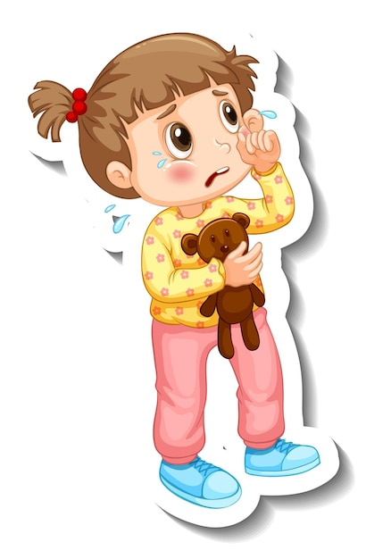
Sample Sentences
During the jungle safari we got to see the does and their fawns drinking water in the river.
DOES
Does anyone know where my bag is?
I like to read books.
READ
Ravi has already read the book I gave him to read.
Don’t tear the paper out of your notebook.
TEAR
I saw a tear roll down the baby’s cheek.
Notes:
Notes for Teacher - < Information for further reference or explanation >
Suggestions: <Ideas/ Images/ Animations / Others – To make better representation of the content >
Source of Multimedia used in this slide - https://www.freepik.com/free-vector/hand-drawn-birthday-calendar-template_35102325.htm#https://www.freepik.com/free-vector/deer-watering-hole-cartoon-illustration_16369149.htm#query=baby%20deer%20water&position=1&from_view=search&track=ais#position=1&query=baby%20deer%20water
https://www.freepik.com/free-vector/sticker-template-with-women-crossbody-bag-isolated_16461930.htm#query=ladies%20hand%20bag&position=40&from_view=search&track=ais
https://www.freepik.com/free-vector/happy-woman-carrying-shopping-bags_4946628.htm#query=indian%20girl%20with%20a%20bag&position=23&from_view=search&track=ais
https://www.freepik.com/free-vector/sticker-template-with-little-girl-crying-cartoon-character-isolated_16448733.htm#query=child%20tear&position=40&from_view=search&track=ais
https://www.freepik.com/free-vector/scientist-girl-cartoon-character-sticker_19728071.htm#query=indian%20child%20writing&position=29&from_view=search&track=ais

Slide 6
Difference
HOMONYMS
HOMOPHONES
HOMOGRAPHS
Same sound
Same spelling
Different meanings
Same sound
Different spellings
Different meanings
Different sounds
Same spelling
Different meanings
Notes:
Notes for Teacher - < Information for further reference or explanation >
Suggestions: <Ideas/ Images/ Animations / Others – To make better representation of the content >
Source of Multimedia used in this slide -

Slide 7
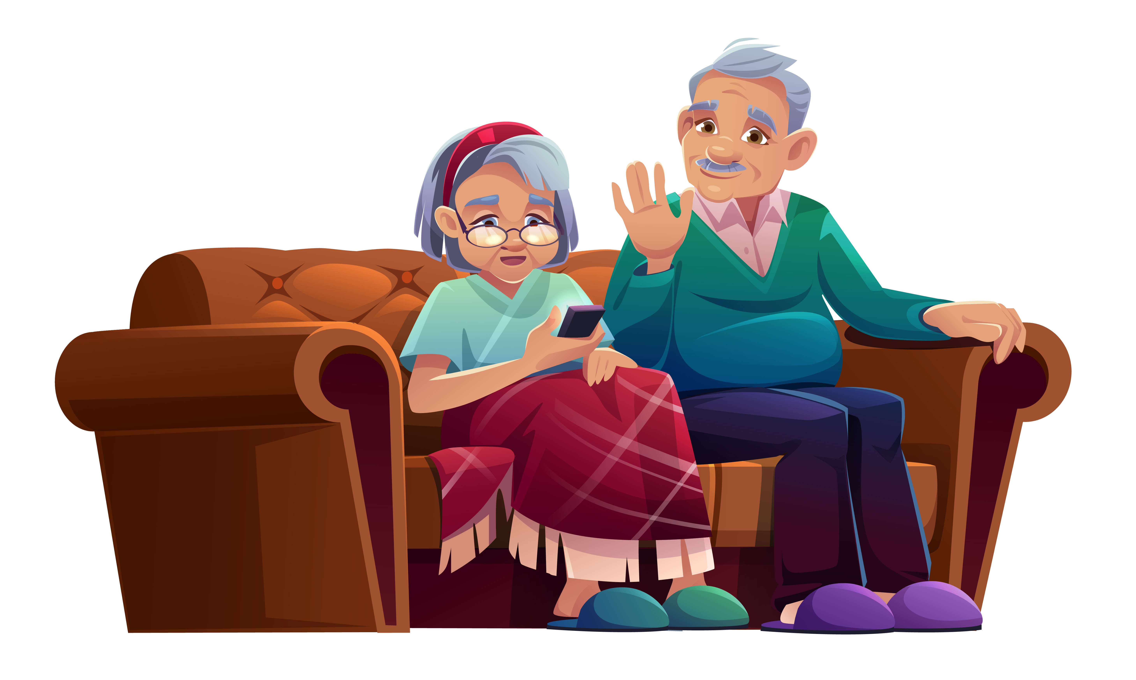
Attribution / Citation
Slide # | Thumbnail | Source link | Author
2 |  | https://www.freepik.com/free-vector/hand-drawn-flat-design-lake-scenery_20289001.htm | Freepik
3 |  | https://www.freepik.com/free-vector/boy-playing-football-beach_4228020.htm# https://www.freepik.com/free-vector/modern-fishing-boat-empty-vessel-floating-waves-side-view-fishery-industry-commercial-transport-bay_24023139.htm# https://www.freepik.com/free-psd/3d-rendering-woman-waving_23735416.htm# https://www.freepik.com/free-vector/school-classroom-with-schoolchild-pupils-teachers-vector-flat-illustration-classroom-education-schoolchild-classroom-lesson-classroom_13381419.htm# https://www.freepik.com/free-vector/variety-suns-icons_791459.htm# | Studiogstock Studio4rt Freepik Macrovector Freepik
5 |  | https://www.freepik.com/free-vector/flat-world-book-day-illustration_23871023.htm# https://www.freepik.com/free-vector/striped-background-heart-shaped-shelf-with-books_1064669.htm#https://www.freepik.com/free-vector/deer-watering-hole-cartoon-illustration_16369149.htm https://www.freepik.com/free-vector/sticker-template-with-women-crossbody-bag-isolated_16461930.htm# https://www.freepik.com/free-vector/happy-woman-carrying-shopping-bags_4946628.htm# https://www.freepik.com/free-vector/sticker-template-with-little-girl-crying-cartoon-character-isolated_16448733.htm# https://www.freepik.com/free-vector/scientist-girl-cartoon-character-sticker_19728071.htm#query=indian%20child%20writing&position=29&from_view=search&track=ais https://www.freepik.com/free-vector/senior-man-woman-talking-by-mobile-phone-sit-couch-nursing-home-old-lady-wrapped-plaid-aged-grey-haired-pensionr-relax-sofa-use-smartphone-chat-cartoon-illustration_9498902.htm# | Freepik freepik Pch.vector Brgfx Freepik Brgfx Brgfx @upklyak
COPYRIGHT Cum DISCLAIMER NOTICE
Content owned by Sri Sathya Sai Central Trust, Prashanthi Nilayam, Puttaparthi, Sathya Sai District, Andhra Pradesh, India.
Strictly not for Commercial Use, excluding content that falls in Public Domain or common knowledge facts.
Content can be downloaded and used for personal, educational, informational and other non-commercial purposes, subject to attribution in the name of ‘Sri Sathya Sai Central Trust, Prashanthi Nilayam, Puttaparthi’ only. Any attempt to remove, alter, circumvent, or distort the data that is accessed is illegal and strictly prohibited.
Some of the content is owned by Third Parties and are used in compliance with their licensing conditions. Anyone infringing the Copyright of such Third Parties will be doing so at their own risks and costs.
Notes:
Notes for Teacher - < Information for further reference or explanation >
Suggestions: <Ideas/ Images/ Animations / Others – To make better representation of the content >
Source of Multimedia used in this slide - <Please provide source URL where we find the image and the license agreement>

