Slide 1
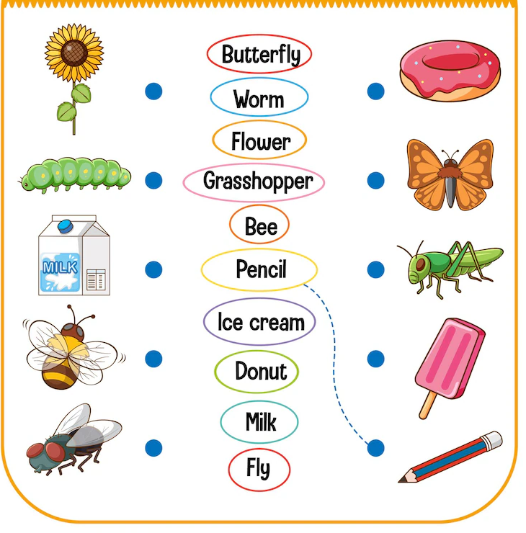
PPY Title
Usage of Material Nouns
Notes:
Notes for Teacher - <N/A>
Suggestions: <N/A>
Source of Multimedia used in this slide - <Please provide source URL where we find the image and the license agreement>
Nouns - https://www.freepik.com/free-vector/match-words-with-correct-pictures-game-kids-illustration_13474700.htm (brgfx)

Slide 2
PPY Title
Material Nouns
Petrol, air, water and rain are examples of uncountable nouns.
Material Nouns refer to physical matter which can be felt, seen or touched. It can be countable or uncountable.
Pebble, paper and stone are examples of countable nouns.
Notes:
Notes for Teacher - < Information for further reference or explanation >
This asset starts with IQ and seamlessly flows into the MS. The teacher could start the class by asking the students to frame a few sentences with the Nouns which they have already learnt in the class. They could then write the sentences on the blackboard spoken by the students. She/he may then underline the Nouns in those sentences and ask the students the kind of Nouns used. She/he can then recap the Nouns already learnt (Proper Noun, Common Noun, Countable - Uncountable Noun and Abstract Noun) and start the MS. The PPT may be used for clarity. Alternatively, the teacher may choose to prepare placards or reading cards with sentences as given in the PPT in the absence of AV facility. Once the children are able to identify the countable and uncountable nouns, she can make use of this opportunity to introduce the nomenclature as Material Nouns.
Suggestions: <Ideas/ Images/ Animations / Others – To make better representation of the content >
Source of Multimedia used in this slide - <Please provide source URL where we find the image and the license agreement>

Slide 3
PPY Title
Example
This paper was given to me by my teacher.
Paper is the material noun in this sentence.
Because paper can be seen, felt or touched.
Notes:
Notes for Teacher - < Information for further reference or explanation >
Suggestions: <Ideas/ Images/ Animations / Others – To make better representation of the content >
Source of Multimedia used in this slide - <Please provide source URL where we find the image and the license agreement>
Honey - https://www.freepik.com/free-photo/honey-jar-with-wooden-spoon_10627844.htm (efe_Madrid)
Curd - https://www.freepik.com/free-photo/greek-yogurt-wooden-bowl-isolated-white-background_35584779.htm (chandlervid85)
Cotton - https://www.freepik.com/free-photo/cotton-flowers_9616040.htm (Racool_studio)

Slide 4
PPY Title
Classification of Material Nouns
Material Nouns from Nature
Countable: rivers, eggs, trees, animals, pebbles stones etc.
Uncountable: water, air, salt, sand, gold, iron,
rock, copper, coal, silver etc.
Material Nouns from Plants
Countable: fruits, vegetables, flowers etc.
Uncountable: food, rubber, coffee, tea, oil, jute, wood, cotton, spices etc.
Material Nouns from Animals
Countable: eggs
Uncountable: milk, meat, honey, silk, wool etc.
Notes:
Notes for Teacher - < Information for further reference or explanation >
Suggestions: <Ideas/ Images/ Animations / Others – To make better representation of the content >
Source of Multimedia used in this slide - <Please provide source URL where we find the image and the license agreement>
GO

Slide 5
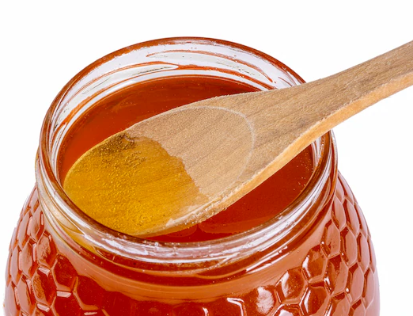
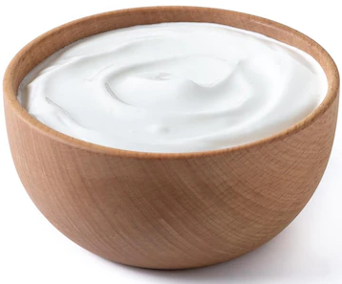
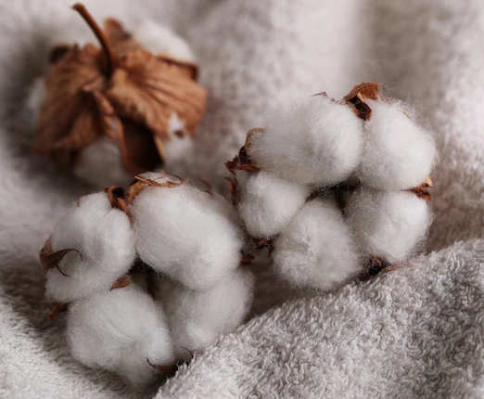
PPY Title
Classification of Material Nouns
1)
My mother gave me a spoon of honey with curd.
Material nouns from animals
2)
Her uncle produces cotton once a year.
Material noun from plants
Notes:
Notes for Teacher - < Information for further reference or explanation >
Suggestions: <Ideas/ Images/ Animations / Others – To make better representation of the content >
Source of Multimedia used in this slide - <Please provide source URL where we find the image and the license agreement>
Honey - https://www.freepik.com/free-photo/honey-jar-with-wooden-spoon_10627844.htm (efe_Madrid)
Curd - https://www.freepik.com/free-photo/greek-yogurt-wooden-bowl-isolated-white-background_35584779.htm (chandlervid85)
Cotton - https://www.freepik.com/free-photo/cotton-flowers_9616040.htm (Racool_studio)

Slide 6
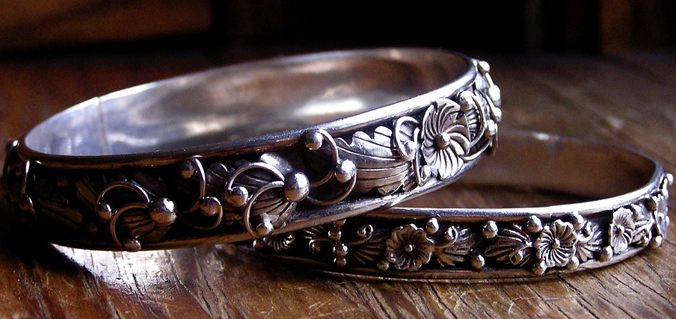
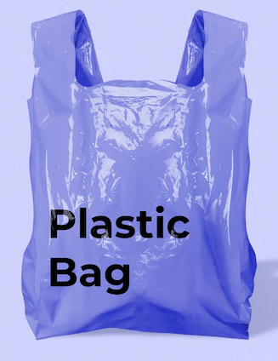
PPY Title
Classification of Material Nouns
3)
Reena gifted me a silver bangle.
Material noun from Nature
4)
Plastic bags should not be used.
Material noun that is countable
Notes:
Notes for Teacher - < Information for further reference or explanation >
Suggestions: <Ideas/ Images/ Animations / Others – To make better representation of the content >
Source of Multimedia used in this slide - <Please provide source URL where we find the image and the license agreement>
Silver Bangle - https://openverse.org/image/1f2bb2df-f666-48e0-a0f2-f18bee153ba9?q=silver%20bangle ("Silver bangles" by
liz west from Boxborough, MA)
Plastic bag = https://www.freepik.com/free-photo/purple-plastic-grocery-bag_18835768.htm (rawpixel.com)

Slide 7
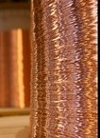
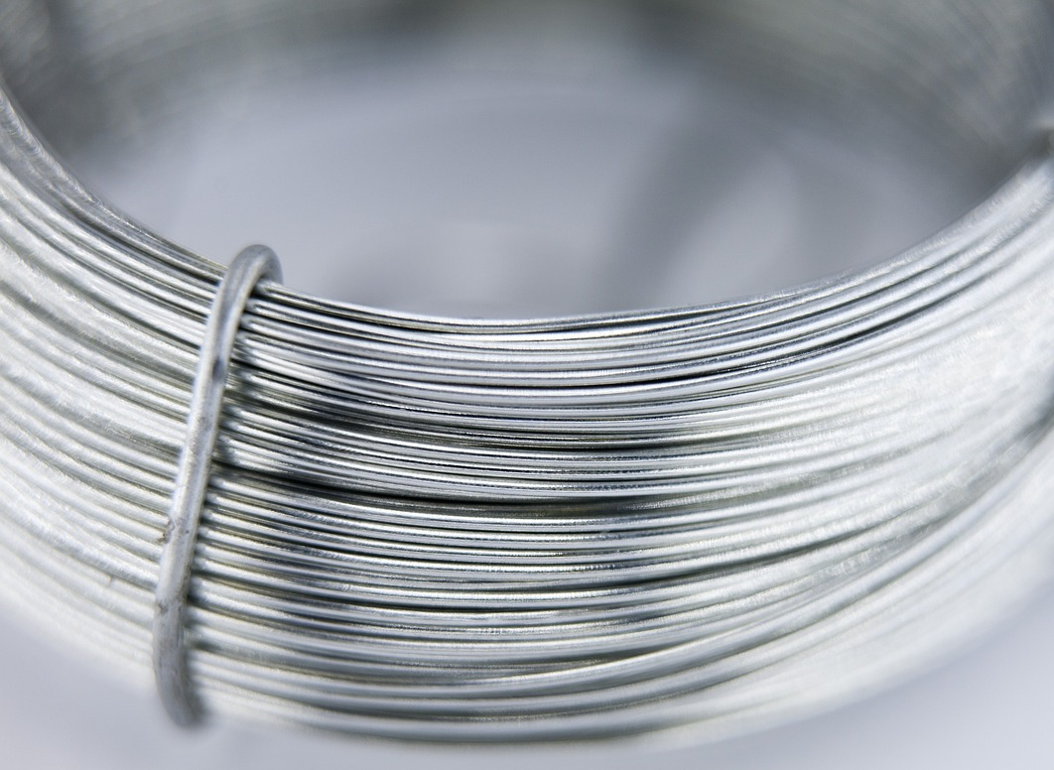
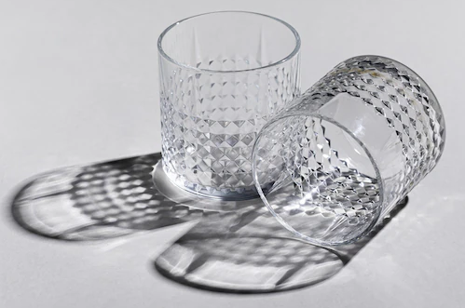
Classification of Material Nouns
PPY Title
5)
The electric wires are made of copper and aluminium.
Material nouns from Nature
6)
Fibre is better than glass for children.
Material noun that is uncountable
Notes:
Notes for Teacher - < Information for further reference or explanation >
Suggestions: <Ideas/ Images/ Animations / Others – To make better representation of the content >
Source of Multimedia used in this slide - <Please provide source URL where we find the image and the license agreement>
Copper wire - https://openverse.org/image/d3d11b9f-065c-4b11-b8cb-8db5dcca6e49?q=copper%20wire
("Industrial Photography: Copper Wires-004“ by Flavio~)
Aluminum wire - https://pixabay.com/photos/wire-won-line-steel-aluminum-2775895/ (HeungSoon)
Fibre - https://www.freepik.com/free-photo/horizontal-shot-two-empty-old-fashioned-glasses-white-surface-with-shadows_15671194.htm (wirestock)

Slide 8
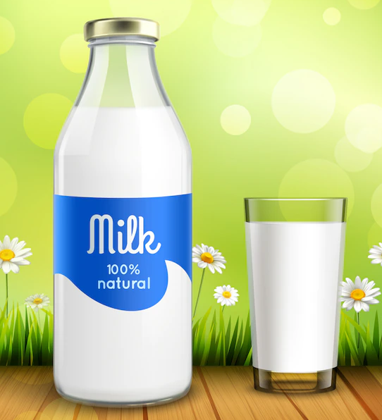
PPY Title
Classification of Material Nouns
7)
Children should not play with the ball near the glass window.
Material noun from Nature
8)
Milk is rich in calcium.
Material noun from animals
Notes:
Notes for Teacher - < Information for further reference or explanation >
Suggestions: <Ideas/ Images/ Animations / Others – To make better representation of the content >
Source of Multimedia used in this slide - <Please provide source URL where we find the image and the license agreement>
Glass window - https://www.freepik.com/free-vector/empty-office-room-interior-with-windows-ceiling_8117291.htm (upklyak)
Boys- https://www.freepik.com/free-vector/boys-playing-different-sports-illustration_1169163.htm (brgfx)
Milk bottle - https://www.freepik.com/free-vector/bottle-glass-milk_3982357.htm (macrovector)

Slide 9
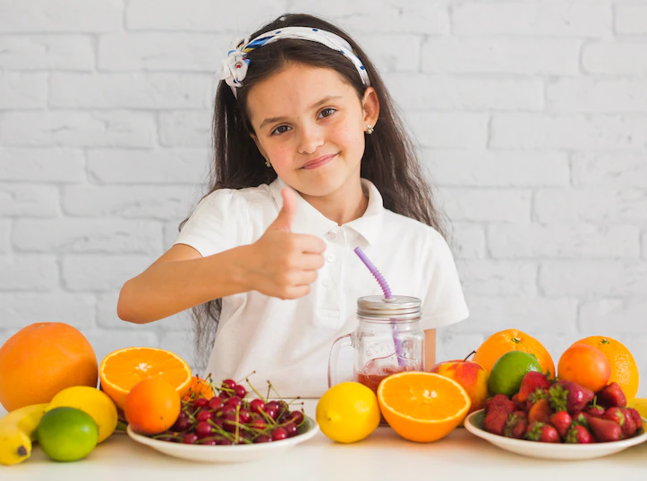
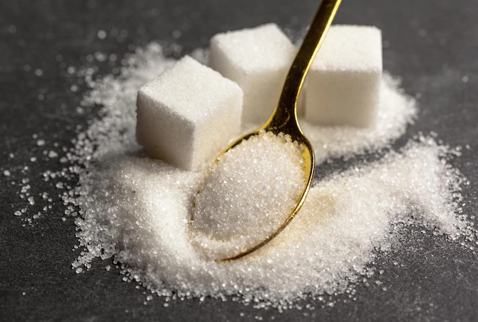
PPY Title
Classification of Material Nouns
9)
We must eat fruits daily.
Material nouns from plants
10)
Too much sugar is not good for health.
Material noun from plants
Notes:
Notes for Teacher - < Information for further reference or explanation >
Suggestions: <Ideas/ Images/ Animations / Others – To make better representation of the content >
Source of Multimedia used in this slide - <Please provide source URL where we find the image and the license agreement>
Fruit bowl - https://www.freepik.com/free-photo/cute-smiling-girl-with-colorful-fruits-showing-thumb-up-sign_2618377.htm (freepik)
Spoon of sugar - https://www.freepik.com/free-photo/background-sugar-cubes_21061385.htm (fabrikasimf)

Slide 10
Attribution / Citation
Slide # | Thumbnail | Source link | Author
1. |  | Nouns - https://www.freepik.com/free-vector/match-words-with-correct-pictures-game-kids-illustration_13474700.htm | brgfx
4. |  | Honey - https://www.freepik.com/free-photo/honey-jar-with-wooden-spoon_10627844.htm Curd - https://www.freepik.com/free-photo/greek-yogurt-wooden-bowl-isolated-white-background_35584779.htm Cotton - https://www.freepik.com/free-photo/cotton-flowers_9616040.htm | efe_Madrid Chandlervid85 Racool_studio
5. |  | Silver Bangle - https://openverse.org/image/1f2bb2df-f666-48e0-a0f2-f18bee153ba9?q=silver%20bangle ("Silver bangles“) Plastic bag = https://www.freepik.com/free-photo/purple-plastic-grocery-bag_18835768.htm | liz west from Boxborough, MA rawpixel.com
6. |  | Copper wire - https://openverse.org/image/d3d11b9f-065c-4b11-b8cb-8db5dcca6e49?q=copper%20wire ("Industrial Photography: Copper Wires-004“ Aluminum wire - https://pixabay.com/photos/wire-won-line-steel-aluminum-2775895/ Fibre - https://www.freepik.com/free-photo/horizontal-shot-two-empty-old-fashioned-glasses-white-surface-with-shadows_15671194.htm | Flavio~ HeungSoon Wirestock
7. |  | Glass window - https://www.freepik.com/free-vector/empty-office-room-interior-with-windows-ceiling_8117291.htm Boys- https://www.freepik.com/free-vector/boys-playing-different-sports-illustration_1169163.htm Milk bottle - https://www.freepik.com/free-vector/bottle-glass-milk_3982357.htm | upklyak brgfx Macrovector
8. |  | Fruit bowl - https://www.freepik.com/free-photo/cute-smiling-girl-with-colorful-fruits-showing-thumb-up-sign_2618377.htm Spoon of sugar - https://www.freepik.com/free-photo/background-sugar-cubes_21061385.htm | Freepik fabrikasimf
COPYRIGHT Cum DISCLAIMER NOTICE
Content owned by Sri Sathya Sai Central Trust, Prashanthi Nilayam, Puttaparthi, Sathya Sai District, Andhra Pradesh, India.
Strictly not for Commercial Use, excluding content that falls in Public Domain or common knowledge facts.
Content can be downloaded and used for personal, educational, informational and other non-commercial purposes, subject to attribution in the name of ‘Sri Sathya Sai Central Trust, Prashanthi Nilayam, Puttaparthi’ only. Any attempt to remove, alter, circumvent, or distort the data that is accessed is illegal and strictly prohibited.
Some of the content is owned by Third Parties and are used in compliance with their licensing conditions. Anyone infringing the Copyright of such Third Parties will be doing so at their own risks and costs.
Notes:
Notes for Teacher - < Information for further reference or explanation >
Suggestions: <Ideas/ Images/ Animations / Others – To make better representation of the content >
Source of Multimedia used in this slide - <Please provide source URL where we find the image and the license agreement>

