Slide 1
To Love is to Care
Notes:
Notes for Teacher – Not applicable
Suggestions: Not applicable
Source of Multimedia used in this slide - https://www.maxpixel.net/Valentine-Design-Heart-Love-Background-Shape-3089409

Slide 2
Abstract and Material Nouns
Abstract nouns refer to ideas, concepts, emotions, qualities or states that cannot be perceived by the five senses.
Material nouns refer to physical substances or objects that can be perceived by the five senses.
Understanding the differences between them can help to use them correctly in writing and communication.
Similarly, we need to understand the needs of others i.e., material needs, objects, ideas or emotions and should show our love and care by acting accordingly.
Notes:
Notes for Teacher - Not applicable
Suggestions: Not applicable
Source of Multimedia used in this slide - Not applicable

Slide 3
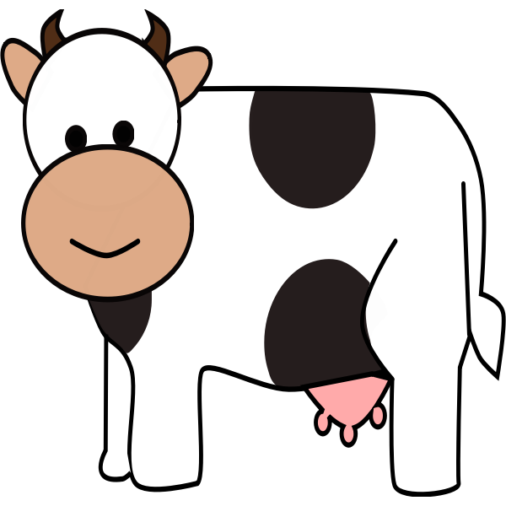
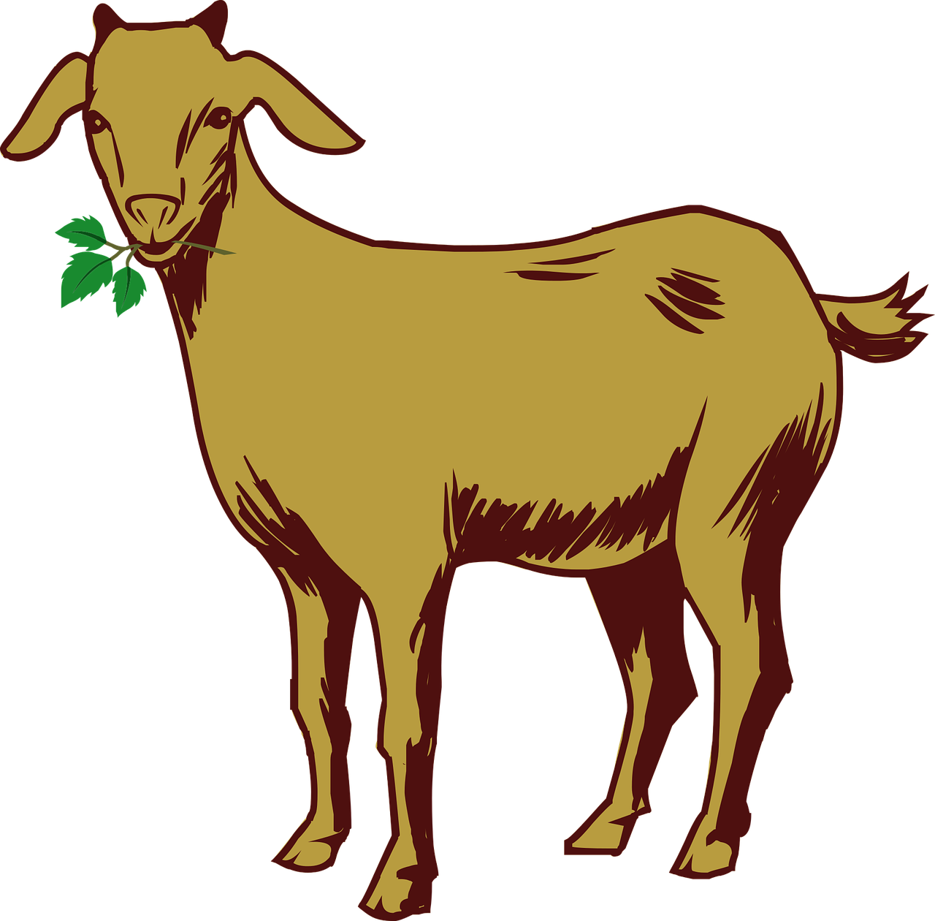
Ramu’s Story
Ramu lived with his grandmother in a small village.
They lived in a small hut and also took care of five cows and two goats.
They earned their living by selling milk.
Ramu was a very caring, loving, fearless, honest and obedient child.
Notes:
Notes for Teacher - Not applicable
Suggestions: Not applicable
Source of Multimedia used in this slide -
1. House in field – https://www.needpix.com/photo/download/1345321/house-architecture-vector-design-field-village-flowers-sky-clouds
2. Lady – https://pixabay.com/illustrations/saree-woman-cartoon-lady-india-7562758/
3. Boy – https://creazilla.com/nodes/7869259-vector
4. Goat – https://pixabay.com/vectors/goat-drawing-animal-1456762/
5. Cow – https://freesvg.org/color-cartoon-cow-vector-drawing

Slide 4
School and Extra-curricular Activities
He studied in the village school. After his school hours when the other children would go to play, Ramu responsibly went home to help his grandmother.
Though they could barely made ends meet, he cared for others and shared whatever he could. He liked sharing his food with the hungry and helping the poor neighbour’s children in their studies.
Notes:
Notes for Teacher - Not applicable
Suggestions: Not applicable
Source of Multimedia used in this slide -
1. School – https://pixabay.com/vectors/school-building-education-property-295210/
2. Boy – https://creazilla.com/nodes/7869259-vector

Slide 5
Admission to College
His grandmother had great faith in him and his ability. He studied well and all the teachers admired his intelligence and sincerity. Ramu stood first in his school and made everyone proud. He also got admission in a very good college in a nearby town on merit.
Since he didn't want to leave his grandmother alone because there was no one else to take care of her, he travelled every day to the town to study.
To and Fro
Notes:
Notes for Teacher - Not applicable
Suggestions: Not applicable
Source of Multimedia used in this slide -
1. Building – https://vectorportal.com/vector/university-building/17271
2. Bus – https://vectorportal.com/vector/school-bus/35763

Slide 6
Ramu’s Motto
He completed his degree with flying colours and topped in the district.
He got a very good offer to work for a big company and accepted it. In this way he became financially sound and in turn helped those in need.
After his work he helped and supported the under-privileged children in their studies and also imparted basic literacy to some illiterate elders in the village.
He believed that as human beings, we need give love and care to others and should try to help those who are in need to the best of our ability.
We may do so by providing materials, ideas, knowledge or emotions.
He believed that the purpose of education is not only to gain ourselves in life or accomplish just for ourselves. It’s also important to help the less fortunate to improve their life.
Notes:
Notes for Teacher - Not applicable
Suggestions: Not applicable
Source of Multimedia used in this slide -
1. Graduation – https://vectorportal.com/vector/student-celebrating-graduation/35565
2. Trophy – https://pixabay.com/vectors/trophy-success-winner-award-prize-6155889/

Slide 7
Points to Ponder
It is very important to show our love and care towards everyone and everything because:
it could make a difference in someone’s life
it makes us and people around us feel happy
it helps us to become the best version of ourselves
it brings in a change in the society
Notes:
Notes for Teacher - Not applicable
Suggestions: Not applicable
Source of Multimedia used in this slide - Not applicable

Slide 8
Attribution / Citation
Slide # | Thumbnail | Source link | Author
1 |  | https://www.maxpixel.net/Valentine-Design-Heart-Love-Background-Shape-3089409 | Max Pixel
3 |  | 1. House in field – https://www.needpix.com/photo/download/1345321/house-architecture-vector-design-field-village-flowers-sky-clouds 2. Lady – https://pixabay.com/illustrations/saree-woman-cartoon-lady-india-7562758/ 3. Boy – https://creazilla.com/nodes/7869259-vector 4. Goat – https://pixabay.com/vectors/goat-drawing-animal-1456762/ 5. Cow – https://freesvg.org/color-cartoon-cow-vector-drawing | 1. House in field – Larisa Koshkina 2. Lady – Nehanya 3. Boy – gahag.net 4. Goat – harshal07 5. Cow – OpenClipart
4 |  | 1. School – https://pixabay.com/vectors/school-building-education-property-295210/ 2. Boy – https://creazilla.com/nodes/7869259-vector | 1. School – Clker-Free-Vector-Images 2. Boy – gahag.net
5 |  | 1. Building – https://vectorportal.com/vector/university-building/17271 2. Bus – https://vectorportal.com/vector/school-bus/35763 | 1. Building – Vectorportal.com 2. Bus – Vectorportal.com
6 |  | 1. Graduation – https://vectorportal.com/vector/student-celebrating-graduation/35565 2. Trophy – https://pixabay.com/vectors/trophy-success-winner-award-prize-6155889/ | 1. Graduation –Vectorportal.com 2. Trophy – satheeshsankaran
COPYRIGHT Cum DISCLAIMER NOTICE
Content owned by Sri Sathya Sai Central Trust, Prashanthi Nilayam, Puttaparthi, Sathya Sai District, Andhra Pradesh, India.
Strictly not for Commercial Use, excluding content that falls in Public Domain or common knowledge facts.
Content can be downloaded and used for personal, educational, informational and other non-commercial purposes, subject to attribution in the name of ‘Sri Sathya Sai Central Trust, Prashanthi Nilayam, Puttaparthi’ only. Any attempt to remove, alter, circumvent, or distort the data that is accessed is illegal and strictly prohibited.
Some of the content is owned by Third Parties and are used in compliance with their licensing conditions. Anyone infringing the Copyright of such Third Parties will be doing so at their own risks and costs.
Notes:
Notes for Teacher - Not applicable
Suggestions: Not applicable
Source of Multimedia used in this slide - Not applicable

