Slide 1
Types of Sentences
“
”
Notes:
Notes for Teacher - < Information for further reference or explanation >
Suggestions: <Ideas/ Images/ Animations / Others – To make better representation of the content >
Source of Multimedia used in this slide - <Please provide source URL where we find the image and the license agreement>

Slide 2
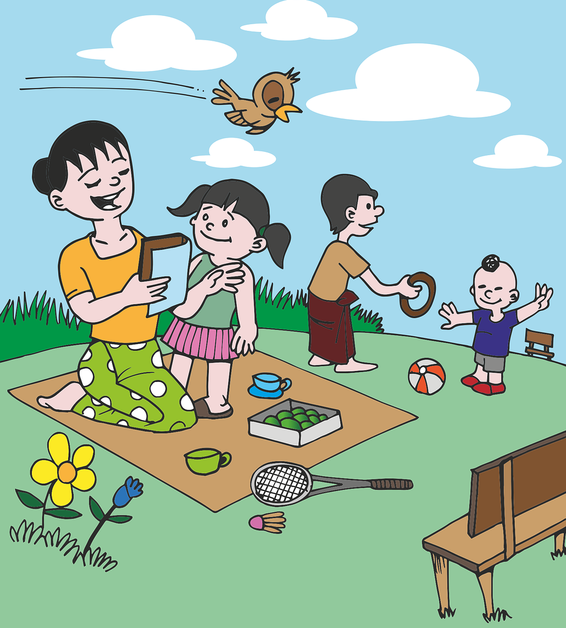
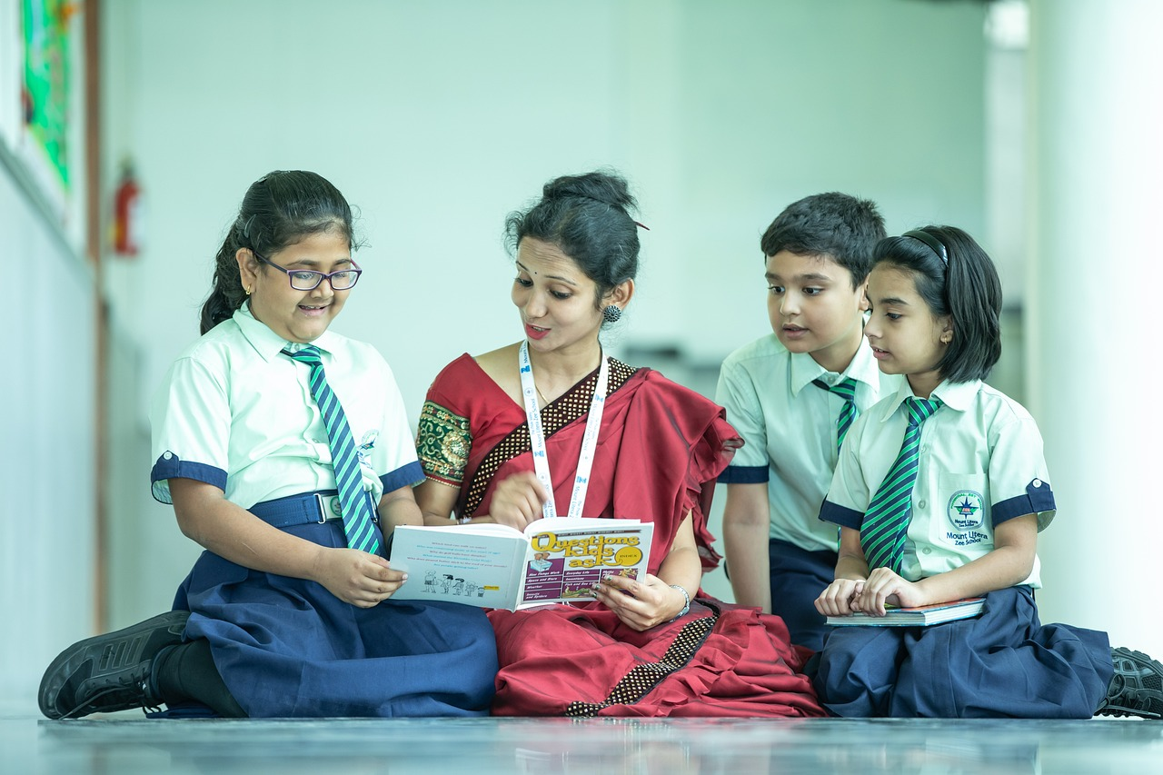
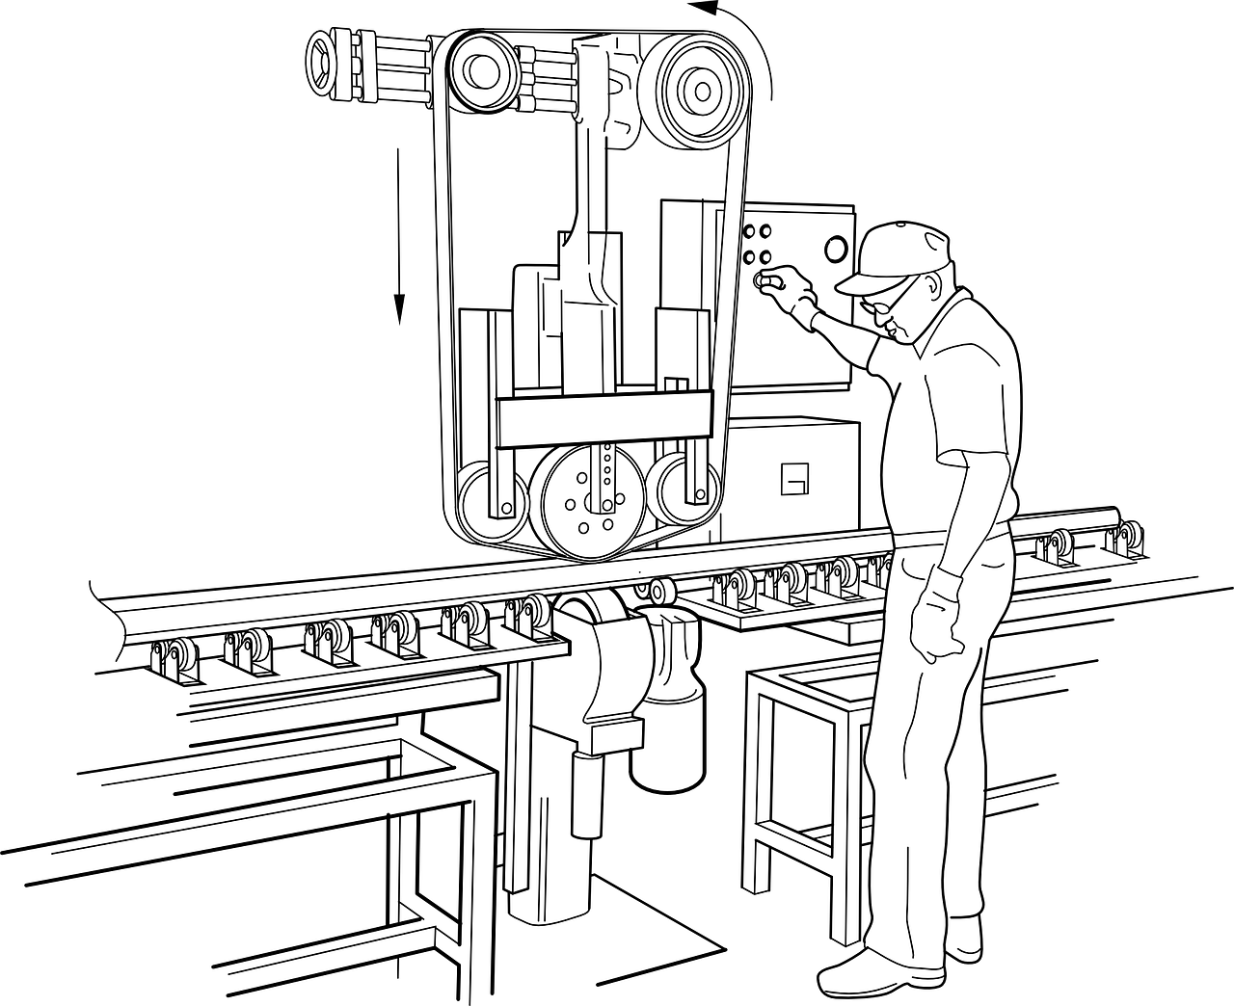
Declarative Or Assertive Sentences
“
”
Declarative sentences are statements with a full stop or period at the end.
Examples
My name is Sudha, and I am a teacher.
He works in a factory.
Children prefer to play outdoor games.
Notes:
Notes for Teacher - < Information for further reference or explanation >
Suggestions: <Ideas/ Images/ Animations / Others – To make better representation of the content >
Source of Multimedia used in this slide - <Please provide source URL where we find the image and the license agreement>
1. Teacher - https://pixabay.com/photos/school-classroom-teacher-7047287/ (Anilsharma26)
2. Factory Worker - https://pixabay.com/vectors/machine-factory-polishing-rail-30512/ (Clker-Free-Vector-Images)
3. Outdoor Games - https://pixabay.com/vectors/games-park-child-children-grass-1459575/ (Mote Oo)

Slide 3
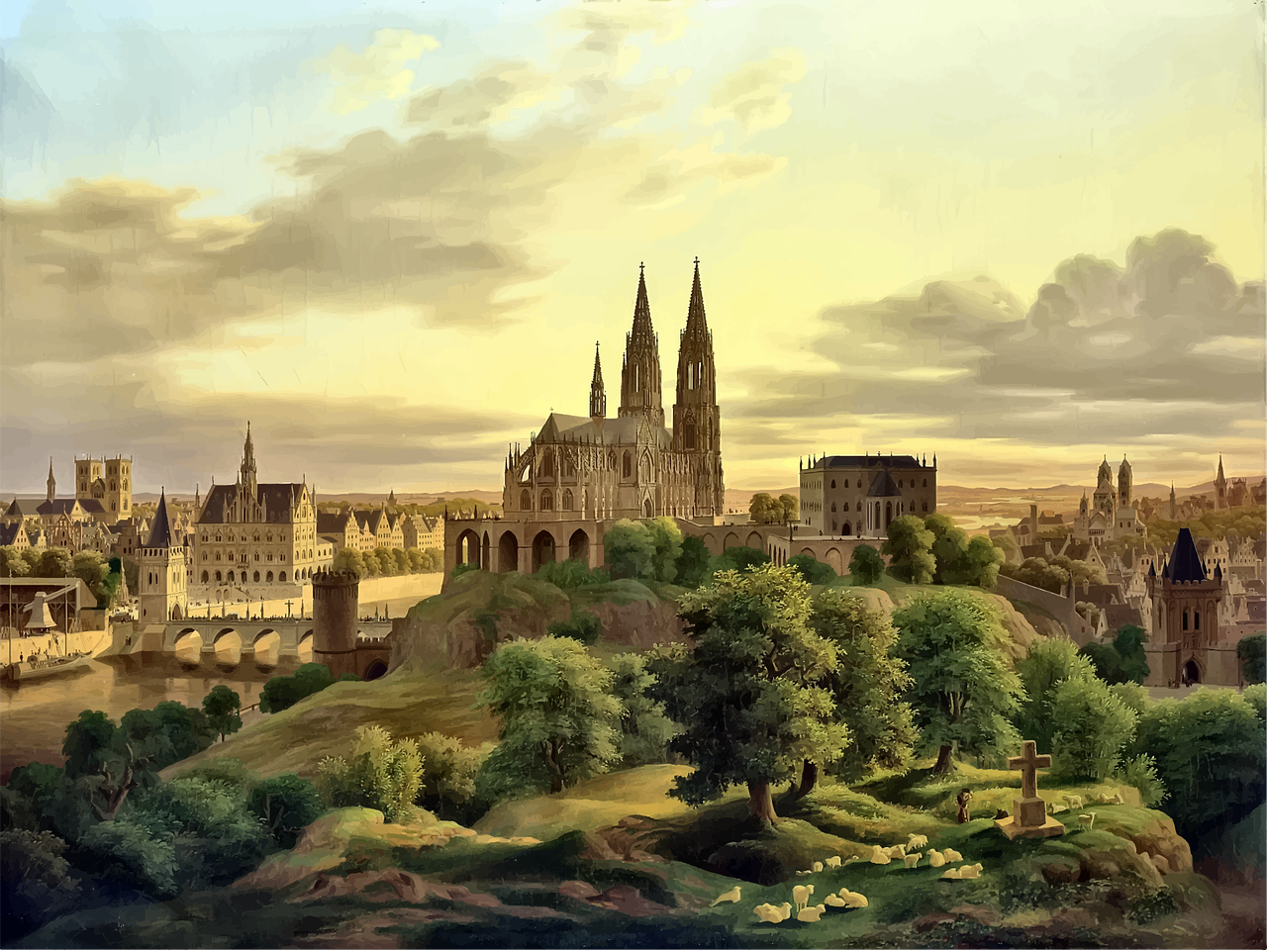
Exclamatory Sentences
“
”
Exclamatory sentences are those sentences that express strong emotions / feelings of joy, excitement, sorrow and
they end with an exclamation mark.
Examples
Congratulations! You have won the cricket match.
What a beautiful painting!
This is the best book I have ever read!
Notes:
Notes for Teacher - < Information for further reference or explanation >
Suggestions: <Ideas/ Images/ Animations / Others – To make better representation of the content >
Source of Multimedia used in this slide - <Please provide source URL where we find the image and the license agreement>
1. Cricketer - https://pixabay.com/photos/cricketer-athlete-cricket-sports-7015983/ (yogendras31)
2. Painting - https://pixabay.com/vectors/medieval-buildings-architechture-5437870/ (GDJ)
3. Reading Woman - https://www.freepik.com/free-vector/hand-drawn-lagom-illustration_34659799.htm

Slide 4
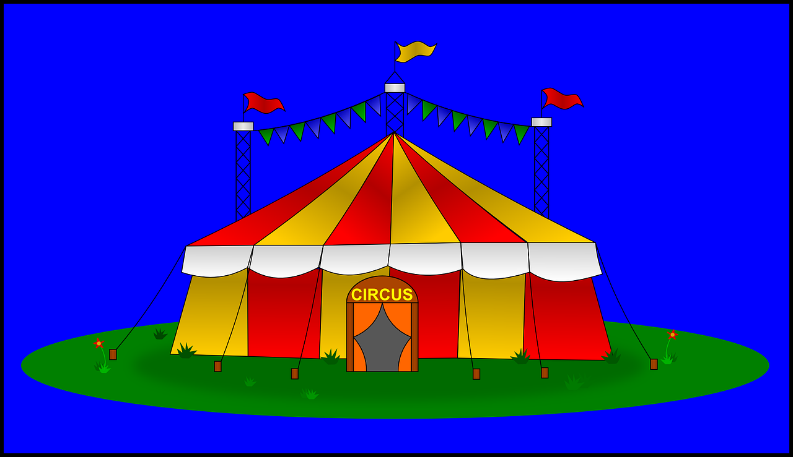
Interrogative Sentences
“
”
Interrogative sentences are those that are asking a question. They end with a question mark.
Examples
Where do you live?
When are we going to see the Circus?
How old are you?
Why were you absent yesterday? What’s your email address?
More Examples
Notes:
Notes for Teacher - < Information for further reference or explanation >
Suggestions: <Ideas/ Images/ Animations / Others – To make better representation of the content >
Source of Multimedia used in this slide - <Please provide source URL where we find the image and the license agreement>
1. Home - https://pixabay.com/vectors/home-house-building-architecture-158089/ (Openclipart-Vectors)
2. Circus - https://pixabay.com/vectors/circus-tent-big-flags-yellow-red-308718/ (Clker-Free-Vector-Images)
3. Conversing Students - https://pixabay.com/vectors/%ee%a4%92-silhouette-university-students-3105485/ (Mohamed Hassan)

Slide 5
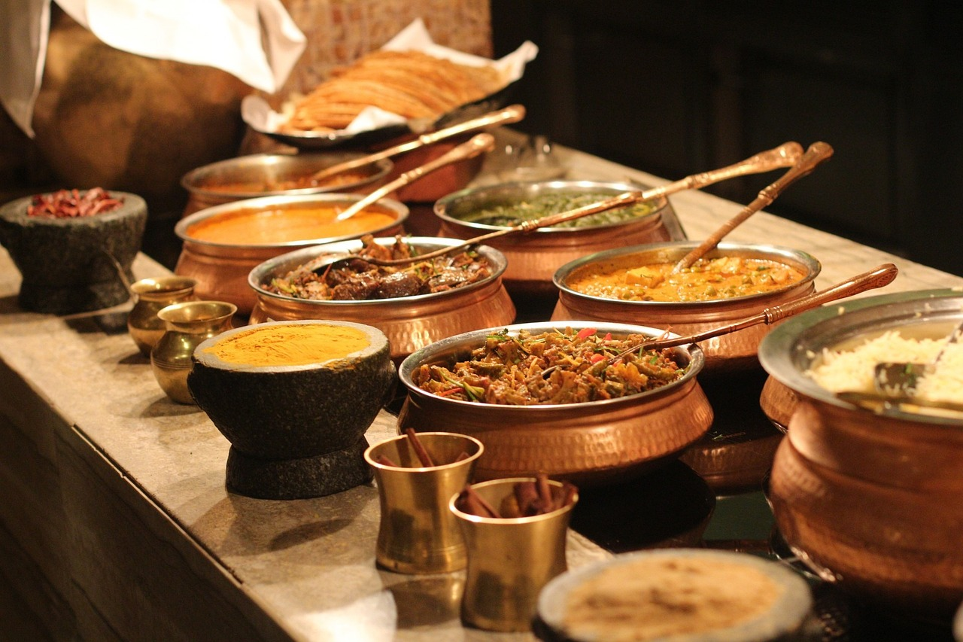
Imperative Sentences
“
”
Imperative sentences are the sentences that include commands. They are used for requests, instructions, or an order.
Examples
Don’t touch my mobile.
Stop the car immediately.
Enjoy this delicious meal.
Notes:
Notes for Teacher - < Information for further reference or explanation >
Suggestions: <Ideas/ Images/ Animations / Others – To make better representation of the content >
Source of Multimedia used in this slide - <Please provide source URL where we find the image and the license agreement>
1. Mobile Phone - https://pixabay.com/vectors/signage-no-mobile-phones-sign-6772538/ (Ezequiel Octaviano)
2. Car - https://pixabay.com/vectors/old-man-drive-vintage-car-car-23793/ (Clker-Free-Vector-Images)

Slide 6
Attribution / Citation
Slide # | Thumbnail | Source link | Author
2 |  | Classroom: https://pixabay.com/photos/school-classroom-teacher-7047287/ Machine: https://pixabay.com/vectors/machine-factory-polishing-rail-30512/ Park: https://pixabay.com/vectors/games-park-child-children-grass-1459575/ | Anilsharma26 Clker-Free-Vector-Images Mote Oo
3 |  | Cricket: https://pixabay.com/photos/cricketer-athlete-cricket-sports-7015983/ Building: https://pixabay.com/vectors/medieval-buildings-architechture-5437870/ Read: https://www.freepik.com/free-vector/hand-drawn-lagom-illustration_34659799.htm | Yogendras31 GDJ freepik
4 |  | House: https://pixabay.com/vectors/home-house-building-architecture-158089/ Circus: https://pixabay.com/vectors/circus-tent-big-flags-yellow-red-308718/ Students: https://pixabay.com/vectors/%ee%a4%92-silhouette-university-students-3105485/ | Openclipart-Vectors Clker-Free-Vector-Images Mohamed Hassan
5 |  | Mobile: https://pixabay.com/vectors/signage-no-mobile-phones-sign-6772538/ Car: https://pixabay.com/vectors/old-man-drive-vintage-car-car-23793/ Food:https://pixabay.com/photos/buffet-indian-food-spices-lunch-315691/ | Ezequiel Octaviano Clker-Free-Vector-Images PublicDomainPictures
COPYRIGHT Cum DISCLAIMER NOTICE
Content owned by Sri Sathya Sai Central Trust, Prashanthi Nilayam, Puttaparthi, Sathya Sai District, Andhra Pradesh, India.
Strictly not for Commercial Use, excluding content that falls in Public Domain or common knowledge facts.
Content can be downloaded and used for personal, educational, informational and other non-commercial purposes, subject to attribution in the name of ‘Sri Sathya Sai Central Trust, Prashanthi Nilayam, Puttaparthi’ only. Any attempt to remove, alter, circumvent, or distort the data that is accessed is illegal and strictly prohibited.
Some of the content is owned by Third Parties and are used in compliance with their licensing conditions. Anyone infringing the Copyright of such Third Parties will be doing so at their own risks and costs.
Notes:
Notes for Teacher - < Information for further reference or explanation >
Suggestions: <Ideas/ Images/ Animations / Others – To make better representation of the content >
Source of Multimedia used in this slide - <Please provide source URL where we find the image and the license agreement>

