Slide 1
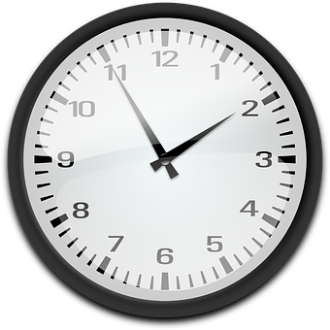
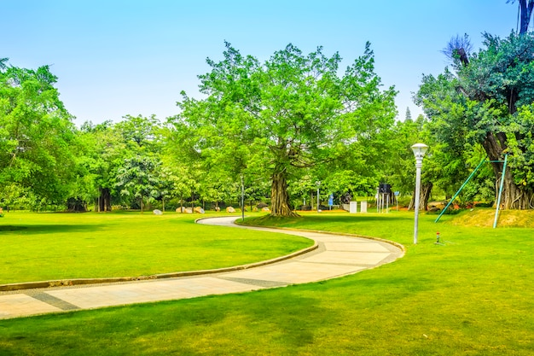
Adverbs – The Enhancers
Notes:
Notes for Teacher - < Information for further reference or explanation >
Suggestions: <Ideas/ Images/ Animations / Others – To make better representation of the content >
Source of Multimedia used in this slide -
Garden: https://www.freepik.com/free-photo/beautiful-park_1278124.htm#query=garden&position=36&from_view=search&track=sph (attribution: 4045)
Clock: https://pixabay.com/vectors/clock-analog-time-watch-147257/ (attribution: openclipart-vectors-27376/)

Slide 2
The Crane and the Crab
Notes:
Notes for Teacher - < Information for further reference or explanation >
Suggestions: <Ideas/ Images/ Animations / Others – To make better representation of the content >
Source of Multimedia used in this slide -
1. https://youtu.be/CUJyPd6lCnk?t=8
2. https://youtu.be/CUJyPd6lCnk?t=74
3. https://youtu.be/CUJyPd6lCnk?t=107
4. https://youtu.be/CUJyPd6lCnk?t=125
5. https://youtu.be/CUJyPd6lCnk?t=130
6. https://youtu.be/CUJyPd6lCnk?t=148
7. https://youtu.be/CUJyPd6lCnk?t=149
8. https://youtu.be/CUJyPd6lCnk?t=157
(1-8 attribution: Anaika Educations)
9. Fish: https://www.freepik.com/free-vector/set-six-fish_2091508.htm#query=fish&position=1&from_view=search&track=sph (attribution: freepik)

Slide 3
The Crane and the Crab
Long ago, a crane lived near a small lake. There were always
plenty of fish and crabs in the lake. The crane never travelled far
to get its food.
Many years passed. The crane had become old and weak. He could not catch any fish nor crab for his daily food. Sometimes, his days
ended without food.
Notes:
Notes for Teacher - < Information for further reference or explanation >
Suggestions: <Ideas/ Images/ Animations / Others – To make better representation of the content >
Source of Multimedia used in this slide - <Please provide source URL where we find the image and the license agreement>

Slide 4
The Crane and the Crab
One day, he thought to himself, “If I do not get fish today, I will die of hunger.” He came up with a brilliant idea. The next day, he stood near the lake and started crying. He told the fish and crabs, “The lake is going to dry up soon. You all have to move to another lake to survive. I can help you all.” The fish immediately agreed. The crane was happy as he knew that his everyday food would be taken care of. He said to the fish, “Oh fish! As I am weak, I can take only a few fish at a time to the new lake.” The fish and the crabs thanked the crane for its generosity.
Notes:
Notes for Teacher - < Information for further reference or explanation >
Suggestions: <Ideas/ Images/ Animations / Others – To make better representation of the content >
Source of Multimedia used in this slide - <Please provide source URL where we find the image and the license agreement>

Slide 5
The Crane and the Crab
Few days later, the crane became strong as he was eating the fish instead of leaving them at the new lake. A crab requested the crane to take him to the new lake too. The crane thought to himself, “I am tired of eating fish daily, crab meat is delicious too.” The crane told the crab to hold his neck tightly while flying. The smart crab noticed that there was no lake nearby. All he could see were the bones of fish lying on the barren land.
Notes:
Notes for Teacher - < Information for further reference or explanation >
Suggestions: <Ideas/ Images/ Animations / Others – To make better representation of the content >
Source of Multimedia used in this slide - <Please provide source URL where we find the image and the license agreement>

Slide 6
The Crane and the Crab
The crab understood what the crane had been doing. He knew that the crane would eat him too like he had eaten the fish earlier. The crab crushed the neck of the crane with his claws and escaped when the crane fell down.
Notes:
Notes for Teacher - < Information for further reference or explanation >
Suggestions: <Ideas/ Images/ Animations / Others – To make better representation of the content >
Source of Multimedia used in this slide - <Please provide source URL where we find the image and the license agreement>

Slide 7
Attribution / Citation
Slide # | Thumbnail | Source link | Author
1 |  | Garden: https://www.freepik.com/free-photo/beautiful-park_1278124.htm#query=garden&position=36&from_view=search&track=sph (attribution: 4045) Clock: https://pixabay.com/vectors/clock-analog-time-watch-147257/ (https://pixabay.com/users/openclipart-vectors-30363/) | 4045 Openclipart-vectors-27376/
2,3,4,5,6 |  | https://youtu.be/CUJyPd6lCnk?t=8 2. https://youtu.be/CUJyPd6lCnk?t=74 3. https://youtu.be/CUJyPd6lCnk?t=107 4. https://youtu.be/CUJyPd6lCnk?t=125 5. https://youtu.be/CUJyPd6lCnk?t=130 6. https://youtu.be/CUJyPd6lCnk?t=148 7. https://youtu.be/CUJyPd6lCnk?t=149 8. https://youtu.be/CUJyPd6lCnk?t=157 9. fish: https://www.freepik.com/free-vector/set-six-fish_2091508.htm#query=fish&position=1&from_view=search&track=sph (attribution: freepik) | Anaika Educations freepik
Notes:
Notes for Teacher - < Information for further reference or explanation >
Suggestions: <Ideas/ Images/ Animations / Others – To make better representation of the content >
Source of Multimedia used in this slide - <Please provide source URL where we find the image and the license agreement>

