Slide 1
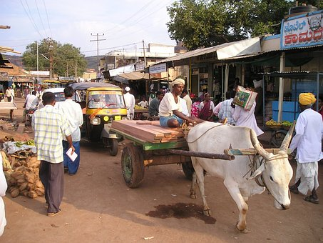
Recalling Adverbs
Notes:
Notes for Teacher - There are 4 parts:
I. Choose the correct adverb.
II. Unscramble the sentences and underline adverbs of time and place.
III. Make sentences using the adverbs.
IV. Underline the adverb and write T for time and P for place.
Suggestions: <Ideas/ Images/ Animations / Others – To make better representation of the content >
Source of Multimedia used in this slide -
Clock: https://pixabay.com/vectors/clock-time-hour-watch-countdown-1300646/ (Attribution: Open Clipart-Vectors)
Place: https://pixabay.com/photos/india-ox-cart-team-of-oxen-dealer-310/ ( Attribution: Simon)

Slide 2
Choose the correct adverb
Choose the correct adverb and fill in the blank
My aunt arrived from London _________. (soon, last week)
last week
I am tired so I am going to sleep_____. (sometimes, early)
early
My father _____ visits my school. (often, just)
often
nearby
Raju decided to visit his grandmother who lives_______. (Jaipur, nearby)
My class went to the zoo _________. (tomorrow, yesterday)
yesterday
Notes:
Notes for Teacher - < Information for further reference or explanation >
Suggestions: <Ideas/ Images/ Animations / Others – To make better representation of the content >
Source of Multimedia used in this slide - <Please provide source URL where we find the image and the license agreement>

Slide 3
Unscramble and underline the adverbs of time and place
Unscramble
a. good marks / I / get / normally / in / the exam
1. I normally get good marks in the exam.
2. Normally, I get good marks in the exam.
b. downstairs / ran / children / to meet / their / grandparents / The
1. The children ran downstairs to meet their grandparents.
c. It / be / holiday / tomorrow / will / a
1. It will be a holiday tomorrow.
d. everywhere / looked / book / They / for / the
1. They looked for the book everywhere.
Notes:
Notes for Teacher - < Information for further reference or explanation >
Suggestions: <Ideas/ Images/ Animations / Others – To make better representation of the content >
Source of Multimedia used in this slide - <Please provide source URL where we find the image and the license agreement>

Slide 4
Identify the Adverbs of Time ‘T’ and Place ‘P’
1
since ‘T’
I haven’t seen my brother since 2020.
2
every month ‘T’
My father goes on business trips every month.
3
near ‘P’
We have a big supermarket near my school.
4
tomorrow ‘T’
Robin is visiting his sister in Delhi tomorrow.
5
soon ‘T’
My uncle is going to buy a new car soon.
Notes:
Notes for Teacher - < Information for further reference or explanation >
Suggestions: <Ideas/ Images/ Animations / Others – To make better representation of the content >
Source of Multimedia used in this slide - <Please provide source URL where we find the image and the license agreement>

Slide 5
Make Sentences
Make sentences using the following adverbs
a. usually b. everywhere c. inside
d. away e. weekly f. later
Notes:
Notes for Teacher - < Information for further reference or explanation >
Suggestions: <Ideas/ Images/ Animations / Others – To make better representation of the content >
Source of Multimedia used in this slide - <Please provide source URL where we find the image and the license agreement>

Slide 6
Attribution / Citation
Slide # | Thumbnail | Source link | Author
1 |  | Clock: https://pixabay.com/vectors/clock-time-hour-watch-countdown-1300646/ (Attribution: Open Clipart-Vectors) Place: https://pixabay.com/photos/india-ox-cart-team-of-oxen-dealer-310/ ( Attribution: Simon) | Open clipart vectors Simon
Notes:
Notes for Teacher - < Information for further reference or explanation >
Suggestions: <Ideas/ Images/ Animations / Others – To make better representation of the content >
Source of Multimedia used in this slide - <Please provide source URL where we find the image and the license agreement>

