Slide 1
Testing Time
Notes:
Notes for Teacher - < Information for further reference or explanation >
Suggestions: <Ideas/ Images/ Animations / Others – To make better representation of the content >
Source of Multimedia used in this slide - <Please provide source URL where we find the image and the license agreement>

Slide 2
Choose the correct option
Choose one option from the box and complete the sentence with or without ‘the’
school grass piano dinner Taj Mahal cockroaches
Many people are afraid of ___________.
cockroaches
b) Don’t sit on ________. It’s wet after the rain.
the grass
c) Radha, do you know how to play ________?
the piano
Notes:
Notes for Teacher - < Information for further reference or explanation >
Suggestions: <Ideas/ Images/ Animations / Others – To make better representation of the content >
Source of Multimedia used in this slide - <Please provide source URL where we find the image and the license agreement>

Slide 3
Choose the correct option
Choose one option from the box and complete the sentence with or without ‘the’
school grass piano dinner Taj Mahal cockroaches
d) We have ______ at 7.30 p.m everyday.
dinner
e) ____________ is in India.
The TajMahal
f) _________ I go to is near my house.
The school
Notes:
Notes for Teacher - < Information for further reference or explanation >
Suggestions: <Ideas/ Images/ Animations / Others – To make better representation of the content >
Source of Multimedia used in this slide - <Please provide source URL where we find the image and the license agreement>

Slide 4
Which is correct?
1
football
My favourite sport is football / the football.
2
The weather
The weather / weather is very hot today.
3
Vegetables
The vegetables / Vegetables are good for health.
4
We had to wait at bus stop / at the bus stop for 2 hours.
at the bus stop
Notes:
Notes for Teacher - < Information for further reference or explanation >
Suggestions: <Ideas/ Images/ Animations / Others – To make better representation of the content >
Source of Multimedia used in this slide - <Please provide source URL where we find the image and the license agreement>

Slide 5
Writing Activity
On the next slide is an image.
Write 5 sentences using the definite article ‘the’ as required.
Notes:
Notes for Teacher - < Information for further reference or explanation >
Suggestions: <Ideas/ Images/ Animations / Others – To make better representation of the content >
Source of Multimedia used in this slide - <Please provide source URL where we find the image and the license agreement>

Slide 6
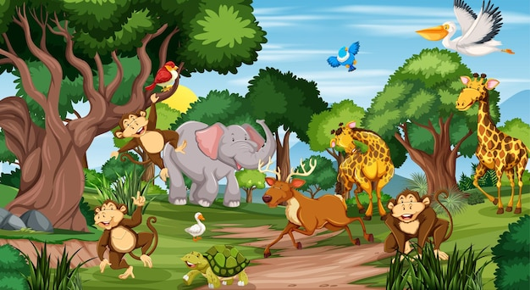
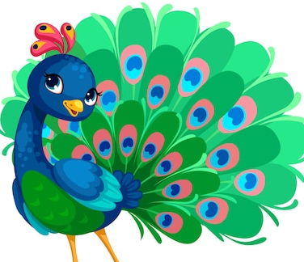
Writing Activity
Notes:
Notes for Teacher – Children maybe asked to write 5 sentences about the image using the definite article ‘the’ appropriately.
Suggestions: <Ideas/ Images/ Animations / Others – To make better representation of the content >
Source of Multimedia used in this slide -
Animals: https://www.freepik.com/free-vector/many-different-animals-forest-scene_12735484.htm#query=animals&position=26&from_view=search&track=sph (Attribution: brgfx)
Peacock: https://www.freepik.com/free-vector/beautiful-peacock-cartoon-outline-drawing-color_7038511.htm#query=animals&position=41&from_view=search&track=sph
(Attribution: user2104819)

Slide 7
Attribution / Citation
Slide # | Thumbnail | Source link | Author
5 |  | Animals: https://www.freepik.com/free-vector/many-different-animals-forest-scene_12735484.htm#query=animals&position=26&from_view=search&track=sph (Attribution: brgfx) Peacock: https://www.freepik.com/free-vector/beautiful-peacock-cartoon-outline-drawing-color_7038511.htm#query=animals&position=41&from_view=search&track=sph (Attribution: user2104819) | Brgfx user2104819
COPYRIGHT Cum DISCLAIMER NOTICE
Content owned by Sri Sathya Sai Central Trust, Prashanthi Nilayam, Puttaparthi, Sathya Sai District, Andhra Pradesh, India.
Strictly not for Commercial Use, excluding content that falls in Public Domain or common knowledge facts.
Content can be downloaded and used for personal, educational, informational and other non-commercial purposes, subject to attribution in the name of ‘Sri Sathya Sai Central Trust, Prashanthi Nilayam, Puttaparthi’ only. Any attempt to remove, alter, circumvent, or distort the data that is accessed is illegal and strictly prohibited.
Some of the content is owned by Third Parties and are used in compliance with their licensing conditions. Anyone infringing the Copyright of such Third Parties will be doing so at their own risks and costs.
Notes:
Notes for Teacher - < Information for further reference or explanation >
Suggestions: <Ideas/ Images/ Animations / Others – To make better representation of the content >
Source of Multimedia used in this slide - <Please provide source URL where we find the image and the license agreement>

