Slide 1
A Letter
Notes:
Notes for Teacher: N/A
Suggestions: N/A
Source of Multimedia used in this slide -
Writing: https://pxhere.com/en/photo/1639699

Slide 2
A Letter
Address: 57, Deshbandhu Society
Patparganj- Delhi 110092
Date: 29th March 2023
Dear Sathya
Hope this letter finds you in the best of health. We are fine here. The weather in Delhi is pleasant now. You should plan a trip to New Delhi to spend a few days with me before your school reopens. We can visit many places like India Gate, Rajghat, Chandini Chowk, Planetarium, The Sansad Bhavan, and many more interesting places. You’ll enjoy the North Indian food of Delhi. We can have a fabulous time together.
The very thought of your coming is so exciting. I have lots of things to tell you. Give my regards to your papa and mamma.
Your loving uncle
Shankar
Notes:
Notes for Teacher - Based on the letter the teacher could ask probing questions to elicit the understanding of the letter and draw their attention to the information and the mood of it.
Suggestions: N/A
Source of Multimedia used in this slide - N/A

Slide 3
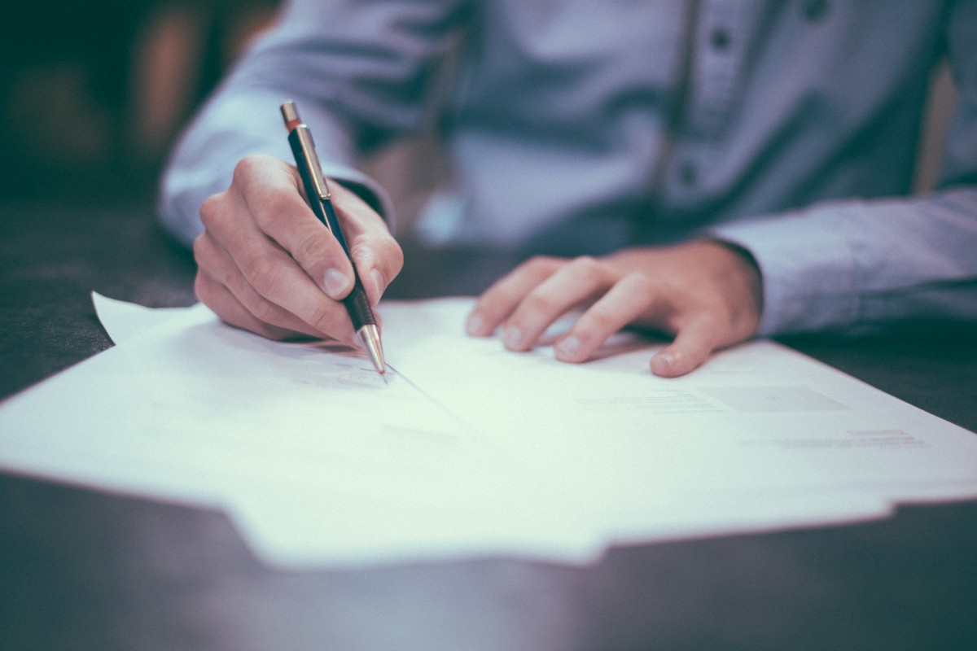
A Letter
Have you seen such writing before? If yes, where?
Yes, our parents/grandparents writing, at home.
Answer
Notes:
Notes for Teacher: N/A
Suggestions: N/A
Source of Multimedia used in this slide -
Writing: https://pxhere.com/en/photo/655321
Finger: PPT Icon

Slide 4
PICTURE QUIZ
A Letter
How is this writing different from other written material that you have come across?
There is greeting and a lot of love and concern shown here. Other writings are very plain.
Answer
Notes:
Notes for Teacher: N/A
Suggestions: N/A
Source of Multimedia used in this slide -
1. Letter writing: https://pixabay.com/illustrations/man-writing-taking-notes-cartoon-6631394/-Elf-Moondance
2. Finger: PPT Icon

Slide 5
Frame the Question
A Letter
What is such writing called?
Letter writing
Answer
Notes:
Notes for Teacher: N/A
Suggestions: N/A
Source of Multimedia used in this slide -
Letter writing: https://pixabay.com/illustrations/man-writing-taking-notes-cartoon-6631394/-Elf-Moondance

Slide 6
Frame the Question
A Letter
Who writes such letters?
Parents, grandparents and elders at home.
Answer
Notes:
Notes for Teacher: N/A
Suggestions: N/A
Source of Multimedia used in this slide -
Letter writing: https://pixabay.com/illustrations/man-writing-taking-notes-cartoon-6631394/-Elf-Moondance

Slide 7
A Letter
Who is writing this letter and to whom?
An uncle is writing to his nephew.
Answer
Notes:
Notes for Teacher: N/A
Suggestions: N/A
Source of Multimedia used in this slide -
Letter writing: https://pixabay.com/illustrations/man-writing-taking-notes-cartoon-6631394/-Elf-Moondance

Slide 8
A Letter
Where is the writer living? How do you know?
The writer is living in Delhi. We can see the address written on top of the letter.
Answer
Notes:
Notes for Teacher: N/A
Suggestions: N/A
Source of Multimedia used in this slide -
Letter writing: https://pixabay.com/illustrations/man-writing-taking-notes-cartoon-6631394/-Elf-Moondance

Slide 9
A Letter
When was the letter written?
On 29th of March 2023
Answer
Notes:
Notes for Teacher: N/A
Suggestions: N/A
Source of Multimedia used in this slide -
Letter writing: https://pixabay.com/illustrations/man-writing-taking-notes-cartoon-6631394/-Elf-Moondance

Slide 10
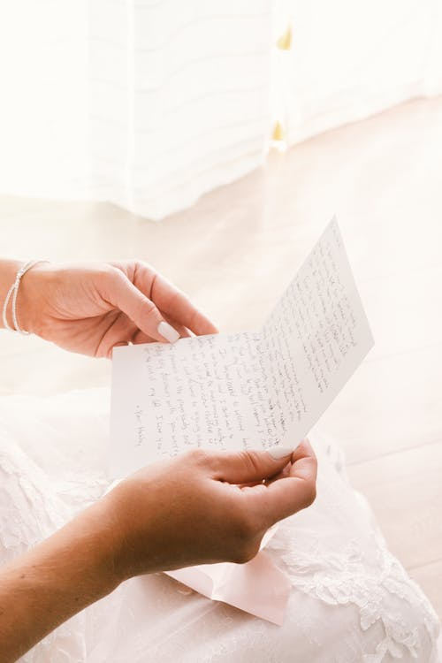
A Letter
Frame the Question
How would you feel if you got a letter like this one? Do you also want to write such a letter to your parents?
Then, let’s write a letter to your parents.
Answer
Notes:
Notes for Teacher: The teacher may then get a little personal and ask the last question that would make them want to send a letter themselves.Thus leading to a hands-on activity of each one writing a letter to their parents.
Suggestions: N/A
Source of Multimedia used in this slide -
Letter: https://www.pexels.com/photo/woman-reading-a-letter-10733404/-Attribute to Miriam Salgado

Slide 11
Attribution / Citation
Slide # | Thumbnail | Source link | Author
1 |  | Writing: https://pxhere.com/en/photo/1639699 | pxhere
2 |  | Writing: https://pxhere.com/en/photo/655321 | pxhere
4,5,6,7,8,9 |  | Letter writing: https://pixabay.com/illustrations/man-writing-taking-notes-cartoon-6631394/ | Elf-Moondance
10 |  | Letter: https://www.pexels.com/photo/woman-reading-a-letter-10733404/ | Miriam Salgado

