Slide 1
Writing an
Informal Letter
Notes:
Notes for Teacher - < Information for further reference or explanation >
Suggestions: <Ideas/ Images/ Animations / Others – To make better representation of the content >
Source of Multimedia used in this slide - <Please provide source URL where we find the image and the license agreement>
<letter> <https://pixabay.com/vectors/envelope-mail-postage-post-office-3172770/>

Slide 2
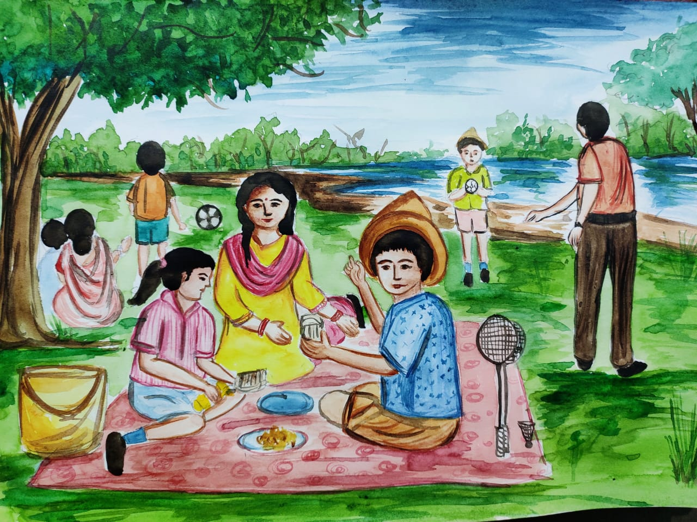
What is an informal letter?
An informal letter is when the letter is written to a family member, a friend or someone who is close, and the content is about sharing wishes, positive thoughts, conveying regards and love.
Notes:
Notes for Teacher - < Information for further reference or explanation >
Suggestions: <Ideas/ Images/ Animations / Others – To make better representation of the content >
Source of Multimedia used in this slide - <Please provide source URL where we find the image and the license agreement>
<Family> <SSSVV-Alpana Samal WhatsApp Image 2021-03-19 at 19 picnic at the lakeside, outdoor picnic, family time>

Slide 3
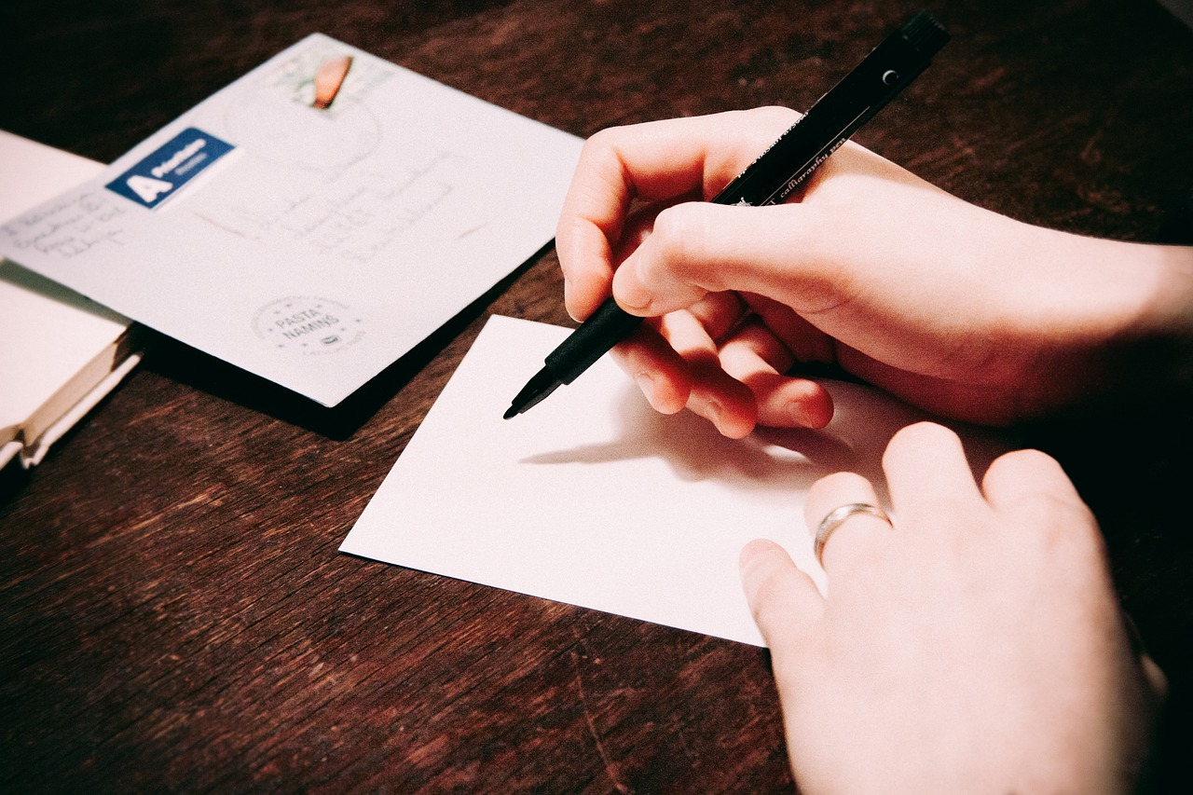
Steps to write an informal letter.
_______________
_______________
Sender’s address (1)
_______________
Date (2)
Dear _________
Salutation/Greeting (3)
__________________
__________________
__________________
Body of the letter (4)
_________
Conclusion (5)
Yours lovingly _________
Complimentary close (6)
Notes:
Notes for Teacher - < Information for further reference or explanation >
Suggestions: <Ideas/ Images/ Animations / Others – To make better representation of the content >
Source of Multimedia used in this slide - <Please provide source URL where we find the image and the license agreement>
<letter writing> <https://pixabay.com/photos/writing-postcard-letter-pen-hands-923404/>

Slide 4
Example of an informal letter
Sender’s address -
11, Gulmohar Marg, New Delhi.
Date -
20/06/2023
Salutation -
Dear Pari
Body of the letter -
How are you doing? I am writing to let you know that I shall be coming to Pune to see you on the 30th of June.
Conclusion -
I am so happy that I will be meeting you soon.
Complimentary close -
Your loving aunt
Ramya
Notes:
Notes for Teacher - < Information for further reference or explanation >
Suggestions: <Ideas/ Images/ Animations / Others – To make better representation of the content >
Source of Multimedia used in this slide - <Please provide source URL where we find the image and the license agreement>
<Family> <SSSVV-Alpana Samal WhatsApp Image 2021-03-19 at 19 picnic at the lakeside, outdoor picnic, family time>

Slide 5
Attribution / Citation
Slide # | Thumbnail | Source link | Author
1 |  | <letter> <https://pixabay.com/vectors/envelope-mail-postage-post-office-3172770/> | bytrangle
3 |  | <letter writing> <https://pixabay.com/photos/writing-postcard-letter-pen-hands-923404/> | stocksnap
Notes:
Notes for Teacher - < Information for further reference or explanation >
Suggestions: <Ideas/ Images/ Animations / Others – To make better representation of the content >
Source of Multimedia used in this slide - <Please provide source URL where we find the image and the license agreement>

