Slide 1
Get Imaginative Prepositional Phrases
Notes:
Notes for Teacher: Teacher may use the attached PPT and tell the students that there could be a possibility of life on another planet, other than the Earth and thus enhance their understanding of the universe.
Before showing the PPT, the teacher may begin the class by asking the students questions related to space and then provide more interesting facts about it.
Why is life possible only on the Earth?
Life is possible only on the Earth because this planet has water on its surface and oxygen gas in its air. It has a perfect range of temperatures for life.
Suggestions: <Ideas/ Images/ Animations / Others – To make better representation of the content >
Source of Multimedia used in this slide - <Please provide source URL where we find the image and the license agreement>

Slide 2
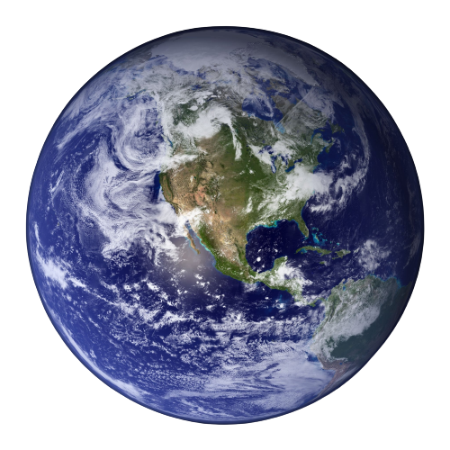
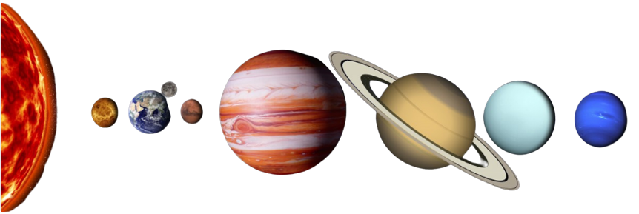
Life on another planet
Is there life on other planets?
This is a really interesting question that the scientists have been trying to understand, explore, and figure out for a long time.
Additionally, orbiters (spacecrafts) have been equipped with cameras to take pictures of the whole surface of Mars.
We have not yet discovered life on any other planet.
Notes:
Notes for Teacher - The teacher may also point to the words in bold font and show them how prepositional phrases can be used to write about man’s efforts to explore space.
Suggestions: <Ideas/ Images/ Animations / Others – To make better representation of the content >
Source of Multimedia used in this slide - <Please provide source URL where we find the image and the license agreement>

Slide 3
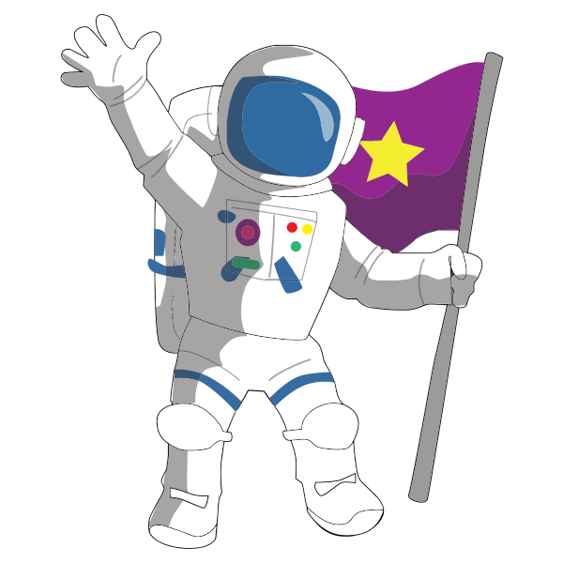
Life on another planet
The only promising planet to look for life is Mars. In the outer solar system, there are moons of other planets as well.
They may have oceans which could make them livable.
This creates more excitement about how many different conditions could exist for life to be found there.
Notes:
Notes for Teacher - The teacher may also point to the words in bold font and show them how prepositional phrases can be used to write about man’s efforts to explore space.
Suggestions: <Ideas/ Images/ Animations / Others – To make better representation of the content >
Source of Multimedia used in this slide - <Please provide source URL where we find the image and the license agreement>

Slide 4
Attribution / Citation
Slide # | Thumbnail | Source link | Author
1 |  | https://www.pxfuel.com/en/free-photo-jrgja | pxfuel.com
2,3 |  | https://www.pexels.com/photo/planet-earth-87651 | pixabay.com
2,3 |  | https://openclipart.org/detail/261323/cartoon-moon-rocket-remix-2 | By Rygle on Wikimedia commons
2,3 |  | https://pxhere.com/en/photo/1461021?utm_content=shareClip&utm_medium=referral&utm_source=pxhere | Image by Pxhere
3 |  | https://freesvg.org/cartoon-astronaut-1573988783 | Image by FreeSvg
2 |  | https://www.rawpixel.com/image/8717955/photo-image-space-planet-public-domain | rawpixel.com
2 |  | https://flickr.com/photos/106368363@N02/51625263331 | Felton Davis
3
Notes:
Notes for Teacher - < Information for further reference or explanation >
Suggestions: <Ideas/ Images/ Animations / Others – To make better representation of the content >
Source of Multimedia used in this slide - <Please provide source URL where we find the image and the license agreement>

