Slide 1
“
Understanding
Prepositional Phrases
”
Notes:
Notes for Teacher - < Information for further reference or explanation >
Suggestions: <Ideas/ Images/ Animations / Others – To make better representation of the content >
Source of Multimedia used in this slide - <Please provide source URL where we find the image and the license agreement>

Slide 2
Prepositional Phrase
“
”
Prepositional Phrase consists of
Preposition
Object
Modifier
Prepositional phrases begin with a preposition, for eg. by the seaside, up the tree.
A prepositional phrase cannot stand on its own.
It is always a part of a sentence.
Few Other Examples:
The squirrel climbed up the tree.
The car went down the hill.
Preposition | Object | Modifier
by | seaside | the
up | tree | the
down | hill | the
Notes:
Notes for Teacher –
The teacher could begin the class with a detailed explanation of prepositions and phrases with pictures. She may write a few sentences on the blackboard as given below:-
He sat on the chair.
The book belongs to Deepa.
They were sitting by the tree.
There is some milk in the fridge.
In the above sentences, on, to, by and in, are prepositions that show the relationship between two parts of a sentence. They tell us about a noun’s place, time, direction or connection to an idea.
There is a new girl in the class.
The dustbin is outside the classroom.
He sat under a mango tree
Sita climbed up the hill.
Look at the underlined group of words e.g., in the class, outside the classroom, under a mango tree, up the hill, these are called prepositional phrases.
Suggestions: <Ideas/ Images/ Animations / Others – To make better representation of the content >
Source of Multimedia used in this slide - <Please provide source URL where we find the image and the license agreement>

Slide 3
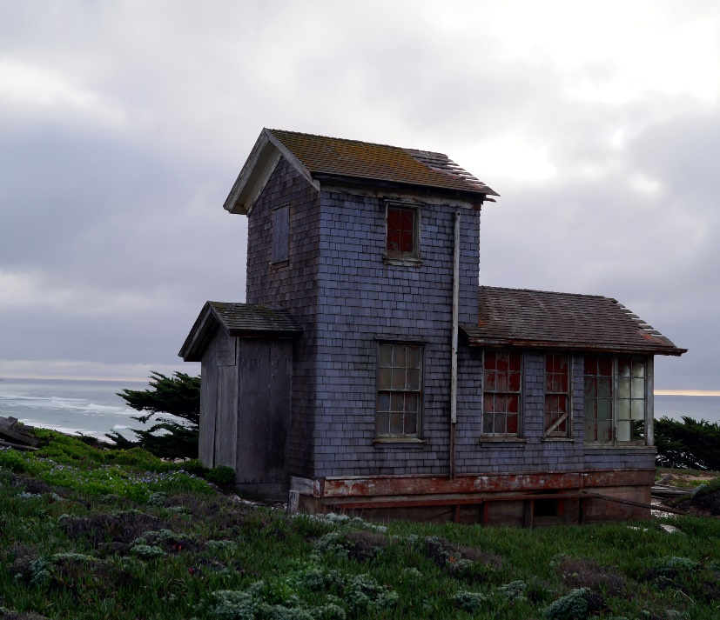
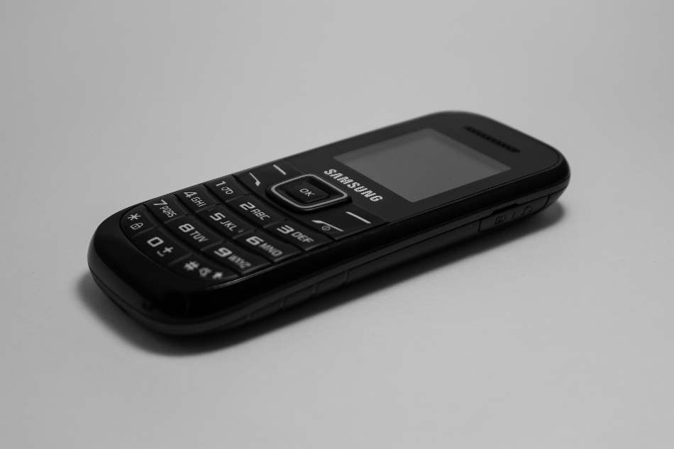
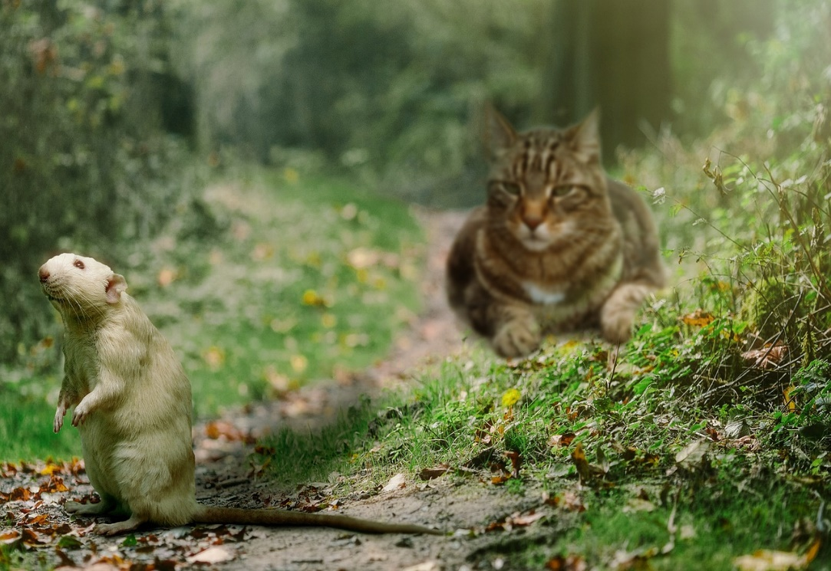
Positioning Of Prepositional Phrases: End
“
”
A prepositional phrase can be placed at the end of a sentence.
Few Examples:
My grandmother’s cottage is by the seaside.
This mobile is out of date.
The cat ran behind the mouse.
She climbed up the hill.
Notes:
Notes for Teacher - < Information for further reference or explanation >
Suggestions: <Ideas/ Images/ Animations / Others – To make better representation of the content >
Source of Multimedia used in this slide - <Please provide source URL where we find the image and the license agreement>
Cottage - https://pxhere.com/en/photo/593497 (Pxhere)
Phone - https://pxhere.com/en/photo/779069 (Pxhere)
Cat - https://pixabay.com/photos/cat-rat-hunt-forest-animals-fun-1177483/ (Sponchia)
Mountaineer - https://pxhere.com/en/photo/1434847 (Mohamed Hassan)

Slide 4
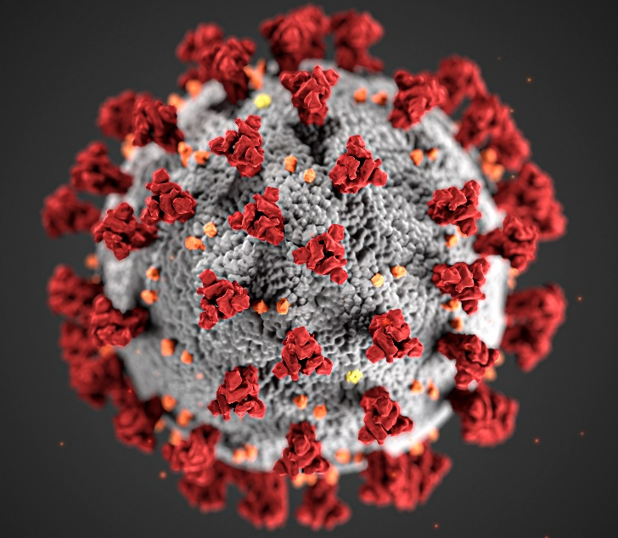
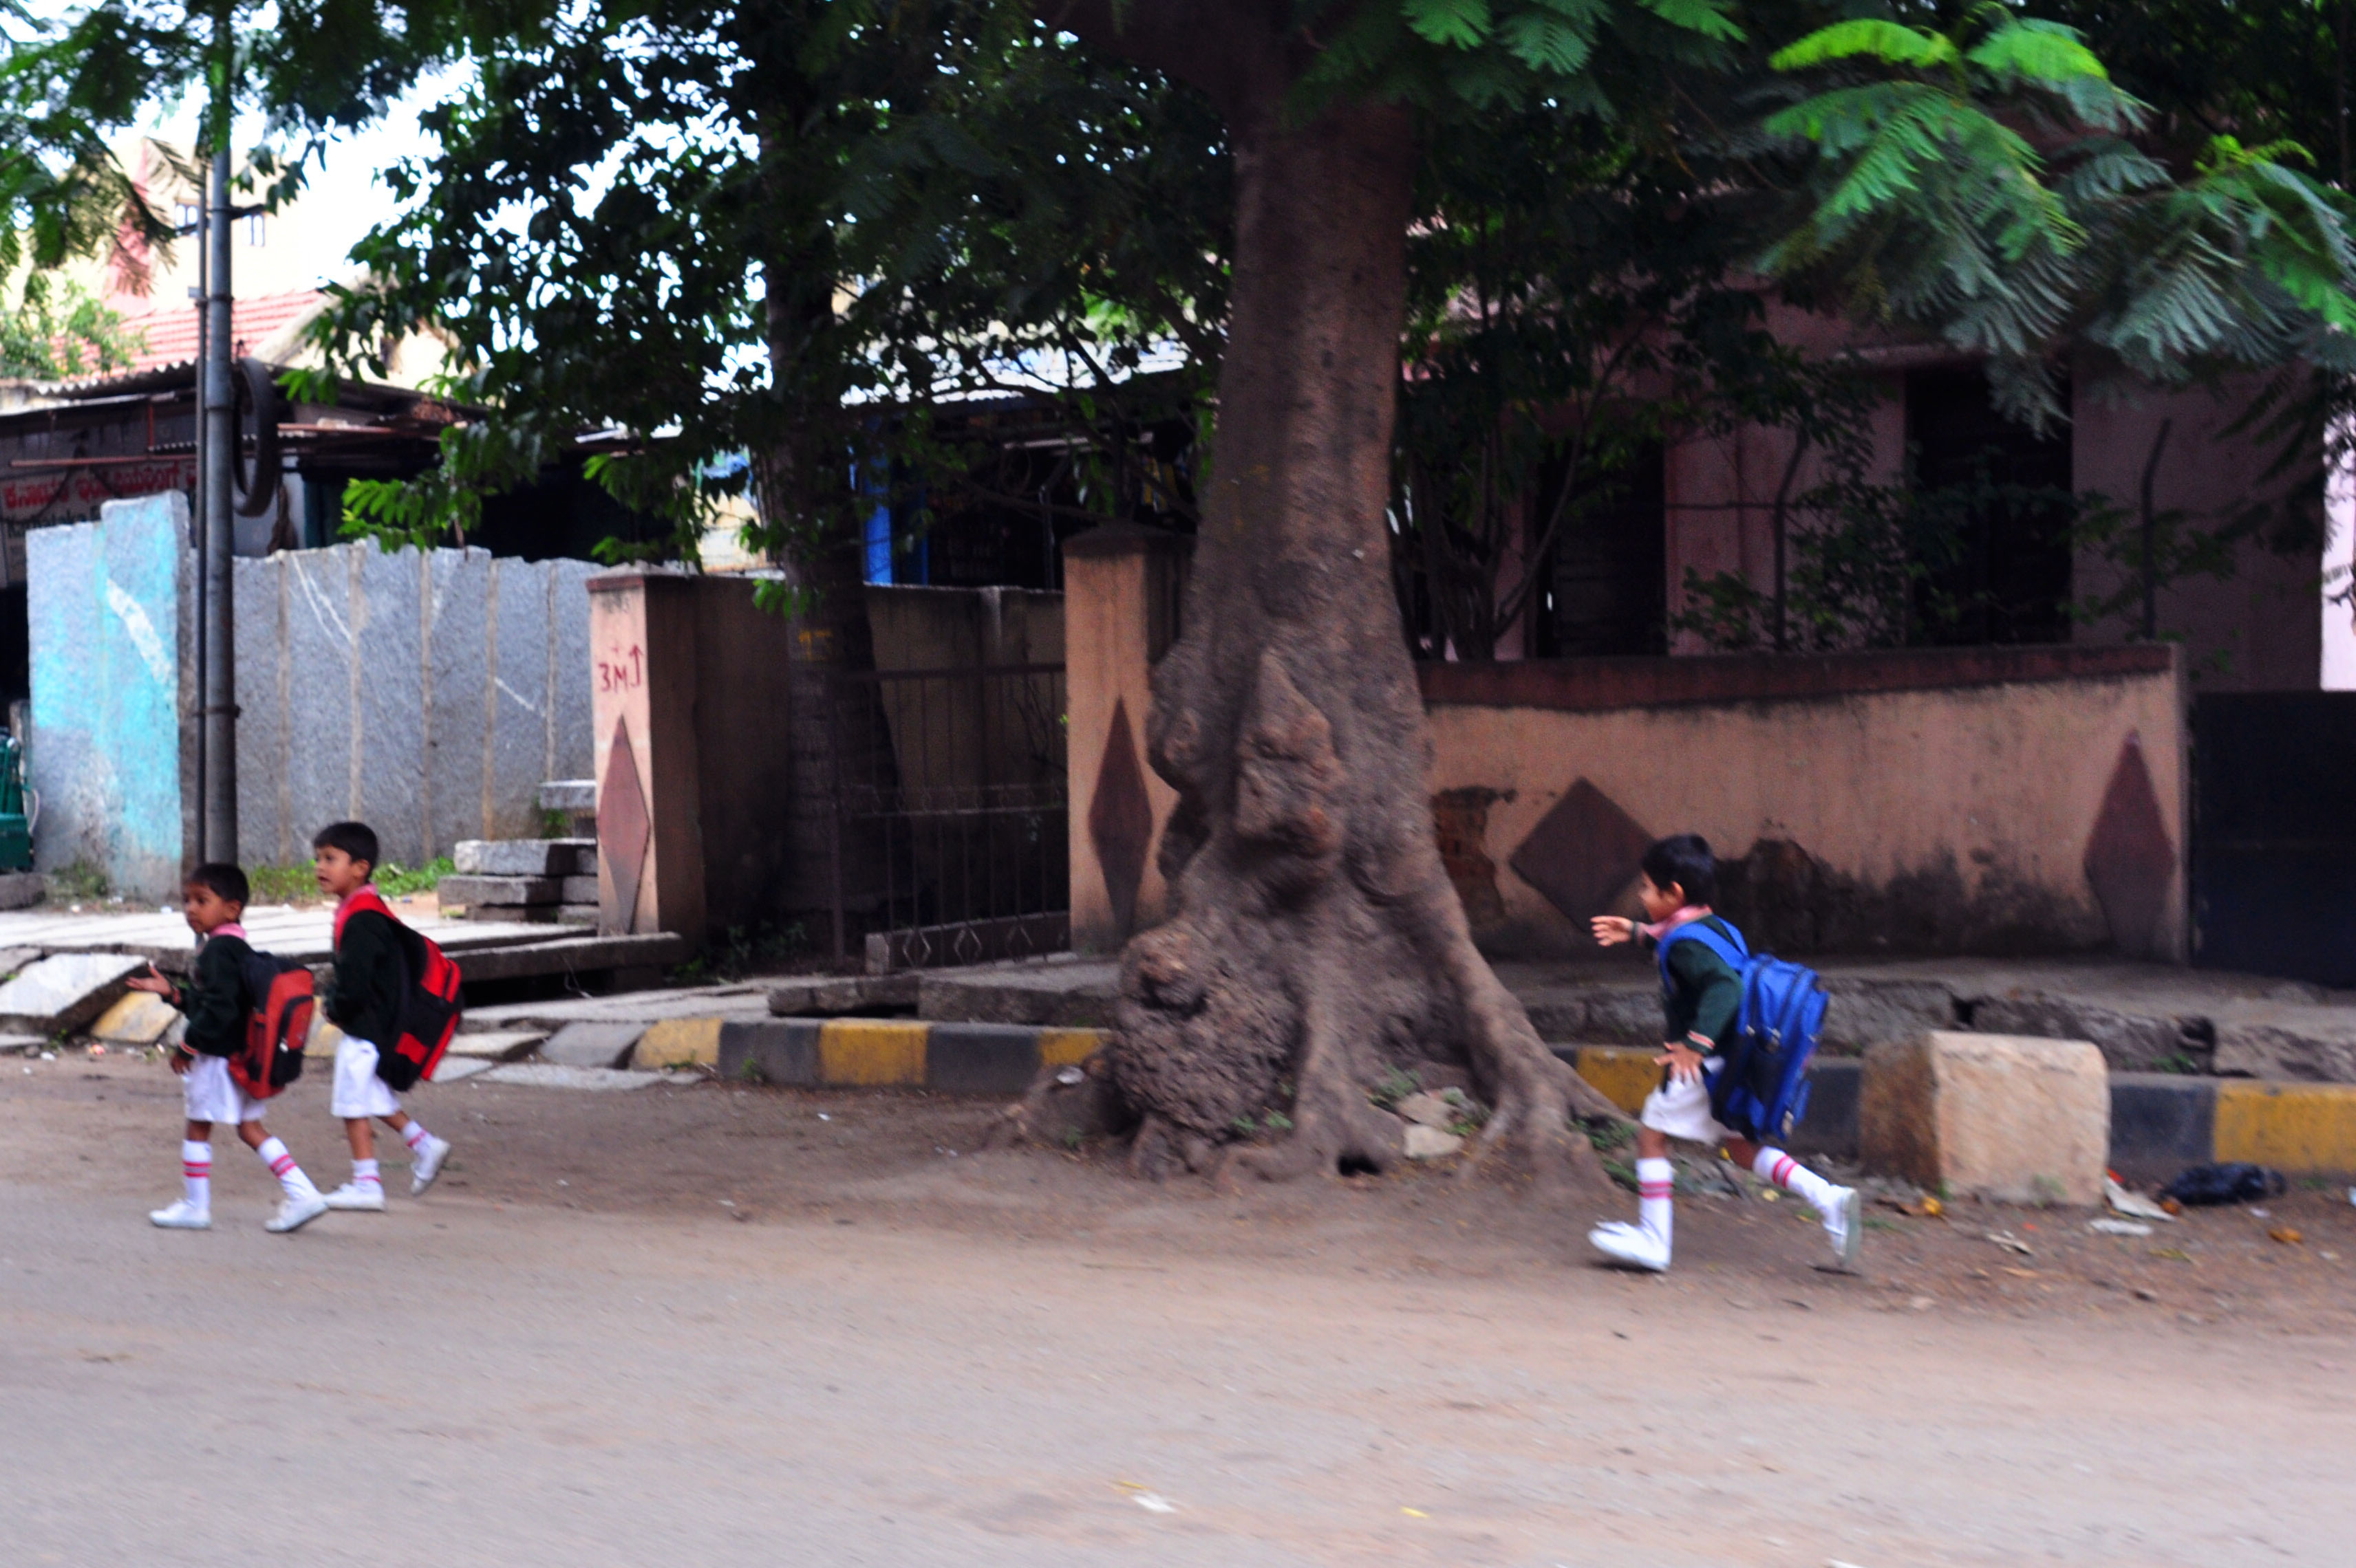
Positioning Of Prepositional Phrases: Beginning
“
”
A prepositional phrase can be placed at the beginning of a sentence.
Few Examples:
During Corona many people lost their jobs.
Without warning, he suddenly ran across the road.
At the beginning of the program the principal addressed the gathering.
By sheer luck, I won the prize.
Notes:
Notes for Teacher - < Information for further reference or explanation >
Suggestions: <Ideas/ Images/ Animations / Others – To make better representation of the content >
Source of Multimedia used in this slide - <Please provide source URL where we find the image and the license agreement>
Corona - https://pxhere.com/en/photo/1608796 (Tmaximumge)
Road Cross - https://www.flickr.com/photos/45651718@N08/5925966213
Gathering - https://www.flickr.com/photos/29780116@N03/31026575152
Prize - https://pxhere.com/en/photo/1584865 (Mohamed Hassan)

Slide 5
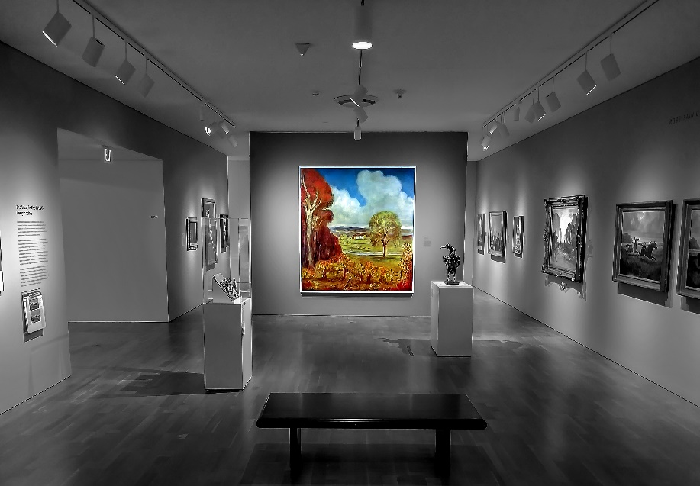
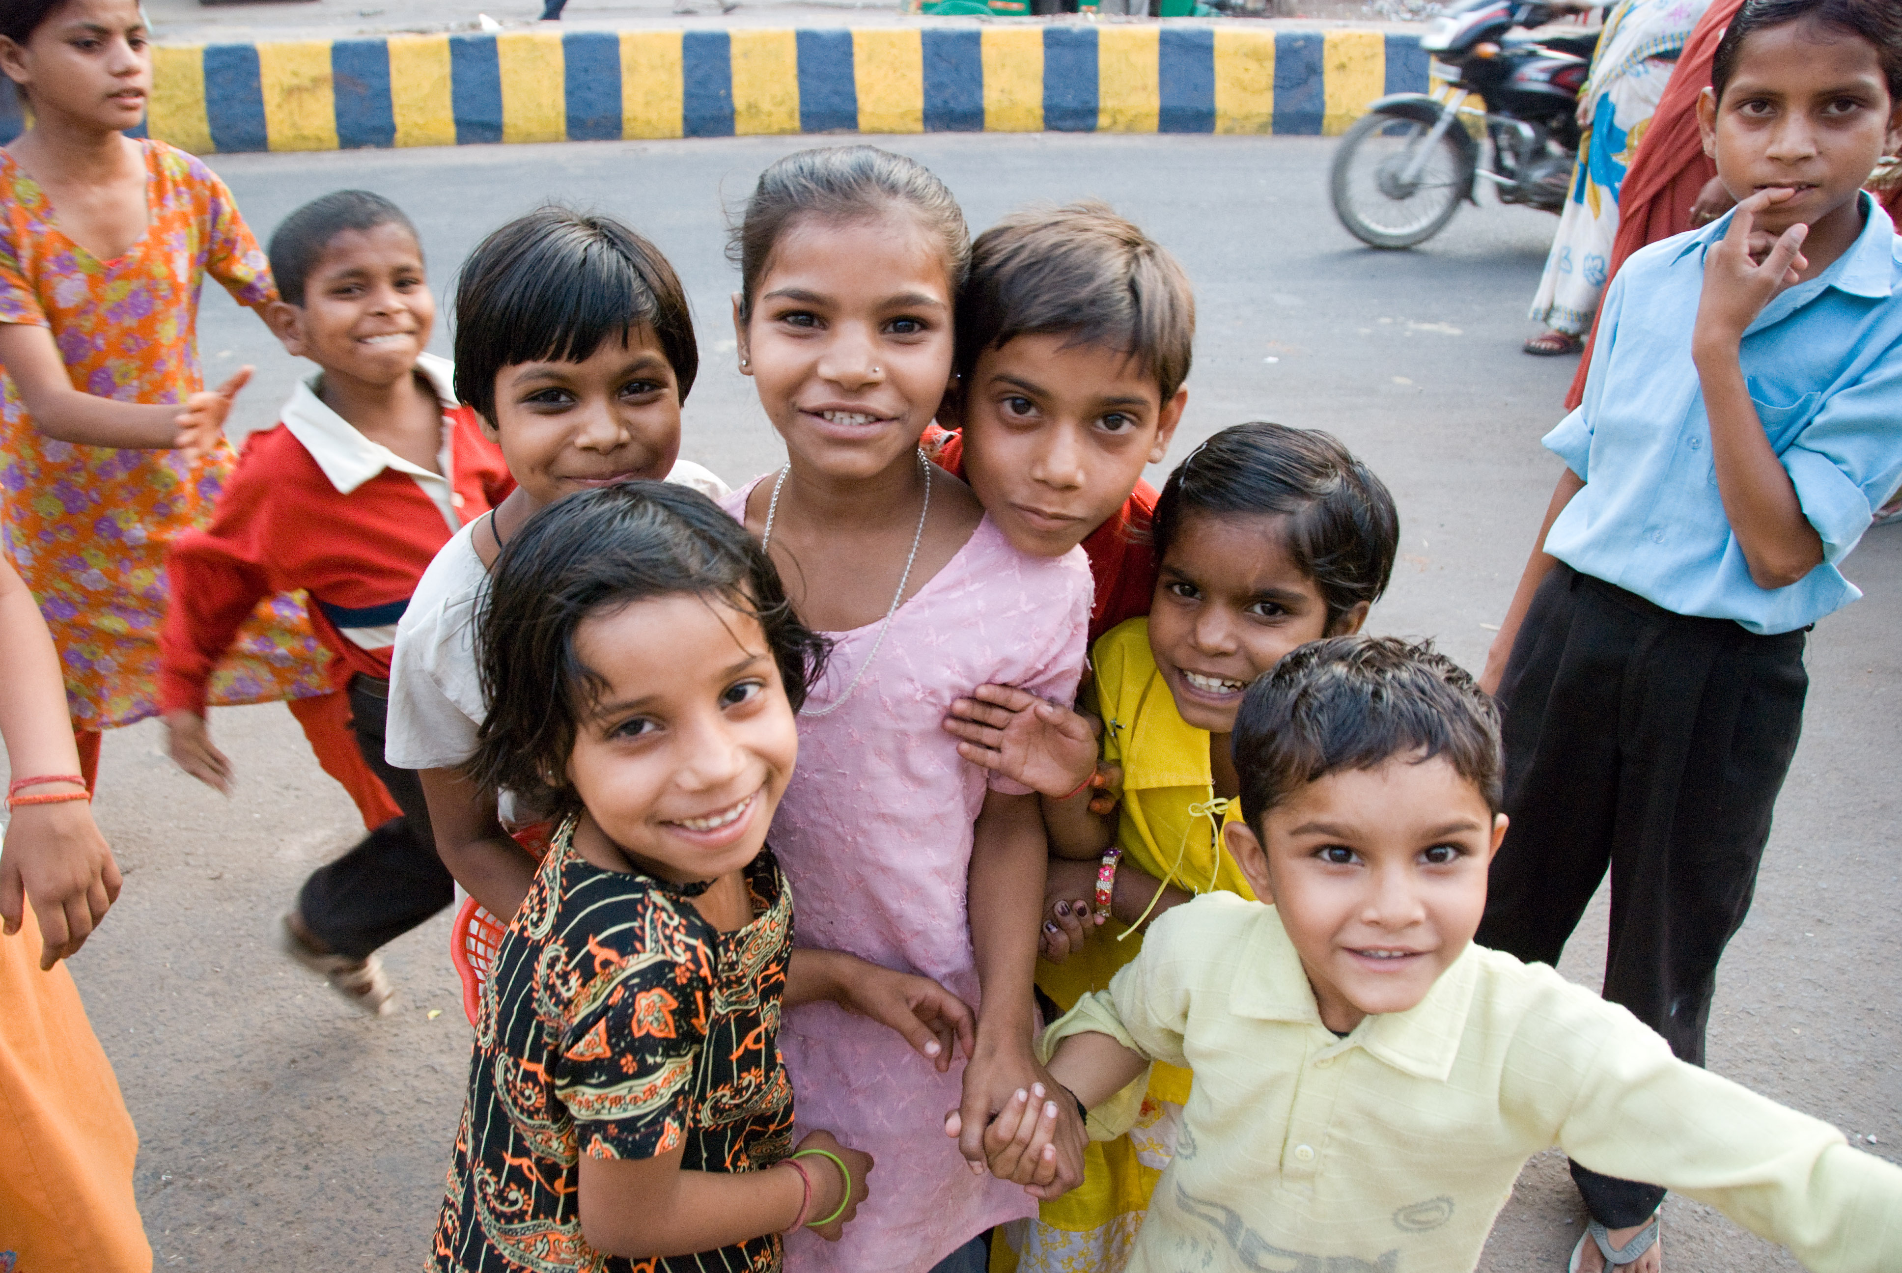
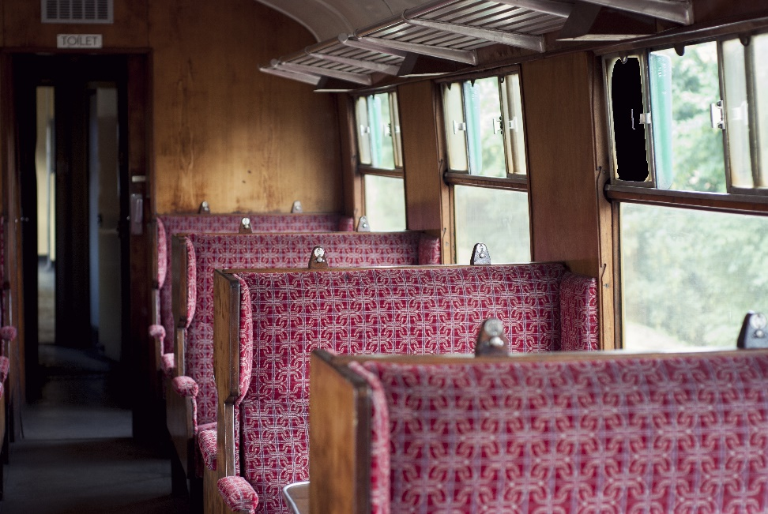
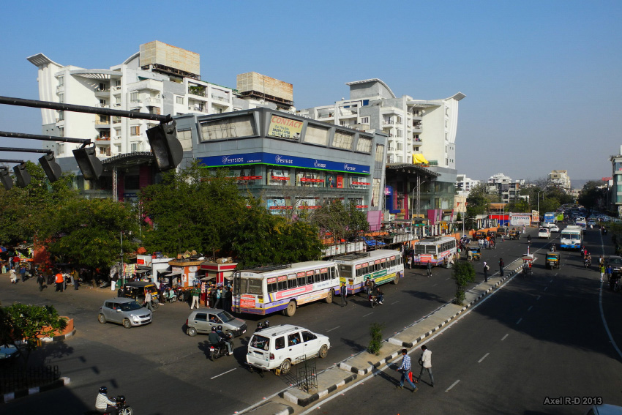
Positioning Of Prepositional Phrases: Middle
“
”
A prepositional phrase can be placed in the middle of a sentence.
Few Examples:
The paintings are on show till September.
The child in the middle is the cutest of all.
I would like a seat next to the window, please.
The shops are within walking distance.
Notes:
Notes for Teacher - < Information for further reference or explanation >
Suggestions: <Ideas/ Images/ Animations / Others – To make better representation of the content >
Source of Multimedia used in this slide - <Please provide source URL where we find the image and the license agreement>
Paintings - https://pxhere.com/en/photo/1587287 (Pxhere)
Children - https://www.flickr.com/photos/7309868@N06/2529443716
Window Seat - https://pxhere.com/en/photo/1173587 (Pxhere)
Shops - https://www.flickr.com/photos/8250978@N04/9210796297

Slide 6
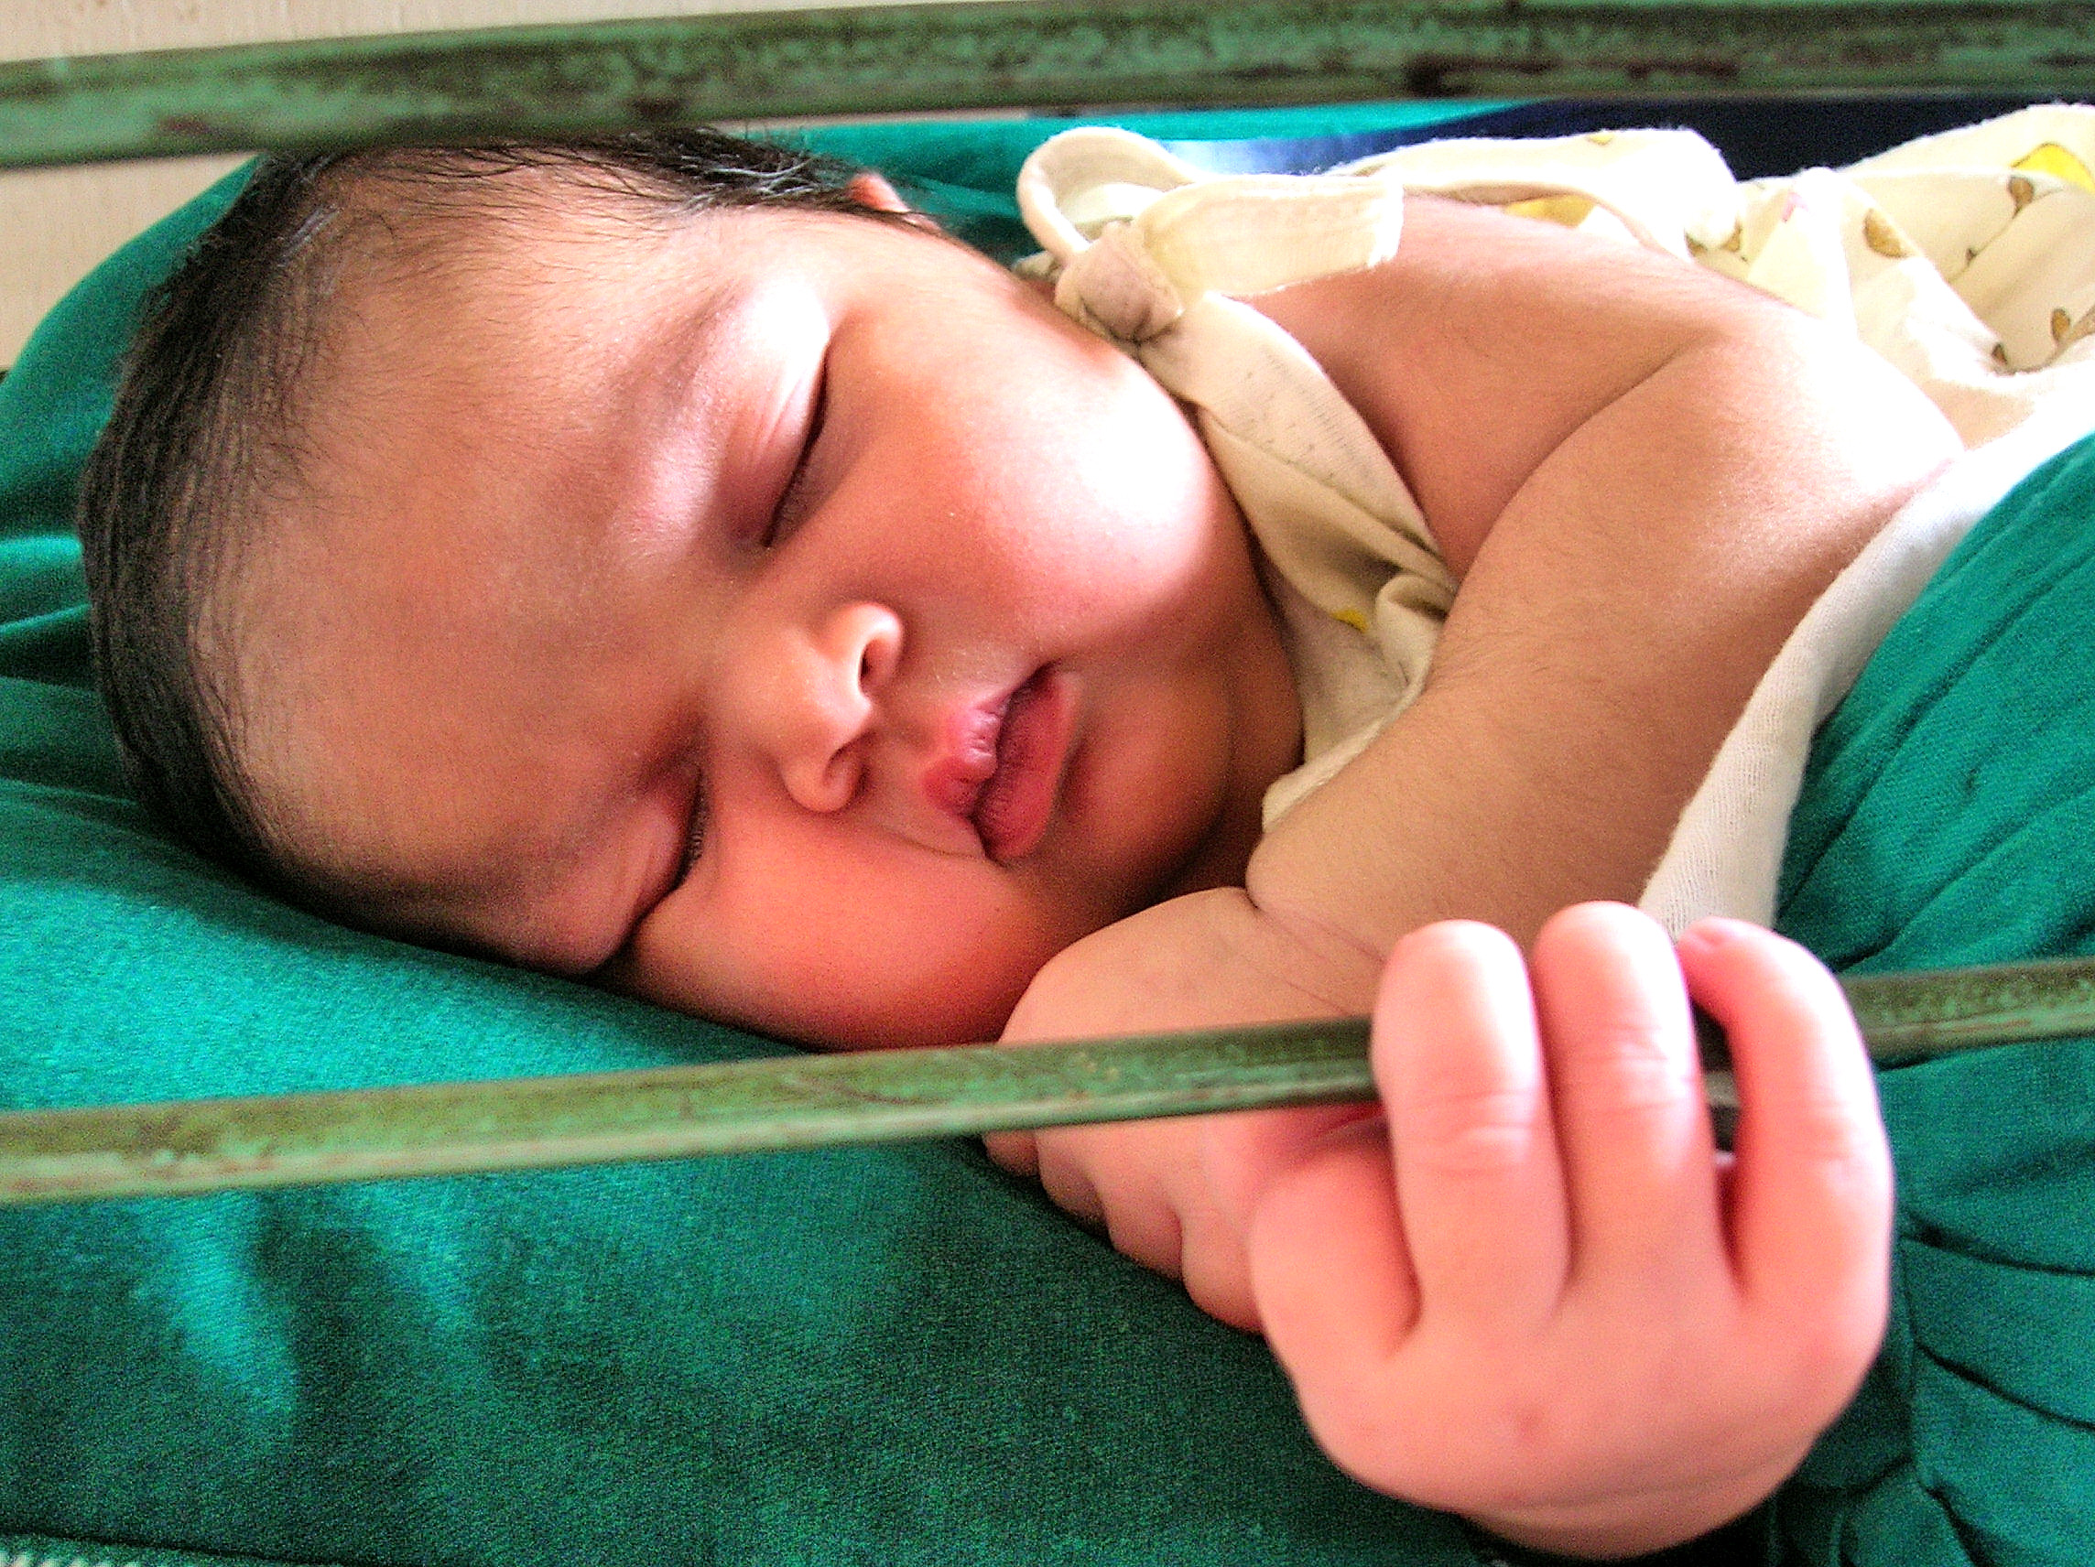
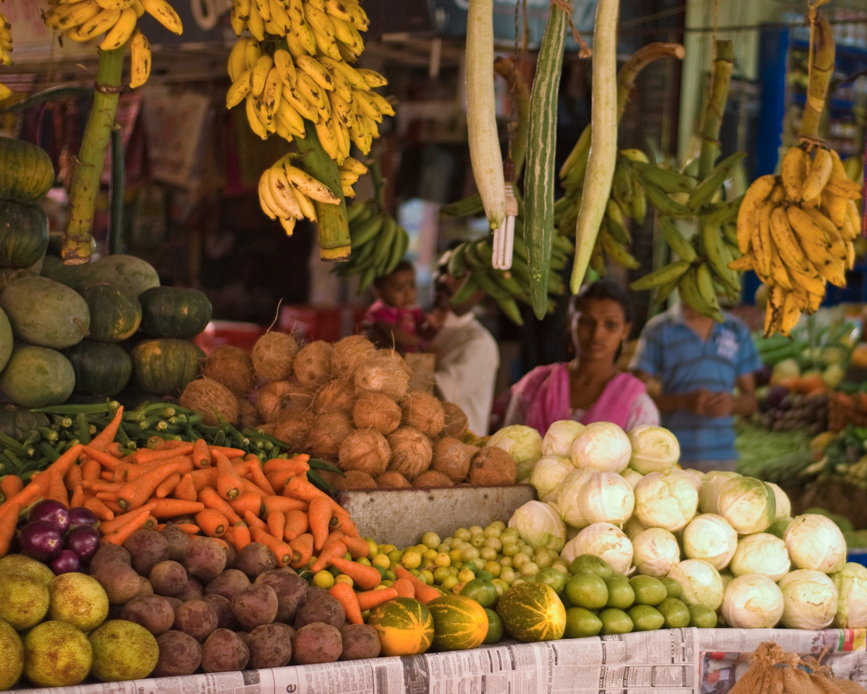
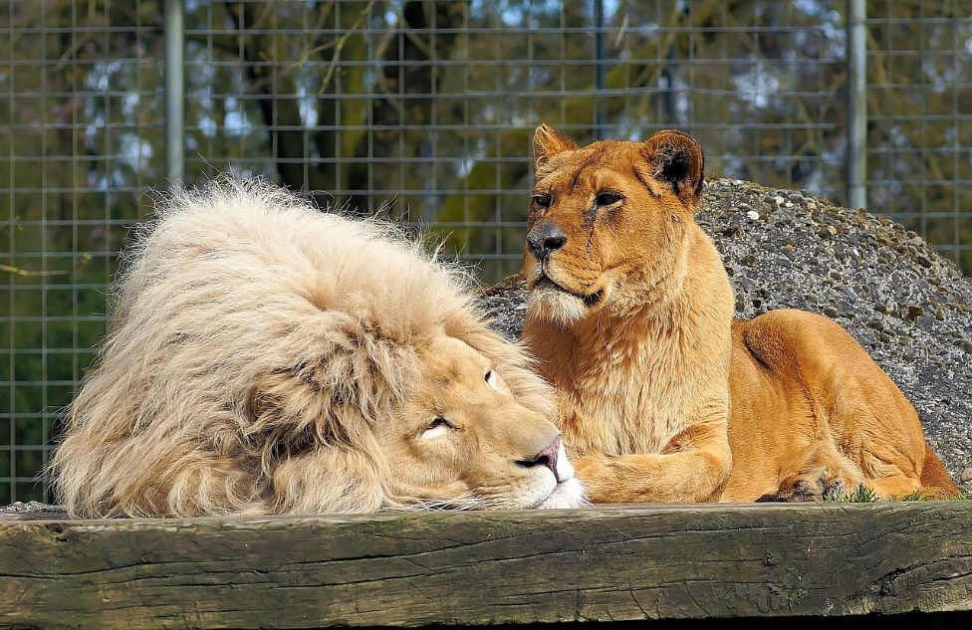
3 Types: Prepositional Phrases as Adjectives
“
”
A prepositional phrase that modifies a noun and acts as an adjective.
Few Examples:
The baby in the crib is very happy
The man at the park was selling ice creams.
The shop behind my house sells vegetables too.
I am going to the zoo with my friend.
Notes:
Notes for Teacher - < Information for further reference or explanation >
Suggestions: <Ideas/ Images/ Animations / Others – To make better representation of the content >
Source of Multimedia used in this slide - <Please provide source URL where we find the image and the license agreement>
Baby - https://www.flickr.com/photos/22853208@N05/3807924947
Ice Cream Vendor - https://pxhere.com/en/photo/1589375 (Mohamed Hassan)
Vegetables -https://www.flickr.com/photos/66866787@N00/5296012908
Lions - https://pixabay.com/photos/lion-lioness-big-cats-wildlife-zoo-712296/ (Kapa65)

Slide 7
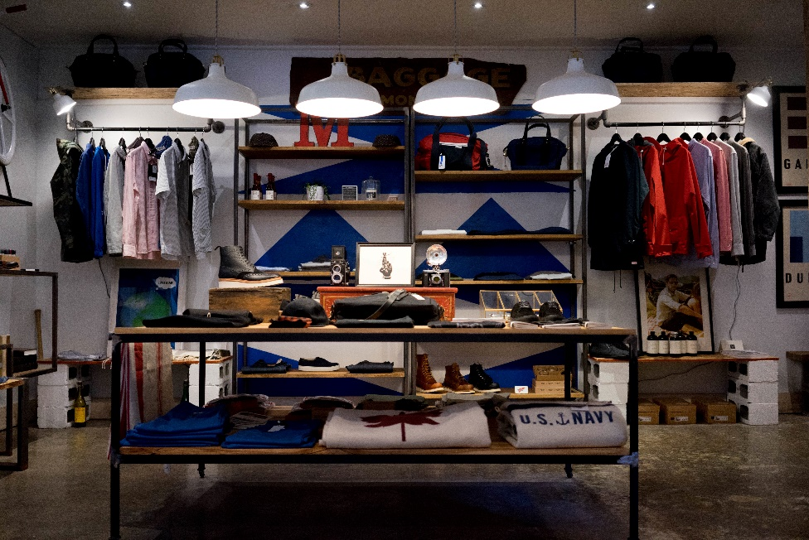
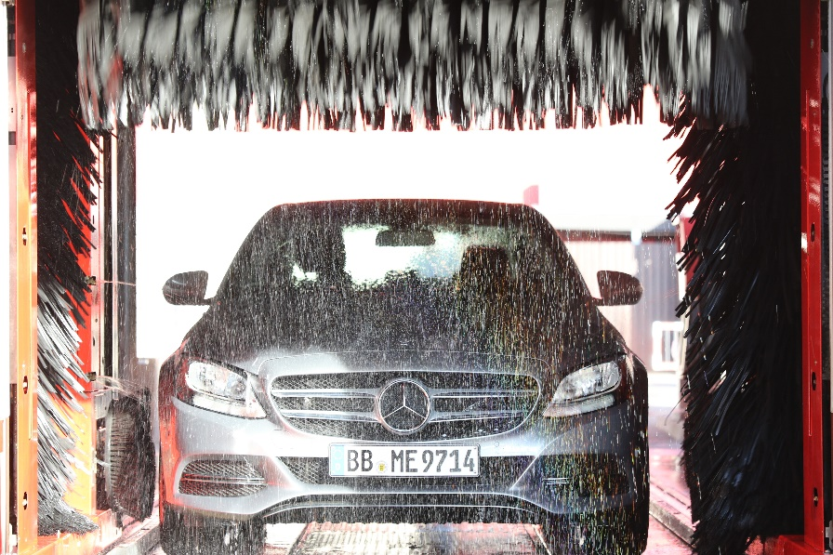
3 Types: Prepositional Phrases as Adverbs
“
”
A prepositional phrase that modifies a verb or acts as an adverb.
Few Examples:
Sita went to the store.
My dad took his car for servicing.
My sister hid behind the bush.
I will be there in a minute.
Notes:
Notes for Teacher - < Information for further reference or explanation >
Suggestions: <Ideas/ Images/ Animations / Others – To make better representation of the content >
Source of Multimedia used in this slide - <Please provide source URL where we find the image and the license agreement>
Store - https://pxhere.com/en/photo/111226 (Pxhere)
Car Servicing - https://pxhere.com/en/photo/619631 (Pxhere)
Hide and Seek - https://www.freepik.com/free-vector/detective-wearing-brown-overcoat-bushes_25673932.htm
Time - https://pxhere.com/en/photo/340692 (Pxhere)

Slide 8
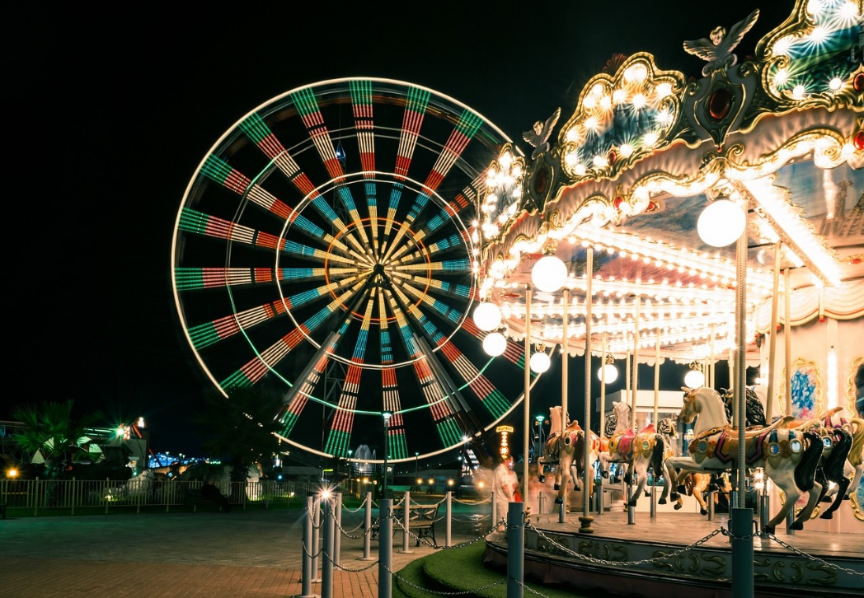
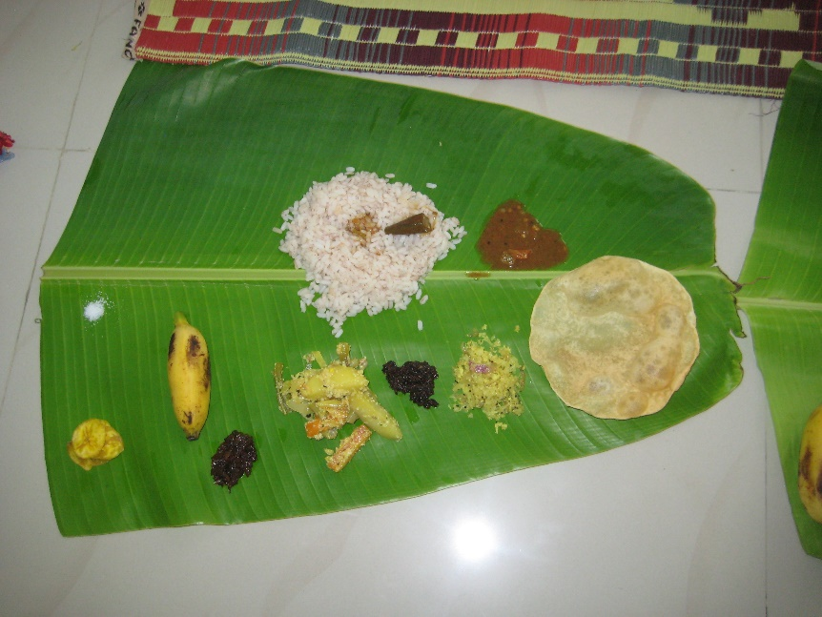
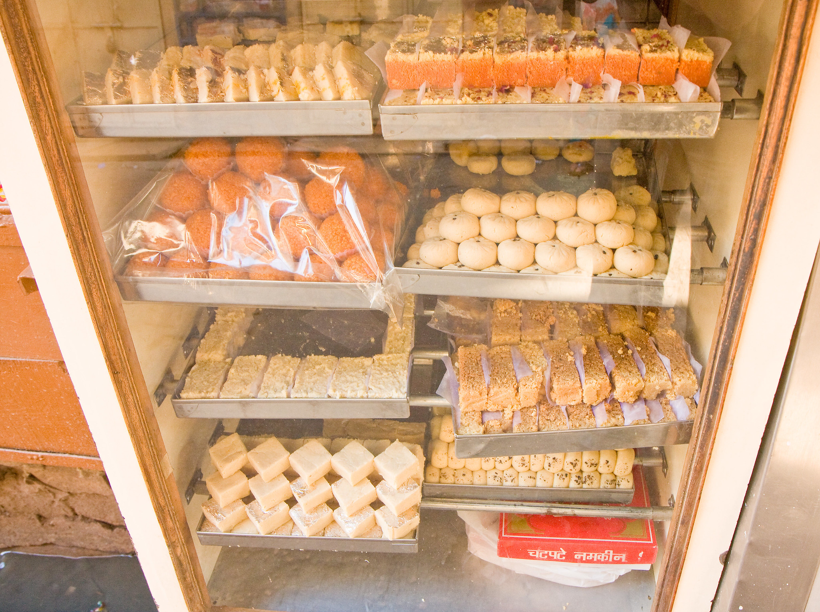
3 Types: Prepositional Phrase as a Noun
“
”
A prepositional phrase sometimes acts as a noun.
Few Examples:
In front of the school is a beautiful park.
After the program, it would be time for dinner.
During the monsoon, I like to make paper boats.
Across the road is the new sweet shop.
Notes:
Notes for Teacher - < Information for further reference or explanation >
Suggestions: <Ideas/ Images/ Animations / Others – To make better representation of the content >
Source of Multimedia used in this slide - <Please provide source URL where we find the image and the license agreement>
Amusement Park - https://pixabay.com/photos/carnival-carousel-ferris-wheel-1492099/ (Harut Movsisyan)
Meal - https://pxhere.com/en/photo/997566 (Pxhere)
Paper Boats - https://pxhere.com/en/photo/916336 (Pxhere)
Sweet Shop - https://www.flickr.com/photos/37601286@N06/6737382603

Slide 9
Examples Of Prepositional Phrases
“
”
Some words that could start a prepositional phrase are:
Below | Above | Under | Behind | Beside | In front of | Toward | During | Between
For | From | In | On | To | By | Out | Over | Upon
Beyond | After | Across | Through | With | Inside | Into | Down | Through
Of | Within | Without | Near | Outside | Since | Amidst | Around | During
Before | Off | Instead of | Ago | Next | Till | Except for | Amongst | Next to
Notes:
Notes for Teacher - < Information for further reference or explanation >
Suggestions: <Ideas/ Images/ Animations / Others – To make better representation of the content >
Source of Multimedia used in this slide - <Please provide source URL where we find the image and the license agreement>

Slide 10
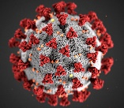
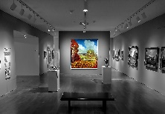
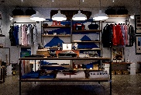
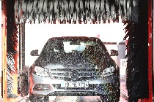
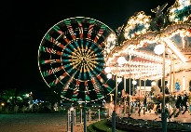
Attribution / Citation
Slide # | Thumbnail | Source link | Author
3 |  | House: https://pxhere.com/en/photo/593497 Phone: https://pxhere.com/en/photo/779069 Cat: https://pixabay.com/photos/cat-rat-hunt-forest-animals-fun-1177483/ Scenery: https://pxhere.com/en/photo/1434847 | Pxhere Pxhere Sponchia Mohamed Hassan
4 |  | Bacteria: https://pxhere.com/en/photo/1608796 Walk: https://www.flickr.com/photos/45651718@N08/5925966213 Conference: https://www.flickr.com/photos/29780116@N03/31026575152 Trophy: https://pxhere.com/en/photo/1584865 | Tmaximumge Syed Nabil Aljunid British High Commission, New Delhi Mohamed Hassan
5 |  | Paint: https://pxhere.com/en/photo/1587287 Boys: https://www.flickr.com/photos/7309868@N06/2529443716 Bench: https://pxhere.com/en/photo/1173587 Market: https://www.flickr.com/photos/8250978@N04/9210796297 | Pxhere Sdfgsdfgasdr Pxhere Axel Drainville
6 |  | Baby: https://www.flickr.com/photos/22853208@N05/3807924947 Girl: https://pxhere.com/en/photo/1589375 Vegetables: https://www.flickr.com/photos/66866787@N00/5296012908 Lion: https://pixabay.com/photos/lion-lioness-big-cats-wildlife-zoo-712296/ | PS Sahana Mohamed Hassan Anuradha Dissanyake Kapa 65
7 |  | Shelf: https://pxhere.com/en/photo/111226 Car: https://pxhere.com/en/photo/619631 Girl: https://www.freepik.com/free-vector/detective-wearing-brown-overcoat-bushes_25673932.htm Clock: https://pxhere.com/en/photo/340692 | Pxhere Pxhere brgfx Pxhere
8 |  | Carousel: https://pixabay.com/photos/carnival-carousel-ferris-wheel-1492099/ Food: https://pxhere.com/en/photo/997566 Boat: https://pxhere.com/en/photo/916336 Sweet: https://www.flickr.com/photos/37601286@N06/6737382603 | Harut Movsisyan Pxhere Pxhere Garrett Ziegler
Notes:
Notes for Teacher - < Information for further reference or explanation >
Suggestions: <Ideas/ Images/ Animations / Others – To make better representation of the content >
Source of Multimedia used in this slide - <Please provide source URL where we find the image and the license agreement>

