Slide 1
Summary
Notes:
Notes for Teacher –N/A
Suggestions: N/A
Source of Multimedia used in this slide - N/A

Slide 2
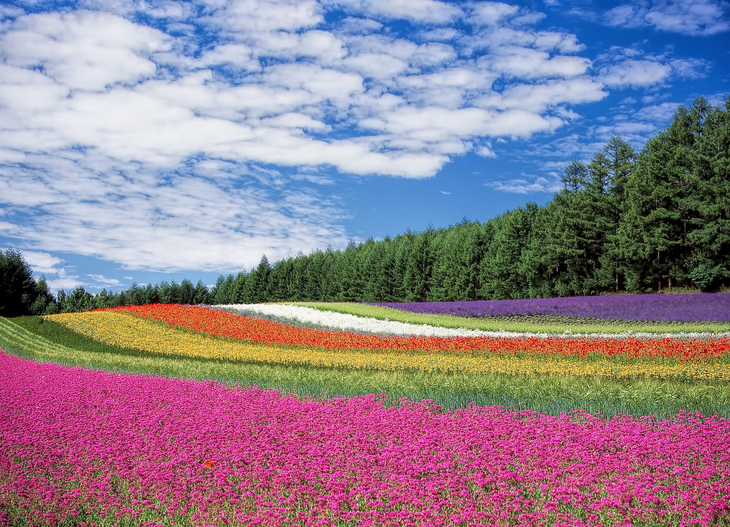
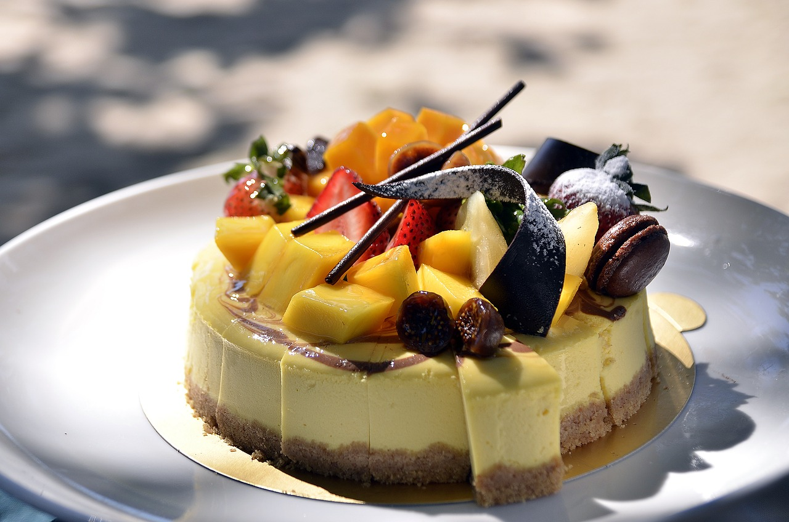
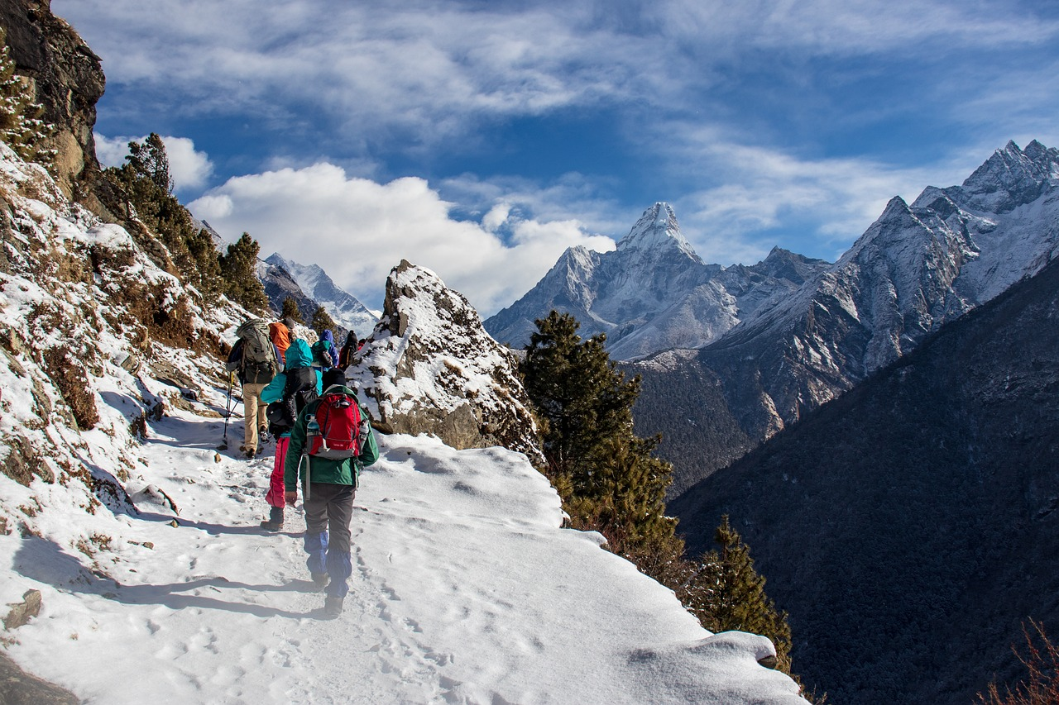
Exclamatory Adjectives
Exclamatory adjectives are used to express strong emotions of wonder/awe, pleasure/joy, disgust/annoyance
What a lovely place!
What an amazing
invention!
What a delicious dessert!
How enjoyable was that trek!
What an awful smell!
How can you be so forgetful!
Notes:
Notes for Teacher –In case the computer room is unavailable ,the teacher can summarize manually with the help of a chart and a diagram.
Suggestions: N/A
Source of Multimedia used in this slide -
Nature: https://pixabay.com/photos/flower-field-flowers-field-trees-250016/-By DeltaWorks
Bulb: https://pixabay.com/vectors/light-bulb-filament-lamp-orange-311119/-By Clker-Free-Vector-Images
Trek: https://pixabay.com/photos/himalayas-nepal-hiking-trek-person-3989411/-By Squirrel_photos
Dessert: https://pixabay.com/photos/cake-torte-dessert-sweet-fruit-1284548/-By Pexels
Forget: https://creazilla.com/nodes/36905-grandfather-is-talking-on-the-telephone-clipart-Attribute to publicdomainq.net
Smell: https://www.flickr.com/photos/135213460@N06/21473796202-Attribute to mmntz

Slide 3
Order of adjectives
NOSASCOMP
Number
Opinion
Size
Age
Shape
Colour
Origin
Material
Purpose
Notes:
Notes for Teacher –When there are more than one adjective in a sentence ,then they must follow a particular order which is:-
Suggestions: N/A
Source of Multimedia used in this slide - N/A

Slide 4
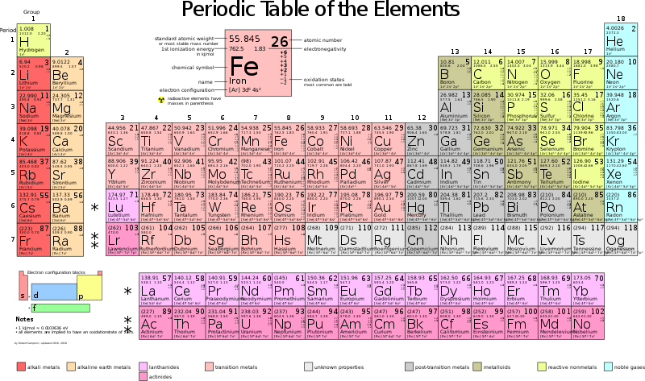
Attribution / Citation
Slide # | Thumbnail | Source link | Author
2 |  | 1. Nature: https://pixabay.com/photos/flower-field-flowers-field-trees-250016/ 2. Bulb: https://pixabay.com/vectors/light-bulb-filament-lamp-orange-311119/ 3. Trek: https://pixabay.com/photos/himalayas-nepal-hiking-trek-person-3989411/ 4. Dessert: https://pixabay.com/photos/cake-torte-dessert-sweet-fruit-1284548/ 5. Forget: https://creazilla.com/nodes/36905-grandfather-is-talking-on-the-telephone-clipart 6. Smell: https://www.flickr.com/photos/135213460@N06/21473796202 | DeltaWorks Clker-Free-Vector-Images Squirrel_photos Pexels publicdomainq.net mmntz

