Slide 1
Learning to Write an
Informal Letter
Notes:
Notes for Teacher - < Information for further reference or explanation >
Suggestions: <Ideas/ Images/ Animations / Others – To make better representation of the content >
Source of Multimedia used in this slide - <Please provide source URL where we find the image and the license agreement>
<letter> <https://pixabay.com/vectors/envelope-mail-postage-post-office-3172770/>

Slide 2
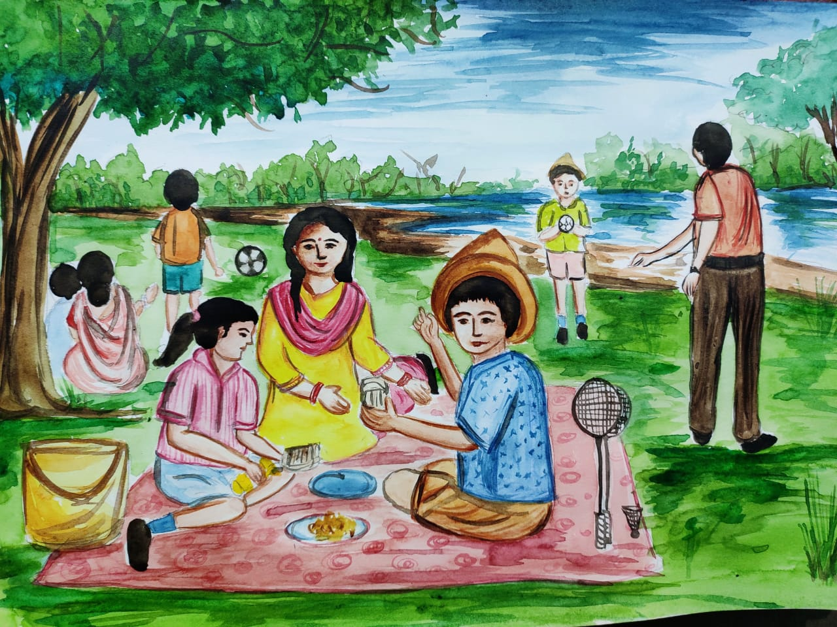
What is an informal letter?
A letter written to a family member, a friend or someone who is close, and the content is about sharing wishes, positive thoughts, conveying regards and love.
Constructive, motivating, positive, compassionate, casual and personal words are used to express our feelings.
Notes:
Notes for Teacher - < Information for further reference or explanation >
Suggestions: <Ideas/ Images/ Animations / Others – To make better representation of the content >
Source of Multimedia used in this slide - <Please provide source URL where we find the image and the license agreement>
<Family> <SSSVV-Alpana Samal WhatsApp Image 2021-03-19 at 19 picnic at the lakeside, outdoor picnic, family time>

Slide 3
Steps to write an informal letter.
_______________
_______________
Sender’s address (1)
_______________
Date (2)
Dear _________
Salutation/Greeting (3)
__________________
__________________
__________________
Body of the letter (4)
_________
Conclusion (5)
Yours lovingly _________
Complimentary close (6)
Notes:
Notes for Teacher - < Information for further reference or explanation >
Suggestions: <Ideas/ Images/ Animations / Others – To make better representation of the content >
Source of Multimedia used in this slide - <Please provide source URL where we find the image and the license agreement>
<letter writing> <https://pixabay.com/photos/writing-postcard-letter-pen-hands-923404/>

Slide 4
Attribution / Citation
Slide # | Thumbnail | Source link | Author
1 |  | <letter> <https://pixabay.com/vectors/envelope-mail-postage-post-office-3172770/> | bytrangle
3 |  | <letter writing> <https://pixabay.com/photos/writing-postcard-letter-pen-hands-923404/> | stocksnap
Notes:
Notes for Teacher - < Information for further reference or explanation >
Suggestions: <Ideas/ Images/ Animations / Others – To make better representation of the content >
Source of Multimedia used in this slide - <Please provide source URL where we find the image and the license agreement>

