Slide 1
Follow the Rule
Notes:
Notes for Teacher - Objective- Students will be able to identify the objects with the help of adjectives used to describe them
Suggestions: Idea to start with
Teacher - Here are some riddles for you today, let us solve them.
Source of Multimedia used in this slide - <Please provide source URL where we find the image and the license agreement>

Slide 2
Follow the rule
Order
When we have more than one adjective in a sentence, we must place them in the right order according to the category to which they belong.
1
Number or Determiner adjectives
2
Opinion adjectives
3
Fact adjectives
Notes:
Notes for Teacher – : We just observed that we used more than one adjective in a sentence, and this helped us to solve the riddles by giving an accurate description of the object.
Notes to the teacher: So the IQ asset seamlessly flows into The MS asset Order of adjectives.
Suggestions: <Ideas/ Images/ Animations / Others – To make better representation of the content >
Source of Multimedia used in this slide - <Please provide source URL where we find the image and the license agreement>

Slide 3
Determiners/ Numbers
Articles
Possessives
a, an, the
my, your, their
Demonstratives
this, that
Quantifiers
Numbers
many, few, some, any
one, two, five
Notes:
Notes for Teacher – < Information for further reference or explanation >
Suggestions: <Ideas/ Images/ Animations / Others – To make better representation of the content >
Source of Multimedia used in this slide - <Please provide source URL where we find the image and the license agreement>

Slide 4
Opinion adjectives
Beautiful
Terrible
Wonderful
Delicious
Ugly
Tasty
Horrible
Cold
Hot
Lovely
Chilling
Steaming
Notes:
Notes for Teacher – < Information for further reference or explanation >
Suggestions: <Ideas/ Images/ Animations / Others – To make better representation of the content >
Source of Multimedia used in this slide - <Please provide source URL where we find the image and the license agreement>

Slide 5
Fact adjectives
big, small, minute, colossal, large, tiny
Size
Age
old, new, recent, ancient
square, round, flat, triangular
Colour
Shape
pink, blue, green, white
Indian, Chinese, Japanese, American, German
wooden, rubber, silken, golden
Origin
Material
fishing, mining, musical, farming
Purpose
Notes:
Notes for Teacher – < Information for further reference or explanation >
Suggestions: <Ideas/ Images/ Animations / Others – To make better representation of the content >
Source of Multimedia used in this slide - <Please provide source URL where we find the image and the license agreement>

Slide 6
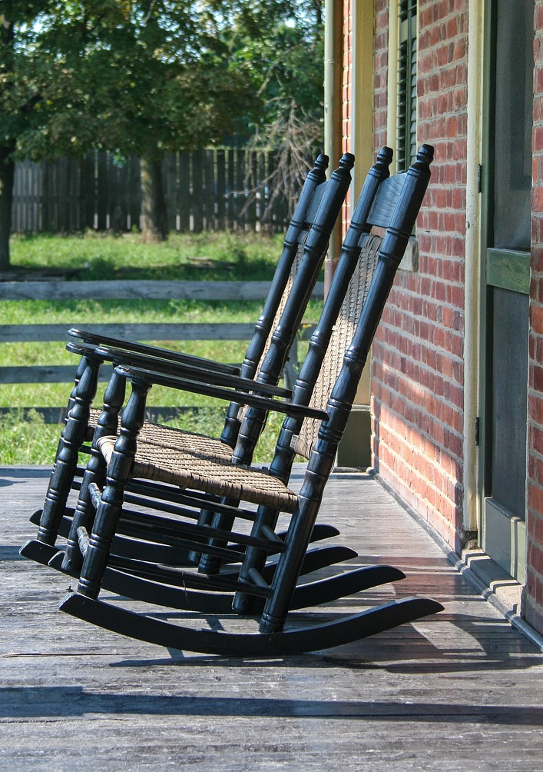
Example -1
I love that comfortable, old, wooden rocking chair.
that
determiner
comfortable
opinion
?
old
age
wooden
material
rocking
purpose
chair
noun
Notes:
Notes for Teacher – < Information for further reference or explanation >
Suggestions: <Ideas/ Images/ Animations / Others – To make better representation of the content >
Source of Multimedia used in this slide - https://pixabay.com/photos/rocking-chair-wooden-rocking-chairs-2683875/
- Chapay

Slide 7
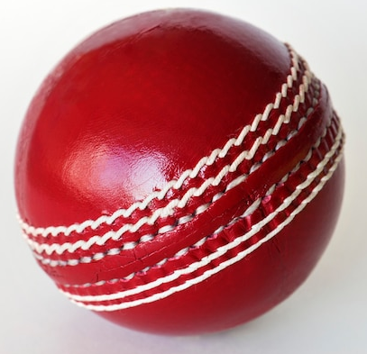
Example 2
A small new red Indian rubber, bouncing ball
A
?
Determiner
Small
Size
Red
Colour
Indian
Origin
Rubber
Material
Bouncing
Purpose
Ball
Noun
Notes:
Notes for Teacher – < Information for further reference or explanation >
Suggestions: <Ideas/ Images/ Animations / Others – To make better representation of the content >
Source of Multimedia used in this slide https://www.freepik.com/free-photo/cricket-ball-isolated_2807389.htm - rawpixel.com

Slide 8
Order of Adjectives
The rule for the Order of adjectives can be easily remembered with the help of an acronym:- NOSASCOMP, where
N
Number/ Determiner
C
Colour
O
Opinion
O
Origin
S
Size
M
Material
A
Age
P
Purpose
S
Shape
Notes:
Notes for Teacher – < Information for further reference or explanation >
Suggestions: <Ideas/ Images/ Animations / Others – To make better representation of the content >
Source of Multimedia used in this slide - <Please provide source URL where we find the image and the license agreement>

Slide 9
This table will help classify the adjectives.
Classification of adjectives
Determiner | Opinion | Size | Age | Shape | Colour | Origin | Material | Purpose
a | delicious | huge | old | oval | white | French | golden | race
that | lovely | tiny | modern | triangular | orange | Indian | metallic | musical
Points to remember:-
Identify the adjectives to which category they belong.
Place them in order with the help of the acronym NOSASCOMP.
Notes:
Notes for Teacher – < Information for further reference or explanation >
Suggestions: <Ideas/ Images/ Animations / Others – To make better representation of the content >
Source of Multimedia used in this slide - <Please provide source URL where we find the image and the license agreement>

Slide 10
Attribution / Citation
Slide # | Thumbnail | Source link | Author
6 |  | https://pixabay.com/photos/rocking-chair-wooden-rocking-chairs-2683875/ | Chapay
7 |  | https://www.freepik.com/free-photo/cricket-ball-isolated_2807389.htm - | rawpixel.com
Notes:
Notes for Teacher - < Information for further reference or explanation >
Suggestions: <Ideas/ Images/ Animations / Others – To make better representation of the content >
Source of Multimedia used in this slide - <Please provide source URL where we find the image and the license agreement>

