Slide 1
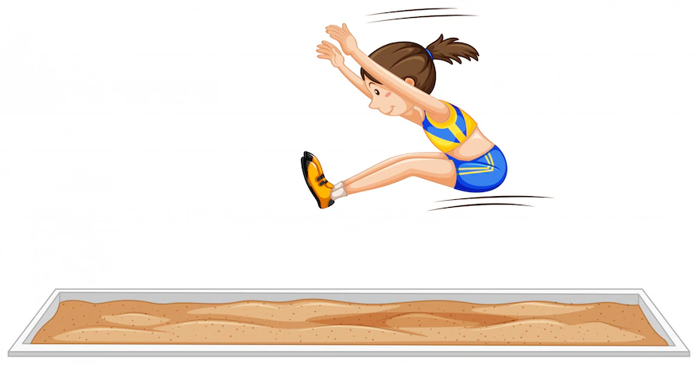
Modal Verbs
Notes:
Notes for Teacher - < Information for further reference or explanation >
Suggestions: <Ideas/ Images/ Animations / Others – To make better representation of the content >
Source of Multimedia used in this slide - <Please provide source URL where we find the image and the license agreement>
https://openclipart.org/detail/296645/skipping-rope (oksmith)
https://www.freepik.com/free-vector/nice-guy-running_1113705.htm (freepik)
https://www.freepik.com/free-vector/long-jump-girl-jumping-sport-event_5072662.htm (brgfx)

Slide 2
Modal verbs are auxiliary verbs
Express the `mode’ or `manner’ of the actions indicated by the main verbs.
Such as - ability, possibility, probability, permission, obligation etc.
Modal Verb Examples – Shall, May, Will, Can
May I come in? (Permission)
She can speak Hindi. (Ability)
I can come with you. (Ability)
It may rain tonight. (Possibility)
I shall be going to the park
today. (Possibility)
Will you be able to complete my
homework? (Request/
Obligation)
Will you shut the door? (Request)
Can I use your pencil? (Permission)
Notes:
Notes for Teacher - < Information for further reference or explanation >
The teacher could draw the attention of the students to the use of ‘helping words’ (that has been taught in the earlier classes) that helped in the subject-verb agreement of the various tense forms. (I was playing. They were playing.) Then continue from the IQ asset and talk about how helping words variate to become Modal verbs and their importance. Elaborate on how they help to express an ability, possibility or permission and their different patterns and rules to function with various verbs.
Suggestions: <Ideas/ Images/ Animations / Others – To make better representation of the content >
Source of Multimedia used in this slide - <Please provide source URL where we find the image and the license agreement>

Slide 3
Modal Verbs
Can
May
Will
Shall
Ability
Permission
Possibility
Request
Permission
Possibility
Promise
Wish/Desire
Request
Prediction
Possibility
Advice
Intention
Notes:
Notes for Teacher - < Information for further reference or explanation >
Using the given GO the teacher could reiterate the mode or manner of the four modal verbs introduced. The teacher could develop the flowchart on the board through the elicitation method.
Suggestions: <Ideas/ Images/ Animations / Others – To make better representation of the content >
Source of Multimedia used in this slide - <Please provide source URL where we find the image and the license agreement>

Slide 4
Modal Verbs – a few examples
Will
1)
I will always stand by you, no matter what.
(Promise)
2)
I will become a doctor when I grow up.
(Wish/Desire)
3)
Will you be quiet please?
(Request)
4)
It looks like it will rain tomorrow.
(Prediction)
Notes:
Notes for Teacher - < Information for further reference or explanation >
Suggestions: <Ideas/ Images/ Animations / Others – To make better representation of the content >
Source of Multimedia used in this slide - <Please provide source URL where we find the image and the license agreement>

Slide 5
Modal Verbs – a few examples
Can
1)
I can play cricket.
(Ability)
2)
Can I go out tonight?
(Permission)
3)
I can come tomorrow if it doesn’t rain.
(Possibility)
4)
Can I go to the washroom, please?
(Request)
Notes:
Notes for Teacher - < Information for further reference or explanation >
Suggestions: <Ideas/ Images/ Animations / Others – To make better representation of the content >
Source of Multimedia used in this slide - <Please provide source URL where we find the image and the license agreement>

Slide 6
Modal Verbs – a few examples
May and Shall
1)
May I borrow your pencil?
(Permission)
2)
It looks like it may rain tomorrow.
(Possibility)
3)
You shall consult a doctor, if you are sick.
(Advice)
4)
You shall be playing on Sunday if the coach agrees.
(Possibility)
5)
I shall do my homework tomorrow.
(Intention)
Notes:
Notes for Teacher - < Information for further reference or explanation >
Suggestions: <Ideas/ Images/ Animations / Others – To make better representation of the content >
Source of Multimedia used in this slide - <Please provide source URL where we find the image and the license agreement>

Slide 7
Attribution / Citation
Slide # | Thumbnail | Source link | Author
1 |  | https://openclipart.org/detail/296645/skipping-rope https://www.freepik.com/free-vector/nice-guy-running_1113705.htm https://www.freepik.com/free-vector/long-jump-girl-jumping-sport-event_5072662.htm | oksmith Freepik brgfx
Notes:
Notes for Teacher - < Information for further reference or explanation >
Suggestions: <Ideas/ Images/ Animations / Others – To make better representation of the content >
Source of Multimedia used in this slide - <Please provide source URL where we find the image and the license agreement>

