Slide 1
Express Yourself !
Notes:
Notes for Teacher - < Information for further reference or explanation >
Suggestions: <Ideas/ Images/ Animations / Others – To make better representation of the content >
Source of Multimedia used in this slide - <Please provide source URL where we find the image and the license agreement>

Slide 2
Express Yourself
Describe the garden using adjectives.
Notes:
Notes for Teacher - < Information for further reference or explanation >
Suggestions: <Ideas/ Images/ Animations / Others – To make better representation of the content >
Source of Multimedia used in this slide - https://openverse.org/image/6fcbd5bb-594c-4ce3-967f-64c5e9d0f756?q=Garden%20with%20flowers%20and%20children,
https://commons.wikimedia.org/wiki/File:Happy_Children_Playing_Kids.jpg

Slide 3
Examples
Beautiful
Many varieties
Lovely
Tall
There are many varieties of flowers in the garden.
There is a lovely lotus pond.
There are tall trees in the garden.
The garden is beautiful.
Notes:
Notes for Teacher - < Information for further reference or explanation >
Suggestions: <Ideas/ Images/ Animations / Others – To make better representation of the content >
Source of Multimedia used in this slide - https://openverse.org/image/6fcbd5bb-594c-4ce3-967f-64c5e9d0f756?q=Garden%20with%20flowers%20and%20children,
https://commons.wikimedia.org/wiki/File:Happy_Children_Playing_Kids.jpg

Slide 4
A Different Way
More Impact
The garden is beautiful.
What a beautiful garden!
There are many varieties of flowers in the garden.
What varieties of flowers are there in the garden!
There is a lovely lotus pond.
What a lovely lotus pond!
There are tall trees in the garden.
n
How tall the trees are in the garden!
Notes:
Notes for Teacher - < Information for further reference or explanation >
Suggestions: <Ideas/ Images/ Animations / Others – To make better representation of the content >
Source of Multimedia used in this slide - <Please provide source URL where we find the image and the license agreement>

Slide 5
Exclamatory Adjectives
Adjectives that express strong emotions are called exclamatory adjectives.
1
They express strong emotions about a noun or pronoun.
2
They are often used to express amazement, wonder, pleasure or disgust about a person, place, animal, thing or an idea.
3
Notes:
Notes for Teacher - < Information for further reference or explanation >
Suggestions: <Ideas/ Images/ Animations / Others – To make better representation of the content >
Source of Multimedia used in this slide - <Please provide source URL where we find the image and the license agreement>

Slide 6
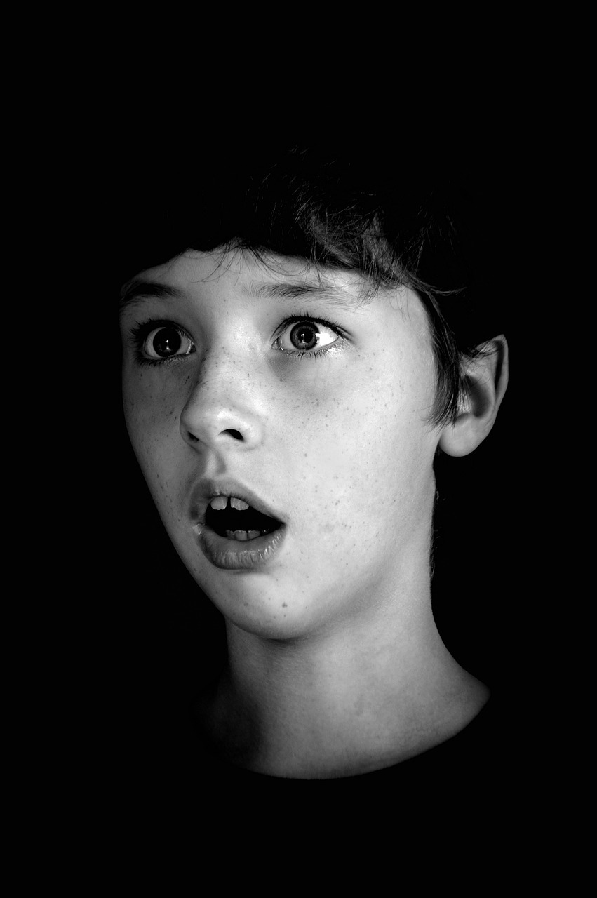
Exclamatory Adjectives
Beginning : ‘What’
Ending : ‘!’
Example : What a wonderful show!
Amazing
Delicious
Horrible
wonder and awe
pleasure and joy
disgust and shock
Notes:
Notes for Teacher - < Information for further reference or explanation >
Suggestions: <Ideas/ Images/ Animations / Others – To make better representation of the content >
Source of Multimedia used in this slide - https://pixabay.com/photos/baby-surprised-expression-shock-6618294/, https://pixabay.com/illustrations/wow-astonished-amazement-emotion-4860815/, https://pixabay.com/vectors/smiley-laughing-face-happy-laugh-304294/
https://pixabay.com/illustrations/emoticon-smile-emoji-happy-2120024/, https://pixabay.com/vectors/smile-emoji-happy-happiness-5865209/, https://pixabay.com/vectors/smiley-laughing-face-happy-laugh-304294/
https://pixabay.com/vectors/graphic-horrified-smiley-emoji-4004029/, https://pixabay.com/illustrations/people-emotions-feelings-7398080/

Slide 7
Exclamatory Adjectives
What + a/an + adjective + singular noun + !
1
What a lovely dress!
What an ancient temple!
With Nouns and Pronouns
What + adjective + plural noun + !
What scary stories!
What delicious flavours!
2
What + a + collective noun + of + adjective + plural noun + !
3
What a galaxy of shining stars!
What a bunch of lovely roses!
Notes:
Notes for Teacher - < Information for further reference or explanation >
Suggestions: <Ideas/ Images/ Animations / Others – To make better representation of the content >
Source of Multimedia used in this slide - <Please provide source URL where we find the image and the license agreement>

Slide 8
Exclamatory Adjectives with a verb
What + a/an + adjective + subject + verb + !
What cute puppies they are!
What a boring book this is!
With Verbs
How + subject + verb + !
How you have grown!
How she has changed!
Notes:
Notes for Teacher - < Information for further reference or explanation >
Suggestions: <Ideas/ Images/ Animations / Others – To make better representation of the content >
Source of Multimedia used in this slide - <Please provide source URL where we find the image and the license agreement>

Slide 9
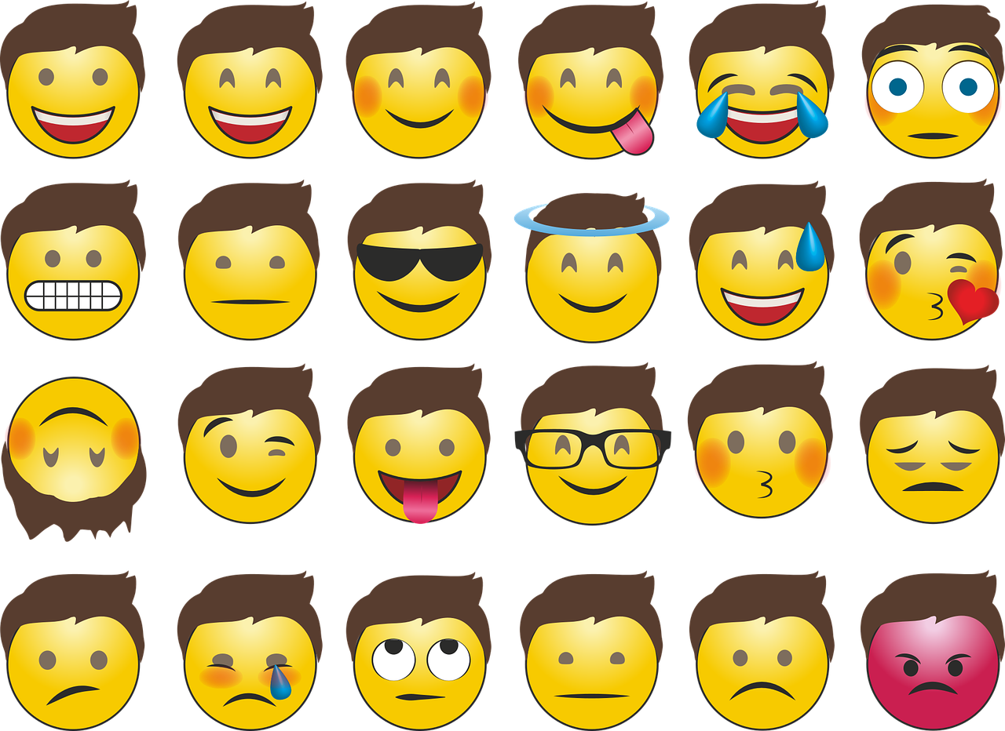
Points to remember
Exclamatory adjectives are used to express strong emotions and for dramatic effect.
Notes:
Notes for Teacher - < Information for further reference or explanation >
Suggestions: <Ideas/ Images/ Animations / Others – To make better representation of the content >
Source of Multimedia used in this slide - https://pixabay.com/vectors/emojis-smilie-whatsapp-emotions-2762567/

Slide 10
Attribution / Citation
Slide # | Thumbnail | Source link | Author
1, 2 |  | https://openverse.org/image/6fcbd5bb-594c-4ce3-967f-64c5e9d0f756?q=Garden%20with%20flowers%20and%20children, https://commons.wikimedia.org/wiki/File:Happy_Children_Playing_Kids.jpg | Adrian F, epSos.de
5 |  | https://pixabay.com/photos/baby-surprised-expression-shock-6618294/, https://pixabay.com/illustrations/wow-astonished-amazement-emotion-4860815/, https://pixabay.com/vectors/smiley-laughing-face-happy-laugh-304294/ | N-region, DesignDrawArtes, Mohamed_hassan
5 |  | https://pixabay.com/illustrations/emoticon-smile-emoji-happy-2120024/, https://pixabay.com/vectors/smile-emoji-happy-happiness-5865209/, https://pixabay.com/vectors/smiley-laughing-face-happy-laugh-304294/ | 95C, 95C, Clker-Free-Vector-Images
5 |  | https://pixabay.com/vectors/graphic-horrified-smiley-emoji-4004029/, https://pixabay.com/illustrations/people-emotions-feelings-7398080/ | BilliTheCat, Bucarama_Pics
9 |  | https://pixabay.com/vectors/emojis-smilie-whatsapp-emotions-2762567/ | Pixaline
Notes:
Notes for Teacher - < Information for further reference or explanation >
Suggestions: <Ideas/ Images/ Animations / Others – To make better representation of the content >
Source of Multimedia used in this slide - <Please provide source URL where we find the image and the license agreement>

