Slide 1
Learning Transitive
and Intransitive Verbs
Notes:
Notes for Teacher - < Information for further reference or explanation >
Suggestions: <Ideas/ Images/ Animations / Others – To make better representation of the content >
Source of Multimedia used in this slide - <Please provide source URL where we find the image and the license agreement>

Slide 2
Verbs
Auxiliary
Show action
Verbs
Transitive
Intransitive
Notes:
Notes for Teacher - < Information for further reference or explanation >
Suggestions: <Ideas/ Images/ Animations / Others – To make better representation of the content >
Source of Multimedia used in this slide - <Please provide source URL where we find the image and the license agreement>

Slide 3
Auxiliary Verbs
Words that help the main verb
to form a tense
or show when action is performed.
Example 1: Sneha is writing in her book.
is – it is helping the main verb (auxiliary verb)
writing – the main action being done (main verb)
Example 2: Ramu was riding a bicycle.
was – it is helping the main verb (auxiliary verb)
riding – the main action being done (main verb)
Notes:
Notes for Teacher - < Information for further reference or explanation >
Suggestions: <Ideas/ Images/ Animations / Others – To make better representation of the content >
Source of Multimedia used in this slide - <Please provide source URL where we find the image and the license agreement>

Slide 4
Transitive Verbs
When an action passes from the subject
to another noun or pronoun in the sentence
the other noun / pronoun is known as an object.
Example 1: John’s father built a treehouse.
Built what? – a treehouse
Example 2: My brother gave me a new pencil.
Gave what? – a new pencil
Gave it to whom? – me
Notes:
Notes for Teacher - < Information for further reference or explanation >
Suggestions: <Ideas/ Images/ Animations / Others – To make better representation of the content >
Source of Multimedia used in this slide - <Please provide source URL where we find the image and the license agreement>

Slide 5
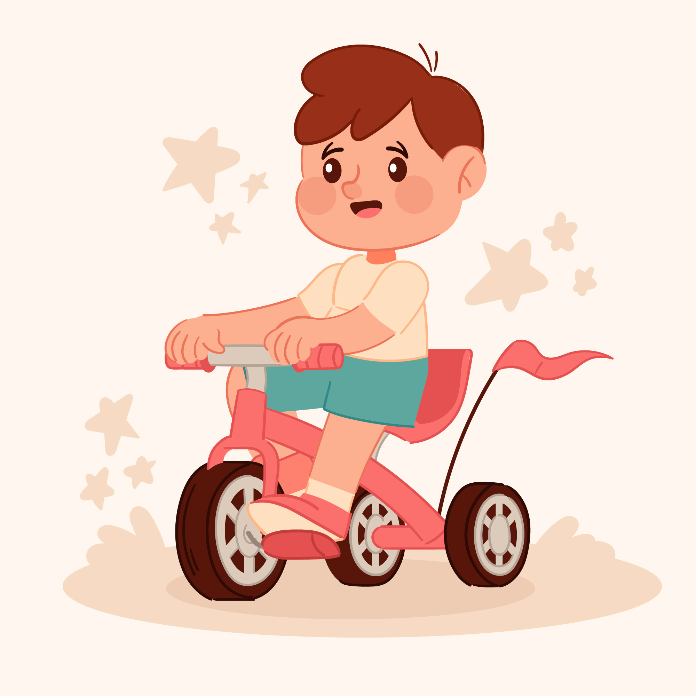
Transitive Verbs
Example 3: Birds eat worms.
Eat what? – worms
Example 4: He gifted my brother a tricycle.
Gifted what? – a tricycle
Gifted it to whom? – my brother
A verb that takes / requires an object
is known as a transitive verb.
to complete itself
We get the direct object by asking ‘what’ or ‘whom’ after the verb.
We get the indirect object by asking ‘to whom’, ‘from whom’ or ‘for whom’ after the verb.
Notes:
Notes for Teacher - < Information for further reference or explanation >
Suggestions: <Ideas/ Images/ Animations / Others – To make better representation of the content >
Source of Multimedia used in this slide - <Please provide source URL where we find the image and the license agreement>

Slide 6
Intransitive Verbs
A verb that does not require an object
to make complete sense
is known as an intransitive verb.
Example 1: She dances gracefully.
Example 2: Birds fly.
Example 3: Children swim in the pool.
Notes:
Notes for Teacher - < Information for further reference or explanation >
Suggestions: <Ideas/ Images/ Animations / Others – To make better representation of the content >
Source of Multimedia used in this slide - <Please provide source URL where we find the image and the license agreement>

Slide 7
Examples
Transitive Verbs – need an object to complete their meaning.
Intransitive Verbs – don’t need an object to complete their meaning.
Mohan eats apples for breakfast.
(Eats what? – Apples: Object)
I was sleeping.
Akash loves his pet dog.
(Loves what? – His pet dog: Object)
She coughs a lot.
Sonu bought a book for me.
(Bought what? – A book: Direct object; For whom? – Me: Indirect object)
I am going now.
Notes:
Notes for Teacher - < Information for further reference or explanation >
Suggestions: <Ideas/ Images/ Animations / Others – To make better representation of the content >
Source of Multimedia used in this slide - <Please provide source URL where we find the image and the license agreement>

Slide 8
Usage of verbs
Most verbs can be used
as both transitive
and intransitive verbs
Verb
Used transitively
Used intransitively
spoke
He spoke the truth.
He spoke softly.
sang
She sang a song with her friends.
She sang loudly.
bark
Dogs bark at strangers.
Dogs bark.
read
I read your book.
I read yesterday.
Notes:
Notes for Teacher - Once the concepts have been explained, the teacher can then proceed with asking the children to work on the worksheet given.
Suggestions: <Ideas/ Images/ Animations / Others – To make better representation of the content >
Source of Multimedia used in this slide - <Please provide source URL where we find the image and the license agreement>

Slide 9
Attribution / Citation
Slide # | Thumbnail | Source link | Author
1 |  | https://www.freepik.com/free-vector/learning-concept-illustration_14230944.htm | storyset on Freepik
3 |  | 1. Writing - https://www.freepik.com/free-vector/cartoon-character-sticker-with-girl-writing-blank-paper_16455705.htm 2. Cycling - https://www.freepik.com/free-vector/boy-riding-bicycle-cartoon-character-isolated-white_13831488.htm | 1. brgfx on Freepik 2. brgfx on Freepik
4 |  | 1. Treehouse - https://www.freepik.com/free-vector/children-playground-with-treehouse-background-wooden-house-tree-with-ladder-playing-with-hanging-tire-swing_28850081.htm 2. Boy with pencil - https://www.freepik.com/free-vector/young-kid-holding-pencil_4382387.htm | 1. studio4rt on Freepik 2. brgfx on Freepik
5 |  | 1. Bird with worm - https://www.freepik.com/free-vector/chicken-eating-worm-concept-illustration_29808139.htm 2. Tricycle - https://www.freepik.com/free-vector/hand-drawn-illustration-tricycle_31546381.htm | 1. storyset on Freepik 2. Freepik
6 |  | 1. Dancing - https://www.freepik.com/free-vector/indian-woman-dancing_1036080.htm 2. Swimming - https://freesvg.org/kid-swimmer 3. Birds - https://freesvg.org/clip-art-of-three-different-flying-birds | 1. ddraw on Freepik 2. OpenClipart 3. OpenClipart
7 |  | 1. Sleeping - https://freesvg.org/sleeping-man 2. Boy with dog - https://freesvg.org/publicdomainq-0011533jjmpbf | 1. OpenClipart 2. OpenClipart
8 |  | 1. Reading - https://www.freepik.com/free-vector/sticker-template-with-boy-reading-book-cartoon-character-isolated_18175368.htm 2. Barking - https://www.freepik.com/free-vector/puppy-catching-piece-bone-isolated_7037288.htm | 1. brgfx on Freepik 2. brgfx on Freepik
Notes:
Notes for Teacher - < Information for further reference or explanation >
Suggestions: <Ideas/ Images/ Animations / Others – To make better representation of the content >
Source of Multimedia used in this slide - <Please provide source URL where we find the image and the license agreement>

