Slide 1
Simile vs Personification
Notes:
Notes for Teacher – Not applicable
Suggestions: Not applicable
Source of Multimedia used in this slide - Not applicable

Slide 2
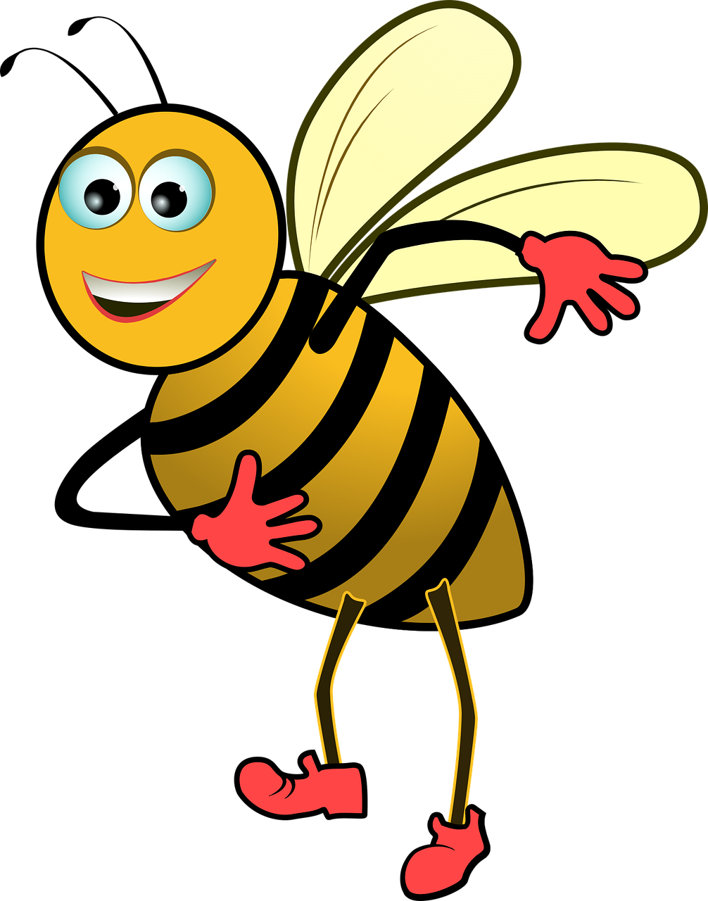
Spot the difference!
In the mornings, my mother remains as busy as a bee.
(Simile)
The trees are dancing with the wind.
(Personification)
Notes:
Notes for Teacher - Not applicable
Suggestions: Not applicable
Source of Multimedia used in this slide -
Bee - https://pixabay.com/vectors/bee-vector-insect-summer-wings-5057110/
Trees - https://vectorportal.com/vector/wind-blowing-trees-vector-image.ai/24909

Slide 3
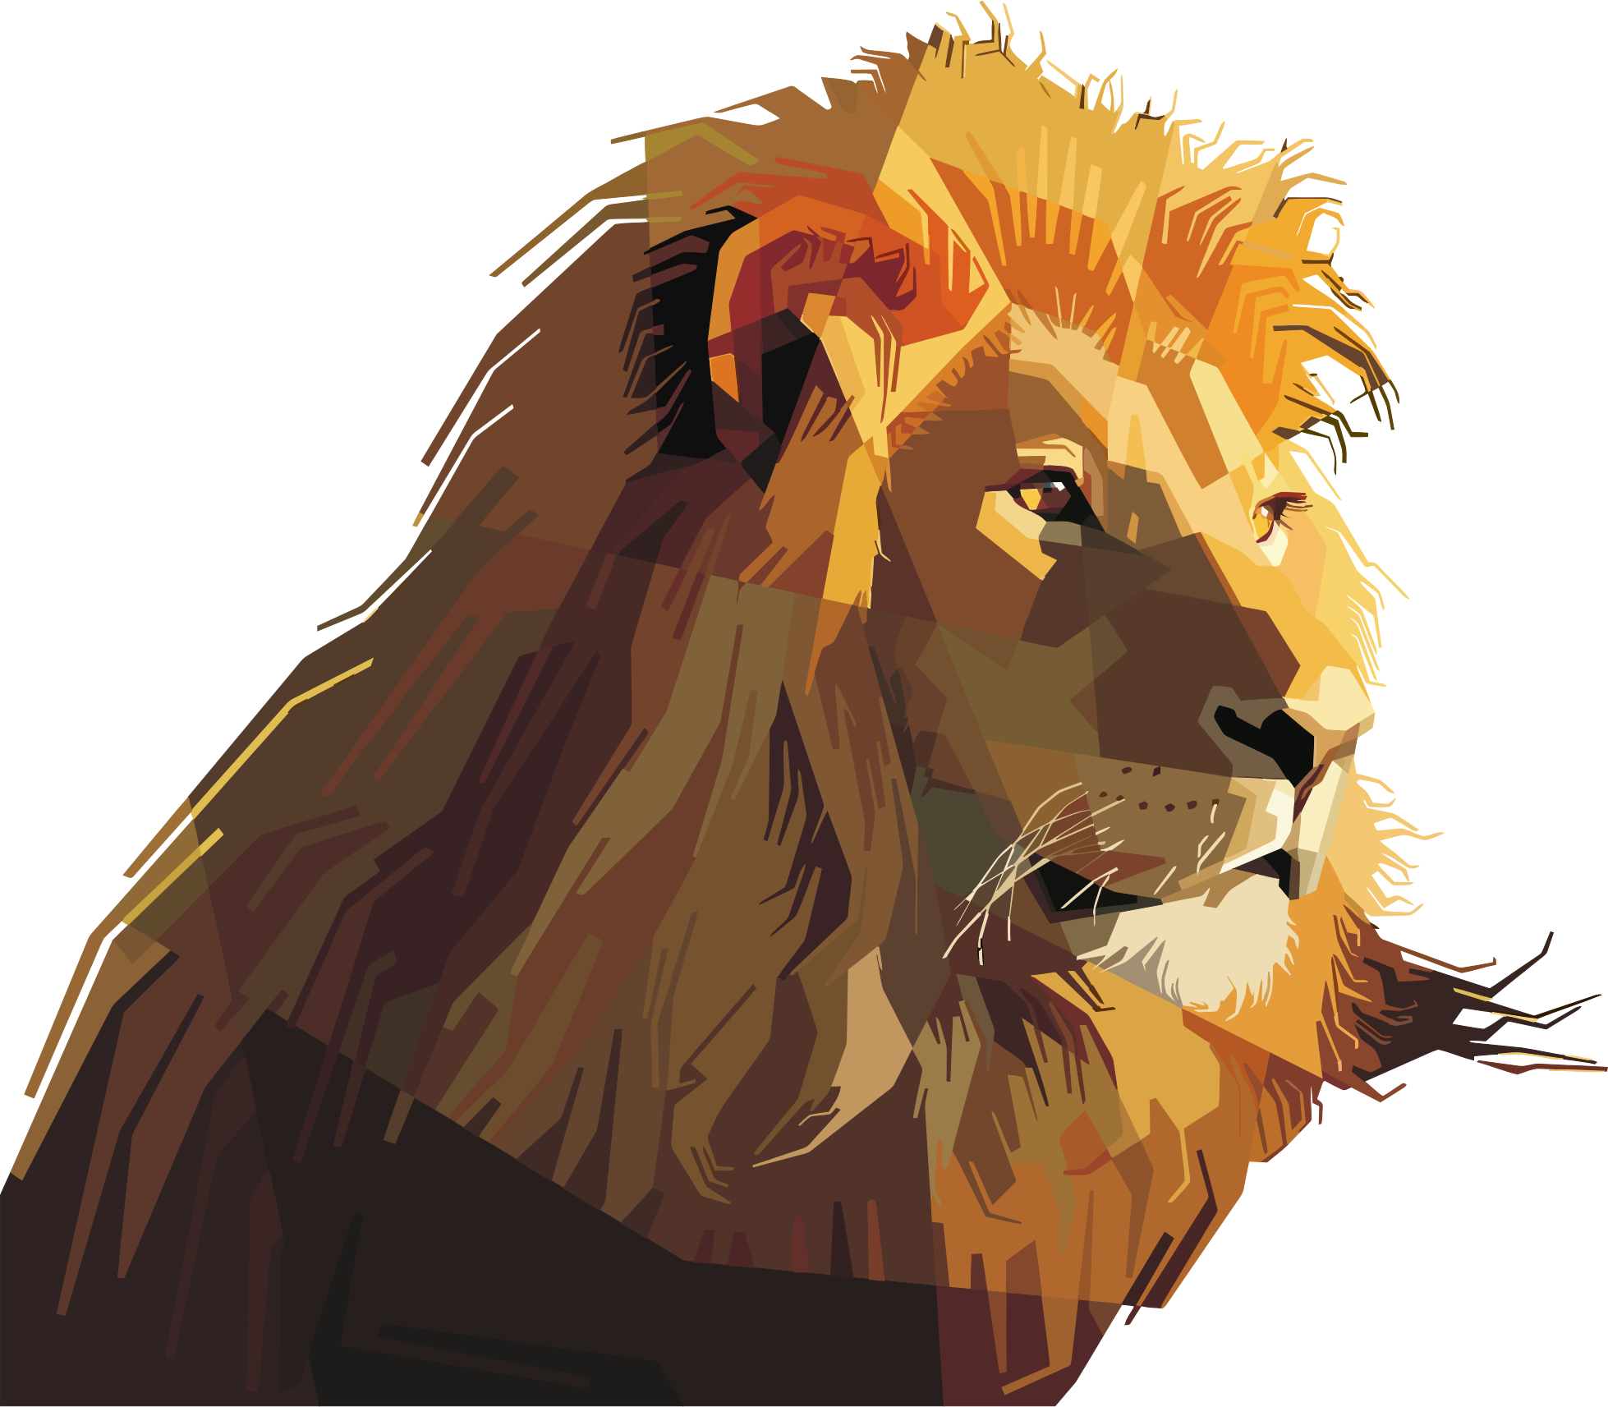
Simile
Compares two different things using the word like or as
Examples:
1. She swam like a fish. (Her swimming skill is similar to that of a fish)
It means something is like or as something else
2. He is as brave as a lion. (His bravery is comparable to a lion’s)
Shows similarities between the two things compared
Notes:
Notes for Teacher – Not applicable
Suggestions: Not applicable
Source of Multimedia used in this slide -
Fish - https://www.wannapik.com/vectors/1520
Lion - https://openclipart.org/detail/302752/geometric-lion-by-peri-priatna

Slide 4
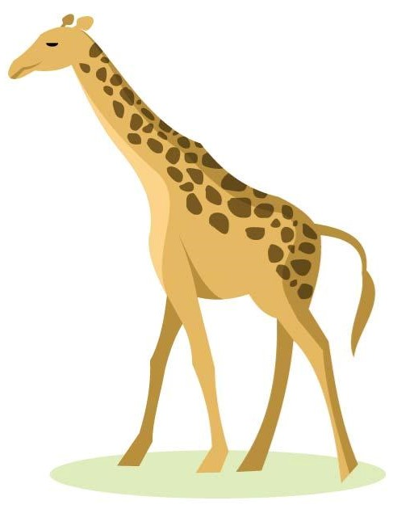
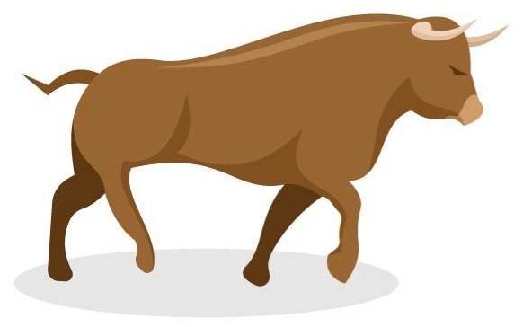
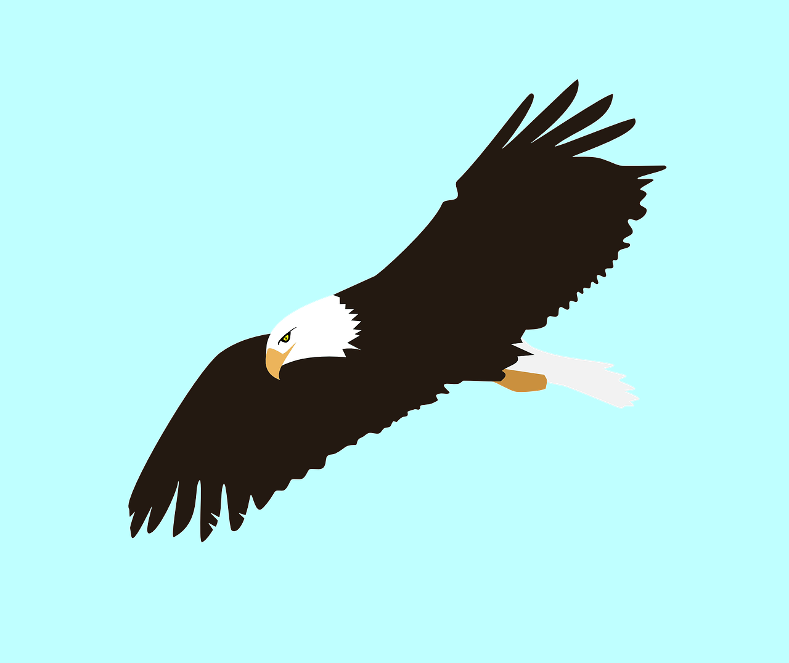
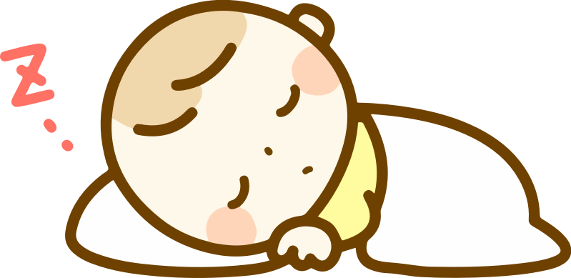
Examples of Simile
as
The wrestler is as strong as an ox.
My friend is as tall as a giraffe.
like
She slept like a baby.
The paraglider soared like an eagle in the sky.
Notes:
Notes for Teacher - Not applicable
Suggestions: Not applicable
Source of Multimedia used in this slide -
Ox - https://vectorportal.com/vector/vector-image-of-a-bull/20251
Giraffe - https://vectorportal.com/vector/giraffe-color-clip-art/22300
Baby - https://freesvg.org/sleeping-baby
Eagle - https://pixabay.com/vectors/eagle-bird-fly-flying-bald-40254/

Slide 5
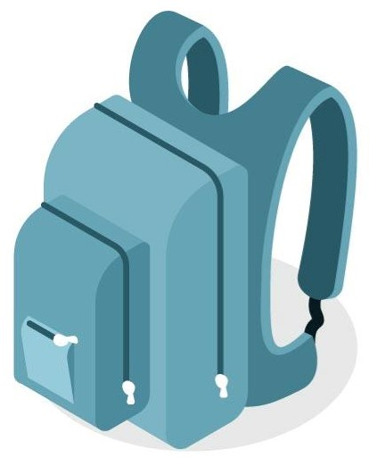
Exercise
Fill in the blanks using the words given in the box.
clean heavy cool fish
cool
1. She is as ____ as a cucumber.
fish
2. He felt like a ____ out of water in the city.
heavy
3. This bag is as _____ as lead.
Click for answers
clean
4. My house is as _____ as a whistle.
hare feather fire nightingale
fire
1. My friends and I get along like a house on ____.
nightingale
2. She sings like a __________.
feather
3. I felt as light as a _______ after exercising.
hare
4. He ran like a ____ in the game.
Notes:
Notes for Teacher - Not applicable
Suggestions: Not applicable
Source of Multimedia used in this slide -
Bag - https://vectorportal.com/vector/blue-backpack/20611
Feather - https://shmector.com/free-vector/other/feather_vector/14-0-764
Hand - PPT icon

Slide 6
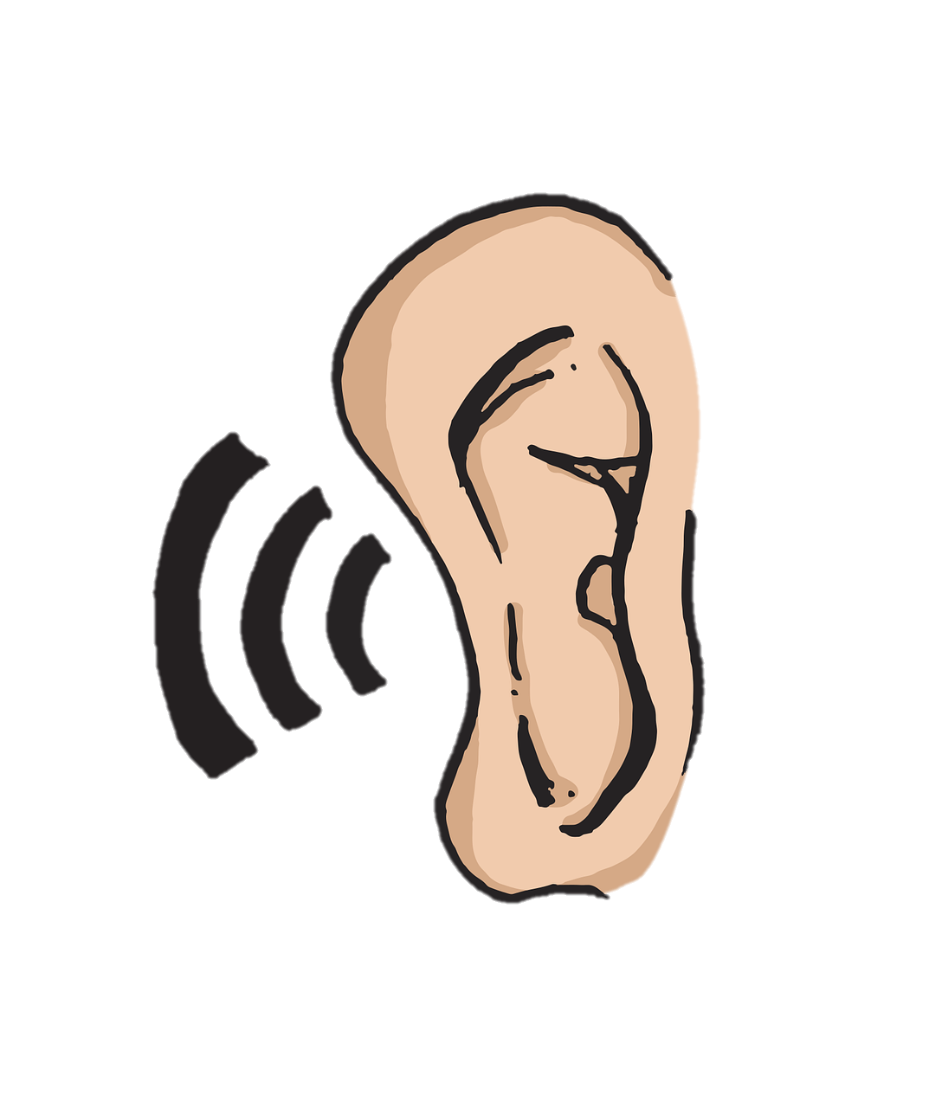
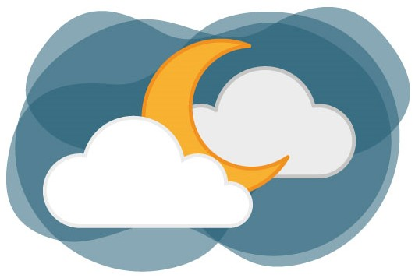
Personification
Gives human qualities (actions, emotions) to non-human things
Examples:
1. The wind whispered secrets in my ear.
Non-human things can be animals or objects
2. The moon played hide and seek with the clouds.
Brings objects to life and makes text interesting
Notes:
Notes for Teacher - Not applicable
Suggestions: Not applicable
Source of Multimedia used in this slide -
Ear - https://pixabay.com/vectors/ear-sound-listen-5204373/
Moon - https://vectorportal.com/vector/moon-night-sky/34754

Slide 7
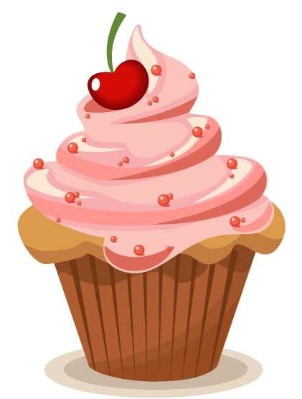
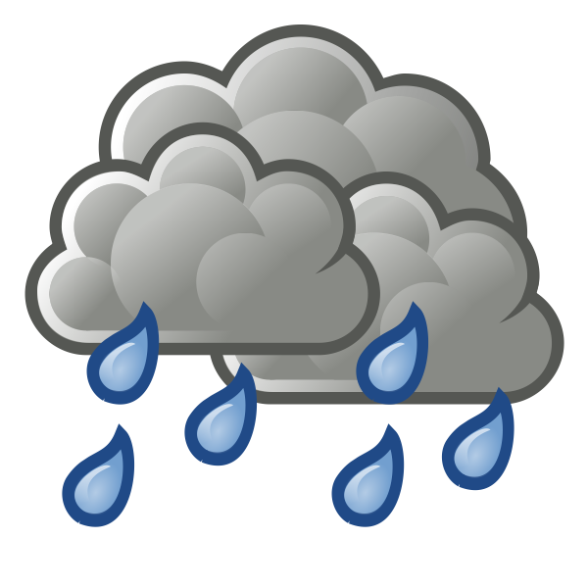
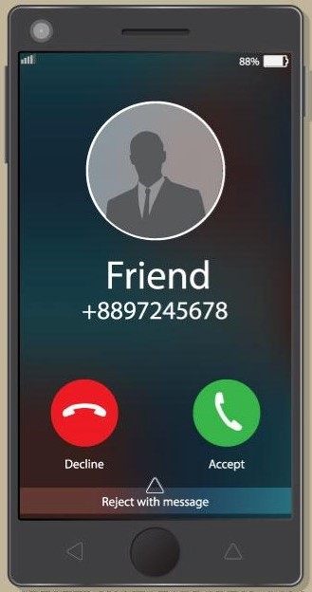
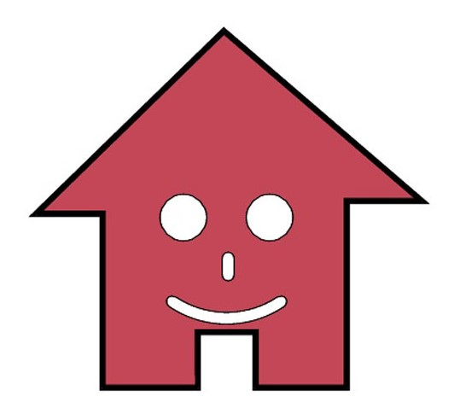
Examples of Personification
The cake begged to be eaten by me.
The forest welcomed the rain after a long, dry summer.
The house greeted me with a smile.
My mobile phone woke me up with a pleasant tune.
Notes:
Notes for Teacher - Not applicable
Suggestions: Not applicable
Source of Multimedia used in this slide -
Cake - https://vectorportal.com/vector/delicious-cake-vector-image.ai/14923
Rain - https://freesvg.org/color-weather-forecast-icon-for-rain-vector-illustration
House - https://vectorportal.com/vector/house-logotype-vector-design/5497
Phone - https://vectorportal.com/vector/mobile-phone-call/23750

Slide 8
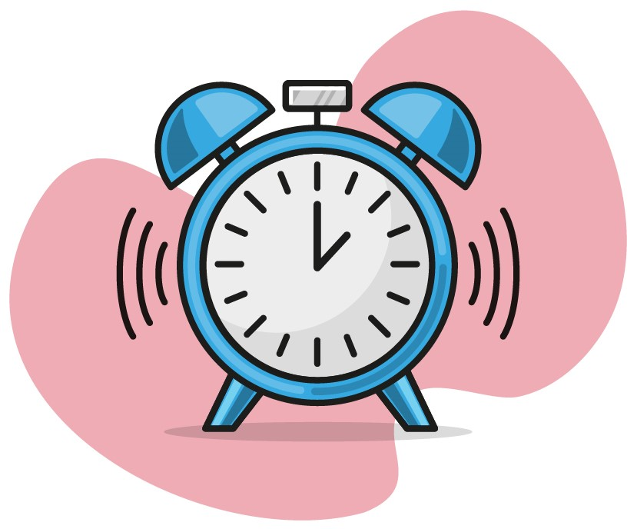
Exercise
Fill in the blanks using the words given in the box.
yelled raged begged waved ran
waved
1. The flowers ______ their colourful petals.
Click for answers
yelled
2. The alarm clock ______ at me to wake up.
3. The wildfire ___ through the forest.
ran
begged
4. The brown grass ______ for water.
raged
5. The storm _____ throughout the night.
Notes:
Notes for Teacher - Not applicable
Suggestions: Not applicable
Source of Multimedia used in this slide -
Flower - https://creazilla.com/nodes/15265-dahlia-flower-clipart
Alarm clock - https://vectorportal.com/vector/alarm-clock/34951
Hand - PPT icon

Slide 9
Simile vs Personification
Simile
Personification
Compares two different things using the words ‘like’ or ‘as’
Gives human qualities to objects or non-human things
Shows similarities between the two things being compared
Human qualities such as behaviours and emotions are given to animals or objects
Examples:
1. The kids were buzzing like bees.
2. I wandered lonely as a cloud.
Examples:
1. The wind howled in the night sky.
2. The train screamed down the tracks.
Notes:
Notes for Teacher - Not applicable
Suggestions: Not applicable
Source of Multimedia used in this slide - Not applicable

Slide 10
Attribution / Citation
Slide # | Thumbnail | Source link | Author
2 |  | 1. Bee - https://pixabay.com/vectors/bee-vector-insect-summer-wings-5057110/ 2. Trees - https://vectorportal.com/vector/wind-blowing-trees-vector-image.ai/24909 | 1. olga-filo 2. Vectorportal.com
3 |  | 1. Fish - https://www.wannapik.com/vectors/1520 2. Lion - https://openclipart.org/detail/302752/geometric-lion-by-peri-priatna | 1. Wannapik Studio 2. Peri Priatna
4 |  | 1. Ox - https://vectorportal.com/vector/vector-image-of-a-bull/20251 2. Giraffe - https://vectorportal.com/vector/giraffe-color-clip-art/22300 3. Baby - https://freesvg.org/sleeping-baby 4. Eagle - https://pixabay.com/vectors/eagle-bird-fly-flying-bald-40254/ | 1. Vectorportal.com 2. Vectorportal.com 3. OpenClipart 4. Clker-Free-Vector-Images
5 |  | 1. Bag - https://vectorportal.com/vector/blue-backpack/20611 2. Feather - https://shmector.com/free-vector/other/feather_vector/14-0-764 | 1. Vectorportal.com 2. Shmector.com
6 |  | 1. Ear - https://pixabay.com/vectors/ear-sound-listen-5204373/ 2. Moon - https://vectorportal.com/vector/moon-night-sky/34754 | 1. MoteOo 2. Vectorportal.com
7 |  | 1. Cake - https://vectorportal.com/vector/delicious-cake-vector-image.ai/14923 2. Rain - https://freesvg.org/color-weather-forecast-icon-for-rain-vector-illustration 3. House - https://vectorportal.com/vector/house-logotype-vector-design/5497 4. Phone - https://vectorportal.com/vector/mobile-phone-call/23750 | 1. Vectorportal.com 2. OpenClipart 3. Vectorportal.com 4. Vectorportal.com
8 |  | 1. Flower - https://creazilla.com/nodes/15265-dahlia-flower-clipart 2. Alarm clock - https://vectorportal.com/vector/alarm-clock/34951 | 1. publicdomainq.net 2. Vectorportal.com
Notes:
Notes for Teacher - Not applicable
Suggestions: Not applicable
Source of Multimedia used in this slide - Not applicable

