Slide 1
Learning about
Reading Comprehension
Notes:
Notes for Teacher – Teacher may say - So students, we just saw that reading and understanding are very important for grasping the content of all subjects. So today we are going to learn about ‘READING COMPREHENSION’. I will give you tips which will make this easy and fun-filled for you all. To begin with, what is ‘Reading Comprehension’? It involves reading a particular text, understanding the meaning of the sentences and gathering the message or information given in the text.
The techniques of reading comprehension will help us to:
improve our reading speed and vocabulary,
understand as we learn,
look for new words and their meanings and
look for the required information from a given paragraph.
When we read any paragraph or text, it is important that we understand the meaning completely. It is only then that we can appreciate what the story/lesson is all about and answer the questions. So, whenever we read it is important to follow these steps:
Read the paragraph carefully. The first reading gives you a general idea of what the author wants to say.
Read the paragraph slowly. Underline the important words and the names of the main characters in the passage.
If there are any words whose meaning you do not know, try to infer the meaning from the context. Otherwise look up a dictionary.
Questions will be given at the end of the passage. Answer them by looking for the relevant portion from the passage. Pay careful attention to spelling and punctuation while answering the questions.
Teacher can then use the upcoming slides.
Suggestions: Not applicable
Source of Multimedia used in this slide - PPT icons

Slide 2
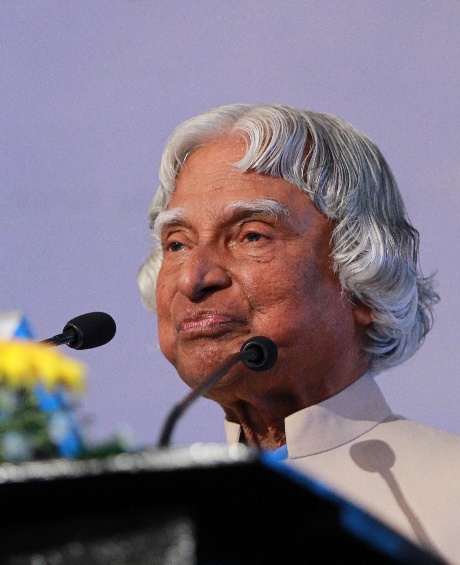
Reading Comprehension
Read the passage and answer the following questions:
Dr. A.P.J. Abdul Kalam is regarded as one of the greatest scientists of the 21st century. He was the 11th President of India. He made a significant contribution to ISRO (Indian Space Research Organization). He helped in the development of Agni and Prithvi missiles and is known as the ‘Missile Man of India’. He also played a major role in developing the first indigenous satellite launch vehicle.
Notes:
Notes for Teacher - Not applicable Suggestions: Not applicable
Source of Multimedia used in this slide - https://commons.wikimedia.org/wiki/File:A._P._J._Abdul_Kalam_%2824207908030%29.jpg

Slide 3
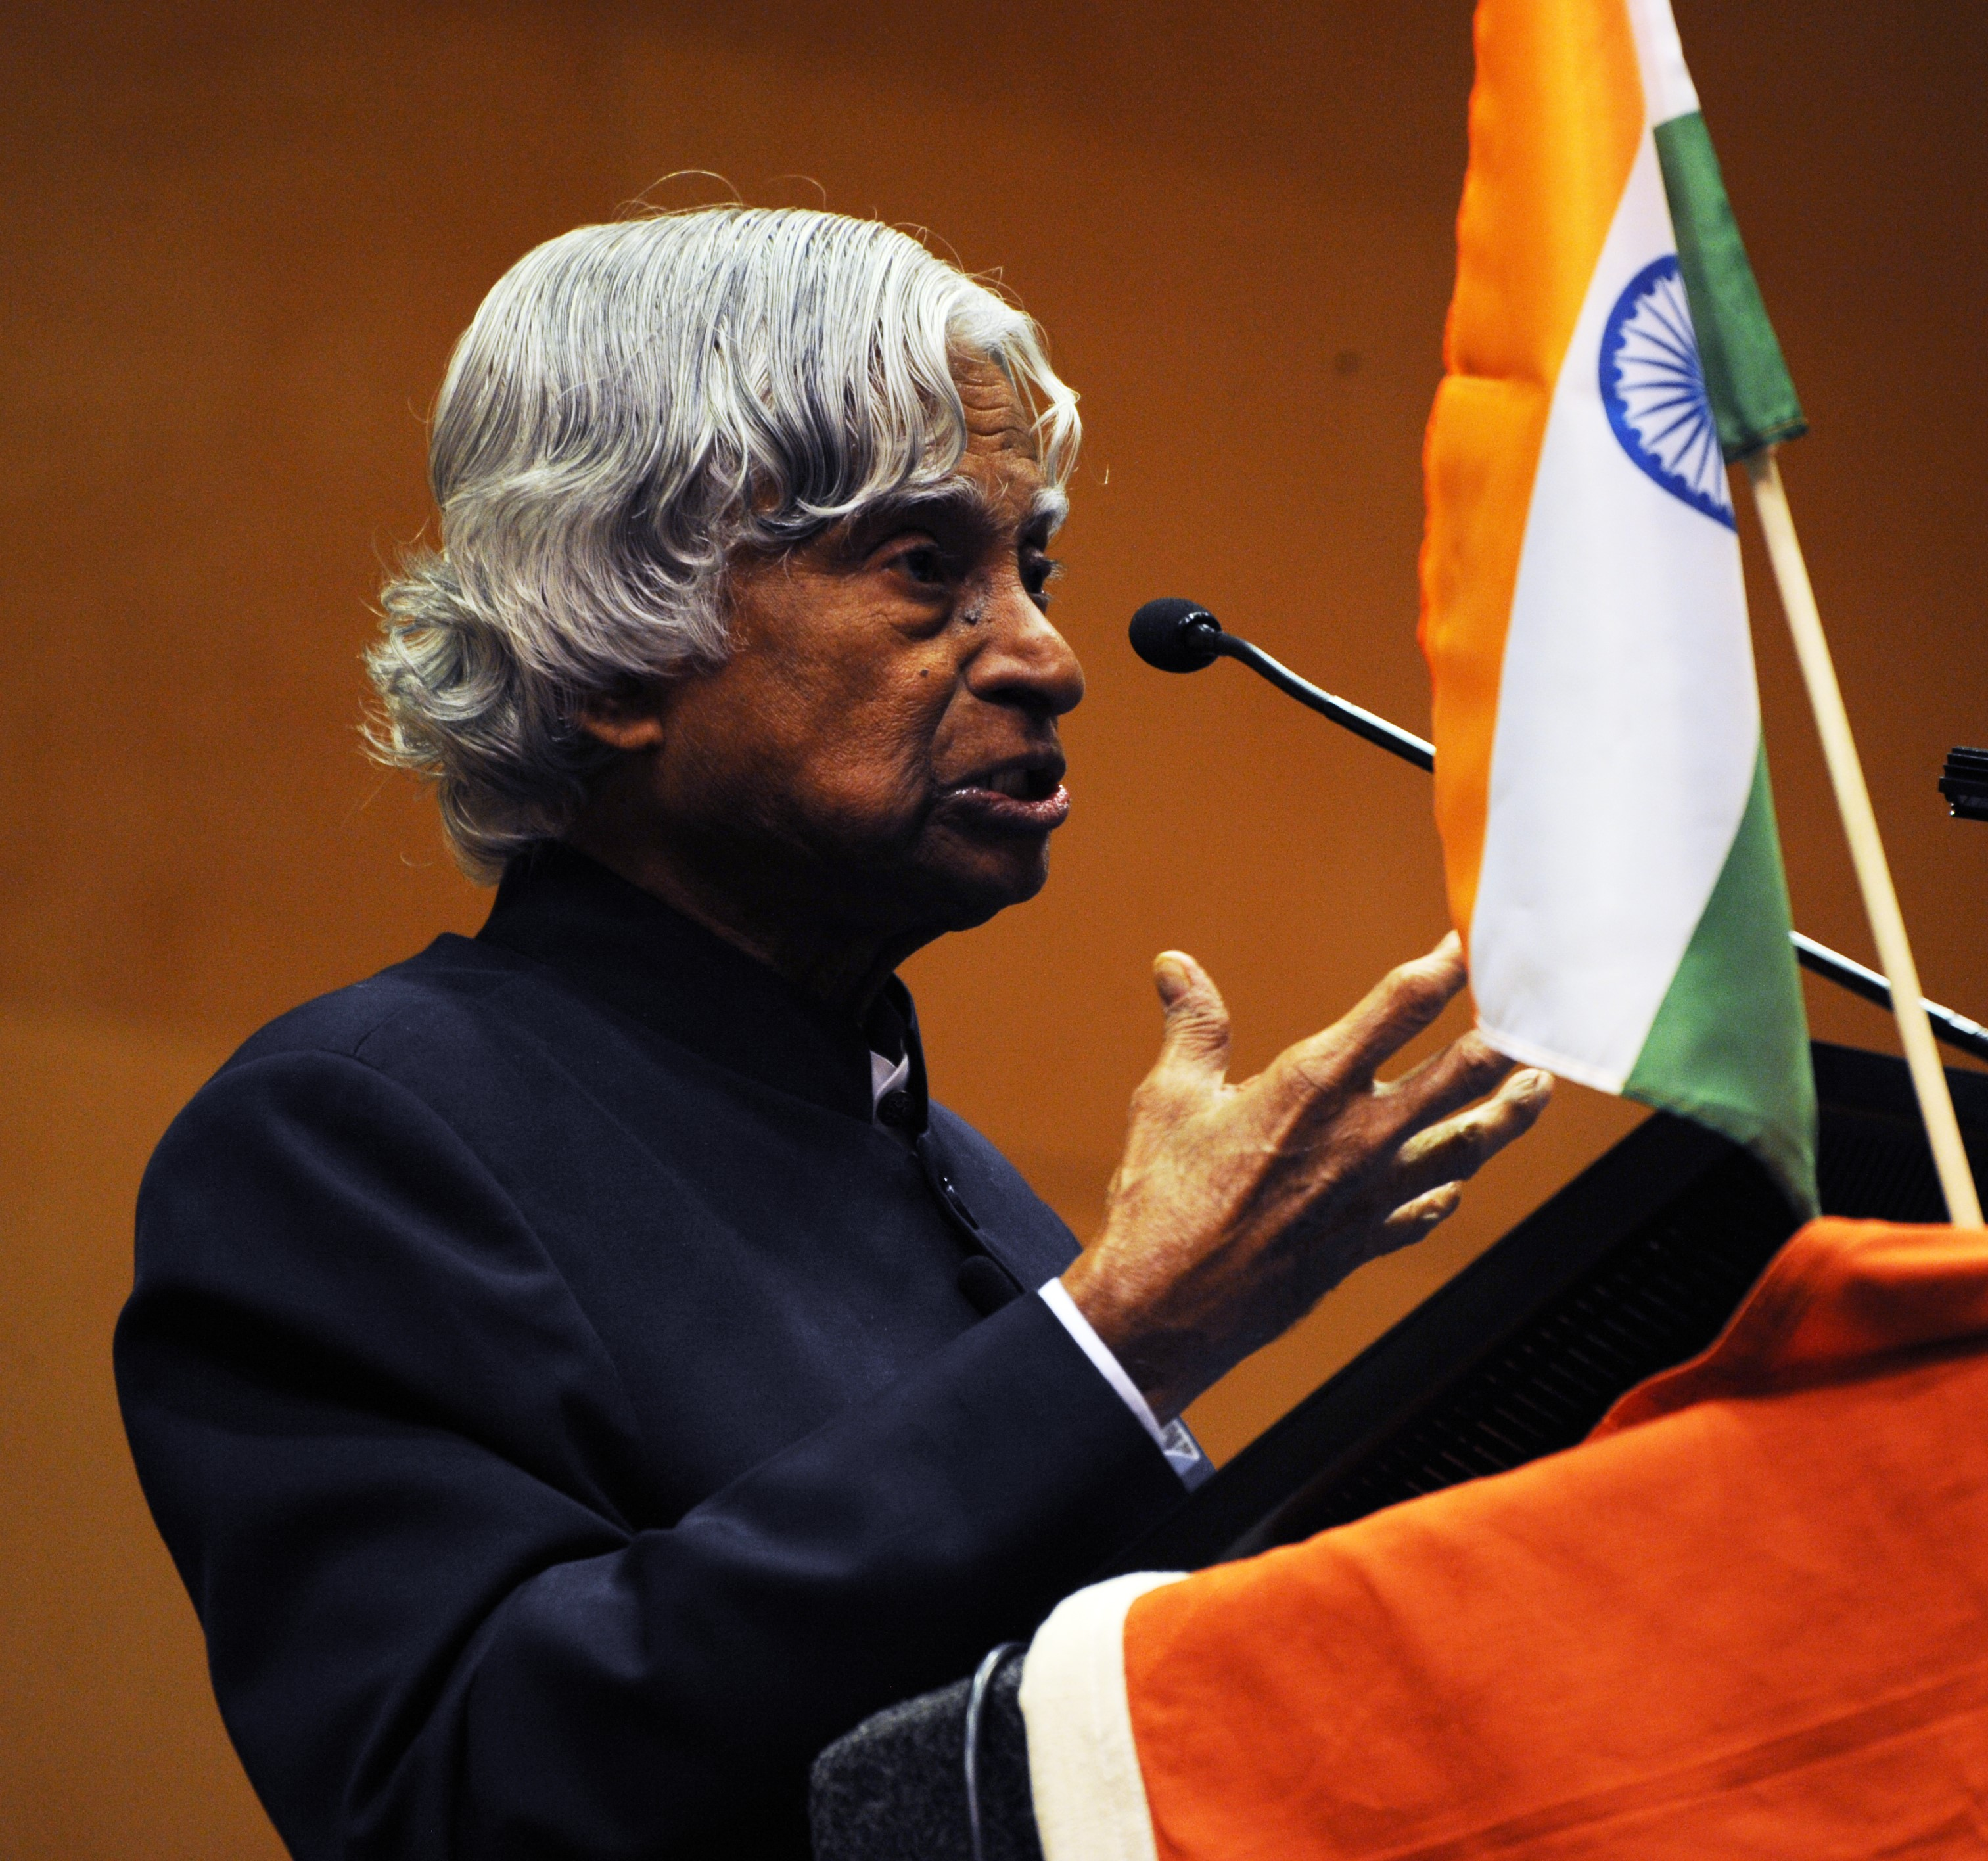
Reading Comprehension
Dr. A.P.J. Abdul Kalam was the Chief Scientific Adviser to the Prime Minister and the Secretary of the DRDO from 1992 to 1999. He was also the Chief Project Coordinator during the Pokhran II tests. He received the coveted civilian awards – Padma Bhushan (1981), Padma Vibhushan (1990) and the highest civilian honour Bharat Ratna (1997). He was a recipient of several other awards and a fellow of many professional institutions.
Notes:
Notes for Teacher - Not applicable Suggestions: Not applicable
Source of Multimedia used in this slide - https://commons.wikimedia.org/wiki/File:Dr._A.P.J_Abdul_Kalam_%284048070416%29.jpg

Slide 4
Reading Comprehension
Shri Kalam was born in a poor family in Tamil Nadu. From an early age, he supported his family financially by selling newspapers. He was a very bright and hardworking student with a strong will to learn. He spent long hours studying his subjects, especially Mathematics. His father inspired him to follow his dreams. He wanted Kalam to pursue higher studies and allowed him to go to Ramanathapuram. He convinced Kalam’s mother to allow him to go and pursue higher education. Kalam graduated as an aeronautical engineer from Indian Institute of Technology (IIT), Madras. He inspired students with his famous speeches and quotes.
“If you want to shine like the sun, first burn like the sun.” – Abdul Kalam
Notes:
Notes for Teacher - Not applicable Suggestions: Not applicable
Source of Multimedia used in this slide - Not applicable

Slide 5
Let’s Answer!
Q1. Where was Dr. Abdul Kalam born?
Ans 1: Dr. Abdul Kalam was born in Tamil Nadu.
Q2. What is he popularly known as?
Click for answers
Ans 2: He is popularly known as the Missile Man of India.
Q3. List the awards and recognitions received by him.
Ans 3: He was the recipient of the Padma Bhushan (1981), Padma Vibhushan (1990) and the highest civilian honour Bharat Ratna (1997). He also received several other awards and was a fellow of many professional institutions.
Notes:
Notes for Teacher - Not applicable Suggestions: Not applicable
Source of Multimedia used in this slide - Not applicable

Slide 6
Let’s Answer!
Q4. How was Dr. Kalam’s attitude as a student?
Ans 4: He was a very bright and hardworking student with a strong will to learn. He spent long hours studying his subjects, especially Mathematics. He was also aware of his family’s financial situation and supported his family by selling newspapers.
Click for answers
Q5. What do ISRO and IIT stand for?
Ans 5: ISRO – Indian Space Research Organisation;
IIT – Indian Institute of Technology
Notes:
Notes for Teacher - Not applicable Suggestions: Not applicable
Source of Multimedia used in this slide - Not applicable

Slide 7
Let’s Answer!
Q6. Give a suitable title to the passage.
Ans 6: Kalam – A Source of Inspiration (or)
A.P.J. Abdul Kalam – The Missile Man of India
Click for answer
Q7. Abdul Kalam achieved his goal of becoming the Missile Man. Have you thought of your goal in life?
Notes:
Notes for Teacher - Not applicable Suggestions: Not applicable
Source of Multimedia used in this slide - Not applicable

Slide 8
Attribution / Citation
Slide # | Thumbnail | Source link | Author
2 |  | https://commons.wikimedia.org/wiki/File:A._P._J._Abdul_Kalam_%2824207908030%29.jpg | Damith Wickramasinghe
3 |  | https://commons.wikimedia.org/wiki/File:Dr._A.P.J_Abdul_Kalam_%284048070416%29.jpg | Tulane Public Relations
Notes:
Notes for Teacher - Not applicable Suggestions: Not applicable
Source of Multimedia used in this slide - Not applicable

