Slide 1
Who Am I
?
Notes:
Notes for Teacher - Objective- Students will be able to identify the objects with the help of adjectives used to describe them
Suggestions: Idea to start with
Teacher - Here are some riddles for you today, let us solve them.
Source of Multimedia used in this slide - <Please provide source URL where we find the image and the license agreement>

Slide 2
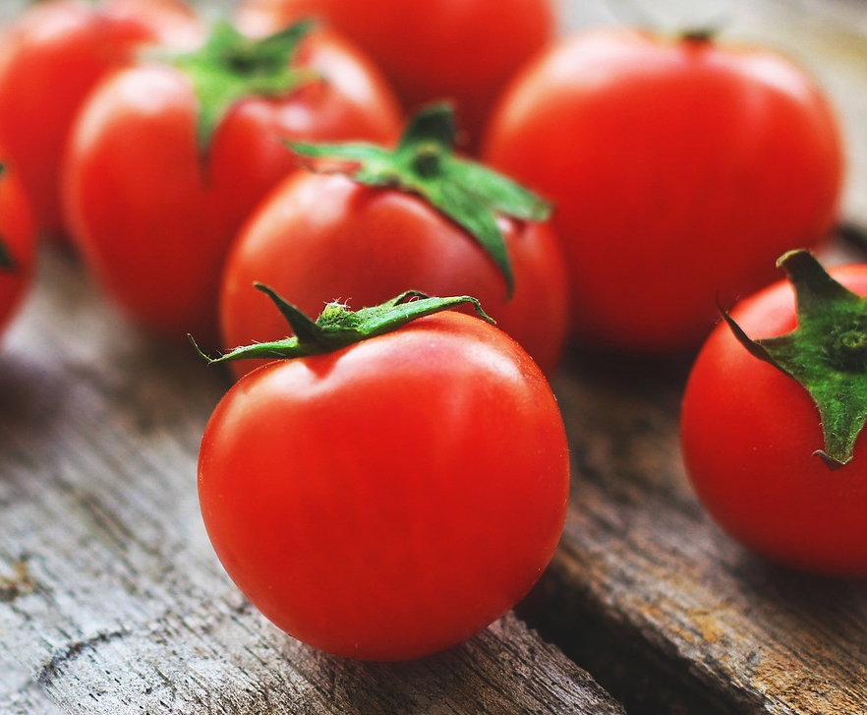
Who am I?
I am a small, tangy, red fruit but people think that I am a vegetable.
Tomato
WHO AM I
?
Notes:
Notes for Teacher -
Suggestions: <Ideas/ Images/ Animations / Others – To make better representation of the content >
Source of Multimedia used in this slide - https://pixabay.com/photos/tomatoes-vegetables-food-fresh-4238247/

Slide 3
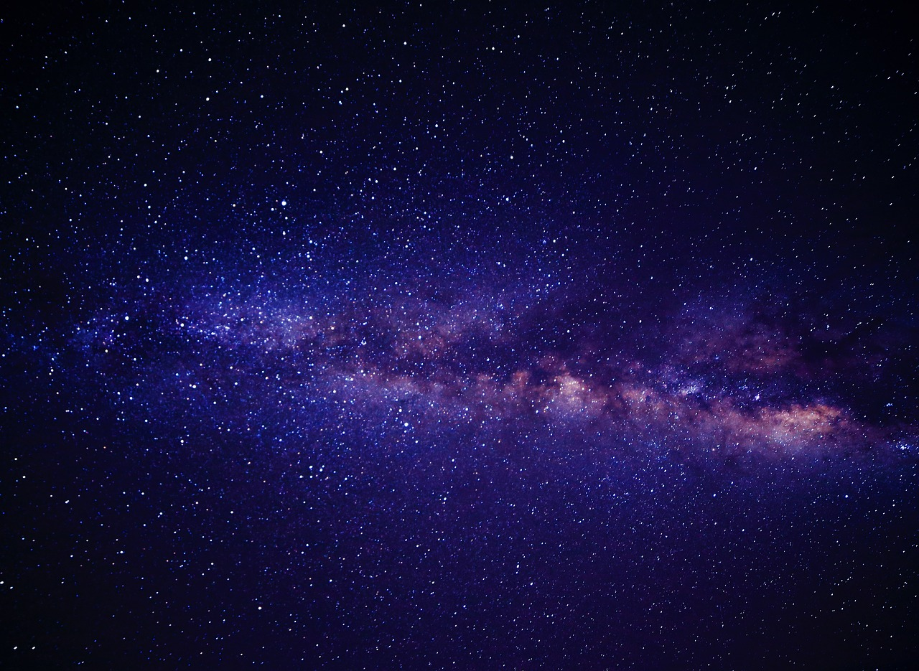
Who am I?
I am a beautiful, tiny, silver light that shines at night.
Star
WHO AM I
?
Notes:
Notes for Teacher - < Information for further reference or explanation >
Suggestions: <Ideas/ Images/ Animations / Others – To make better representation of the content >
Source of Multimedia used in this slide - https://pixabay.com/photos/stars-sky-night-starry-sky-1837306/

Slide 4
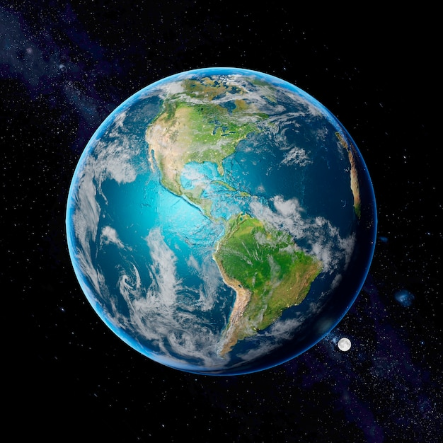
Who am I?
I am a big, bluish green, spherical planet.
Earth
WHO AM I
?
Notes:
Notes for Teacher - < Information for further reference or explanation >
Suggestions: <Ideas/ Images/ Animations / Others – To make better representation of the content >
Source of Multimedia used in this slide - https://www.freepik.com/free-photo/3d-rendering-planet-earth_44957909.htm

Slide 5
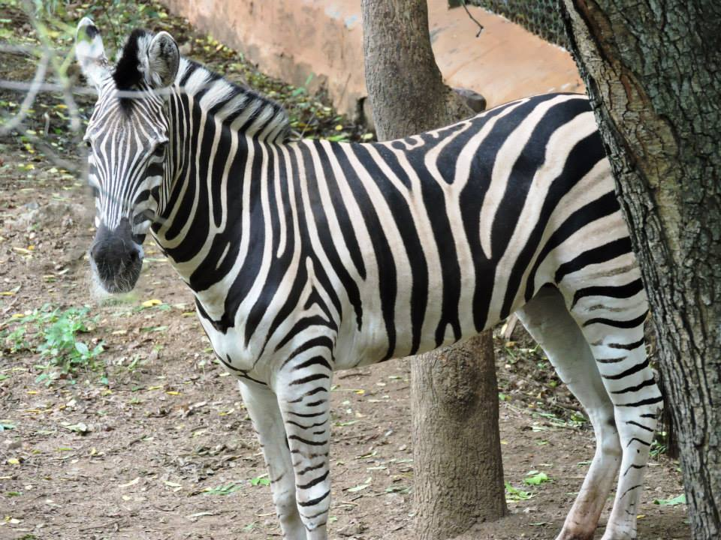
Who am I?
I am a herbivorous, tall, black and white striped animal.
Zebra
WHO AM I
?
Notes:
Notes for Teacher - < Information for further reference or explanation >
Suggestions: <Ideas/ Images/ Animations / Others – To make better representation of the content >
Source of Multimedia used in this slide - SSSVV Gallery

Slide 6
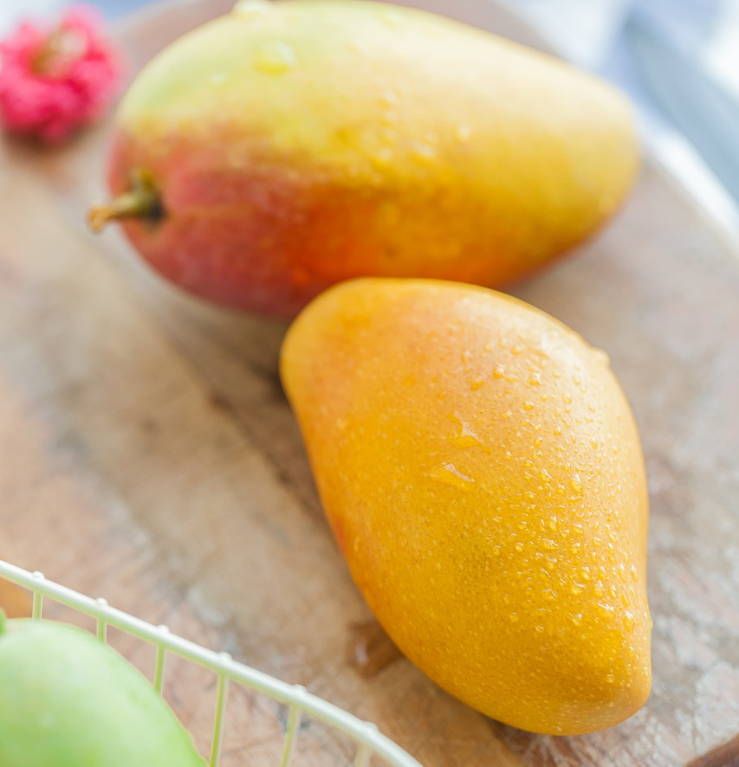
Who am I?
I am a delicious, big, golden yellow, Indian fruit.
Mango
?
WHO AM I
Notes:
Notes for Teacher - < Information for further reference or explanation >
Suggestions: <Ideas/ Images/ Animations / Others – To make better representation of the content >
Source of Multimedia used in this slide - https://pixabay.com/photos/mango-chaise-mans-hainan-sanya-2215041/

Slide 7
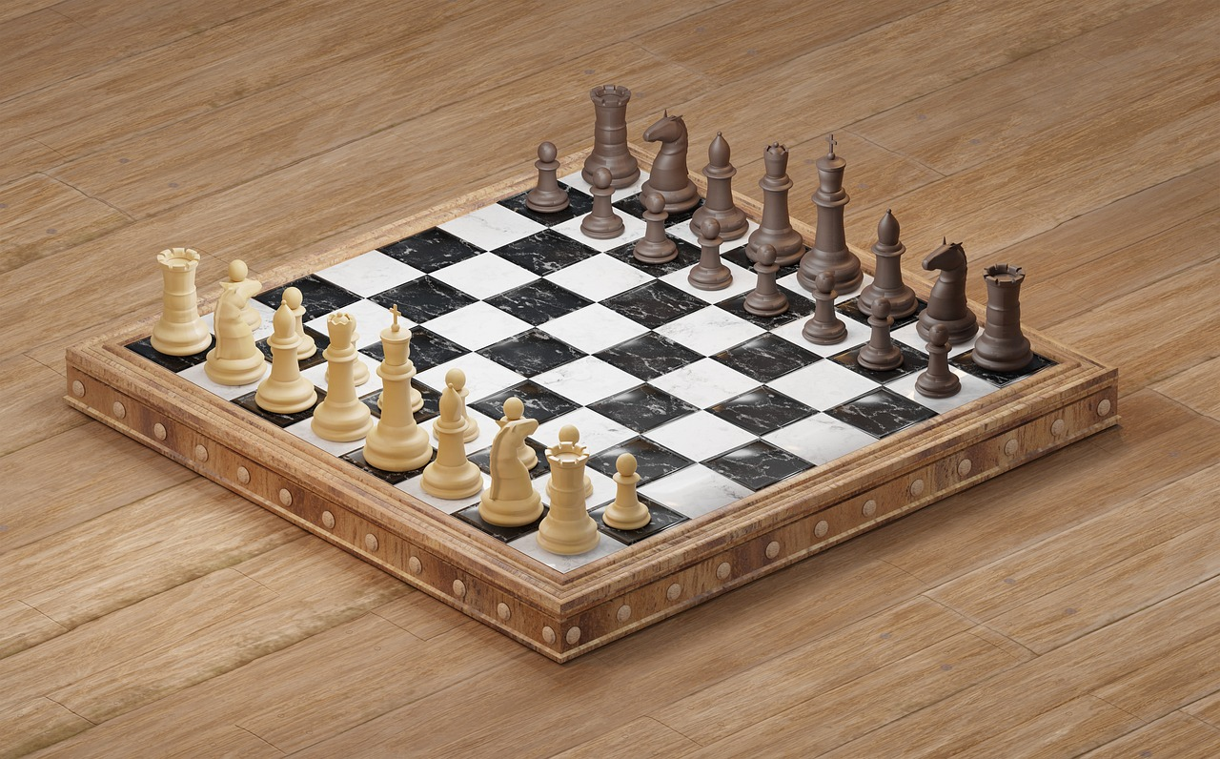
Who am I?
I am a flat, black and white chequered gaming board.
WHO AM I
Chessboard
?
Notes:
Notes for Teacher - Teacher - What are these underlined words ,yes they are adjectives, words used to describe a noun. Remember with the help of these adjectives you were able to solve the riddles.
Suggestions: <Ideas/ Images/ Animations / Others – To make better representation of the content >
Source of Multimedia used in this slide - https://pixabay.com/photos/chess-chess-board-knight-king-pawn-5395175/

Slide 8
Attribution / Citation
Slide # | Thumbnail | Source link | Author
2 |  | https://pixabay.com/photos/tomatoes-vegetables-food-fresh-4238247/ | -Lernestorod
3 |  | https://pixabay.com/photos/stars-sky-night-starry-sky-1837306/ | Pexels
4 |  | SSSVV Gallery
5 |  | https://www.freepik.com/free-photo/3d-rendering-planet-earth_44957909.htm - | freepik
6 |  | https://pixabay.com/photos/mango-chaise-mans-hainan-sanya-2215041/ | luhaifeng279
7 |  | https://pixabay.com/photos/chess-chess-board-knight-king-pawn-5395175/ | taintedtextures
Notes:
Notes for Teacher - < Information for further reference or explanation >
Suggestions: <Ideas/ Images/ Animations / Others – To make better representation of the content >
Source of Multimedia used in this slide - <Please provide source URL where we find the image and the license agreement>

