Slide 1
Gaining Knowledge -
Direct and Indirect Speech
Notes:
Notes for Teacher - < Information for further reference or explanation >
Suggestions: <Ideas/ Images/ Animations / Others – To make better representation of the content >
Source of Multimedia used in this slide - https://pixabay.com/de/photos/schule-klassenzimmer-lehrer-7047287/Anilsharma26

Slide 2
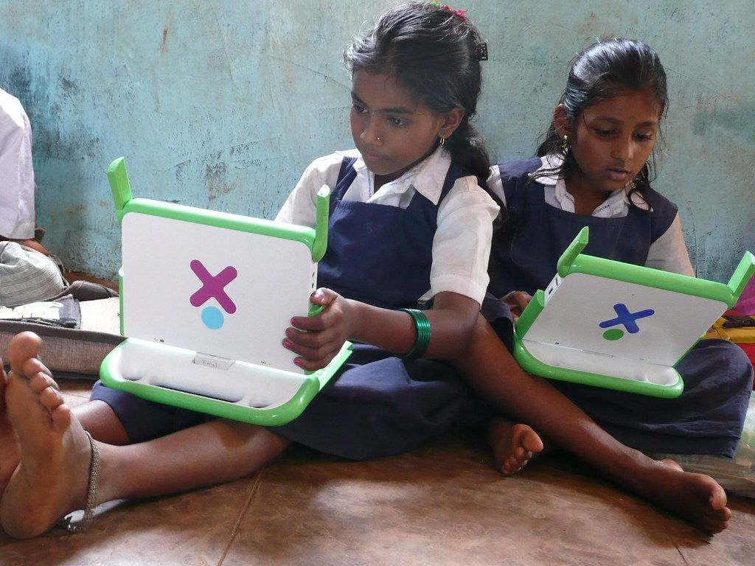
Introducing Direct and Indirect Speech
Rekha and Reema converse on a simple topic - Today’s weather
“The weather is very pleasant today.”
Rekha said that the weather was very pleasant that day.
Direct Speech - exact words spoken by a person and placed within quotation marks.
Indirect speech - report something said or written by another person, without using quotation marks or using the exact words.
Direct Speech or ‘Quoted speech,’ uses the exact words of the speaker.
Indirect speech or ‘Reported speech,’ narrates what is spoken by a person.
Direct Speech is the speech spoken by someone. Indirect speech is narrated from the listener’s viewpoint.
Notes:
Notes for Teacher - After the discussion on the IQ asset the teacher may use the Interactive Approach to introduce Direct and Indirect Speech with a short dialogue.
Through this dialogue the teacher may ask the students to state one difference that they noticed.
Suggestions: <Ideas/ Images/ Animations / Others – To make better representation of the content >
Source of Multimedia used in this slide - "India girls Banner" by One Laptop per Child is licensed under CC BY 2.0.///
One Laptop per Child

Slide 3
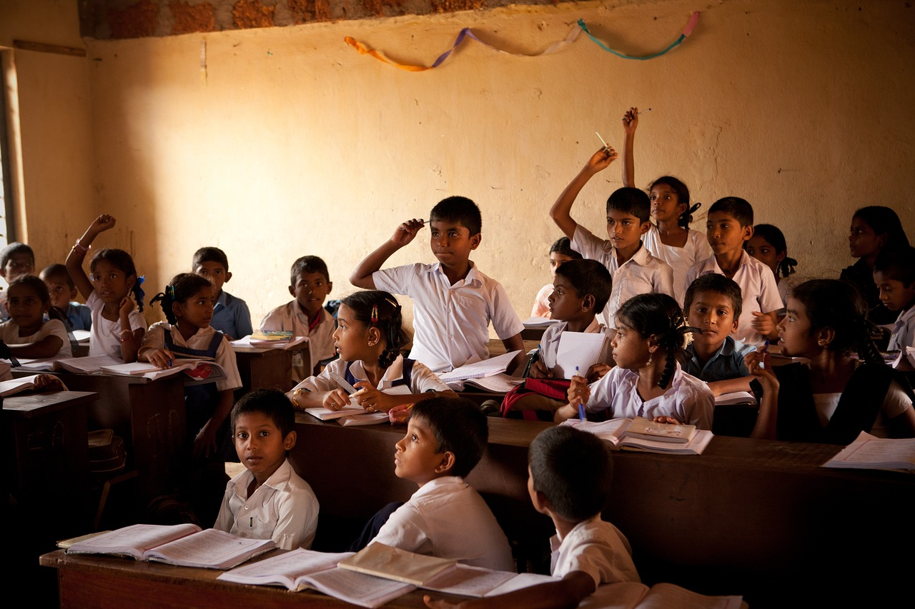
Rules for changing Direct to Indirect Speech
Rule 1. | We remove Inverted Commas and use ‘that’ while changing direct to indirect speech. | Example: Direct Speech - She said, “I can sing.” Indirect Speech: She said that she could sing.
Notes:
Notes for Teacher - The teacher may then explain a few rules to change Direct speech to Indirect speech:
https://pixabay.com/de/photos/schule-klassenzimmer-kinder-jungen-298680/Akshayapatra

Slide 4
Rules for changing Direct to Indirect Speech
Rule 2. Pronouns | Direct | Indirect Speech / Reported Speech
 | I we you you us me my mine our ours your ours | he, she they I, he, she, we they, him, her, them, us them him, her his, her his, hers their theirs my, his, her, our, their mine, his, hers, ours, theirs

Slide 5
Rules for changing Direct to Indirect Speech
Rule 3 .Tense | Direct Speech | Indirect Speech
Present Simple | I like ice cream | He said that he liked ice cream
Present Continuous | I am living in New Delhi. | He said that he is living in New Delhi.
Simple Past | I bought a motorbike. | He said he bought a motorbike.
Past Continuous | I was listening to the DD news channel. | He said he was listening to the DD news channel.
Contd…

Slide 6
Rules for changing Direct to Indirect Speech
Some Exceptions | If the sentence is in direct speech and it states scientific or universal truth. Example: The teacher said: “Water has three forms: solid, liquid and gas.” Regular habits do not change to their past tense form in indirect speech. Example: “I go for swimming everyday.” Ramu said If the reporting verb has says. Example: He says: ”I like dancing.” | This sentence doesn’t change to the past form in indirect speech, the tense remains the same. The teacher said that water has three forms: solid, liquid and gas. Ramu said he goes for swimming everyday. Reporting verb does not change. He says that he likes dancing.

Slide 7
Rules for changing Direct to Indirect Speech
Rule 4.Changes Adverbs/ Adjectives | Here This These Now Ago Today Tomorrow Tonight Yesterday Last week Next week | There That Those Then Before That day The next day or the following day That night The previous day/ the day before The week before/ previous week The week after/ the following week

Slide 8
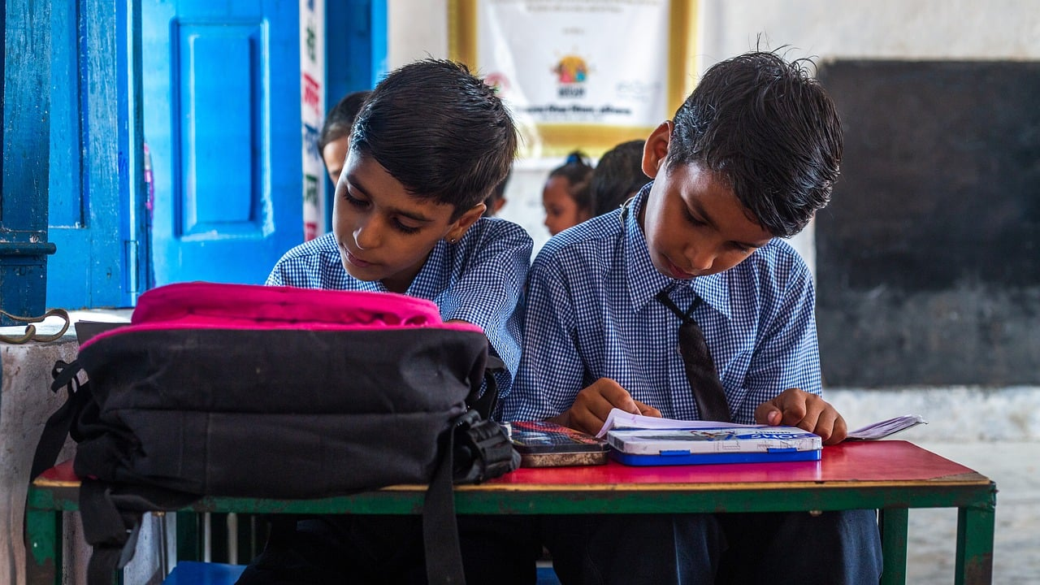
Rules for changing Direct to Indirect Speech
Rule 5. Modals | Can Will May Shall Must | Could Would Might Should Have to / had to
Notes:
https://pixabay.com/de/photos/indische-schulkinder-8196287/SwastikArora

Slide 9
Attribution / Citation
Slide # | Thumbnail | Source link | Author
1 |  | https://pixabay.com/de/photos/schule-klassenzimmer-lehrer-7047287/ | Anilsharma26
2 |  | https://www.flickr.com/photos/27861585@N02/3080618518 | One Laptop per Child
3 |  | https://pixabay.com/de/photos/schule-klassenzimmer-kinder-jungen-298680/ | Akshayapatra
8 |  | https://pixabay.com/de/photos/indische-schulkinder-8196287/ | SwastikArora
Notes:
Notes for Teacher - < Information for further reference or explanation >
Suggestions: <Ideas/ Images/ Animations / Others – To make better representation of the content >
Source of Multimedia used in this slide - <Please provide source URL where we find the image and the license agreement>

