Slide 1
Summary
Simile & Personification
Notes:
Notes for Teacher - < Information for further reference or explanation >
Suggestions: <Ideas/ Images/ Animations / Others – To make better representation of the content >
Source of Multimedia used in this slide - <Please provide source URL where we find the image and the license agreement>
Background - https://www.freepik.com/free-vector/set-wooden-sign-banner_24465062.htm#page=2&query=board&position=1&from_view=search&track=sph (@brgfx)

Slide 2
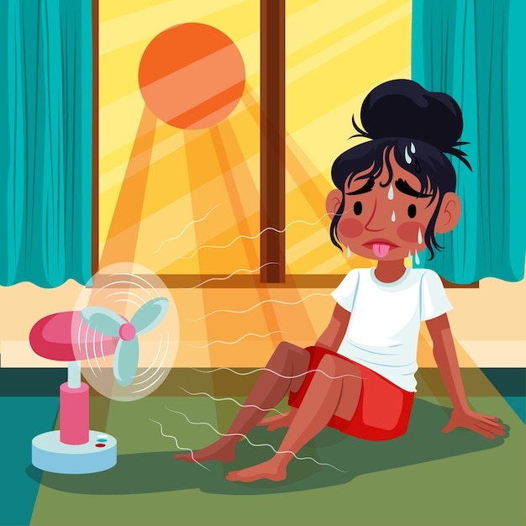
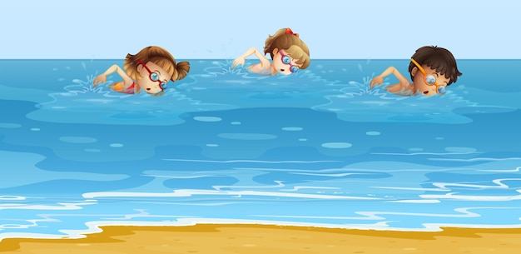
Summary
Simile
Personification
This room is like an oven.
The pool invited us to come and swim.
Compares two unlike things using “like” or “as”.
Giving human qualities to non-human things (animals or objects).
Shows similarity between the two
things compared.
Human qualities can be actions, behaviour, emotions etc.
Notes:
Notes for Teacher – < Information for further reference or explanation >
Suggestions: <Ideas/ Images/ Animations / Others – To make better representation of the content >
Source of Multimedia used in this slide - <Please provide source URL where we find the image and the license agreement>
Room - https://www.freepik.com/free-vector/flat-summer-heat-illustration-with-woman-sweating-front-fan_27432029.htm#query=hot%20room&position=21&from_view=search&track=ais (@freepik)
Swimming pool - https://www.freepik.com/free-vector/children-swimming-ocean_22747068.htm#page=3&query=swimming%20pool&position=3&from_view=search&track=ais (@brgfx)

Slide 3
Attribution / Citation
Slide # | Thumbnail | Source link | Author
1 |  | Background - https://www.freepik.com/free-vector/set-wooden-sign-banner_24465062.htm#page=2&query=board&position=1&from_view=search&track=sph | Brgfx
2 |  | Room - https://www.freepik.com/free-vector/flat-summer-heat-illustration-with-woman-sweating-front-fan_27432029.htm Swimming pool - https://www.freepik.com/free-vector/children-swimming-ocean_22747068.htm | freepik brgfx
Notes:
Notes for Teacher - < Information for further reference or explanation >
Suggestions: <Ideas/ Images/ Animations / Others – To make better representation of the content >
Source of Multimedia used in this slide - <Please provide source URL where we find the image and the license agreement>

