Slide 1
Rules for Subject Verb Agreement
Notes:
Notes for Teacher - < Information for further reference or explanation >
Suggestions: <Ideas/ Images/ Animations / Others – To make better representation of the content >
Source of Multimedia used in this slide - <Please provide source URL where we find the image and the license agreement>

Slide 2
The Subject and Its number
Identify the subject in each of the sentences and state its number
Anil and Sunil are walking to school.
Neither the farmer nor the bull was available for
  sowing the seeds.
A few seats in the train are still vacant.
The quality of mangoes was not good.
Physics is an interesting subject.
PLURAL
SINGULAR
PLURAL
SINGULAR
SINGULAR
Click for answers
Notes:
Notes for Teacher - After the identification is done, the teacher could draw the attention to the 2nd sentence and explain why the subject is singular when there are two nouns in it and also the 4th sentence where the word ‘mangoes’ is plural yet the subject is singular. Ask whether the verbs are dependent on the subject and its number in the sentence and lead them to the topic of discussion- MS_Rules for Subject Verb Agreement.
Suggestions: <Ideas/ Images/ Animations / Others – To make better representation of the content >
Source of Multimedia used in this slide - <Please provide source URL where we find the image and the license agreement>

Slide 3
Rules for Subject Verb Agreement
Subject in a sentence:
Every sentence has a subject and a predicate. The subject represents what or whom the sentence is about.
E.g. The girl ate the biscuits. The girl is the subject.
Predicate in a sentence:
The predicate is the part of the sentence, or a clause, that tells what the subject is doing or what the subject is.
E.g. The girl ate the biscuits. Here ‘ate the biscuits’ is the predicate. The predicate always begins with a verb.
The girl ate the biscuits. (girl- subject, ate- verb)
Agreement of Subject with Verb
When the subject is singular the verb must be in agreement.
When the subject is plural the verb must be in agreement.

Slide 4


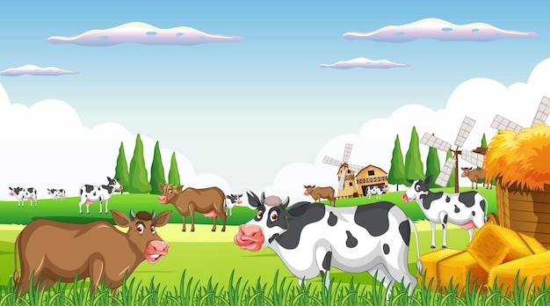
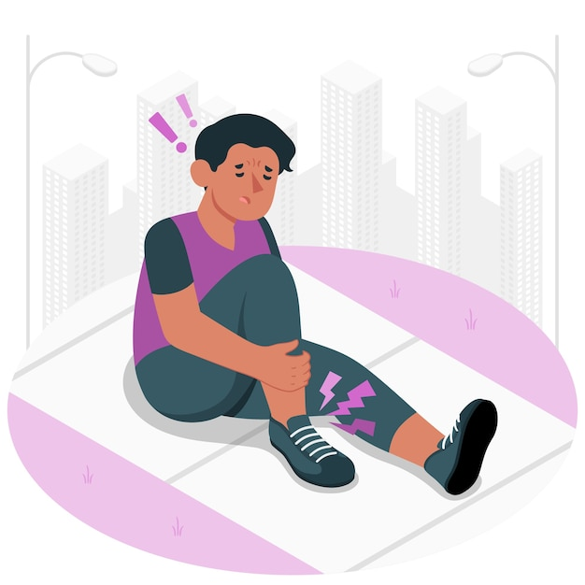
Rules for Subject Verb Agreement
WHEN THE SUBJECT………………. | VERB TO BE USED
ends in an -s but is singular in meaning E.g. The news is all about the floods in Himachal Pradesh. | singular
2. has a collective noun like a flock of sheep, a bunch of grapes etc.(Cattle and people take a plural verb) E.g. A bunch of grapes is always kept on the table. The cattle are grazing in the field. | singular plural
3. is ‘one of ‘ followed by a plural noun E.g. One of the players was hurt during the match. | singular (to agree with one)
Notes:
Notes for Teacher –
Suggestions: <Ideas/ Images/ Animations / Others – To make better representation of the content >
Source of Multimedia used in this slide - <Please provide source URL where we find the image and the license agreement>
https://www.freepik.com/free-vector/tsunami-ocean-front-with-bungalow-tropical-coast_7437858.htm
https://www.freepik.com/free-vector/vector-bunch-grapes-plate-with-leaves-isolated-wooden-background-top-view_11062322.htm
https://www.freepik.com/free-vector/outdoor-cow-farm-scene-with-happy-animals-cartoon_25593225
https://www.freepik.com/free-vector/food-pain-concept-illustration_40329586.htm

Slide 5

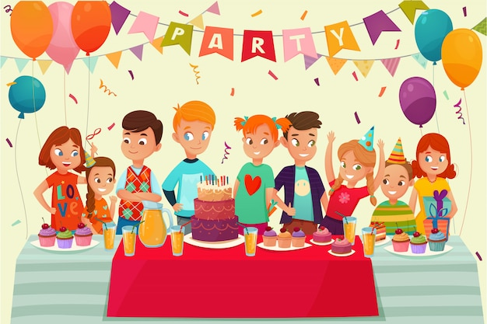
Rules for Subject Verb Agreement
WHEN THE SUBJECT………………. | VERB TO BE USED
4. is an uncountable noun (E.g. money, rice, time, water, grass, oil, time) E.g. Time seems to fly while playing a game. | singular
5. is a paired conjunction that agrees with the nearest noun (E.g. either….or, neither…nor, not only…. but also, not….but) E.g. Neither Rajiv nor his brothers want to miss the party. Neither the elder boys nor Rajiv wants to miss the party. | plural singular
Notes:
Notes for Teacher –
Suggestions: <Ideas/ Images/ Animations / Others – To make better representation of the content >
Source of Multimedia used in this slide - https://www.freepik.com/free-vector/game-streamer-concept-elements-illustrated_13597630.htm
https://www.freepik.com/free-vector/kids-party-poster_4385359.htm

Slide 6
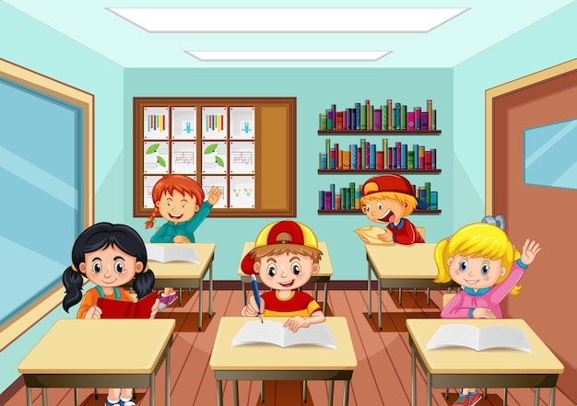
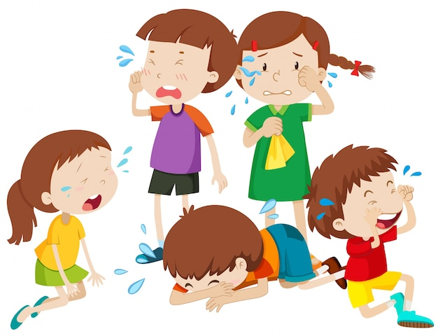
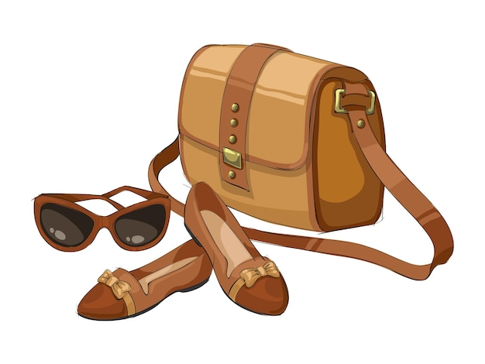
Rules for Subject Verb Agreement
WHEN THE SUBJECT………………. | VERB TO BE USED
6. an indefinite pronoun (E.g. everyone, anyone, nothing, everything, everybody, each, either, neither, no one, one, someone, anybody, somebody ) E.g. Everyone has to attend the class tomorrow. | singular
7. begins with the following words both, a few, few, many, several E.g. Many students fell sick after drinking the contaminated water. | plural
8. has names of things that come in pairs (E.g. spectacles, shoes, scissors, trousers) E.g. My pair of spectacles are in my bag. | plural
Notes:
Notes for Teacher –
Suggestions: <Ideas/ Images/ Animations / Others – To make better representation of the content >
Source of Multimedia used in this slide -
https://www.freepik.com/free-vector/scene-with-many-kids-studying-classroom_18342596.htm
https://www.freepik.com/free-vector/five-kids-crying-with-tears-illustration_1138560.htm
https://www.freepik.com/free-vector/fashion-accessory-composition-with-isolated-image-luxury-female-goods-blank-background-vector-illustration_23128839.htm

Slide 7


Rules for Subject Verb Agreement
WHEN THE SUBJECT………………. | VERB TO BE USED
9. refers to a category of things (E.g. crockery, cutlery, furniture, clothing, stationery, footwear. These words have no plural form) E.g. This furniture is made of wood. | singular
10. has plural numbers that apply to amounts of money, weights, distances, heights taken as a whole (it is considered as a singular subject) E.g. Five hundred rupees is a lot of money. | singular
Notes:
Notes for Teacher –
Suggestions: <Ideas/ Images/ Animations / Others – To make better representation of the content >
Source of Multimedia used in this slide -
https://www.freepik.com/free-vector/flashcard-brown-color-furniture-white-background_1148491.htm
https://www.freepik.com/free-vector/wads-bills-design-with-white-background_1108340.htm

Slide 8


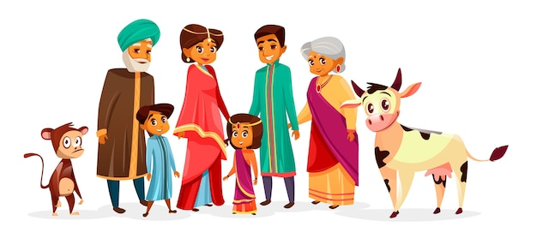
Rules for Subject Verb Agreement
WHEN THE SUBJECT………………. | VERB TO BE USED
11. has two or more singular nouns or pronouns joined by ’and’. E.g. Kavita and Sheela are good friends. But if the two nouns joined by ’and’ refer to the same person, thing or idea it is a singular subject. E.g. The great thinker and scientist was given an award for his service to the nation. | plural singular
12. has two singular nouns joined by ‘and’ and are preceded by each or every E.g. Every man and every woman in this village is educated. | singular
Notes:
Notes for Teacher –
Suggestions: <Ideas/ Images/ Animations / Others – To make better representation of the content >
Source of Multimedia used in this slide -
https://www.freepik.com/free-vector/hand-drawn-sari-illustration_31751699.htm
https://en.wikipedia.org/wiki/A._P._J._Abdul_Kalam#/media/File:A._P._J._Abdul_Kalam.jpg
https://www.freepik.com/free-vector/indian-family-people-hindu-national-clothes-cartoon-indian-characters_2703434.htm

Slide 9

Rules for Subject Verb Agreement
WHEN THE SUBJECT………………. | VERB TO BE USED
13. begins with a lot of, a plenty of, some of, half of, most of take a plural verb if the reference is to the number (countable noun). E.g. Some of the shops were closed by the time I got there. But they take a singular verb if the reference is to amount or quantity (non-countables). E.g. Half of the money is spent. | plural singular
Notes:
Notes for Teacher –
Suggestions: <Ideas/ Images/ Animations / Others – To make better representation of the content >
Source of Multimedia used in this slide -
https://www.freepik.com/free-vector/closed-sign-concept-illustration_13106804.htm
https://www.freepik.com/free-vector/wads-bills-design-with-white-background_1108340.htm

Slide 10
Attribution / Citation
Slide # | Thumbnail | Source link | Author
4 |  | https://www.freepik.com/free-vector/tsunami-ocean-front-with-bungalow-tropical-coast_7437858.htm https://www.freepik.com/free-vector/vector-bunch-grapes-plate-with-leaves-isolated-wooden-background-top-view_11062322.htm https://www.freepik.com/free-vector/outdoor-cow-farm-scene-with-happy-animals-cartoon_25593225 https://www.freepik.com/free-vector/food-pain-concept-illustration_40329586.htm | Macrovector Macrovector Brgfx storyset
5 |  | https://www.freepik.com/free-vector/game-streamer-concept-elements-illustrated_13597630.htm https://www.freepik.com/free-vector/kids-party-poster_4385359.htm | Freepik Macrovector
6 |  | https://www.freepik.com/free-vector/scene-with-many-kids-studying-classroom_18342596.htm https://www.freepik.com/free-vector/five-kids-crying-with-tears-illustration_1138560.htm https://www.freepik.com/free-vector/fashion-accessory-composition-with-isolated-image-luxury-female-goods-blank-background-vector-illustration_23128839.htm | Brgfx Brgfx macrovector
7 |  | https://www.freepik.com/free-vector/flashcard-brown-color-furniture-white-background_1148491.htm https://www.freepik.com/free-vector/wads-bills-design-with-white-background_1108340.htm | Brgfx Dimas_sugih
8 |  | https://www.freepik.com/free-vector/hand-drawn-sari-illustration_31751699.htm https://www.freepik.com/free-vector/happy-cartoon-character-winning-prize_2741432.htm https://www.freepik.com/free-vector/indian-family-people-hindu-national-clothes-cartoon-indian-characters_2703434.htm | Freepik Freepik vectorpouch
9 |  | https://www.freepik.com/free-vector/closed-sign-concept-illustration_13106804.htm https://www.freepik.com/free-vector/wads-bills-design-with-white-background_1108340.htm | Storyset Dimas_Sugih
Notes:
Notes for Teacher - < Information for further reference or explanation >
Suggestions: <Ideas/ Images/ Animations / Others – To make better representation of the content >
Source of Multimedia used in this slide - <Please provide source URL where we find the image and the license agreement>

