Slide 1
Creative Writing
Notes:
Notes for Teacher - < Information for further reference or explanation >
Suggestions: <Ideas/ Images/ Animations / Others – To make better representation of the content >
Source of Multimedia used in this slide - <Please provide source URL where we find the image and the license agreement>

Slide 2
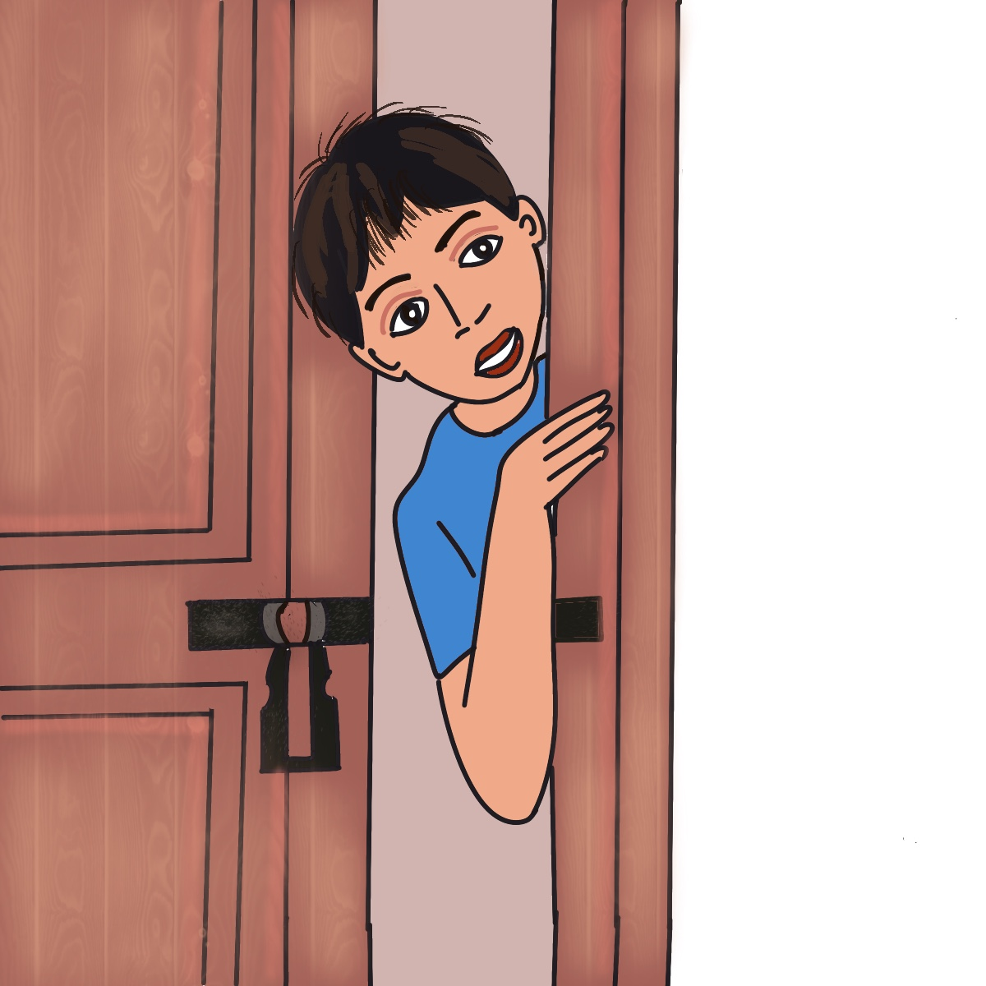
Keen Learners
Frame questions around this sentence
“I opened the door.”
1. Why did you open the door?
2. Who was there when you opened the door?
3. What was there when you opened the door?
4. When did you open the door?
5. Which door did you open?
6. How did you open the door?
Notes:
Notes for Teacher - Ask students to frame questions around the sentence using -why, what, when, which, how.
Explain how the answers to these questions can become the building blocks for many stories
I opened the door because I heard a strange noise coming from inside. (This can lead to a story about finding a stray puppy, an alien hiding inside or a new invention. (Value story or Science fiction.)
I opened the door by mistake, as I was running away from a monster who was chasing me. I saw brilliant light inside the room- (this too can lead to stories Adventures and mysteries.)
There was a weird looking machine inside that could talk, there was a fairy singing as she worked. (This can lead to a fairy tale or a science fiction.)
A kitten was trapped inside,
A prisoner who had escaped. (Values and adventure stories )
(Students can be asked to give their own imaginative answers.
How questions around any sentence can be the seed for numerous stories can be highlighted )
Suggestions: <Ideas/ Images/ Animations / Others – To make better representation of the content >
Source of Multimedia used in this slide - <Please provide source URL where we find the image and the license agreement>
Boy : SSSVV Media bank

Slide 3
Keen Learners
Building blocks for stories
A kitten was trapped inside.
Value Story
There was a fairy singing as she worked.
Fairy tale story
A prisoner who had escaped.
Adventure Stories
I opened the door by mistake, as I was running away from a monster, who was chasing me.
Adventures and mysteries
Notes:
Notes for Teacher – Students can be asked to give their own imaginative answers.
Suggestions: <Ideas/ Images/ Animations / Others – To make better representation of the content >
Source of Multimedia used in this slide - <Please provide source URL where we find the image and the license agreement>
Prisoner : https://www.freepik.com/free-vector/law-justice-isometric-background-with-icons-judge-symbols-wristbands-highly-litigious-prisoner-editable-text-description-illustration_6869951.htm#page=5&query=prisoner&position=29&from_view=search&track=sph (macrovector)
Man : https://www.freepik.com/free-vector/man-running-track-background_1105214.htm#query=indian%20man%20running&position=17&from_view=search&track=ais (freepik)
Monster : https://www.freepik.com/free-vector/goblin-troll-color-silhouette-cartoon-character-white_9957179.htm#
Kitten : https://www.freepik.com/free-vector/cat-walking-narrow-window_27284131.htm#
Fairy : https://www.freepik.com/free-vector/set-cute-fairies-cartoon-charater_43182109.htm#

Slide 4
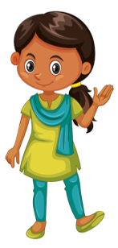
Learn to Craft a Story
Introduction
Hello I am Isha!! I love stories!! I grew up listening to stories from parents and grandparents.
Stories sometimes make you cry, sometimes they make you laugh.
Stories always carry a special message.
I am sure sometimes you may be spinning stories even without realizing it.
Notes:
Notes for Teacher - < Information for further reference or explanation >
Suggestions: <Ideas/ Images/ Animations / Others – To make better representation of the content >
Source of Multimedia used in this slide - <Please provide source URL where we find the image and the license agreement>
Girl : https://www.freepik.com/free-vector/cute-happy-smiling-child-isolated-white_5934381.htm#query=indian%20girl%20character&position=4&from_view=search&track=ais (brgfx)
Laugh : https://www.freepik.com/free-vector/gradient-international-day-happiness-illustration_12812222.htm#query=laugh%20face&position=22&from_view=search&track=ais (pikisuperstar)
Cry : https://www.freepik.com/free-vector/gradient-sad-emoji-illustration_63339185.htm#query=crying%20face&position=2&from_view=search&track=ais (freepik)
Boy : https://www.freepik.com/free-vector/flat-world-book-day-illustration_23871023.htm#query=reading&position=2&from_view=search&track=sph (freepik)

Slide 5
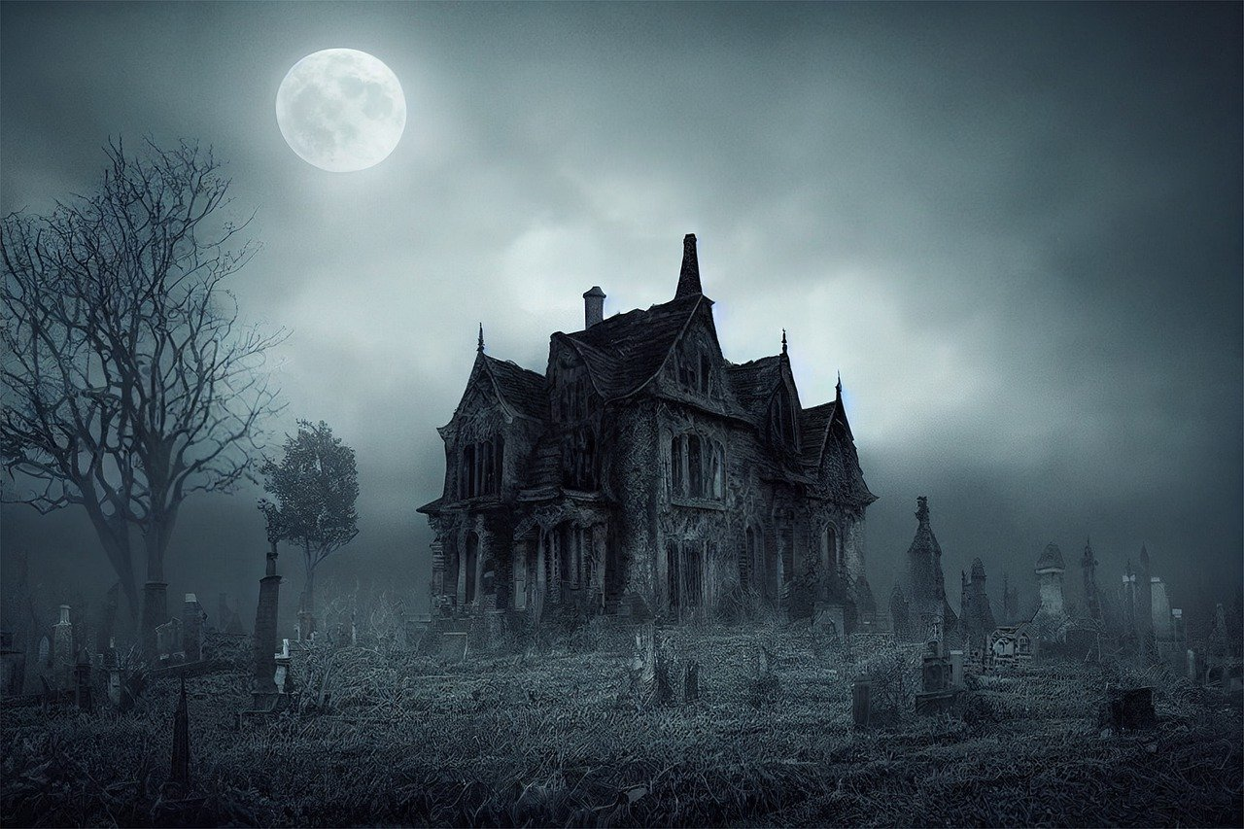
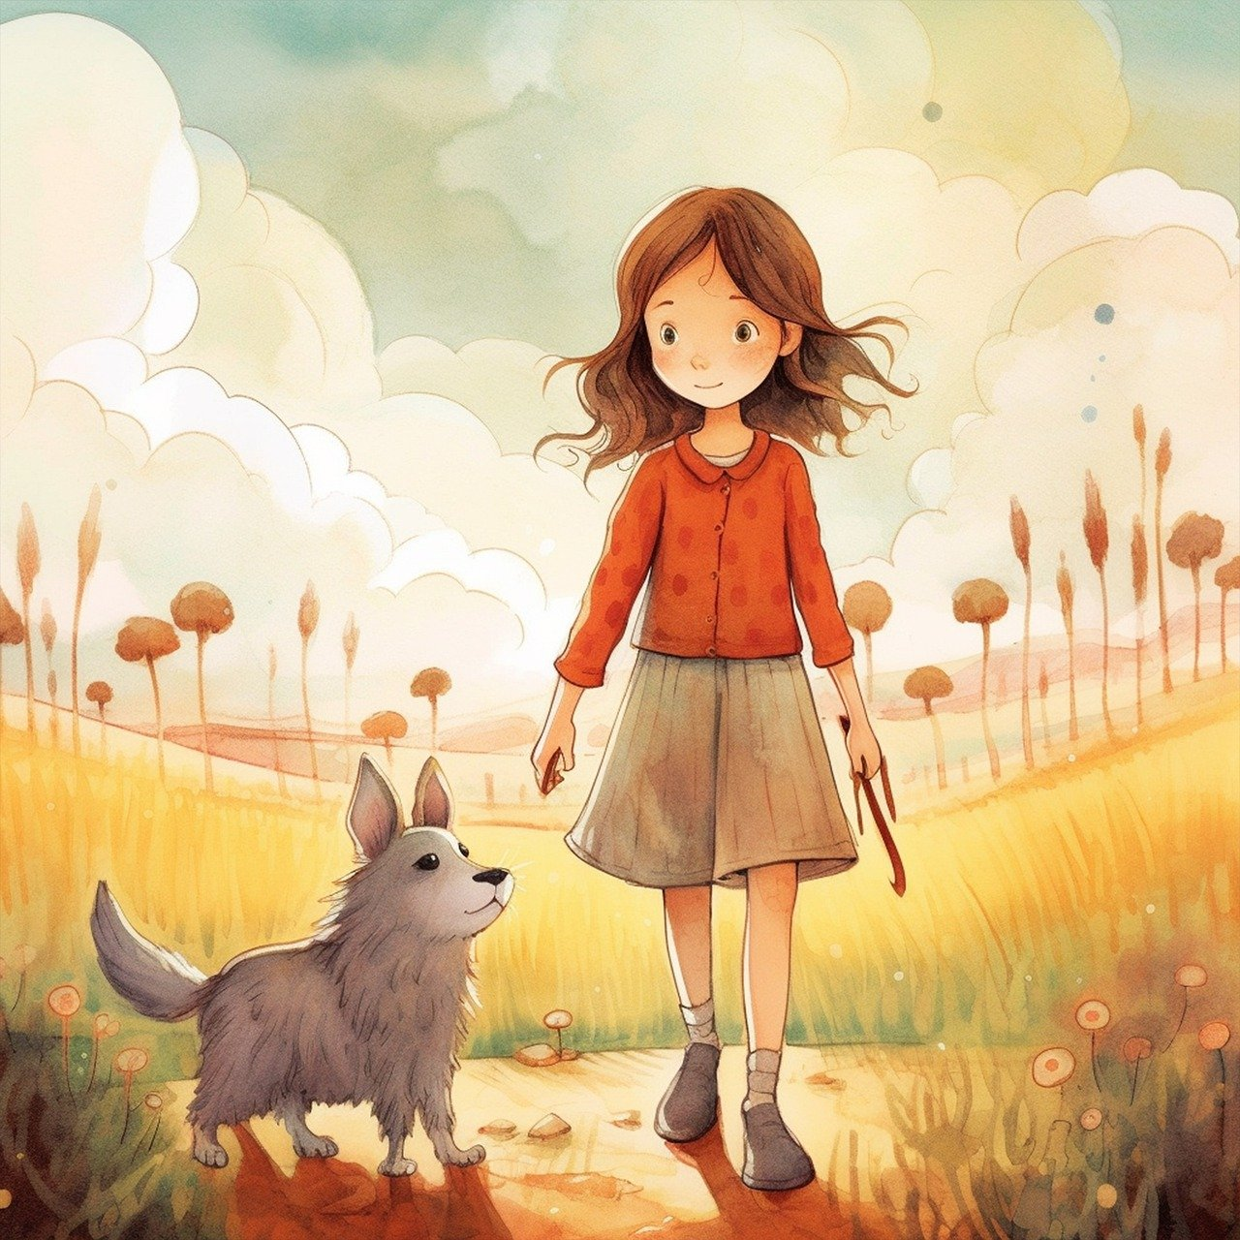
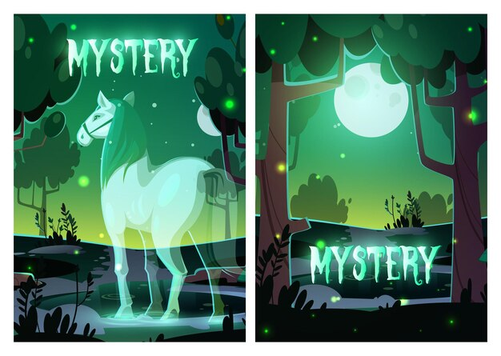
Types of Stories
Adventure
Horror
Thriller
Mystery
If an outline is provided, how do you build an interesting story from it?
Notes:
Notes for Teacher - < Information for further reference or explanation >
Suggestions: <Ideas/ Images/ Animations / Others – To make better representation of the content >
Source of Multimedia used in this slide - <Please provide source URL where we find the image and the license agreement>
Adventure : https://pixabay.com/illustrations/climbing-climber-ice-pick-rope-4514507/ (Rappellingusa)
Mystrey : https://www.freepik.com/free-vector/mystery-horror-cartoon-posters-with-horse-soul_20495038.htm#
Thriller : https://pixabay.com/illustrations/book-cover-childrens-book-7971244/ (Kyra_Starr)
Horror : https://pixabay.com/photos/haunted-house-halloween-graveyard-7508035/ (Sananthropis)

Slide 6
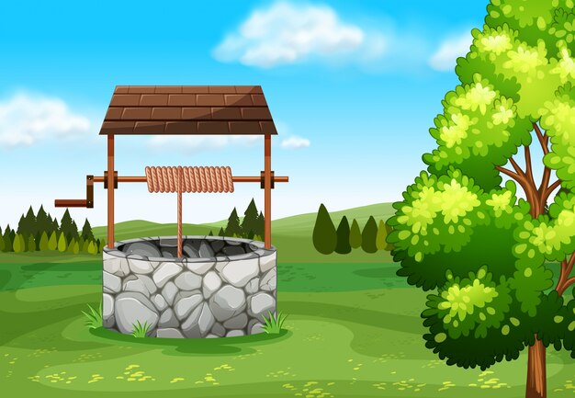
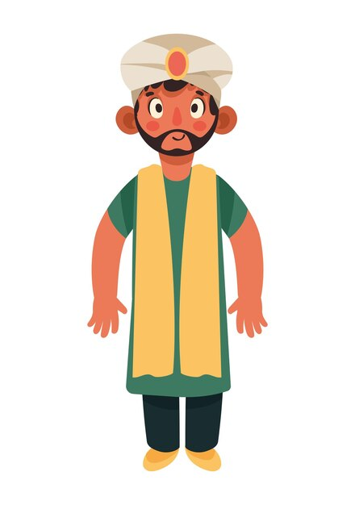
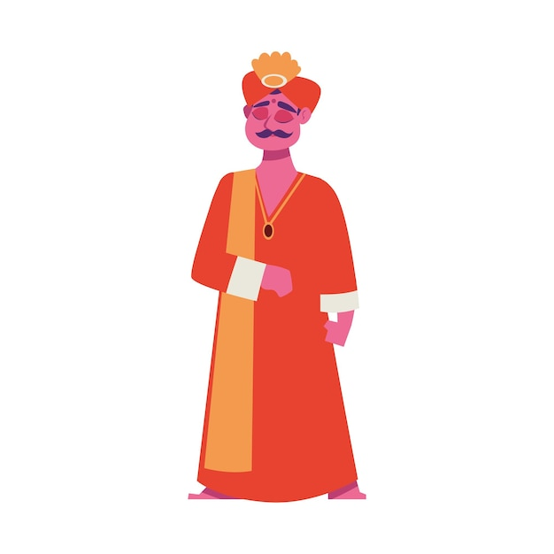
Outline of a Story
Poor farmer in Emperor Akbar’s kingdom – bought well from a rich man – farmer went to draw water - rich man stopped him – said you did not pay for water – farmer went to the King – rich man told the reason for not allowing – Birbal told the rich man pay rent or remove water since well is not yours – farmer happy.
Farmer
Akbar
Well
Rich Man
Birbal
Notes:
Notes for Teacher - < Information for further reference or explanation >
Suggestions: <Ideas/ Images/ Animations / Others – To make better representation of the content >
Source of Multimedia used in this slide - <Please provide source URL where we find the image and the license agreement>
Farmer : https://www.freepik.com/free-vector/flat-farmer-s-day-celebration-illustration_32832794.htm#query=indian%20farmer&position=0&from_view=search&track=ais&uuid=fa4b21ff-88db-433a-954c-d6a7bbdd7abc (freepik)
Birbal : https://www.freepik.com/free-vector/indian-man-traditional-clothes-icon-isolated_74221586.htm#query=man%20turban%20indian&position=15&from_view=search&track=ais&uuid=64480452-ca15-4fb6-bd53-ecf30d182ac4 (djvstock)
Man : https://www.freepik.com/free-vector/indian-culture-young-man-character_73897548.htm#query=indian%20king&position=18&from_view=search&track=ais&uuid=5c19e980-e649-4b13-b647-d56b7a95dce7 (jemastock)
Akbar : https://pixabay.com/vectors/lego-babur-babur-mughal-emperor-5569807/ (BilliTheCat)
Well : https://www.freepik.com/free-vector/stone-will-field-illustration_1109783.htm#query=water%20well&position=0&from_view=search&track=ais (brgfx)

Slide 7
Points to Remember
This outline gives us an idea about the series of events.
Identify all the characters in the story.
Every story has a beginning, the middle part and interesting end.
1
2
Imagine yourself reading the story, make it interesting and enjoyable.
4
Use dialogues and give details to
create an interesting story.
3
Write the story in the past tense.
Choose a title that highlights the main character or event.
5
6
Notes:
Notes for Teacher - < Information for further reference or explanation >
Suggestions: <Ideas/ Images/ Animations / Others – To make better representation of the content >
Source of Multimedia used in this slide - <Please provide source URL where we find the image and the license agreement>

Slide 8
Points to Remember
Do Not
Give unnecessary details that may change the story.
Treat it as a fill in the blank activity.
Make the story very short.
Notes:
Notes for Teacher - < Information for further reference or explanation >
Suggestions: <Ideas/ Images/ Animations / Others – To make better representation of the content >
Source of Multimedia used in this slide - <Please provide source URL where we find the image and the license agreement>
Book : https://pixabay.com/vectors/book-read-open-published-write-147292/ (OpenClipart-Vectors)

Slide 9
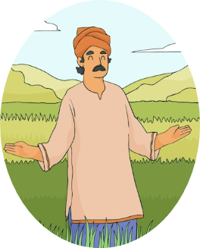
The Story
In the kingdom of the Mughal Emperor Akbar, there lived a poor farmer whose name was Shyam Bahadur. Shyam saved money regularly for five years. Then, he bought a well from Mohit Seth, who was a rich man. Shyam paid the full amount to Mohit. He was very happy as he could now irrigate his land using the water from the well. He hoped to have a bumper crop and earn enough money for his family.
Shyam Bahadur
The next day when Shyam went to draw water from the well, Mohit stopped him. He said, “Since you have not paid for the water but only for the well, you cannot draw any water from the well.”
Mohit Seth
Notes:
Notes for Teacher - < Information for further reference or explanation >
Suggestions: <Ideas/ Images/ Animations / Others – To make better representation of the content >
Source of Multimedia used in this slide - <Please provide source URL where we find the image and the license agreement>

Slide 10
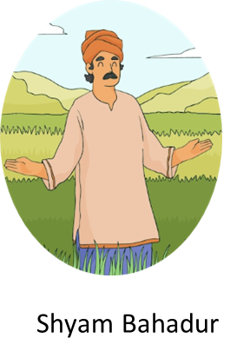
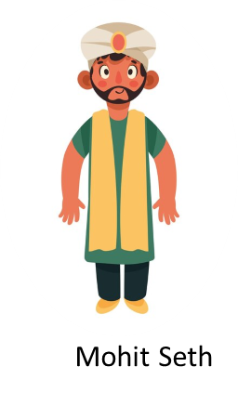
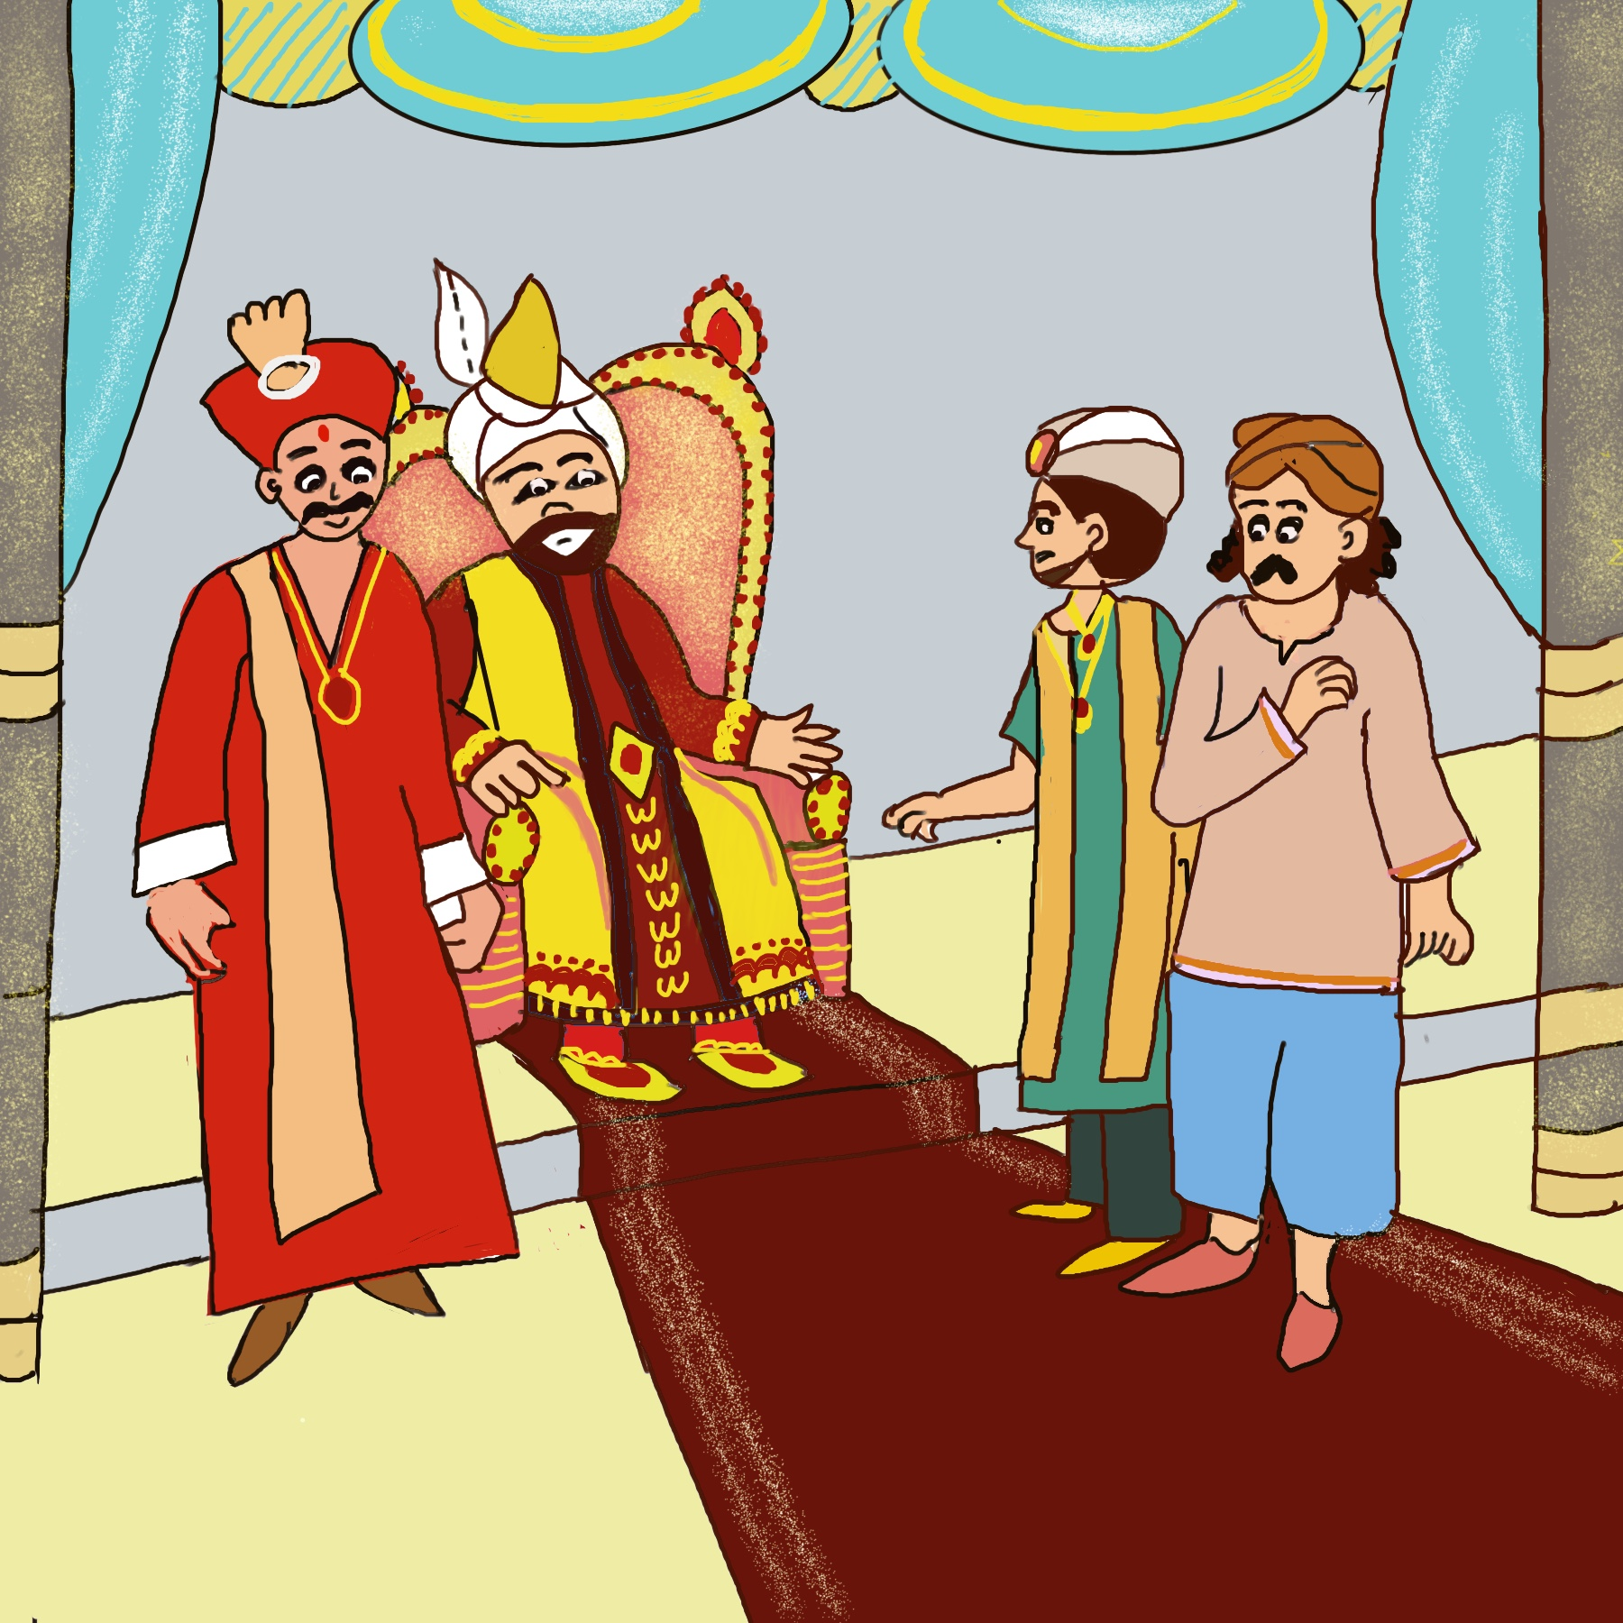
Story Continued….
Shyam said, “Sethji, what are you saying? I have paid the full price for the well. Please allow me to draw water from it. What is the use of the well if I cannot use the water from it?”
Mohit said angrily- “Leave before I ask my men to push you out.”
Shyam Bahadur was very upset. He did not know what to do. He decided to go to Emperor Akbar’s court for justice. He reached Akbar’s court and said, “Maharaj, please help me.”
Akbar said, “What is the matter?” The farmer told him all that had happened.
Notes:
Notes for Teacher - < Information for further reference or explanation >
Suggestions: <Ideas/ Images/ Animations / Others – To make better representation of the content >
Source of Multimedia used in this slide - <Please provide source URL where we find the image and the license agreement>
Darbar : SSSVV MB (key words: king’s darbar, king’s courtroom, Akbar, Birbal)

Slide 11
Story Continued….
The king called his able minister Birbal. Emperor Akbar ordered, “Birbal, go and solve this case. I don’t want anyone in my land to be exploited.” Birbal was famous for his witty solutions.
The next day, all the parties assembled. The rich man said, “Sir, I cannot allow the farmer to draw water from the well. He has paid only for the well and not for the water.” Birbal smiled and said, “Sethji, I understand your case. Now that the well has already been sold to Shyam, kindly remove all the water from the well or pay rent to Shyam Bahadur to keep the water in it.” The rich man said, “Alas! How can I do that?”
Shyam was allowed to draw water from the well. “Thank you Mantriji,” said Shyam as he bowed to Birbal with great joy.
Birbal’s intelligence was proved yet again!
Notes:
Notes for Teacher - < Information for further reference or explanation >
Suggestions: <Ideas/ Images/ Animations / Others – To make better representation of the content >
Source of Multimedia used in this slide - <Please provide source URL where we find the image and the license agreement>
Darbar : SSSVV MB (key words: king’s darbar, king’s courtroom, Akbar, Birbal)

Slide 12
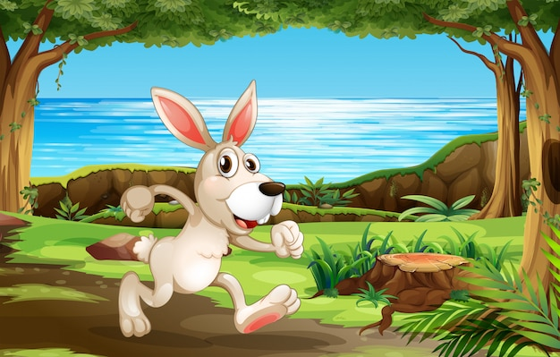
The Hare and the Tortoise
Weave a Tale in Verse
The hare and the tortoise started a race,
The quick hare set off at a fast pace.
He looked back to see the tortoise trudging along,
To reach me, thought the hare, it will take him long.
So under this shady tree, I will take a short nap,
As he nears, I will be up and away in a snap.
The slow and steady tortoise crept past the sleeping hare,
He reached the winning post without any fanfare.
Trudging –Walking with slow heavy steps.
Fanfare – Loud sound to annouce the arrival of an important person.
Notes:
Notes for Teacher - Ask a student to tell the story of The Hare and the Tortoise.
Show or write the same story in verse that is in poetry form.
Trudging- to walk with slow heavy steps. Fanfare - Loud sound to announce the arrival of an important person.
Ask one student to read it aloud first, then the whole class together.( or rows together.
Students will relate to the idea of converting familiar stories into poems.)
Suggestions: <Ideas/ Images/ Animations / Others – To make better representation of the content >
Source of Multimedia used in this slide - <Please provide source URL where we find the image and the license agreement>
Story : https://www.freepik.com/free-vector/rabbit-running-park_4567217.htm#query=hare%20and%20tortoise&position=23&from_view=search&track=ais (brgfx)
Dog : https://www.freepik.com/free-vector/cute-dog-holding-megaphone-cartoon-vector-icon-illustration-animal-technology-icon-concept-isolated_33099680.htm#query=dog%20with%20microphone&position=0&from_view=search&track=ais (catalyststuff)
Story : https://www.freepik.com/free-vector/opposite-adjective-words-with-fast-slow_12364592.htm#query=hare%20and%20tortoise&position=6&from_view=search&track=ais (brgfx)

Slide 13
The Poet In The Making
What is this?
All things bright and beautiful,
All creatures great and small,
All things wise and wonderful,
The good God made them all.
It is a verse from a poem.
So, what is a poem?
Cecil Frances Alexander
A poem is a form of writing where words are chosen for their meaning, beauty and sound. These are carefully arranged, often in short lines which rhyme, sometimes poems are written in free verse. Sometimes they convey profound messages and joy to the readers.
Notes:
Notes for Teacher - These poems can be taken up in earlier classes.
Suggestions: <Ideas/ Images/ Animations / Others – To make better representation of the content >
Source of Multimedia used in this slide - <Please provide source URL where we find the image and the license agreement>
Girl : https://www.freepik.com/free-vector/boy-girl-from-india-green-blue-outfit_4806905.htm#query=indian%20kids&position=6&from_view=search&track=ais (brgfx)
Man : https://www.freepik.com/free-vector/flat-summer-illustration-with-older-woman-reading-book-house_27448071.htm#page=2&query=old%20people%20reading%20and%20laughing&position=11&from_view=search&track=ais (freepik)

Slide 14
Types of Poetry
Narrative poems are which tell a story.
Narrative poetry
Dramatic poetry
Old sacred texts like Ramayana and Mahabharata were written in verse in the sanskrit language.
Lyrical poetry
The Blue Umbrella by Ruskin Bond has been written in narrative poetry form by Moloy Bhattacharya.
The king was sick, his cheeks were red.
And his eye was clear and bright.
He ate and drank with kingly zest,
And peacefully snored at night.
A story can be told in the form of a poem. This is called a ballad.
Notes:
Notes for Teacher - The Enchanted Shirt by John Hay is another example for Narrative poems
Suggestions: <Ideas/ Images/ Animations / Others – To make better representation of the content >
Source of Multimedia used in this slide - <Please provide source URL where we find the image and the license agreement>
Book : https://www.freepik.com/free-vector/hand-holding-pen-writing-blank-book_34913409.htm#query=book%20writing&position=37&from_view=search&track=ais (brgfx)

Slide 15
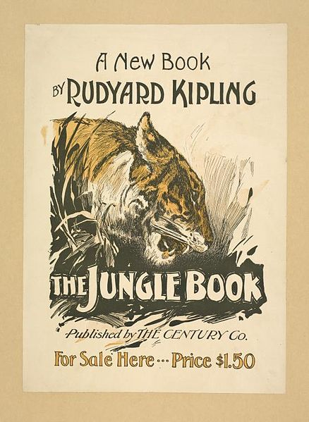
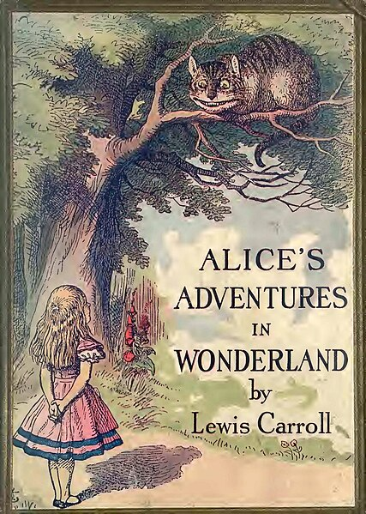
Types of Poetry
Dramatic poems are part of a drama or play.
Poems in Jungle Book by Rudyard Kipling
For example
Hunting Song Of the Seeonee Pack
Alice’s Adventures In Wonderland by Lewis Carrol
Dear, Dear!
How queer everything is to-day!
And yesterday things went on just as usual,
I wonder if I’ve been changed in the night.
Notes:
Notes for Teacher - < Information for further reference or explanation >
Suggestions: <Ideas/ Images/ Animations / Others – To make better representation of the content >
Source of Multimedia used in this slide - <Please provide source URL where we find the image and the license agreement>
Book : https://commons.wikimedia.org/wiki/File:Jungle_Book_Rudyard_Kipling_poster.jpeg (Rudyard Kiping (The Century Company)
Lewis : https://commons.wikimedia.org/wiki/File:Alice%27s_adventures_in_Wonderland_-_(IA_alicesadventures00carr_25)_(page_1_crop).jpg (Carroll, Lewis, 1832-1898)

Slide 16
Types of Poetry
Lyrical poetry expresses feelings or state
of mind.
For example
The Bangle Seller by Sarojini Naidu
I Wish
The flower thought just imagine the fun
If I could fly to any place under the sun!
Determined it spread its wings one day,
Became a butterfly and fluttered away.
I Wish by Rabindranath Tagore
Notes:
Notes for Teacher - < Information for further reference or explanation >
Suggestions: <Ideas/ Images/ Animations / Others – To make better representation of the content >
Source of Multimedia used in this slide - <Please provide source URL where we find the image and the license agreement>
Kids : https://pixabay.com/illustrations/singing-children-song-sing-child-18382/ (publicDomainPictures)

Slide 17
Steps for Writing a Poem
Inspiration
Word Bank
Search
You can be inspired by a person, object, nature.
The second step
is to build a vast vocabulary that can be achieved by reading a lot of prose and poetry.
Search for the apt word that conveys your message correctly.
Notes:
Notes for Teacher - < Information for further reference or explanation >
Suggestions: <Ideas/ Images/ Animations / Others – To make better representation of the content >
Source of Multimedia used in this slide - <Please provide source URL where we find the image and the license agreement>
Boy : https://www.freepik.com/free-vector/boy-wearing-scientist-gown-with-empty-paper-table_17622287.htm#query=boy%20writing&position=1&from_view=search&track=ais (brgfx)

Slide 18
Poetry Tools
1
Similes
Personification
2
3
Alliterations
Rhyming words
4
The point to remember always is that the backbone of poetry is the feelings or the message that is conveyed in the poem.
Notes:
Notes for Teacher - Examples of different forms of poetry can be given from the text book.
a. Similes - Like a diamond in the sky’ from Twinkle Twinkle little star
b. Personification-.The flower in the poem I Wish is given a human attribute of thinking.
d.Alliterations- where most letters in the line start with the same letter- Betty bought a bit of butter.
e. Think of rhyming words suitable for your poem. rain,
again.
Suggestions: <Ideas/ Images/ Animations / Others – To make better representation of the content >
Source of Multimedia used in this slide - <Please provide source URL where we find the image and the license agreement>

Slide 19
Laugh and Learn
A bear did not like to be bare,
So, he bought a shirt and pants to wear.
On the streets, he scared everyone,
Away they ran like a shot from a gun.
Well! Well! Sighed the bear no one can bear a friendly bear.
This poem is a limerick.
So, what is a limerick?
A limerick is a humorous five line poem with a rhyme scheme of aabba.
Notes:
Notes for Teacher – Write the poem on the board.
Words Bear and bare are homophones , bear and bear in the last line are homonyms
Suggestions: <Ideas/ Images/ Animations / Others – To make better representation of the content >
Source of Multimedia used in this slide - <Please provide source URL where we find the image and the license agreement>
Board : https://www.freepik.com/free-vector/realistic-chalk-blackboard_19380853.htm#query=board&position=20&from_view=search&track=sph (pikisuperstar)
Bear : https://www.freepik.com/free-vector/wild-animal-doing-human-activities_37368168.htm#query=bear%20clothes&position=6&from_view=search&track=ais (freepik)

Slide 20
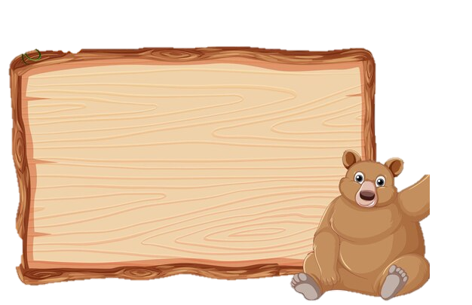
Laugh and Learn
Homophones are words which are pronounced the same but have different spellings.
A bear did not like to be bare,
So, he bought a shirt and pants to wear.
On the streets, he scared everyone,
Away they ran like a shot from a gun.
Well! Well! Sighed the bear no one can bear a friendly bear.
Homonyms are words that sound the same but have different meanings.
Notes:
Notes for Teacher - Students can be asked to find the homophone and Homonym in the limerick.
Words Bear and bare are homophones , bear and bear in the last line are homonyms.
Suggestions: <Ideas/ Images/ Animations / Others – To make better representation of the content >
Source of Multimedia used in this slide - <Please provide source URL where we find the image and the license agreement>
Frame : https://www.freepik.com/free-vector/bear-with-wooden-sign-banner_24080774.htm#query=bear%20frame&position=4&from_view=search&track=ais (brgfx)
Boy : https://www.freepik.com/free-vector/doodle-cartoon-character-singer-man-singing-with-musical-melody-symbols_21185691.htm#query=kids%20singing&position=37&from_view=search&track=ais (brgfx)

Slide 21
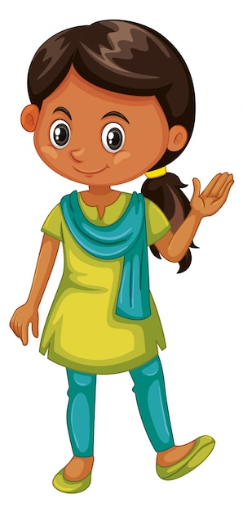
Attribution / Citation
Slide # | Thumbnail | Source link | Author
3 |  | Kitten : https://www.freepik.com/free-vector/cat-walking-narrow-window_27284131.htm# Fairy : https://www.freepik.com/free-vector/set-cute-fairies-cartoon-charater_43182109.htm# Prisoner : https://www.freepik.com/free-vector/law-justice-isometric-background-with-icons-judge-symbols-wristbands-highly-litigious-prisoner-editable-text-description-illustration_6869951.htm# Man : https://www.freepik.com/free-vector/man-running-track-background_1105214.htm# https://www.freepik.com/free-vector/goblin-troll-color-silhouette-cartoon-character-white_9957179.htm# Monster : https://www.freepik.com/free-vector/goblin-troll-color-silhouette-cartoon-character-white_9957179.htm# | brgfx brgfx macrovector freepik brgfx
4 |  | Girl : https://www.freepik.com/free-vector/cute-happy-smiling-child-isolated-white_5934381.htm# Laugh : https://www.freepik.com/free-vector/gradient-international-day-happiness-illustration_12812222.htm# Cry : https://www.freepik.com/free-vector/gradient-sad-emoji-illustration_63339185.htm# Boy : https://www.freepik.com/free-vector/flat-world-book-day-illustration_23871023.htm# | brgfx pikisuperstar freepik freepik
5 |  | Adventure : https://pixabay.com/illustrations/climbing-climber-ice-pick-rope-4514507/ Mystrey : https://www.freepik.com/free-vector/mystery-horror-cartoon-posters-with-horse-soul_20495038.htm# Thriller : https://pixabay.com/illustrations/book-cover-childrens-book-7971244/ Horror : https://pixabay.com/photos/haunted-house-halloween-graveyard-7508035/ | Rappellingusa Upklyak Kyra_Starr Sananthropis
6 |  | Farmer : https://www.freepik.com/free-vector/flat-farmer-s-day-celebration-illustration_32832794.htm# Birbal : https://www.freepik.com/free-vector/indian-man-traditional-clothes-icon-isolated_74221586.htm# Man : https://www.freepik.com/free-vector/indian-culture-young-man-character_73897548.htm# Akbar : https://pixabay.com/vectors/lego-babur-babur-mughal-emperor-5569807/ Well : https://www.freepik.com/free-vector/stone-will-field-illustration_1109783.htm# | freepik djvstock jemastock Billithecat brgfx
8 |  | Book : https://pixabay.com/vectors/book-read-open-published-write-147292/ | OpenClipart-Vectors
12 |  | Story : https://www.freepik.com/free-vector/opposite-adjective-words-with-fast-slow_12364592.htm# Story : https://www.freepik.com/free-vector/rabbit-running-park_4567217.htm# Dog : https://www.freepik.com/free-vector/cute-dog-holding-megaphone-cartoon-vector-icon-illustration-animal-technology-icon-concept-isolated_33099680.htm# | brgfx brgfx catalyststuff
13 |  | Girl : https://www.freepik.com/free-vector/boy-girl-from-india-green-blue-outfit_4806905.htm# Man : https://www.freepik.com/free-vector/flat-summer-illustration-with-older-woman-reading-book-house_27448071.htm# | brgfx freepik

Slide 22
Attribution / Citation
Slide # | Thumbnail | Source link | Author
14 |  | Book : https://www.freepik.com/free-vector/hand-holding-pen-writing-blank-book_34913409.htm# | brgfx
15 |  | Book : https://commons.wikimedia.org/wiki/File:Jungle_Book_Rudyard_Kipling_poster.jpeg Lewis : https://commons.wikimedia.org/wiki/File:Alice%27s_adventures_in_Wonderland_-_(IA_alicesadventures00carr_25)_(page_1_crop).jpg | Rudyard Kiping (The Century Company) Carroll, Lewis, (1832-1898)
16 |  | Kids : https://pixabay.com/illustrations/singing-children-song-sing-child-18382/ | PublicDomainPictures
1, 17 |  | Boy : https://www.freepik.com/free-vector/boy-wearing-scientist-gown-with-empty-paper-table_17622287.htm#query=boy%20writing&position=1&from_view=search&track=ais | brgfx
19 |  | Board : https://www.freepik.com/free-vector/realistic-chalk-blackboard_19380853.htm#query=board&position=20&from_view=search&track=sph Bear : https://www.freepik.com/free-vector/wild-animal-doing-human-activities_37368168.htm#query=bear%20clothes&position=6&from_view=search&track=ais | pikisuperstar freepik
20 |  | Frame : https://www.freepik.com/free-vector/bear-with-wooden-sign-banner_24080774.htm# Boy : https://www.freepik.com/free-vector/doodle-cartoon-character-singer-man-singing-with-musical-melody-symbols_21185691.htm# | brgfx brgfx

