Slide 1
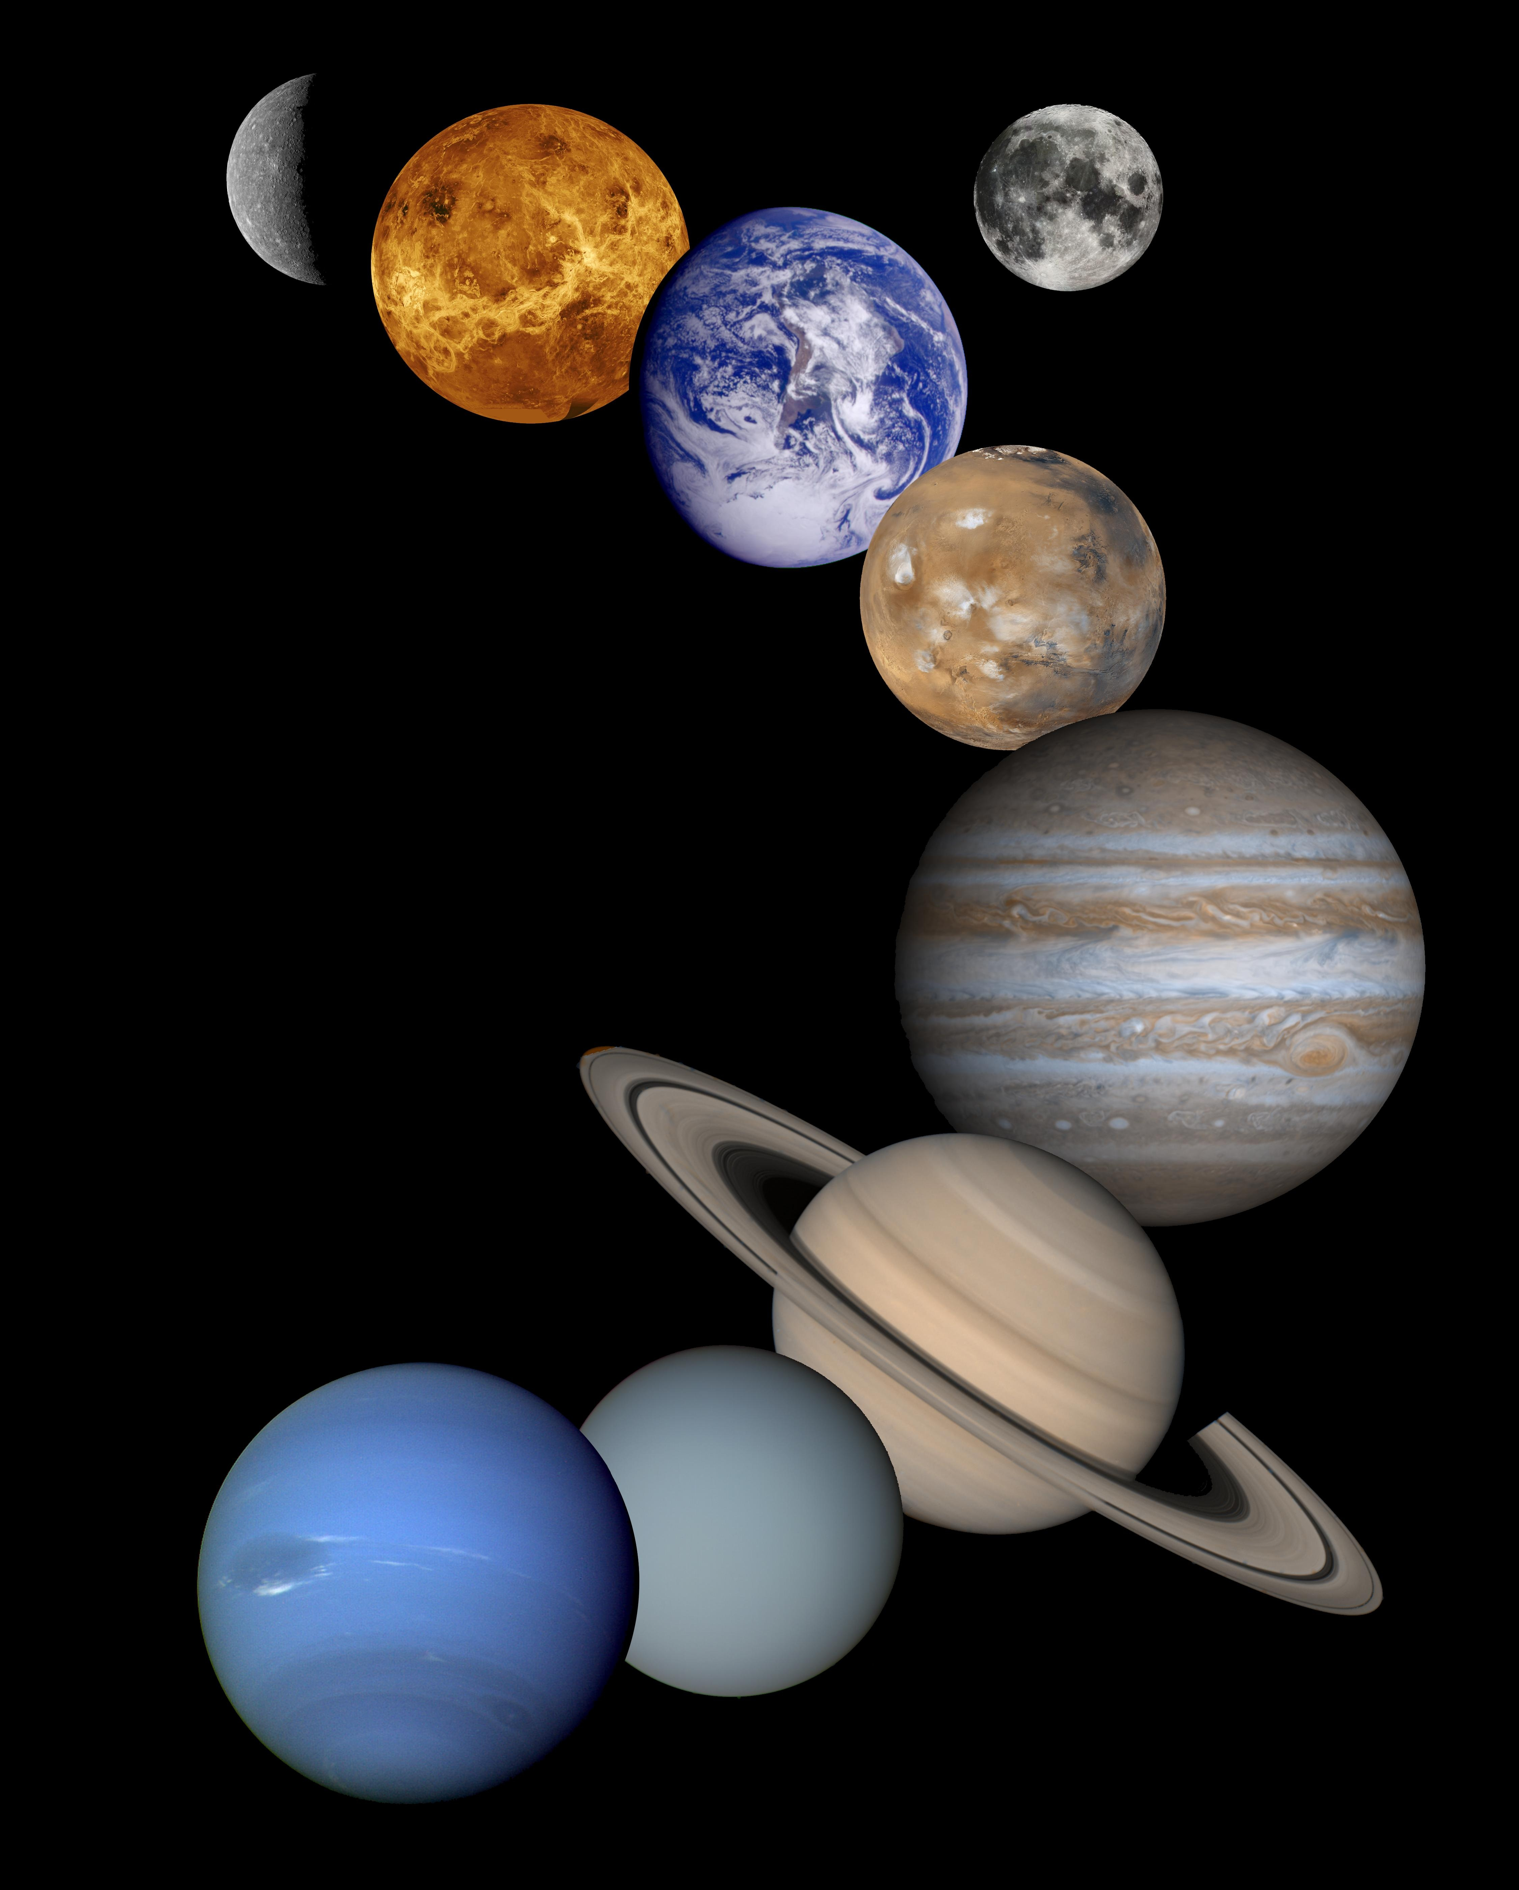
Conversation Between Planets
Notes:
Notes for Teacher -
This asset paves way for Peer Learning and an Interdisciplinary subject.
Show the PPT and allow the monitor of the class and the vice monitor to read the dialogue between Mars and Earth, followed by a short question and answer session conducted by the monitor.
Suggestions: <Ideas/ Images/ Animations / Others – To make better representation of the content >
Source of Multimedia used in this slide -
1. Solar System - https://pxhere.com/en/photo/1087836 - Pxhere

Slide 2
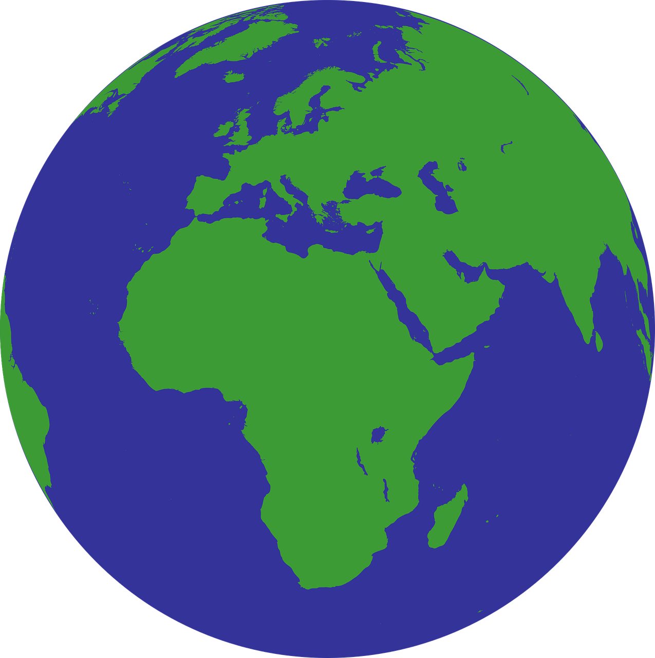
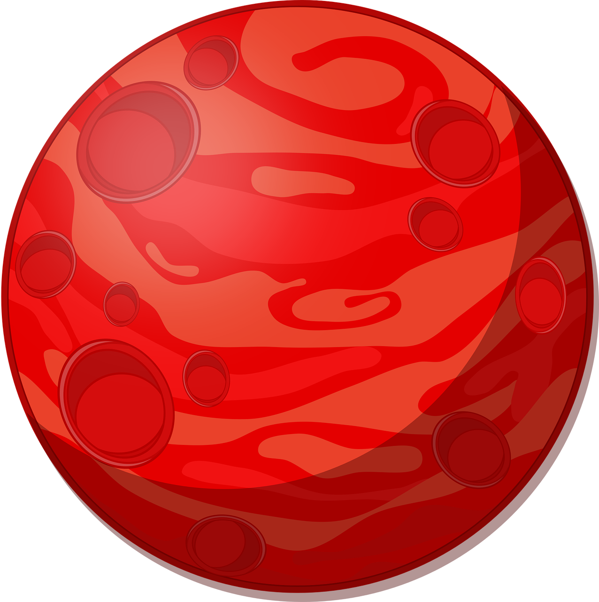
Conversation Between Planets
I am fine.
How are you?
I am good.
But not like what I was before.
Notes:
Notes for Teacher - < Information for further reference or explanation >
Suggestions: <Ideas/ Images/ Animations / Others – To make better representation of the content >
Source of Multimedia used in this slide –
Earth - https://pixabay.com/vectors/globe-world-green-blue-earth-1579177/ – librarianlady
Mars - https://pixabay.com/vectors/cartoon-cosmos-mars-planet-red-1298905/ - OpenClipart-Vectors

Slide 3
Conversation Between Planets
I can understand. Look at me.
I’ve carried humans for years.
I have tolerated every unjustified act of theirs.
But they went on destroying me,
choking me to death.
Oh, my friend! Nothing can change them. I’m afraid now they intend
to bind me and eventually
destroy me too.
Notes:
Notes for Teacher - < Information for further reference or explanation >
Suggestions: <Ideas/ Images/ Animations / Others – To make better representation of the content >
Source of Multimedia used in this slide –
Earth - https://pixabay.com/vectors/globe-world-green-blue-earth-1579177/ – librarianlady
Mars - https://pixabay.com/vectors/cartoon-cosmos-mars-planet-red-1298905/ - OpenClipart-Vectors

Slide 4
Conversation Between Planets
Even though they exploited me,
I have given them whatever they asked
for and never left them; they are my kids.
No mother can leave her children
stranded. My love for them is
unconditional. I will continue to
take care of them.
Notes:
Notes for Teacher - < Information for further reference or explanation >
Suggestions: <Ideas/ Images/ Animations / Others – To make better representation of the content >
Source of Multimedia used in this slide -
Earth - https://pixabay.com/vectors/globe-world-green-blue-earth-1579177/ – librarianlady
Mars - https://pixabay.com/vectors/cartoon-cosmos-mars-planet-red-1298905/ - OpenClipart-Vectors

Slide 5
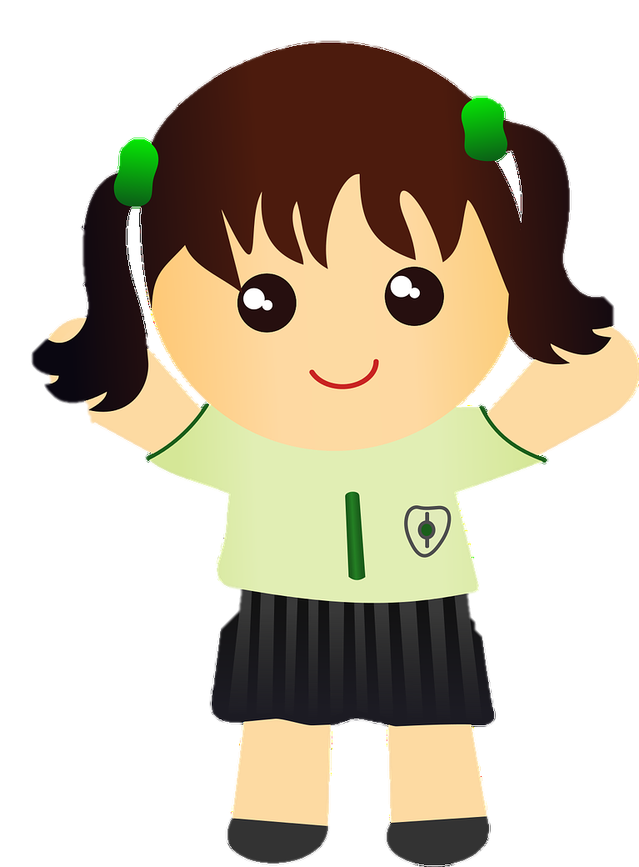
Interaction Between Students
Did you like the conversation between the planets?
Yes, we liked it.
Is the Earth in a happy mood?
Give one reason for your answer.
The planet Earth is sad because humans
exploit her in spite of being so loving and generous.
Notes:
Notes for Teacher - < Information for further reference or explanation >
Suggestions: <Ideas/ Images/ Animations / Others – To make better representation of the content >
Source of Multimedia used in this slide -
1. Students - https://pixabay.com/vectors/asian-cartoon-child-kids-mural-1294104/ - OpenClipart-Vectors

Slide 6
Interaction Between Students
What do you think is the reason for man’s insensitive behavior towards Earth?
It’s his greed for more.
What is Mars afraid of?
Mars is afraid of humans’ intentions of exploiting it and eventually destroying it.
Notes:
Notes for Teacher - < Information for further reference or explanation >
Suggestions: <Ideas/ Images/ Animations / Others – To make better representation of the content >
Source of Multimedia used in this slide -
1. Students - https://pixabay.com/vectors/asian-cartoon-child-kids-mural-1294104/ - OpenClipart-Vectors

Slide 7
Interaction Between Students
How many forms of direct and indirect structures
are there in the conversation?
Four Forms –
question, exclamatory, request and statement.
Notes:
Notes for Teacher - < Information for further reference or explanation >
Suggestions: <Ideas/ Images/ Animations / Others – To make better representation of the content >
Source of Multimedia used in this slide –
1. Students - https://pixabay.com/vectors/asian-cartoon-child-kids-mural-1294104/ - OpenClipart-Vectors

Slide 8
Attribution / Citation
Slide # | Thumbnail | Source link | Author
1 |  | https://pxhere.com/en/photo/1087836 | Pxhere
2 - 4 |  | https://pixabay.com/vectors/globe-world-green-blue-earth-1579177/ https://pixabay.com/vectors/cartoon-cosmos-mars-planet-red-1298905/ | librarianlady OpenClipart-Vectors
5 - 7 |  | https://pixabay.com/vectors/asian-cartoon-child-kids-mural-1294104/ | OpenClipart-Vectors
Notes:
Notes for Teacher - < Information for further reference or explanation >
Suggestions: <Ideas/ Images/ Animations / Others – To make better representation of the content >
Source of Multimedia used in this slide - <Please provide source URL where we find the image and the license agreement>

