Slide 1
Classifying Direct
and Indirect Speech
Direct
Indirect
Notes:
Notes for Teacher – This asset is aimed for assessment as learning. Carry forward the basic understanding that the students have on Direct and Indirect Speech. Vary the explanation based on your assessment of the students’ grasping level. Use the content given in the TA for a detailed explanation on the different forms of Direct and Indirect Speech. Assign more of written assignments on the concept taught.
Suggestions: Not applicable
Source of Multimedia used in this slide - Not applicable

Slide 2
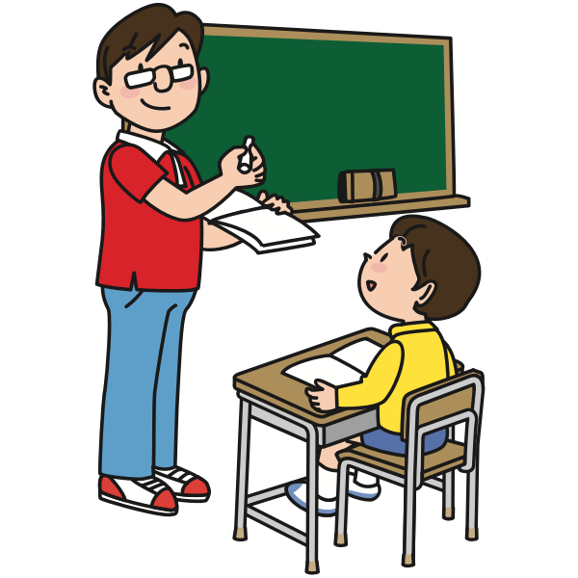
In the Classroom
I don’t like idli and chutney. Ananth, what did I just say?
You said, “I don’t like idli and chutney”.
Good! Now, report that sentence in indirect speech.
He said that he didn’t like idli and chutney.
Notes:
Notes for Teacher – Begin the class with a simple conversation between the teacher and the students. First, call on one of the students and read a simple sentence aloud. Then, have the student report the information back to you first using direct speech. Then call another student to rephrase the sentence using indirect speech. Repeat this process with a different sentence to ensure that all the students have successfully understood how to report statements back to you using both direct and indirect speech.
Suggestions: Not applicable
Source of Multimedia used in this slide - Not applicable

Slide 3
Exclamatory Sentences
To report exclamations and greetings
Indirect speech is introduced by a verb
Like exclaimed, wished, shouted with joy, etc.
He said, “Alas! I have lost the game.”
He exclaimed sadly that he had lost the game.
D
I
Aruna said, “How clever I am!”
Aruna exclaimed that she was very clever.
D
I
He said, “Bravo! You have done well.”
He applauded him and said that he had done well.
D
I
Notes:
Notes for Teacher – Not applicable
Suggestions: Not applicable
Source of Multimedia used in this slide - PPT icons

Slide 4
Requests and Commands
Requests are reported using verbs like asked, requested, told, etc.
Commands are reported using verbs like reminded, ordered, told, etc.
Teacher: “Don’t forget to do your homework!”
The teacher reminded me not to forget to do my homework.
D
I
Mother: “Wash your hands before you eat!”
My mother told me to wash my hands before I ate.
D
I
He said to Ram, “Please wait here till I return.”
He requested Ram to wait there till he returned.
D
I
Notes:
Notes for Teacher – Not applicable
Suggestions: Not applicable
Source of Multimedia used in this slide - PPT icons

Slide 5
Requests and Commands (contd.)
“Could you be quiet, please!” she said.
She requested me to be quiet.
D
I
“Be quiet!” said the monitor.
The monitor ordered us to be quiet.
D
I
She always says: “Don’t forget to close the door.”
She always asks me not to forget to close the door.
D
I
Notes:
Notes for Teacher – Not applicable
Suggestions: Not applicable
Source of Multimedia used in this slide - PPT icons

Slide 6
Questions in Reported Speech
The word order in a reported question
Is the same as in the statement
The subject comes before the verb
Question:
She asked, “Are you ready?”
Statement:
She asked me if I was ready.
Question in reported speech:
She wanted to know if I was ready.
Notes:
Notes for Teacher - Not applicable
Suggestions: Not applicable
Source of Multimedia used in this slide - Not applicable

Slide 7
Questions in Reported Speech: Punctuation
If the sentence is a statement
End it with a full stop
Even if it contains a reported question
Question containing a reported question
What do you think of the book?
Statement containing a reported question
She asked me what I thought of the book.
Notes:
Notes for Teacher - Not applicable
Suggestions: Not applicable
Source of Multimedia used in this slide - Not applicable

Slide 8
Yes or No Questions
To report yes or no questions
‘If’ or ‘Whether’ is used in indirect speech
‘Whether or not’ may also be used
“Did you turn off the gas stove?” I asked.
I asked her if she had turned off the gas stove.
D
I
My father asked, “Is the dinner ready?”
My father wanted to know whether the dinner was ready.
D
I
“Should I tell her the good news?” asked Rahul.
Rahul wanted to know if he should tell her the good news.
D
I
Notes:
Notes for Teacher – Not applicable
Suggestions: Not applicable
Source of Multimedia used in this slide - PPT icons

Slide 9
Information Questions
To report information based questions
We begin with the question word
And use the sentence word order
Arun asked, “Where do they live?”
Arun wanted to know where they lived.
D
I
She said, “Where will you stay in this big city?”
She wanted to know where I would stay in that big city.
D
I
Priya asked me, “What does friendship mean to you?”
Priya asked what friendship meant to me.
D
I
Notes:
Notes for Teacher – Not applicable
Suggestions: Not applicable
Source of Multimedia used in this slide - PPT icons

Slide 10
Attribution / Citation
Slide # | Thumbnail | Source link | Author
1 |  | https://openclipart.org/detail/287942/boy-and-girl-with-speech-bubbles | GDJ
2 |  | https://freesvg.org/male-teacher-and-student | OpenClipart
7 |  | https://vectorportal.com/vector/man-reading/35771 | Vectorportal.com
Notes:
Notes for Teacher - Not applicable
Suggestions: Not applicable
Source of Multimedia used in this slide - Not applicable

