Slide 1
A Peek into the World of Letters

Slide 2
Formal Letters
Formal letters are letters that are written for an official purpose using a designated format and language.
Sample 1: Business Letter
(written to a business firm or a particular person)
You wish to do a French course from the institute 'French Ace’. Write a letter to inquire about the course details, fee, duration etc.
Notes:
Notes for Teacher - The formats and uses of the letters shown can be written on the blackboard or taught orally as all will be shown in the class.
Suggestions: <Ideas/ Images/ Animations / Others – To make better representation of the content >
Source of Multimedia used in this slide - <Please provide source URL where we find the image and the license agreement>

Slide 3
Business Letter
Rahul Vohra
802, Sector 10
Chandigarh
16th November 2023
The Manager
French Ace, Sector 11
Chandigarh -130001
Sir/Ma'am
Subject-Enquiring about French learning course
I wish to enquire about the French learning course offered by your institute. Since I am new to the language, I would like to start with the basic level.
Notes:
Notes for Teacher - The formats and uses of the letters shown can be written on the blackboard or taught orally as all will be shown in the class.
Suggestions: <Ideas/ Images/ Animations / Others – To make better representation of the content >
Source of Multimedia used in this slide - <Please provide source URL where we find the image and the license agreement>

Slide 4
Business Letter
I request you to provide the following details relating to the basic level French learning course-
1. fee of the course
2. duration of the course
3. class schedule
4. course material
5. other relevant details
Please, e-mail me the brochure with the admission form, looking forward to a quick response regarding the enquiry.
Thanking you
Yours truly
Rahul Vohra
Notes:
Notes for Teacher - The formats and uses of the letters shown can be written on the blackboard or taught orally as all will be shown in the class.
Suggestions: <Ideas/ Images/ Animations / Others – To make better representation of the content >
Source of Multimedia used in this slide - <Please provide source URL where we find the image and the license agreement>

Slide 5
Official Letter
Sample 2: Official letter
Write a letter to the municipal commissioner regarding the poor road
conditions in your locality.
Karan Ahuja
301/9, Adarsh colony
Main street
Ambala
15th July 2023
The Municipal Commissioner
SAS Nagar
Ambala
Notes:
Notes for Teacher - The formats and uses of the letters shown can be written on the blackboard or taught orally as all will be shown in the class.
Suggestions: <Ideas/ Images/ Animations / Others – To make better representation of the content >
Source of Multimedia used in this slide - <Please provide source URL where we find the image and the license agreement>

Slide 6
Official Letter
Respected Sir,
Subject : The road conditions in our locality
With due respect, I would like to bring to your kind attention the poor road conditions in my colony (Adarsh colony). The prolonged monsoon this year has turned the roads into a mesh of potholes, due to which the residents are facing a lot of problems. The divider and side markings have also faded.
This ”pothole” issue got dangerous recently when a lady commuter met with an accident. It could have been fatal, but she was lucky that the incident did not develop into a tragic one. These kinds of incidents keep happening in our area from time to time. Every year, we face a lot of hindrance in commuting in our area due to poor road conditions.
I sincerely hope that you will take immediate action regarding the issue we are facing.
Thanking you
Karan Ahuja
Notes:
Notes for Teacher - The formats and uses of the letters shown can be written on the blackboard or taught orally as all will be shown in the class.
Suggestions: <Ideas/ Images/ Animations / Others – To make better representation of the content >
Source of Multimedia used in this slide - <Please provide source URL where we find the image and the license agreement>

Slide 7
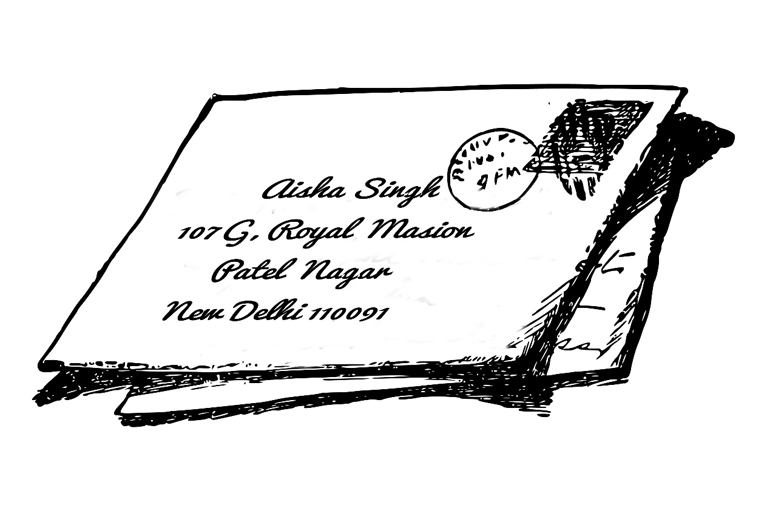
Letter to the Editor
Sample 3: Letter to the Editor (regarding frequent breakdown of electricity)
Aisha Singh
107G, Royal Mansion
Patel Nagar
New Delhi-110091
15th June 2023
The Editor
The Times
Lodhi Road
New Delhi-110082
Notes:
Notes for Teacher - The formats and uses of the letters shown can be written on the blackboard or taught orally as all will be shown in the class.
Suggestions: <Ideas/ Images/ Animations / Others – To make better representation of the content >
Source of Multimedia used in this slide - <Please provide source URL where we find the image and the license agreement>

Slide 8
Letter to the Editor
Respected Sir/Madam,
Subject : Frequent breakdown of electricity
I, Aisha Singh, have been living with my family in the Royal Mansion for the past fifteen years, and we have not faced many problems with electric supply in our area. Recently, in our area, we have been experiencing frequent breakdown (power cuts) of electricity for more than eight to eleven hours. Sometimes we don't have electricity for the whole day.
These frequent outages of electricity are causing a lot of inconvenience to the residents, as this affects their daily life and activities. Due to continuous fluctuations in voltage, the working condition of electronic devices is affected. In my house itself, three of my devices got burned.
Notes:
Notes for Teacher - The formats and uses of the letters shown can be written on the blackboard or taught orally as all will be shown in the class.
Suggestions: <Ideas/ Images/ Animations / Others – To make better representation of the content >
Source of Multimedia used in this slide - <Please provide source URL where we find the image and the license agreement>

Slide 9
Letter to the Editor
It would be a relief to all the residents, if necessary steps were taken by the electricity board to restore continuous power with proper voltage. I request that you highlight this situation in a column of your esteemed newspaper. Doing this will grab the attention of the authorities, and some action will be taken regarding this matter.
Thank you for your time and consideration.
Yours sincerely
Signature
Aisha Singh
Resident of Royal Mansion
Notes:
Notes for Teacher - The formats and uses of the letters shown can be written on the blackboard or taught orally as all will be shown in the class.
Suggestions: <Ideas/ Images/ Animations / Others – To make better representation of the content >
Source of Multimedia used in this slide - <Please provide source URL where we find the image and the license agreement>

Slide 10
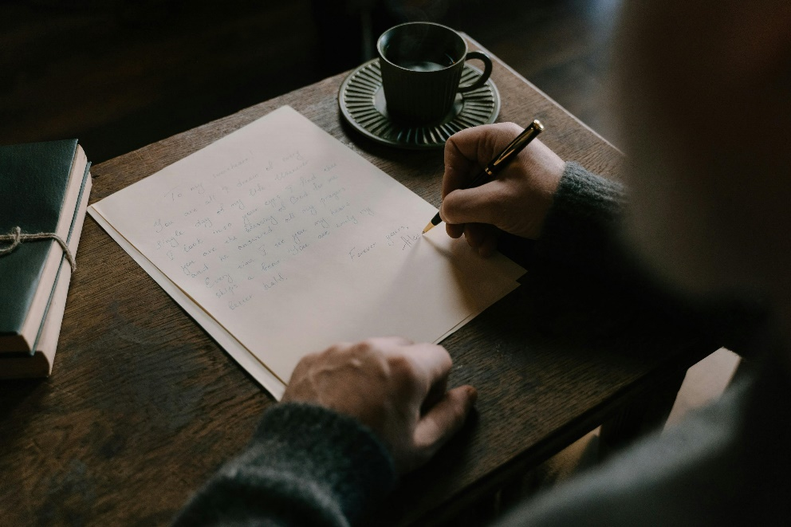
Fun with Writing
Questionnaire: MCQ for formal letter writing
1. What is the purpose of Formal letters?
a) To inform friend about personal news
b) To share informal thoughts
c) To communicate professionally and formally
Click for answer
2. Why is it necessary to use respectful salutation in a formal letter?
a) It makes letter longer
b) It saves time
c) It shows professionalism and courtesy
Click for answer
Notes:
Notes for Teacher – Click for each question to appear
The formats and uses of the letters shown can be written on the blackboard or taught orally as all will be shown in the class.
Questionnaires with MCQs will be provided to the students which will be answered based on the letters shown. Depending on the strength of the class, the students can be divided into four groups. Each group will be given a different reason to write a leave application to the principal. Using the template provided the students will write Formal Letters Independently on the lined A4 sheets .
Suggestions: <Ideas/ Images/ Animations / Others – To make better representation of the content >
Source of Multimedia used in this slide - <Please provide source URL where we find the image and the license agreement>

Slide 11
Fun with Writing
3. A formal letter begins with ________
a) Date
b) Sender's address, date, receivers address
c) Salutations
Click for answer
4. Which of the following is NOT typically included in the heading of a formal letter?
a) Date
b) Salutation
c) Sender's address
Click for answer
Notes:
Notes for Teacher - < Information for further reference or explanation >
Suggestions: <Ideas/ Images/ Animations / Others – To make better representation of the content >
Source of Multimedia used in this slide - <Please provide source URL where we find the image and the license agreement>

Slide 12
Fun with Writing
5. What comes after salutation?
a) Subject
b) Sender's name
c) Date
Click for answer
6. A Complimentary close in a formal letter does NOT use __________
a) Yours sincerely
b) Yours faithfully
c) Yours lovingly
Click for answer
Notes:
Notes for Teacher - < Information for further reference or explanation >
Suggestions: <Ideas/ Images/ Animations / Others – To make better representation of the content >
Source of Multimedia used in this slide - <Please provide source URL where we find the image and the license agreement>

Slide 13
Template for Leave Application to The Principal
Name
______________________} –Sender’s name and address
16th July 2023} –Date
The Principal
—--------------------------------} –Receiver’s address
Respected Sir/Madam- –}Salutation
Subject:---------------------------
____________________________________________________________________________________________________________________________________________________________________
Thank you
Yours faithfully} –Complimentary close
Your name} –Sender's name
Notes:
Notes for Teacher - < Information for further reference or explanation >
Suggestions: <Ideas/ Images/ Animations / Others – To make better representation of the content >
Source of Multimedia used in this slide - <Please provide source URL where we find the image and the license agreement>

Slide 14
Attribution / Citation
Slide # | Thumbnail | Source link | Author
1 |  | https://vectorportal.com/vector/postmark-vector-graphics/7605 | Vectorstock.com
1 |  | https://vectorportal.com/vector/passport-stamp-vector-graphics/7594 | Vectorstock.com
2 |  | https://www.rawpixel.com/image/7669838/stamp-illustration-free-public-domain-cc0-image
5 |  | https://vectorportal.com/vector/sending-a-letter-vector-image/29474 | Vectorportal.com
8 |  | https://www.rawpixel.com/image/6314999/png-vintage-public-domain | rawpixel
11,12,13 |  | https://www.vecteezy.com/vector-art/5101378-post-stamp-icon-style | Circlon Tech
11 |  | https://www.pexels.com/photo/a-man-writing-a-letter-6830863/ | Cottonbro studio

